Slide 1
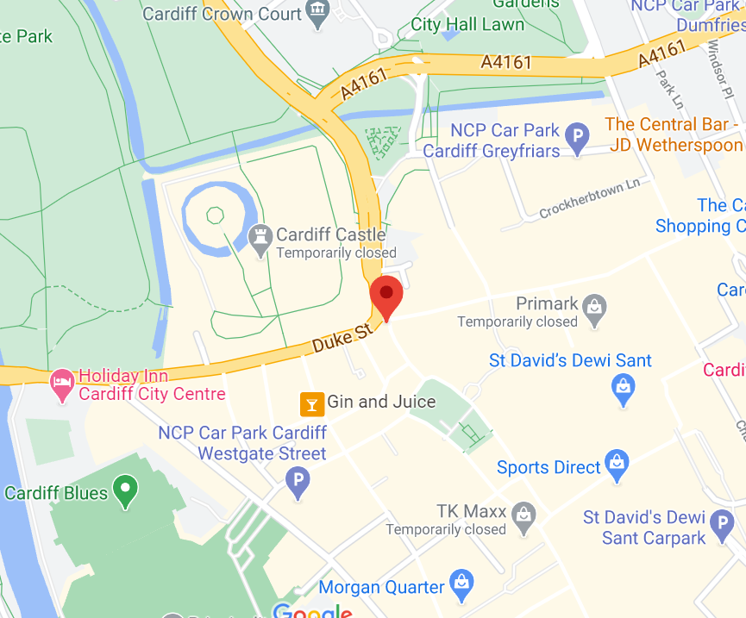
Geography Cardiff Castle
Let’s find out about Cardiff Castle. Your reading comprehension this week will help you to spot the features of a motte and bailey castle. So, why don’t we go and have a look around!
If you Google ‘Cardiff Castle’ and look at maps, then zoom in, you will find the Duke Street entrance to Cardiff Castle.
If you are lucky, they will have left the gates open and you can move the little yellow Google man, into the bailey area and get close to the motte and the keep.
Ask a grown up to help you.

Slide 2
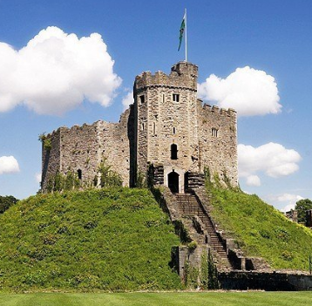
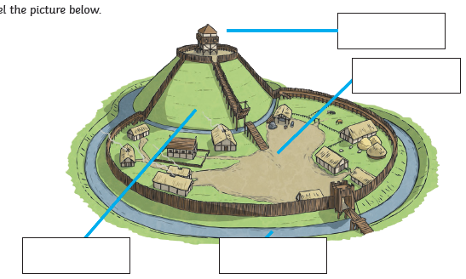
Cardiff Castle
Cardiff is the capital city of ……………………………………..
The national flower is the ……………………………………….
North, South, East or West?
Cardiff is in the ……………………………………….. of Wales.
The river running through Cardiff is the River ……………
The motte is the ……………………………………….…….
The bailey is the ………………………………………........
The sides of the motte were steep because ……………………………………………………………………..…
The motte is the moat. True or false?
Draw the national flower

