Slide 1

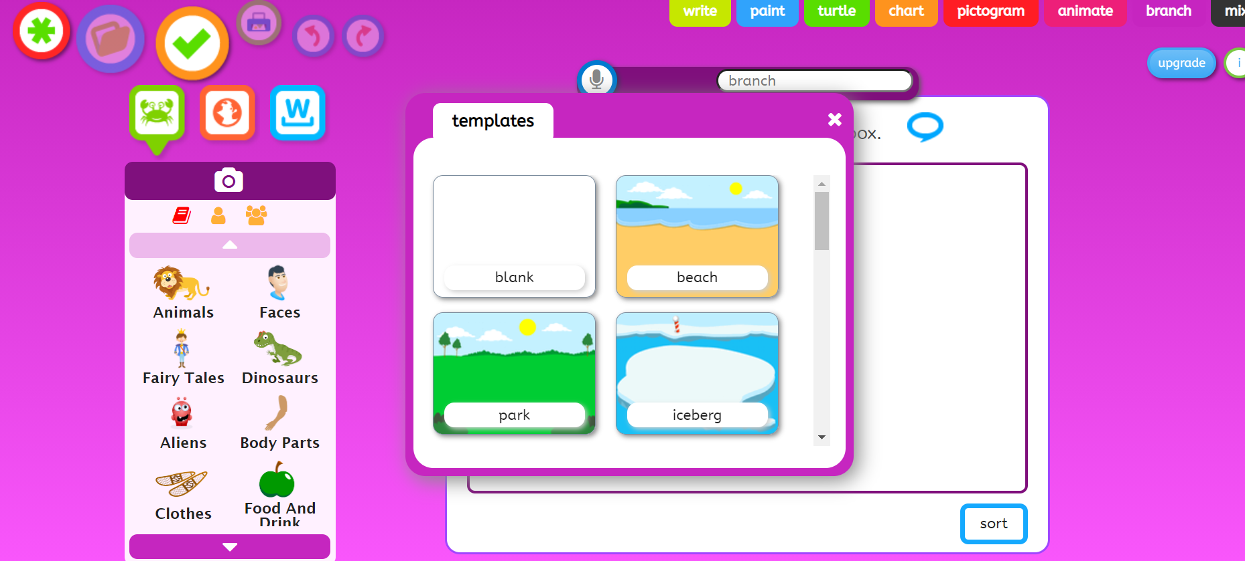
Click on the green star to start again.
Choose a background
sound button

Slide 2
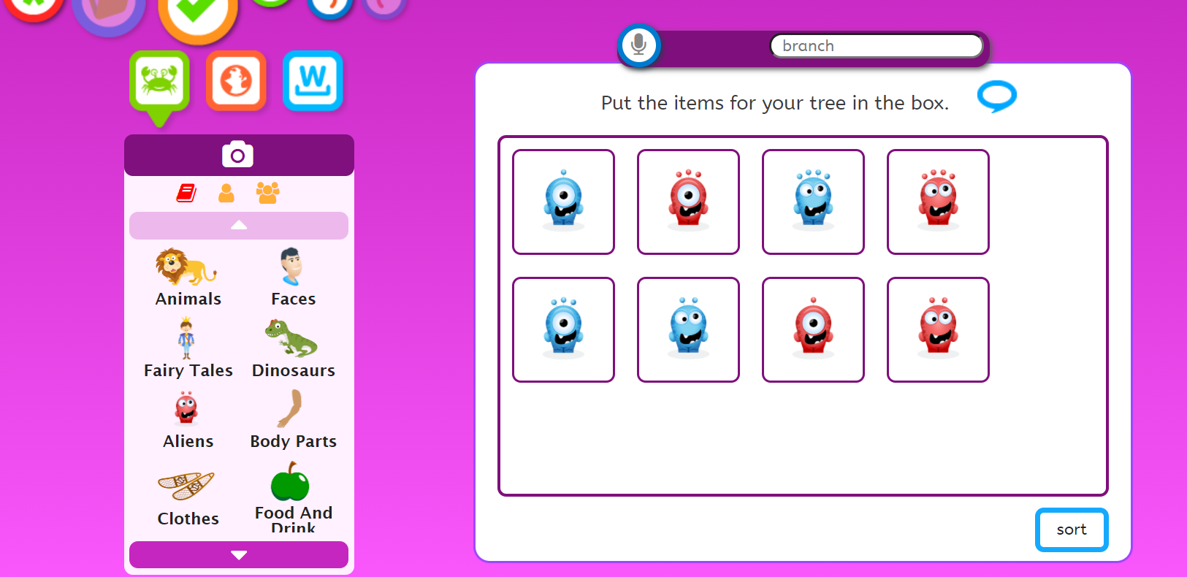
1. Click on aliens and find the same aliens as me. Use the arrows to move up and down. Choose your own background
sound button
2. Click on ‘sort’

Slide 3
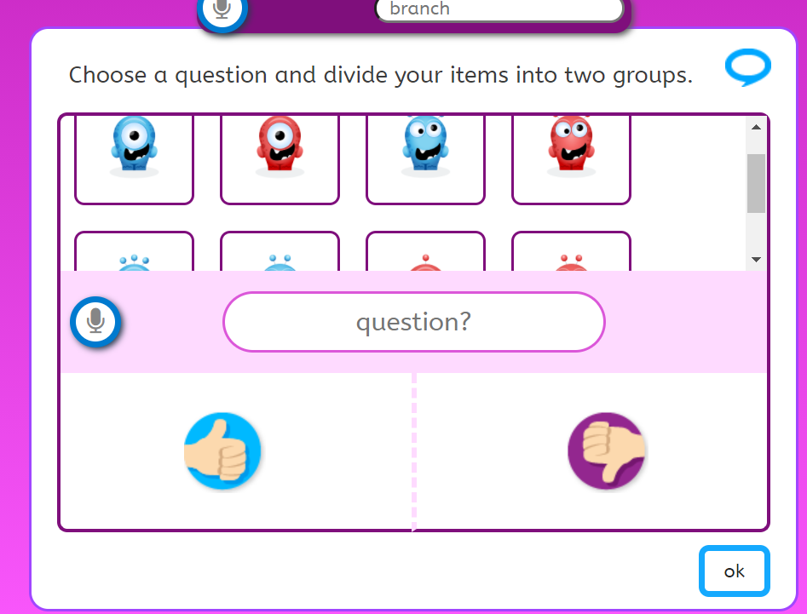
sound button 1
2. Write a question which splits the aliens into two groups. Think about colour? Eyes? Antennae?
3. Drag the aliens to the thumbs up or the thumbs down to answer yes or no
Then click ‘ok’
4. You will need to think of more questions to separate the aliens.
sound button 2

Slide 4
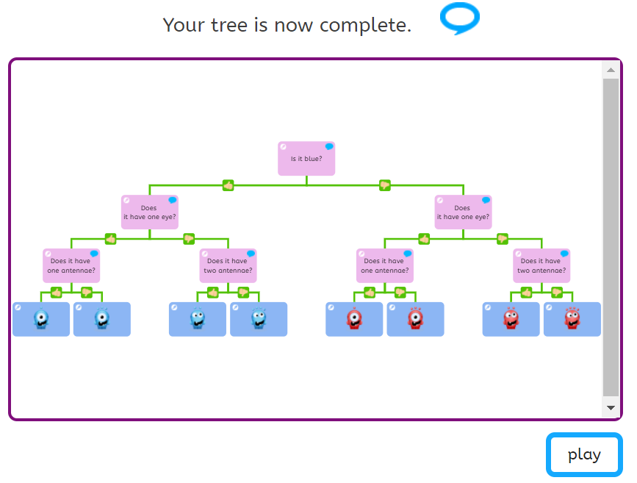
5. Your branching database may look like this.
Ask someone to choose an alien.
You ask the questions, remember yes or no answers only.
Did it work?
Great. Press the green star to start a new database.
You could send me a picture of your branching database when you get to this point, on Seesaw, thank you.
sound button

