Slide 1
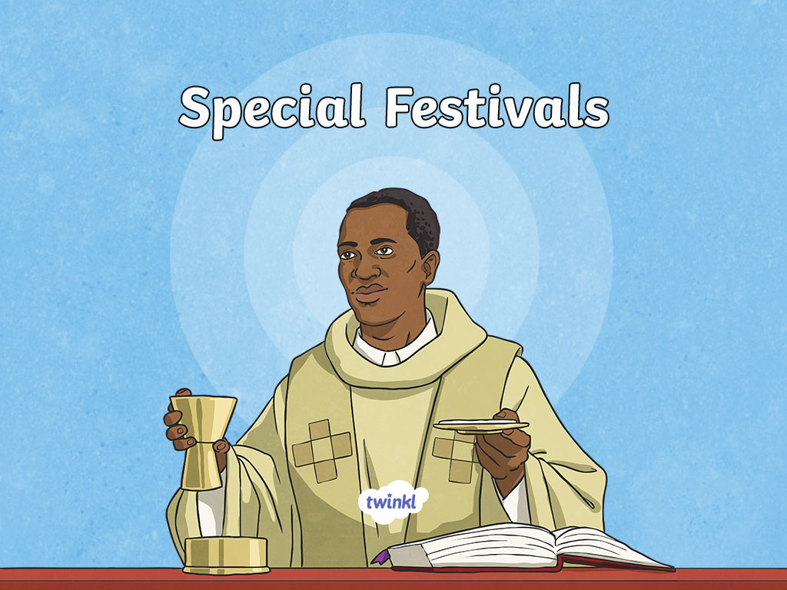

Slide 2
Aim
I can name and explain the main Christian festivals.
Success Criteria
I can explain what happened when Jesus was in the desert and how this is marked by Christians today.
I can explain how the main Christian festivals are connected to each other.

Slide 3
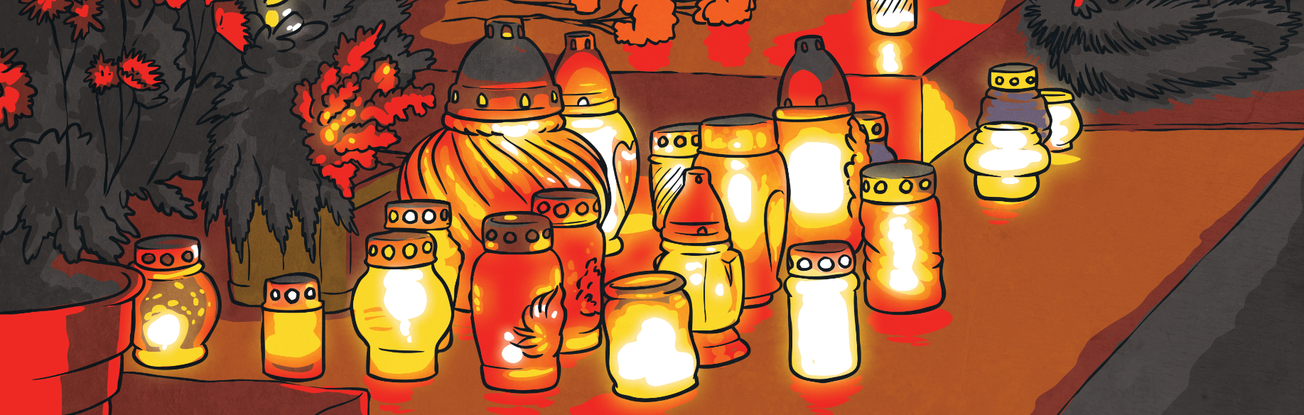

Festivals
What do you think the word ‘festival’ means?
A festival is a day or period of celebrating, usually for a religious meaning.
Do you or your families ever celebrate anything?
What are the similarities or differences between how your family celebrate a festival to how it may be celebrated for religious reasons?

Slide 4

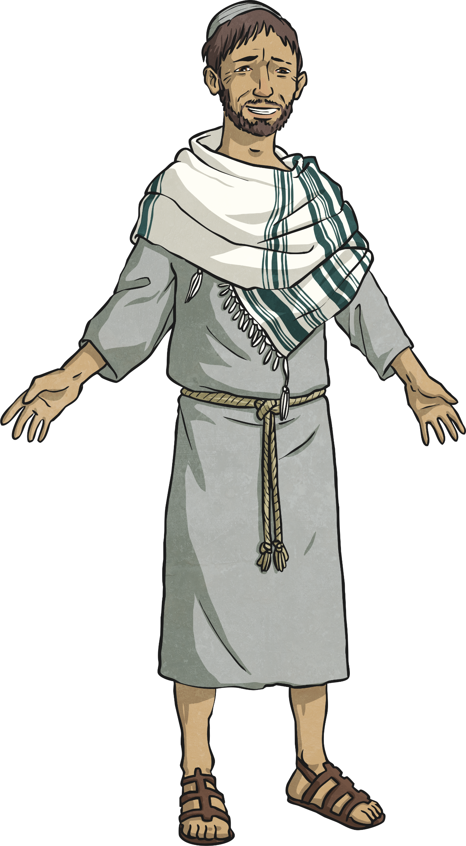
Easter and Christmas
Have you heard of the festivals Easter and Christmas before?
What do you know about these festivals?
Easter and Christmas are Christian festivals. They both celebrate important times of Jesus Christ, who Christians believe was the Son of God.

Slide 5

Christmas
Christmas is a festival celebrating the birth of Jesus Christ. Christians believe his birth showed God’s love for the world. Christians celebrate Christmas by exchanging gifts to show their love for each other and going to church services. During these services hymns are sung and special meals are eaten in the home.

Slide 6
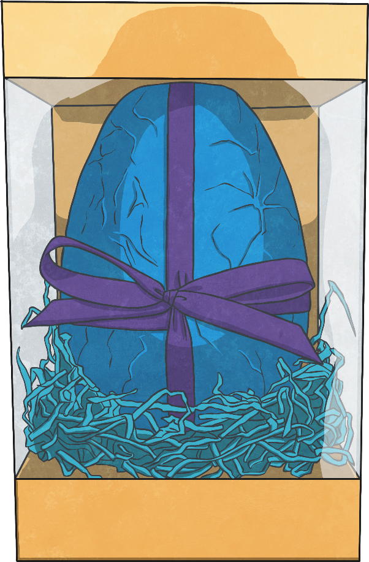
Easter
Easter is a festival celebrating the death and resurrection of Jesus Christ. This festival is very important to Christians as they believe it shows them that Jesus died for their sins. Christians also believe that Jesus will one day come again.

Slide 7


Christmas and Easter
What is the connection between these festivals?

Slide 8

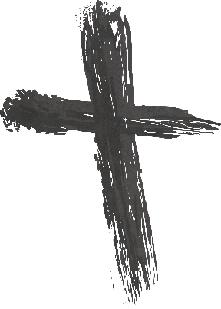
Lent
Lent is a Christian festival marking the 40 days and nights before Easter.
Lent begins on Ash Wednesday when a service is held and ash crosses are marked on Christian’s foreheads. This is to say sorry to God for any wrong doings. The final week of Lent is called Holy Week.
It is a time when Christians reflect and prepare for Easter. Christians remember Jesus going into the desert for 40 days and 40 nights to fast and pray before beginning his work for God.

Slide 9
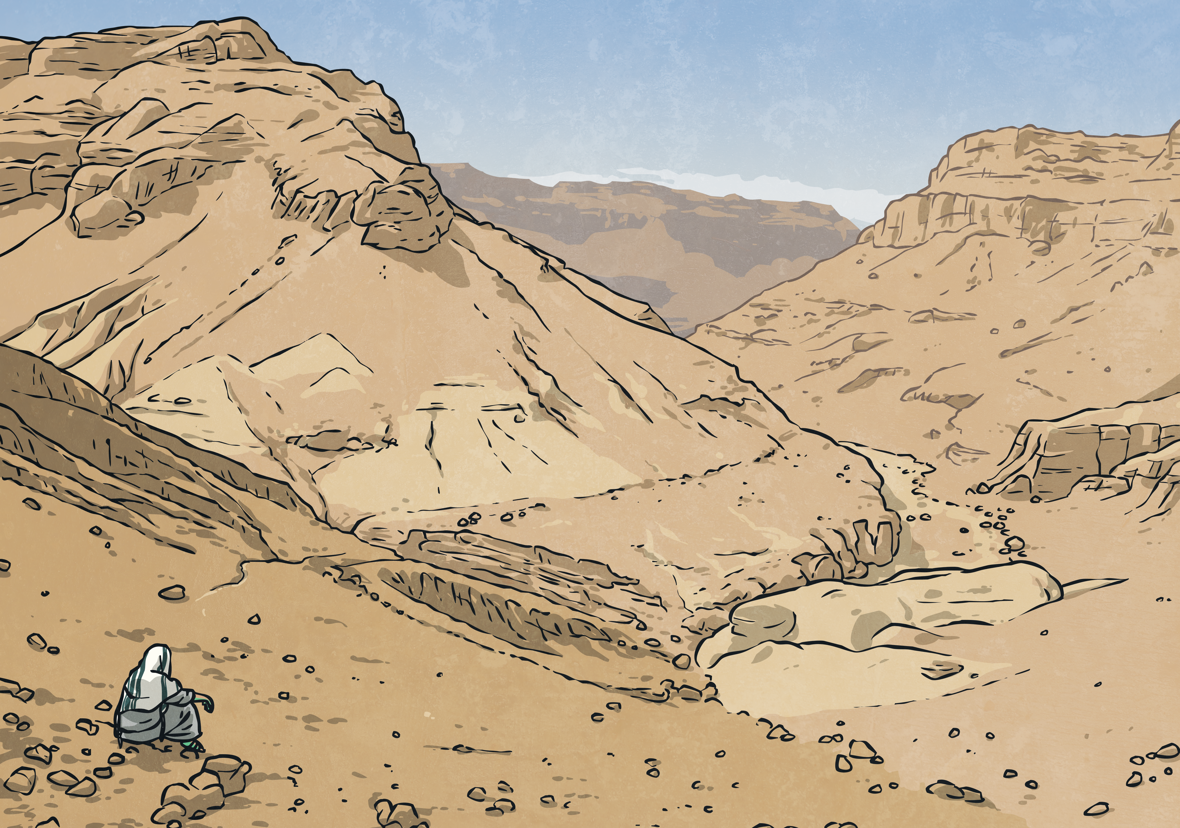
Lent
Lent is a Christian festival marking the 40 days and nights before Easter.
Lent is a time of giving things up and showing self-discipline. Christian sacrifices during this time are a reflection of Jesus’ deprivation in the desert and a test of self-discipline.
What sort of things do you think Christians could give up for Lent?

Slide 10
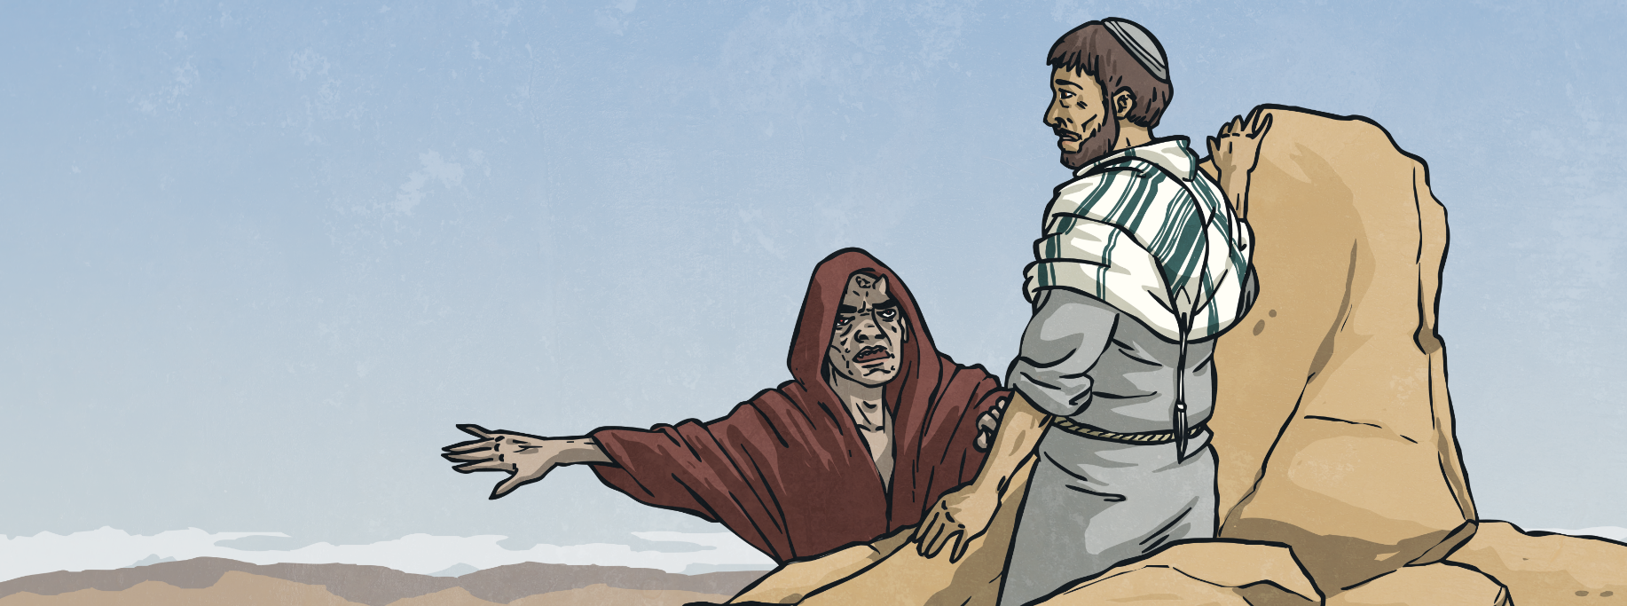
The Desert
The Bible tells Christians that Jesus was tempted by the devil many times whilst he was in the desert. Temptation is wanting to do something, especially when it is wrong or unwise.
The devil tried to tempt Jesus as Jesus was very tired and very hungry. These tests were to see how strong Jesus’ faith was and if he was ready to start teaching.

Slide 11
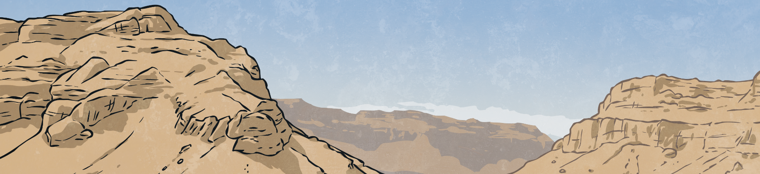
The Desert
The devil tried to…
get Jesus to turn stones into bread;
jump off a temple to see if God would protect him;
tell Jesus that he would have all the kingdoms and wealth if he worshipped him (the devil).
Jesus was strong and managed to resist all of the temptations from the devil. This showed God that Jesus was ready to start teaching.

Slide 12
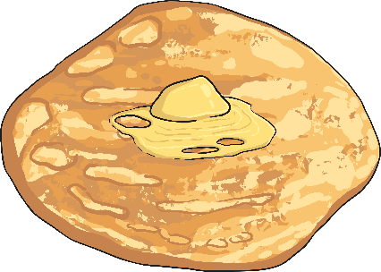
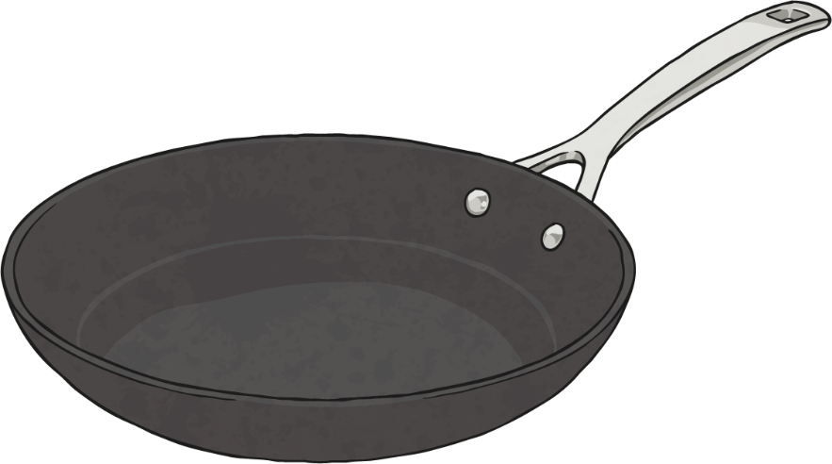
Pancakes
Why are pancakes significant to Lent for Christians?
Shrove Tuesday (Pancake Day) is the day before Ash Wednesday (the start of Lent). It is the last day before the fasting begins so it is a time to eat up the things that you are about to give up. It is also a day of confessing sins and receiving absolution (forgiveness from God).

Slide 13
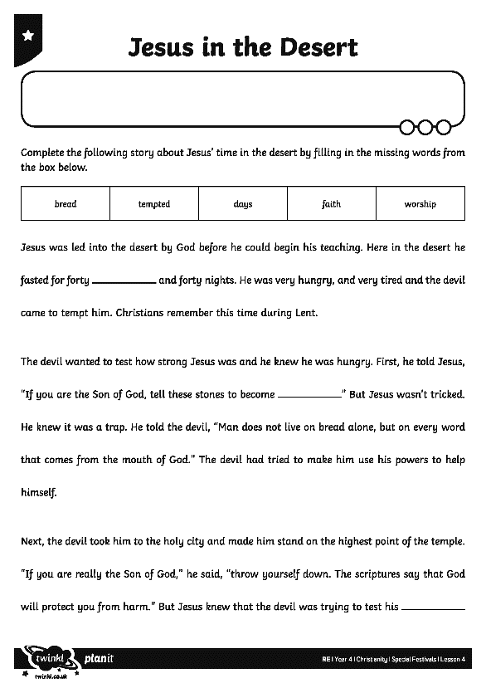
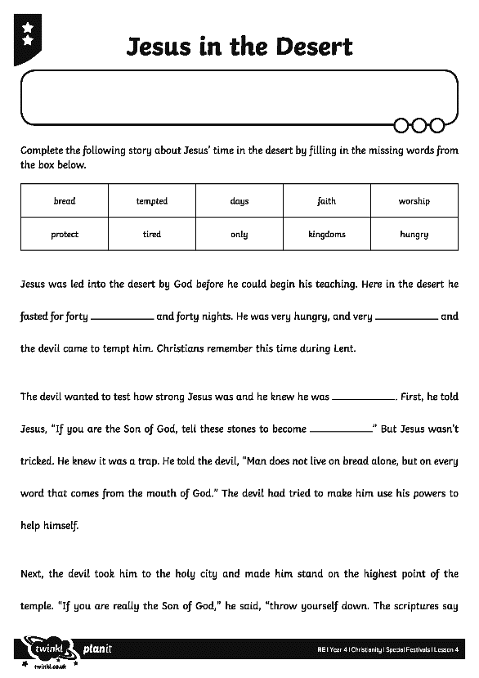
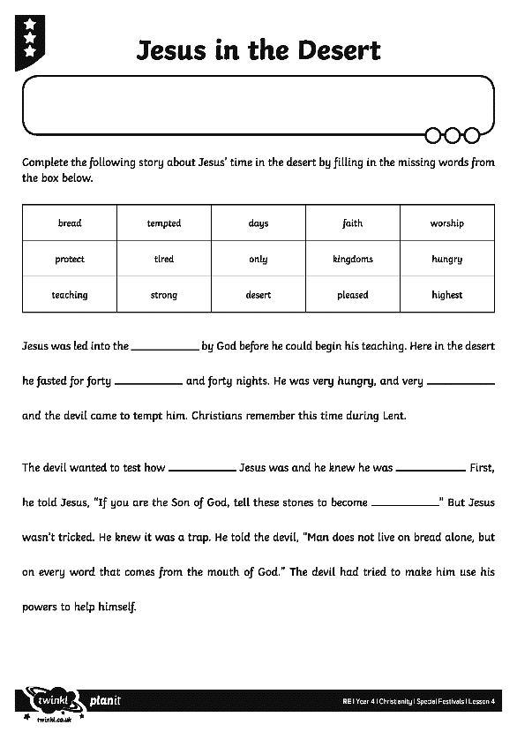
The Desert
Complete your activity sheet to retell the story of Jesus in the Desert.

Slide 14

Aim
I can name and explain the main Christian festivals.
Success Criteria
I can explain what happened when Jesus was in the desert and how this is marked by Christians today.
I can explain how the main Christian festivals are connected to each other.

