Slide 1



LIFE/work balance
We have started a #LIFEworkbalance campaign and we need your help to complete our LIFE/work balance survey.
We hope to publish the results soon, so please give 15 minutes of your time to help us get a true picture of school life.
Want to be a part of this campaign? Take the survey on our website and share it with your colleagues!
© Classroom Secrets Limited 2020

Slide 2
Year 4 – Spring Block 2 – Area – Counting Squares
About This Resource:
This PowerPoint has been designed to support your teaching of this small step. It includes a starter activity and an example of each question from the Varied Fluency and Reasoning and Problem Solving resources also provided in this pack. You can choose to work through all examples provided or a selection of them depending on the needs of your class.
National Curriculum Objectives:
Mathematics Year 4: (4M7b) Find the area of rectilinear shapes by counting squares
More Year 4 Area resources.
Did you like this resource? Don’t forget to review it on our website.
© Classroom Secrets Limited 2018

Slide 3
Year 4 – Spring Block 2 – Area
Step 2: Counting Squares
© Classroom Secrets Limited 2018

Slide 4
Introduction
Estimate the area of the shapes below. Use the reference square to help you.
A
B
© Classroom Secrets Limited 2018

Slide 5
Introduction
Estimate the area of the shapes below. Use the reference square to help you.
A = 17 squares
A = 16 squares
© Classroom Secrets Limited 2018

Slide 6
Varied Fluency 1
Circle the correct area for the shape below.
15 squares |  | 17 squares |  | 19 squares
© Classroom Secrets Limited 2018

Slide 7
Varied Fluency 1
Circle the correct area for the shape below.
15 squares |  | 17 squares |  | 19 squares
© Classroom Secrets Limited 2018

Slide 8
Varied Fluency 2
Match the shape to the correct number sentences.
A.
20 squares
5 x 4 = 20 squares
B.
14 squares
2 x 4 and 2 x 3 = 14 squares
© Classroom Secrets Limited 2018

Slide 9
Varied Fluency 2
Match the shape to the correct number sentences.
A.
20 squares
5 x 4 = 20 squares
B.
14 squares
2 x 4 and 2 x 3 = 14 squares
© Classroom Secrets Limited 2018

Slide 10
Varied Fluency 3
Calculate the area of this shape.
 | squares
© Classroom Secrets Limited 2018

Slide 11
Varied Fluency 3
Calculate the area of this shape.
18 | squares
© Classroom Secrets Limited 2018

Slide 12
Varied Fluency 4
Complete the inequality statement.
© Classroom Secrets Limited 2018

Slide 13
Varied Fluency 4
Complete the inequality statement.
<
17 squares
21 squares
© Classroom Secrets Limited 2018

Slide 14
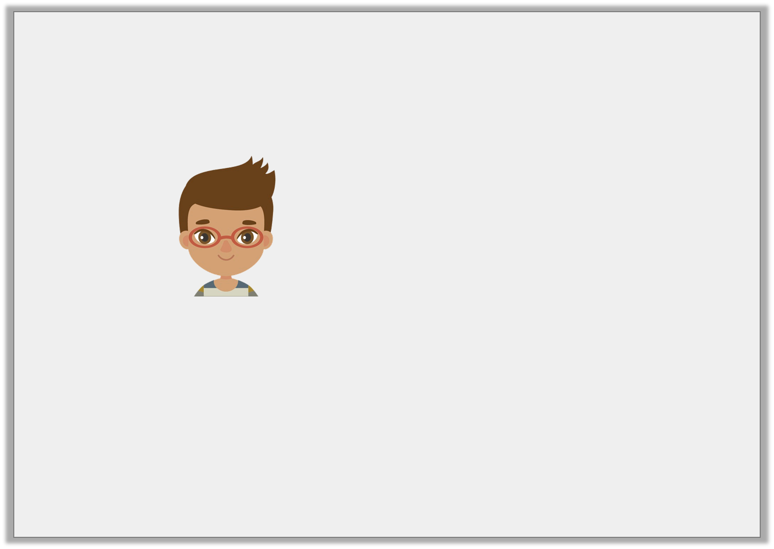
Problem Solving 1
Billy is making patterns using bricks.
He continues his pattern so it is 5 squares wide and 4 squares long.
What is the area of white bricks?
What is the area of grey bricks?
© Classroom Secrets Limited 2018

Slide 15
Problem Solving 1
Billy is making patterns using bricks.
He continues his pattern so it is 5 squares wide and 4 squares long.
What is the area of white bricks? 8 squares
What is the area of grey bricks? 12 squares
© Classroom Secrets Limited 2018

Slide 16
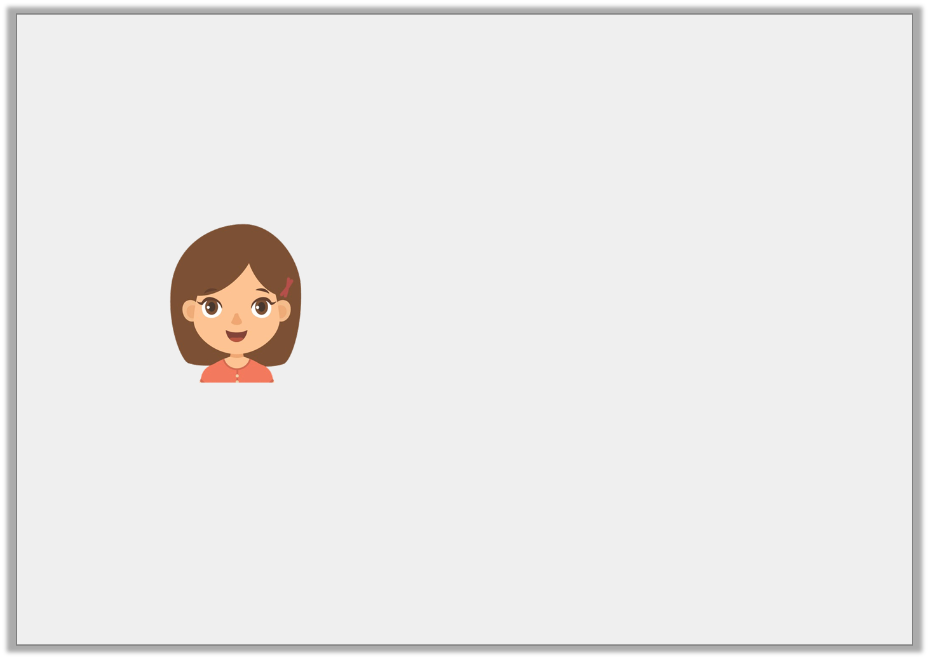
Reasoning 1
Becky is trying to work out if she has enough paving slabs to make this pattern on her patio. She has 10 paving slabs.
Does she have enough slabs?
Explain how you know.
© Classroom Secrets Limited 2018

Slide 17
Reasoning 1
Becky is trying to work out if she has enough paving slabs to make this pattern on her patio. She has 10 paving slabs.
Does she have enough slabs?
Explain how you know.
Becky doesn’t have enough slabs because…
© Classroom Secrets Limited 2018

Slide 18
Reasoning 1
Becky is trying to work out if she has enough paving slabs to make this pattern on her patio. She has 10 paving slabs.
Does she have enough slabs?
Explain how you know.
Becky doesn’t have enough slabs because the area of her pattern is 13 squares so she needs 3 more slabs.
© Classroom Secrets Limited 2018

Slide 19

Reasoning 2
Alice has started carpeting a room with two different carpet tiles.
Is she correct? Explain your answer.
To complete the pattern, I will need 6 more patterned tiles and 7 more plain tiles.
© Classroom Secrets Limited 2018

Slide 20
Reasoning 2
Alice has started carpeting a room with two different carpet tiles.
Is she correct? Explain your answer.
Alice is incorrect because…
To complete the pattern, I will need 6 more patterned tiles and 7 more plain tiles.
© Classroom Secrets Limited 2018

Slide 21
Reasoning 2
Alice has started carpeting a room with two different carpet tiles.
Is she correct? Explain your answer.
Alice is incorrect because she needs 7 more patterned tiles and 6 more plain tiles to fill the 13 square area that is left to cover.
To complete the pattern, I will need 6 more patterned tiles and 7 more plain tiles.
© Classroom Secrets Limited 2018

