Slide 1
Click onto “Slideshow mode” and if you click or press one of the arrows, you should be able to see the animations I have used!

Slide 2
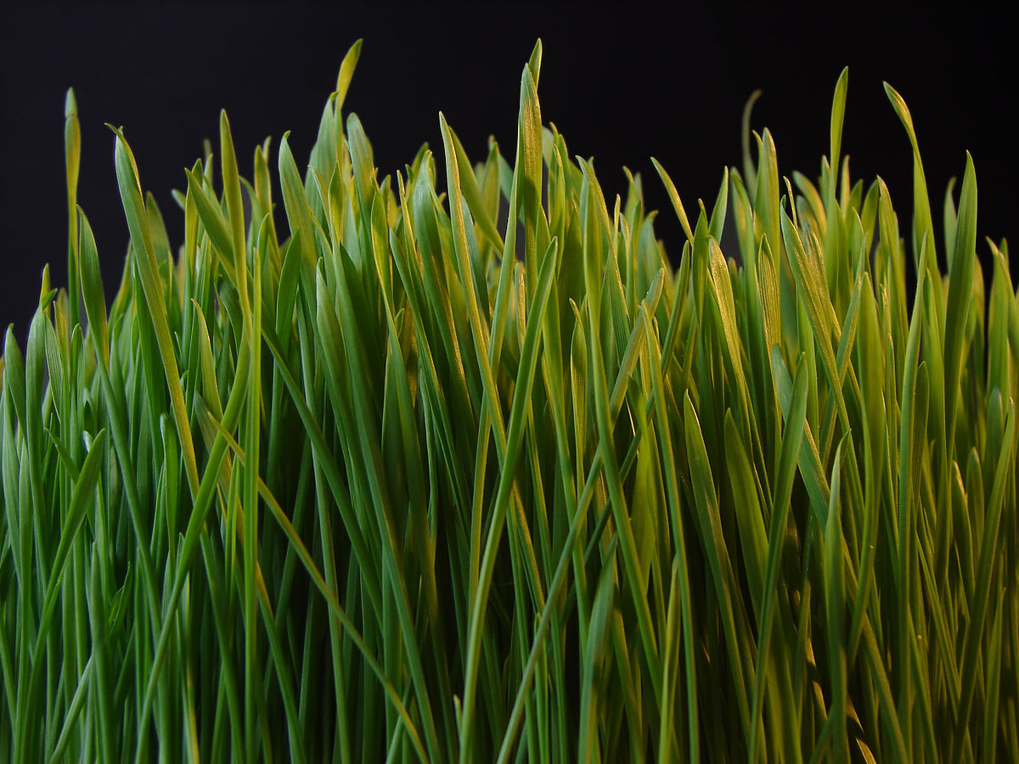
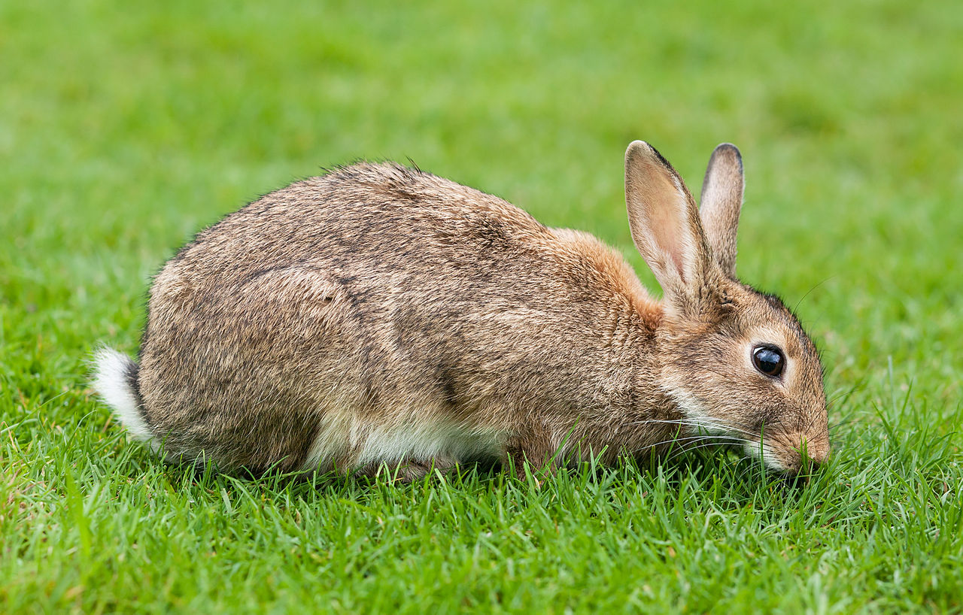
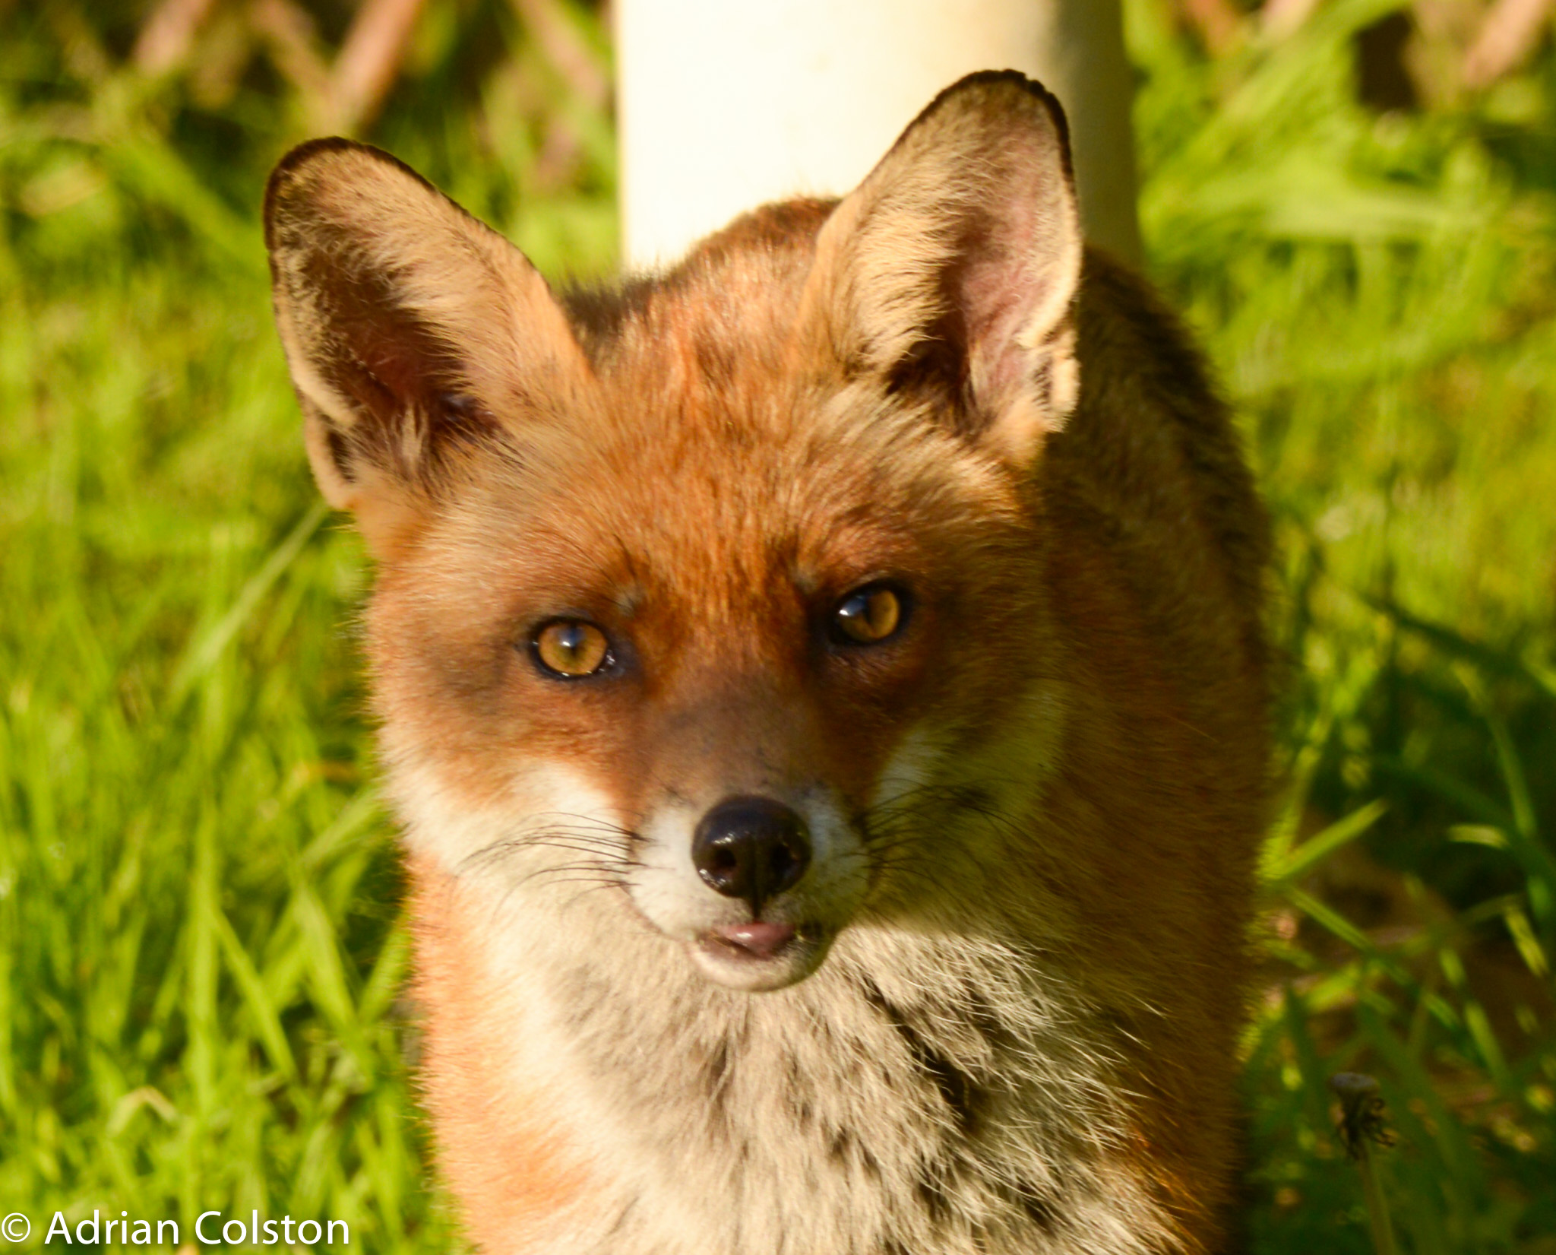
Grass
Fox
Rabbit
Producer
Primary consumer
Predator
Herbivore
Carnivore

Slide 3
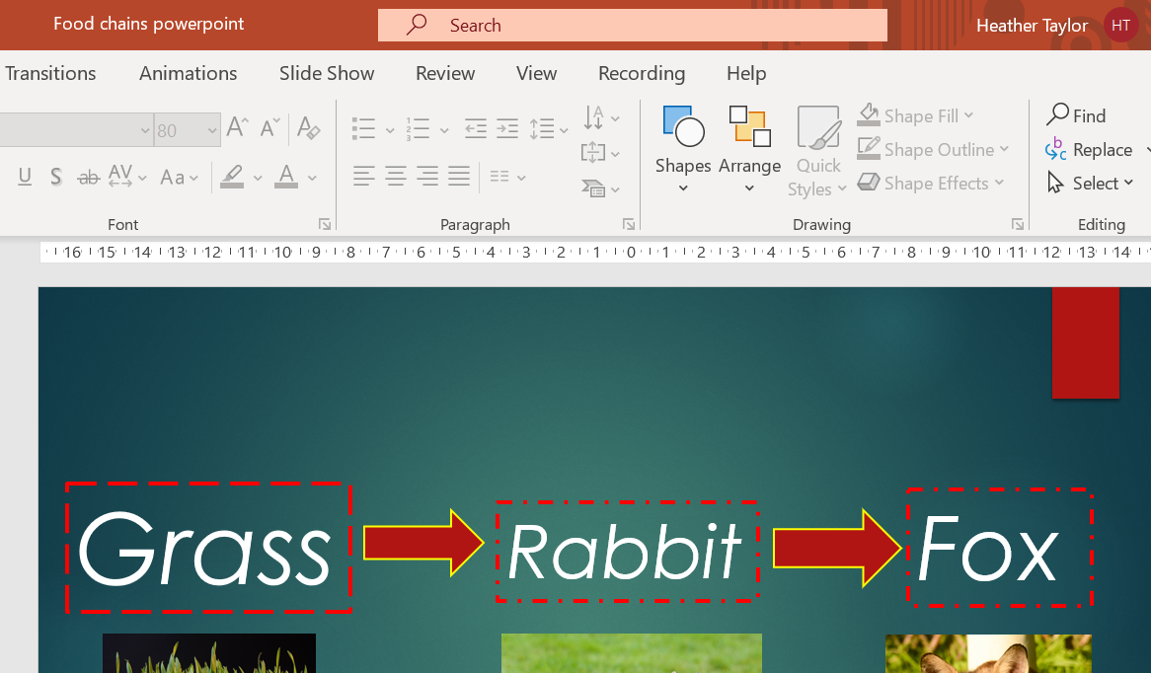
Now it’s your turn…
Click on a text box/picture then

Slide 4
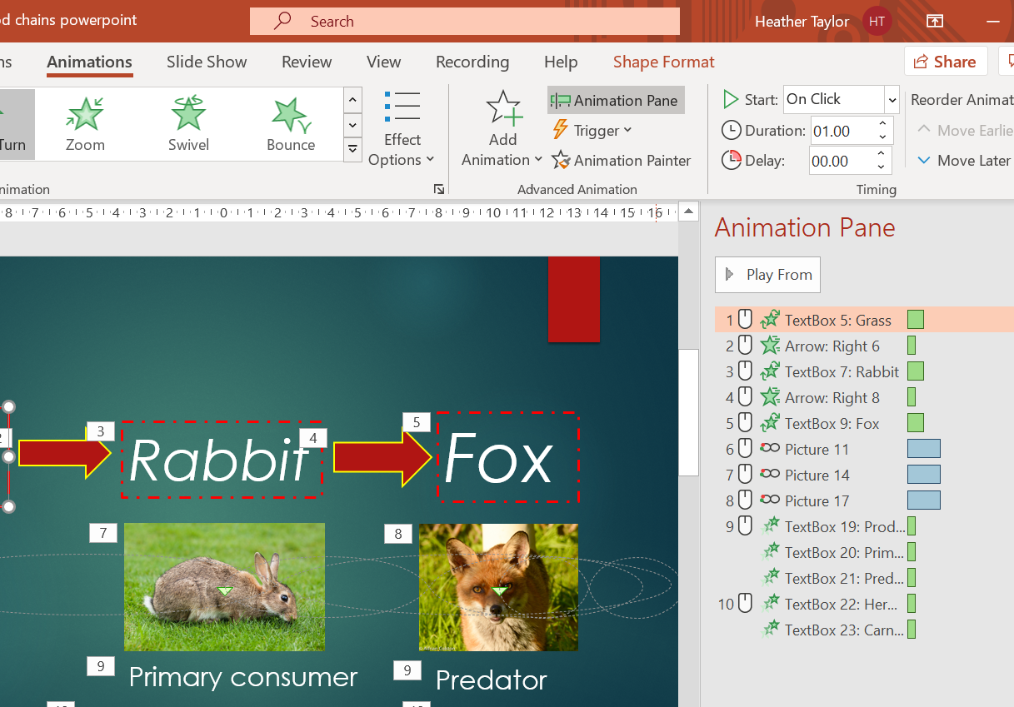
Animation pane shows up all the animations you have applied to your PowerPoint.
Think about what order they need to happen in.
Do any need to happen at the same time?
Do you want them to happen after a click or after a certain amount of time?

