Slide 1
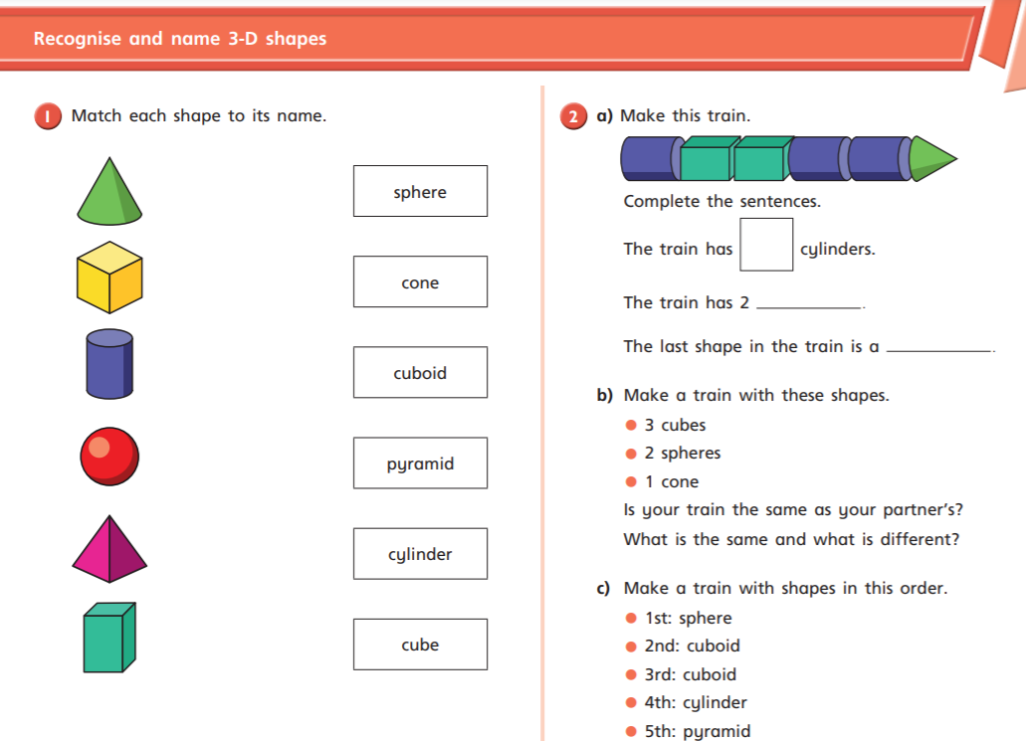

Slide 2
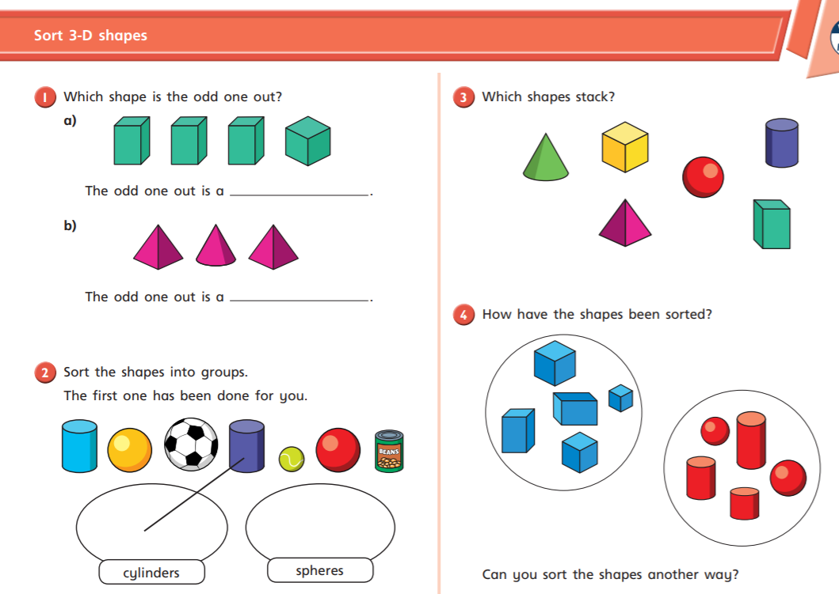

Slide 3
Go on a 3D shape hunt around your home, just like you did for 2D shapes. Which 3D shapes can you find?
3D shape | object
cuboid cylinder | cereal box in of beans

