Slide 1

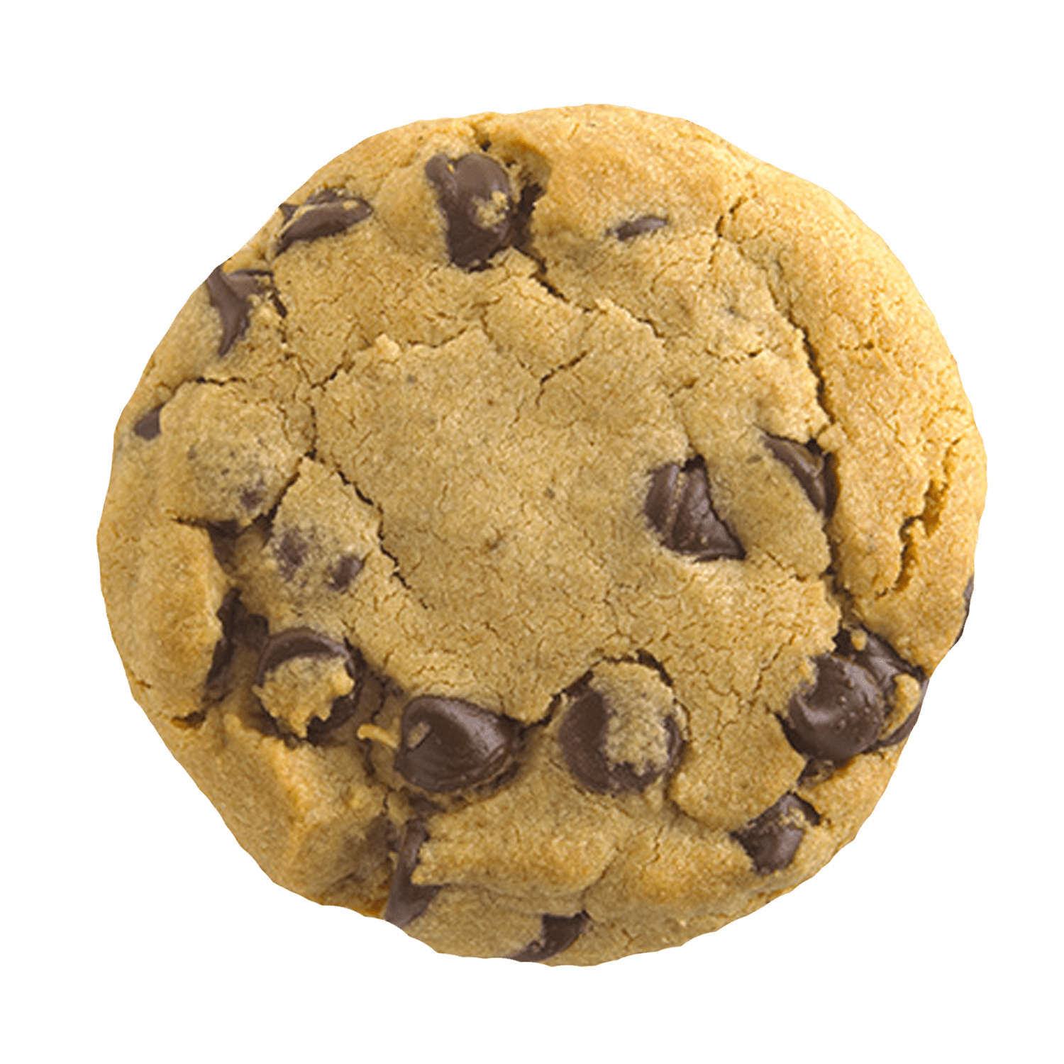
English Wednesday 21 January
Over the next few days we are going to write an information text about snakes.
We will look at the features of information texts on Thursday.
Today let’s practise joining ideas and writing questions.
Think of someone who lives in your house and think of two facts about them.
E.g. Dad likes coffee. Dad likes biscuits.
Use these two facts in one sentence.
Dad likes drinking coffee and he likes eating biscuits.
sound button

Slide 2

Now let’s do the same again with ‘but’
Think about someone who lives in your house. Think of two facts that seem like opposites or that do not go together.
E.g. George likes eating cucumber. George does not like tomatoes.
Use these two facts in one sentence using ‘but’ to join the facts.
George likes eating cucumber, but he does not like eating tomatoes.
Now you try. Think of people or animals in your home and write two sentences about each of them.
Remember to write an ‘and’ sentence and a ‘but’ sentence for each person or animal.
Write 6 sentences or more. Send a photograph of your writing via Seesaw, thank you.
sound button

Slide 3
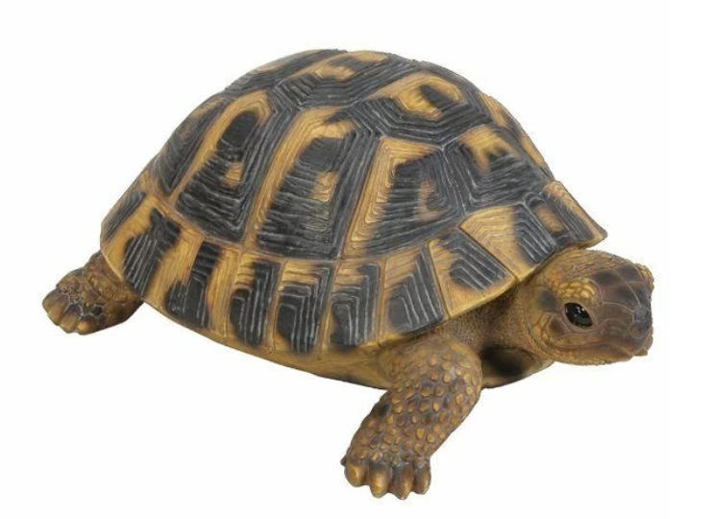
In your riddle writing you used question marks.
What am I?
In information texts a good question start is
Did you know…………………………………………………………….?
Look at the facts you have already written. Choose two facts and turn them into questions.
Did you know that Dad likes eating biscuits?
Did you know that George does not like eating tomatoes?
Please send me a photograph of your sentences via Seesaw, thank you.
sound button

