Slide 1

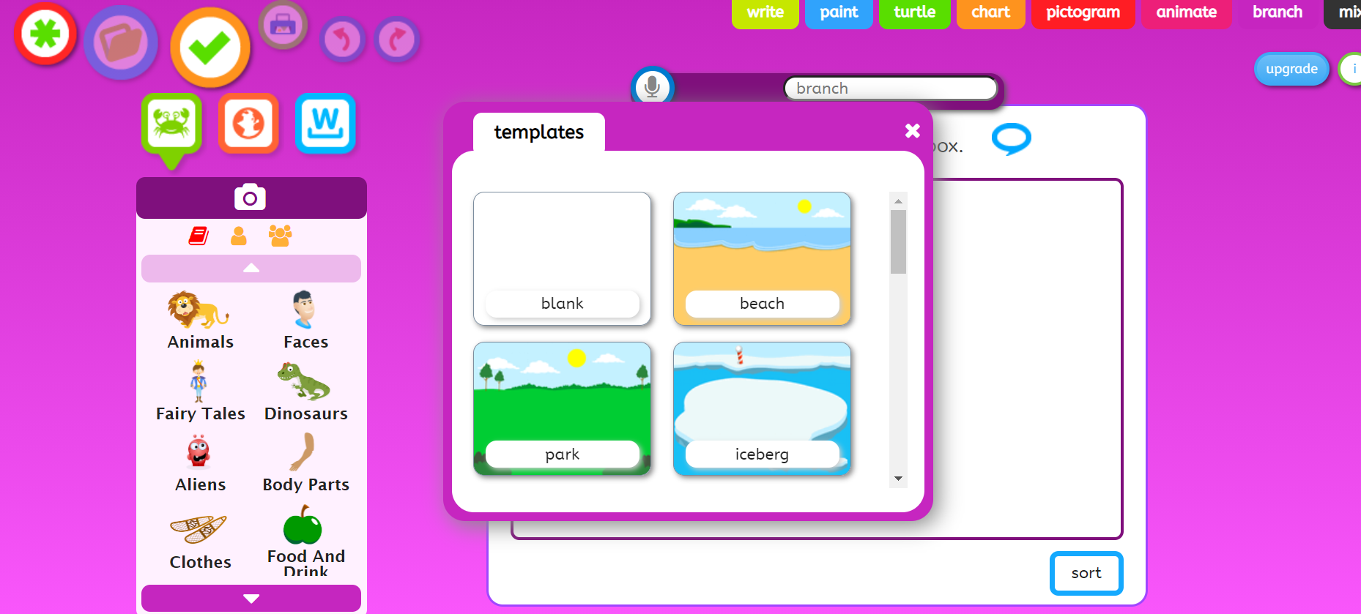
Click on the green star to start again.
Choose a background
sound button

Slide 2
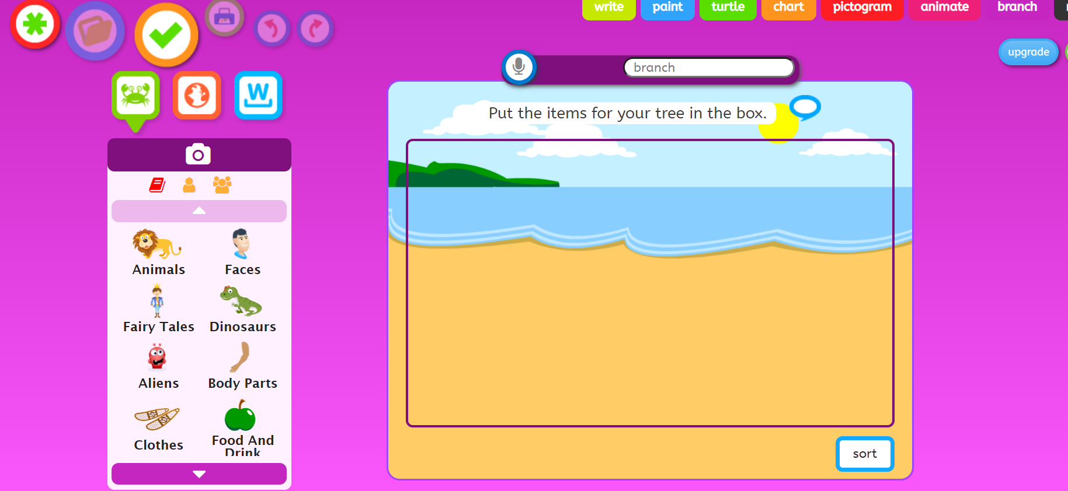
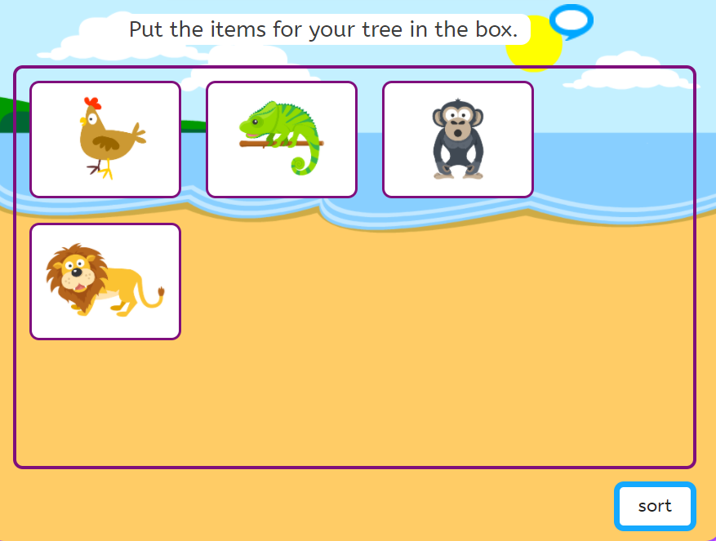
1 Click on animals and find the same animals as me. Use the arrows to move up and down.
I chose the beach background.
sound button
2 Click on ‘sort’

Slide 3
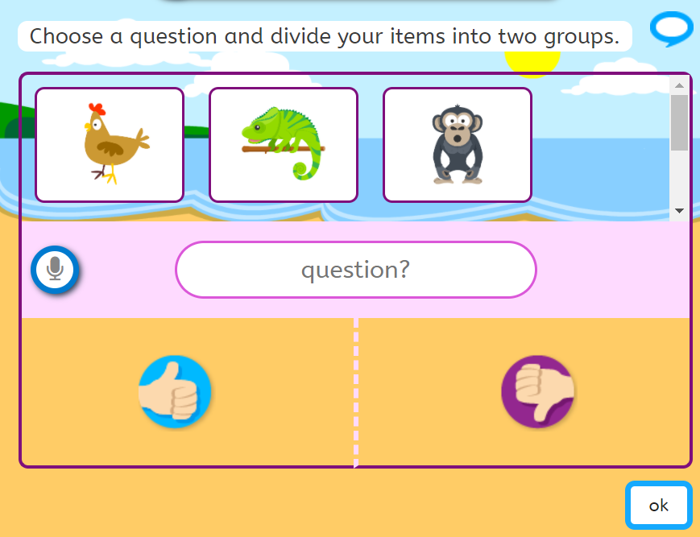
sound button
3 Write a question which splits the animals into two groups like:
Is it a mammal?
Or Is it a reptile?
4 Drag the animals to the thumbs up or the thumbs down to answer yes or no
Then click ‘ok’

Slide 4
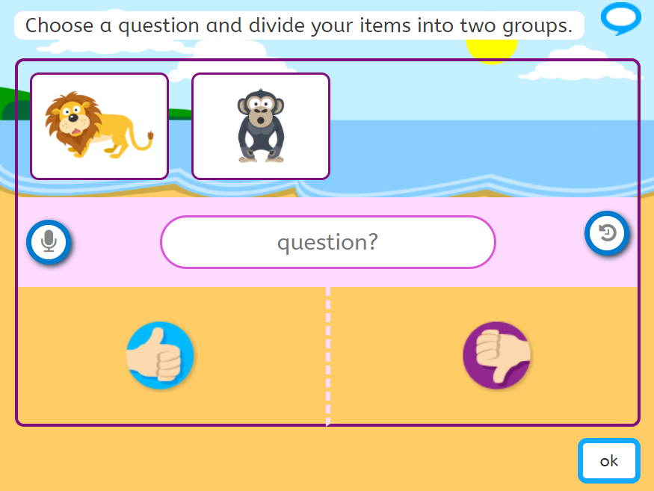
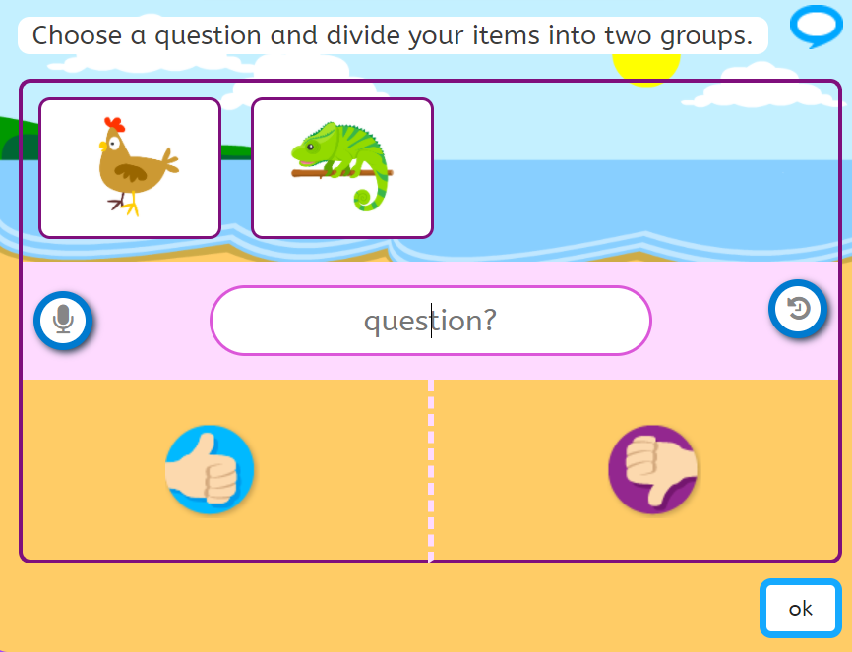
5 These two mammals need to be sorted.
Write a question to separate them like:
Am I brown?
Or does it have a mane?
6 Drag the animal to the thumbs up or the thumbs down to answer the question.
Click OK
7 These two animals need to be sorted.
Write a question to separate them like:
Is it a reptile?
Is it a bird?
8 Drag the animal to the thumbs up or the thumbs down to answer the question.
Click OK
sound button
sound button

Slide 5
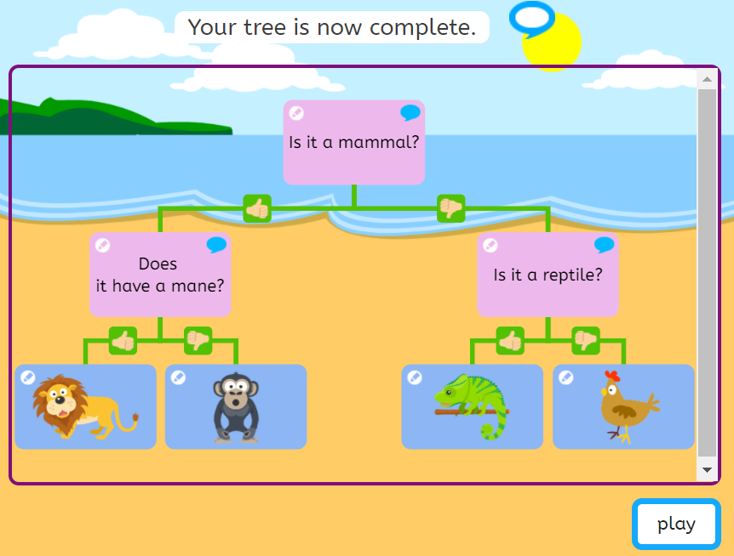
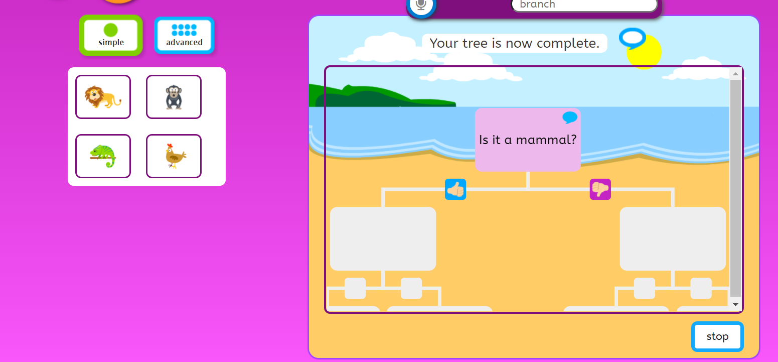
Ask someone to choose an animal.
You ask the questions.
Did you get it right?
Click on the green star to start again and make your own branching database with 4 or 6 or 8 items to sort.
This is what your branching database should look like.
Read through it.
Then click ‘play’ and ask someone to choose an animal.
You ask the questions. Did they get it right?
sound button
sound button

