Slide 1


Slide 2
Aim
To explain how volcanoes affect people’s lives.
Success Criteria
I can tell you where volcanoes are found.
I can use extinct, dormant and active when describing volcanoes.
I can list the risks and benefits of living near to a volcano.

Slide 3







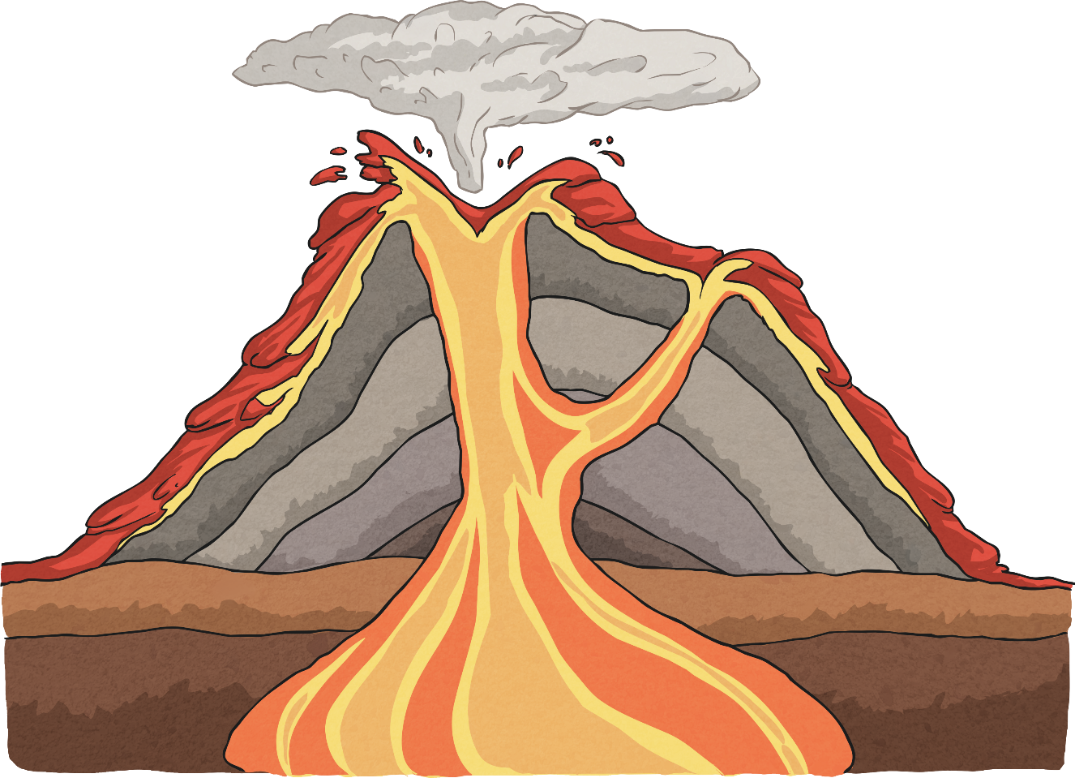
What’s It All Called?
Can you name the main parts of this volcano?
Can you explain how the grey layers were made?
eruption cloud
crater
conduit/main vent
magma chamber

Slide 4
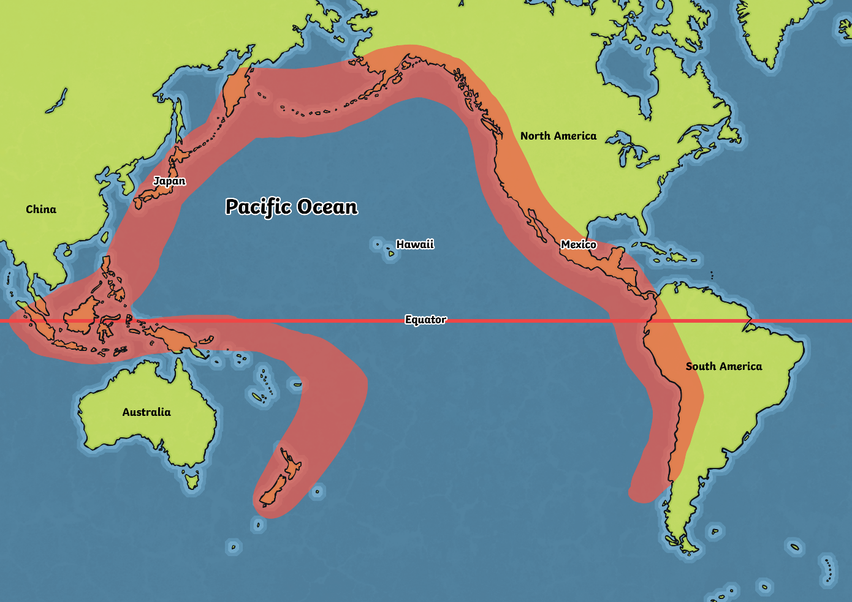
Where Are Most Volcanoes Located?
Look at this map.
Most volcanoes are located in the red area, which is named “Ring of Fire”.
Why do you think it is called that?

Slide 5
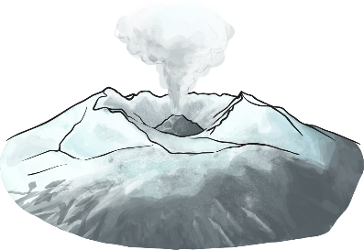
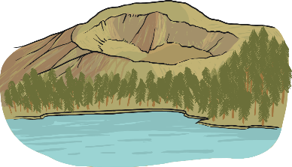
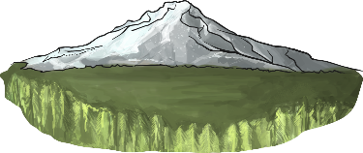
What Do They Mean?
active
A volcano that has erupted in the last 10 000 years.
dormant
A volcano that hasn’t erupted in the last 10 000 years, but may erupt again.
extinct
A volcano that hasn’t erupted in the last 10 000 years, and isn’t expected to erupt again.

Slide 6
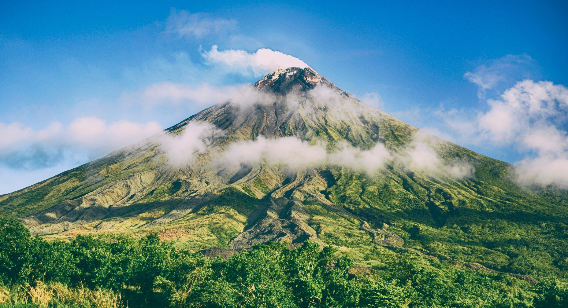
Would You Like to Live Near
These Volcanoes?

Slide 7
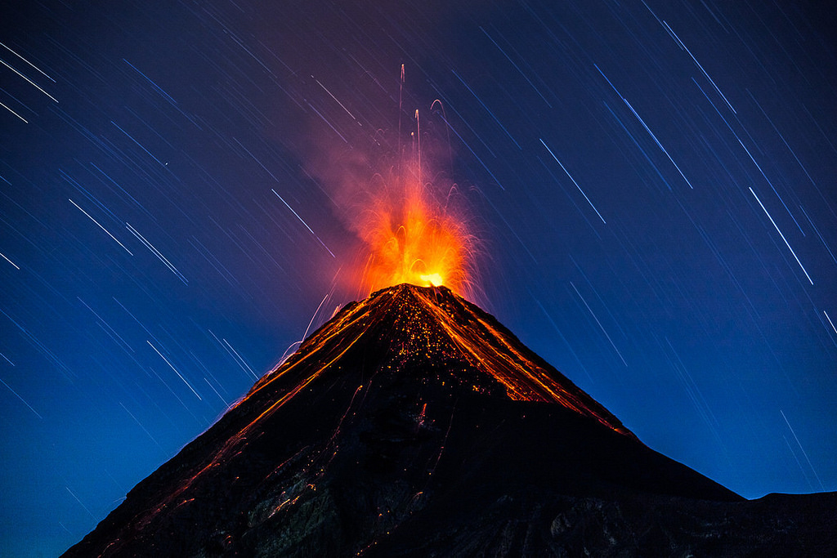
Would You Like to Live Near
These Volcanoes?
Photo courtesy of ierdnall @flickr.com) - granted under creative commons licence - attribution

Slide 8
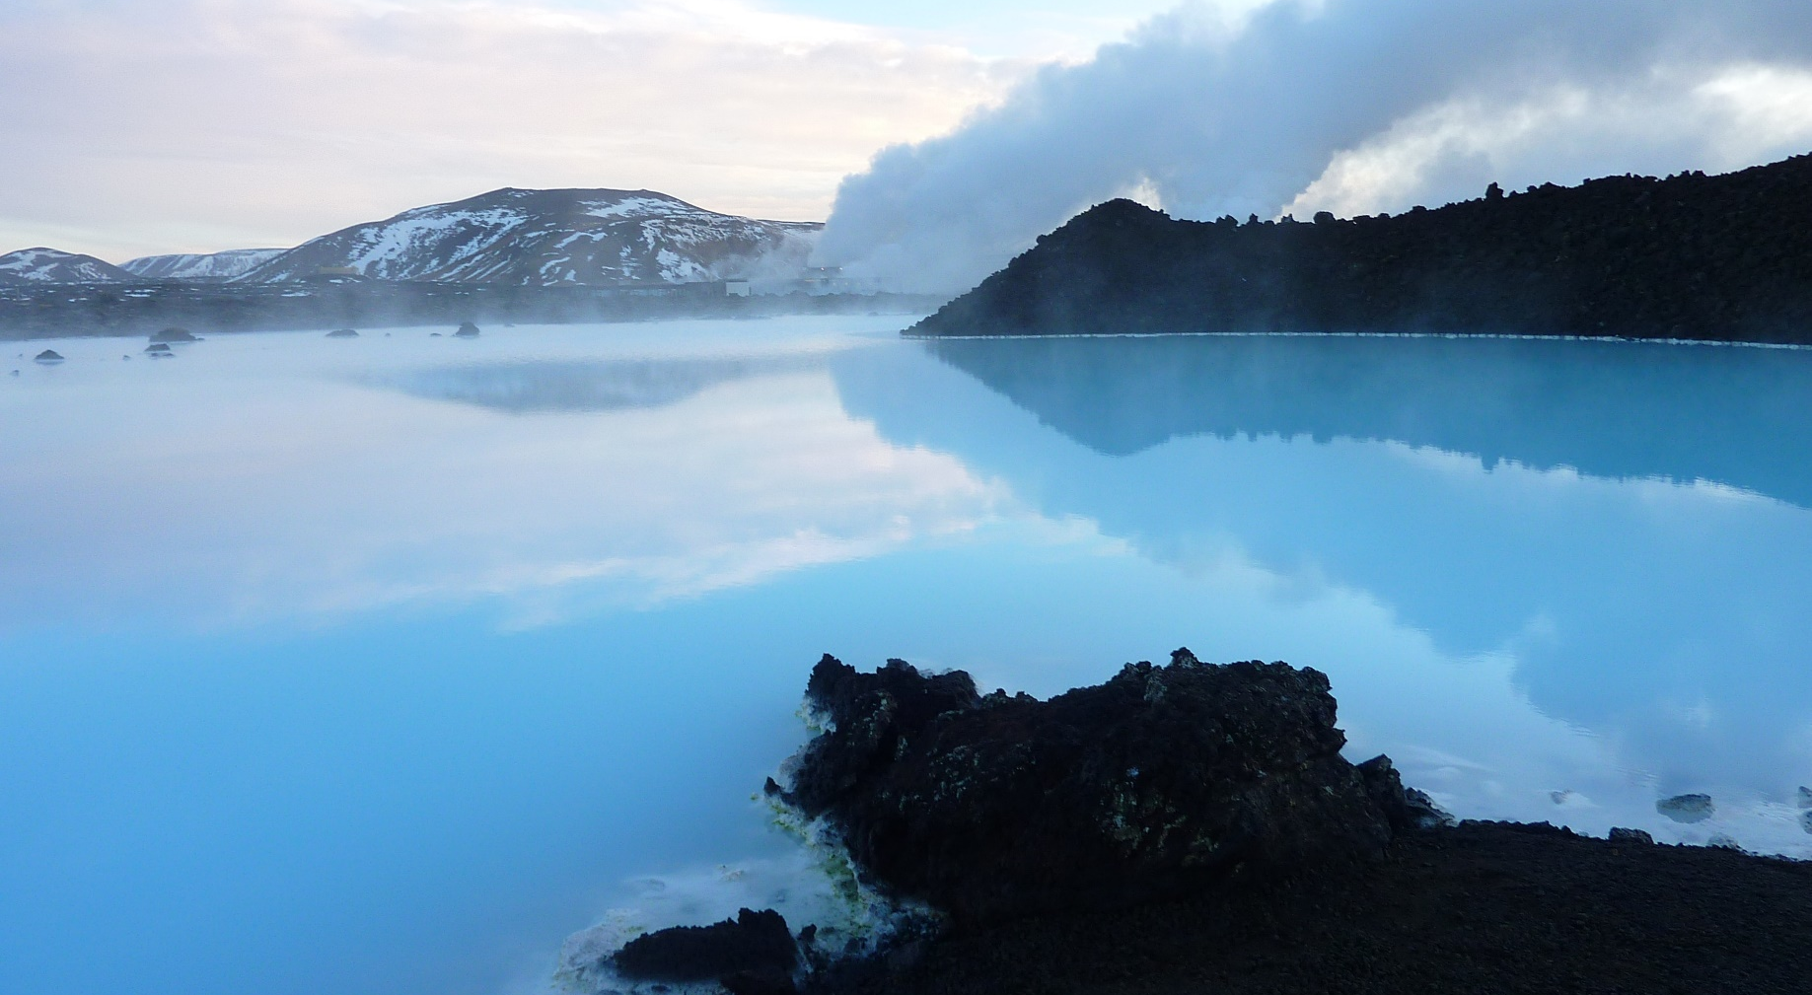
Would You Like to Live Near
These Volcanoes?

Slide 9
Task
For todays Geography lesson I would like you to research and list as many for and against reasons for living near to a volcano. For example:
FOR
AGAINST
Farming near a volcano can be really good, because the volcanic soil can produce very good crops.
Buildings can be destroyed by lava flow.

