Slide 1


Year 4 – Spring Block 1 – Multiplication and Division
Correspondence Problems
© Classroom Secrets Limited 2019

Slide 2
Introduction
Complete the calculations.
 |  |  | Total
2 x 5 = | + | 4 x 3 =
4 x 6 = | + | 3 x 3 =
6 x 2 = | + | 5 x 4 =
8 x 5 = | + | 9 x 1 =
10 x 10 = | + | 2 x 6 =
© Classroom Secrets Limited 2019

Slide 3
Introduction
Complete the calculations.
 |  |  | Total
2 x 5 = 10 | + | 4 x 3 = 12 | 22
4 x 6 = 24 | + | 3 x 3 = 9 | 33
6 x 2 = 12 | + | 5 x 4 = 20 | 32
8 x 5 = 40 | + | 9 x 1 = 9 | 49
10 x 10 = 100 | + | 2 x 6 = 12 | 112
© Classroom Secrets Limited 2019

Slide 4

Varied Fluency 1
One box contains 5 different forks and a variety of shaped spoons. There are 35 possible combinations of forks and spoons.
Circle the number of spoons in the box.
6 |  | 8 |  | 7
© Classroom Secrets Limited 2019

Slide 5
Varied Fluency 1
One box contains 5 different forks and a variety of shaped spoons. There are 35 possible combinations of forks and spoons.
Circle the number of spoons in the box.
6 |  | 8 |  | 7
© Classroom Secrets Limited 2019

Slide 6
Varied Fluency 2
True or false?
There are 18 combinations of cake flavours and toppings. Show your working.
Cake flavour | Toppings
vanilla chocolate | milk chocolate chips white chocolate chips sprinkles sweets strawberries cherry blueberries
© Classroom Secrets Limited 2019

Slide 7
Varied Fluency 2
True or false?
There are 18 combinations of cake flavours and toppings. Show your working.
False, there are 14 combinations (2 x 7 = 14)
Cake flavour | Toppings
vanilla chocolate | milk chocolate chips white chocolate chips sprinkles sweets strawberries cherry blueberries
© Classroom Secrets Limited 2019

Slide 8
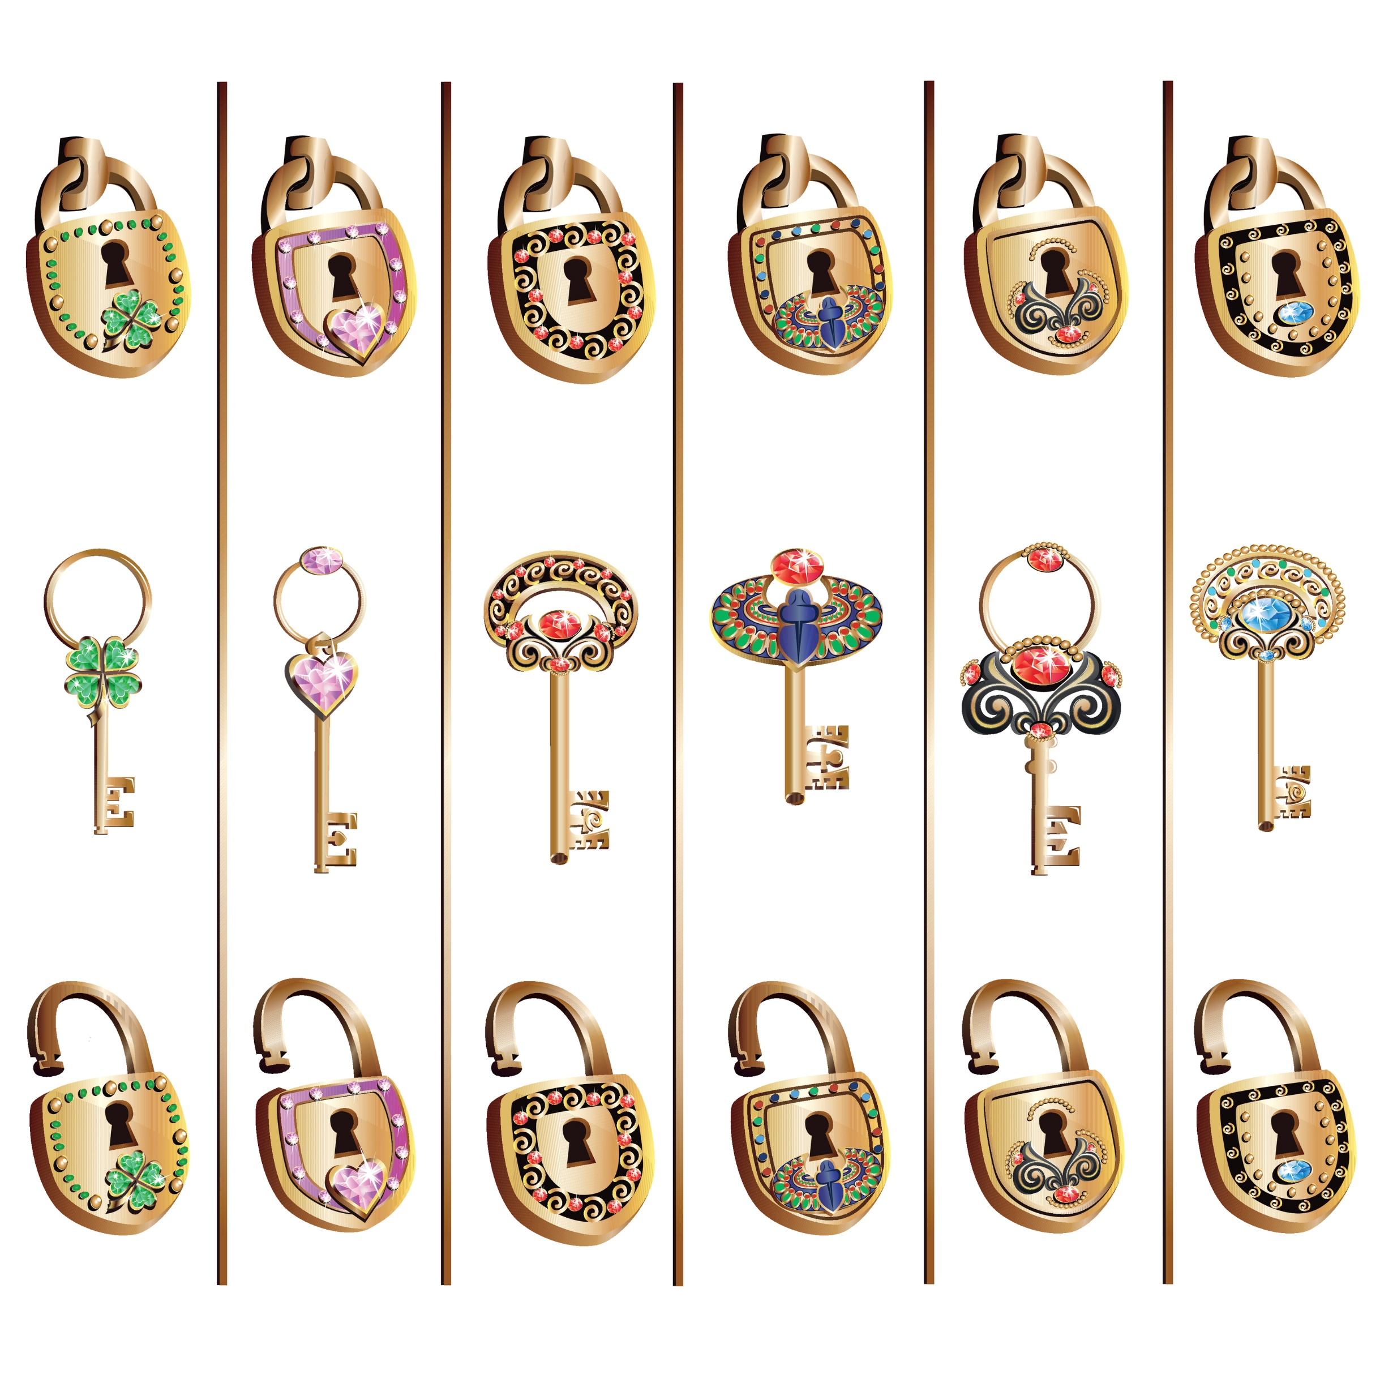
Varied Fluency 3
There are two groups of keys and locks.
How many combinations of lock and key can be made?
Complete the calculation below to show the total number of combinations.
A.
B.
 |  | x |  |  |  | =
© Classroom Secrets Limited 2019

Slide 9
Varied Fluency 3
There are two groups of keys and locks.
How many combinations of lock and key can be made?
Complete the calculation below to show the total number of combinations.
A.
B.
5 |  | x |  | 4 |  | = |  | 20
© Classroom Secrets Limited 2019

Slide 10
Varied Fluency 4
Tick the correct number of possible combinations.
Shelf 1 | Shelf 2
tetra guppy catfish angel fish goldfish blue tang mollies | tetra guppy catfish angel fish neon tetra
28
30
35
© Classroom Secrets Limited 2019

Slide 11
Varied Fluency 4
Tick the correct number of possible combinations.
Shelf 1 | Shelf 2
tetra guppy catfish angel fish goldfish blue tang mollies | tetra guppy catfish angel fish neon tetra
✓
28
30
35
© Classroom Secrets Limited 2019

