Slide 1


Year 4 – Spring Block 1 – Multiplication and Division – Divide 3-Digits by 1-Digit
About This Resource:
This PowerPoint has been designed to support your teaching of this small step. It includes a starter activity and an example of each question from the Varied Fluency and Reasoning and Problem Solving resources also provided in this pack. You can choose to work through all examples provided or a selection of them depending on the needs of your class.
National Curriculum Objectives:
Mathematics Year 4: (4C6a) Recall multiplication and division facts for multiplication tables up to 12 × 12
Mathematics Year 4: (4C6b) Use place value, known and derived facts to multiply and divide mentally, including: multiplying by 0 and 1; dividing by 1; multiplying together three numbers
More resources which follow the same small steps as White Rose.
Did you like this resource? Don’t forget to review it on our website.
© Classroom Secrets Limited 2018

Slide 2
Year 4 – Spring Block 1 – Multiplication and Division
Step 10: Divide 3-Digits by
1-Digit
© Classroom Secrets Limited 2018

Slide 3
Introduction
Match the calculation to the answer.
85 ÷ 5
13
84 ÷ 3
17
64 ÷ 4
28
91 ÷ 7
16
© Classroom Secrets Limited 2018

Slide 4
Introduction
Match the calculation to the answer.
85 ÷ 5
13
84 ÷ 3
17
64 ÷ 4
28
91 ÷ 7
16
© Classroom Secrets Limited 2018

Slide 5
Varied Fluency 1
Use place value counters to divide the amount below by 5.
Record your calculations using the short division method.
H | T | O
100
100
10
10
1
1
10
10
1
1
100
100
1
100
10
10
© Classroom Secrets Limited 2018

Slide 6
Varied Fluency 1
Use place value counters to divide the amount below by 5.
Record your calculations using the short division method.
H | T | O
100
100
10
10
1
1
1
1
 | 1 | 1 | 3
5 | 5 | 6 | 5
100
100
10
10
1
1
100
10
10
1
1
1
1
1
1
1
1
1
1
© Classroom Secrets Limited 2018

Slide 7
Varied Fluency 2
Draw the place value counters to divide five hundred and sixty eight by four.
Use short division to show your calculations.
H | T | O
© Classroom Secrets Limited 2018

Slide 8
Varied Fluency 2
Draw the place value counters to divide five hundred and sixty eight by four.
Use short division to show your calculations.
H | T | O
100
100
10
10
10
1
1
 | 1 | 4 | 2
4 | 5 | 6 | 8
10
10
10
1
1
100
100
1
10
10
1
1
100
10
10
10
10
1
1
10
10
10
10
© Classroom Secrets Limited 2018

Slide 9
Varied Fluency 3
True or false?
232 ÷ 4 = 51
Partition the number to support your calculations.
232
÷ 4
© Classroom Secrets Limited 2018
Notes:
Partition 200 + 32, divide both by 4.

Slide 10
Varied Fluency 3
True or false?
232 ÷ 4 = 51
Partition the number to support your calculations.
232
200
32
÷ 4
50
8
50 + 8 = 58
© Classroom Secrets Limited 2018

Slide 11
Varied Fluency 4
Add the symbol <, > or = to make the following statement correct.
627 ÷ 3
763 ÷ 7
© Classroom Secrets Limited 2018

Slide 12
Varied Fluency 4
Add the symbol <, > or = to make the following statement correct.
627 ÷ 3
>
763 ÷ 7
© Classroom Secrets Limited 2018

Slide 13
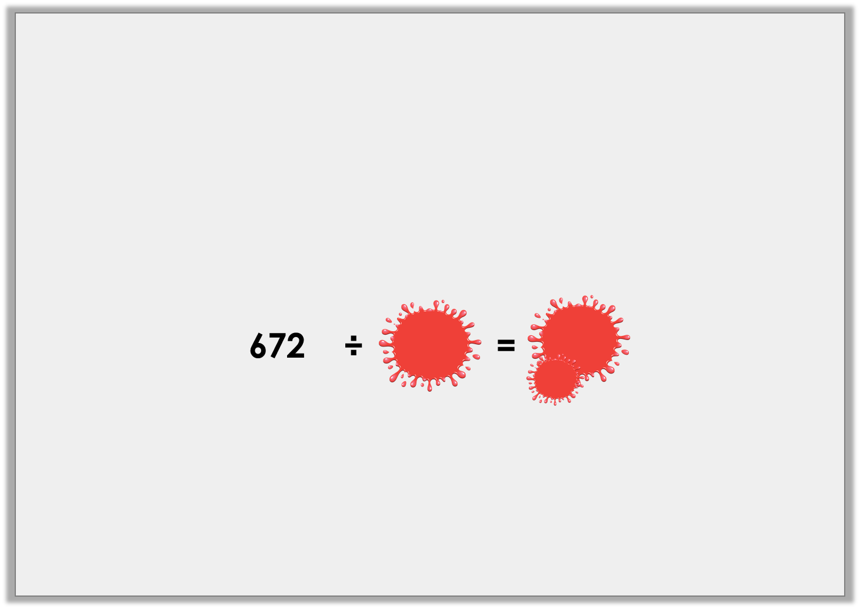
Problem Solving 1
Ellie has spilt paint all over her maths homework!
She was dividing 672 by a 1 digit number, and she remembers her answer was a whole number less than 300.
What could her equation have been?
© Classroom Secrets Limited 2018

Slide 14
Problem Solving 1
Ellie has spilt paint all over her maths homework!
She was dividing 672 by a 1 digit number, and she remembers her answer was a whole number less than 300.
What could her equation have been?
The equation could have been 672 ÷ 3 = 224 or 672 ÷ 6 = 112.
672 | ÷ | 3 | = | 224
672 | ÷ | 6 | = | 112
© Classroom Secrets Limited 2018

Slide 15
Reasoning 1
Which is the odd one out? Explain how you know.
A. 212 ÷ 4
B. 486 ÷ 9
C. 378 ÷ 7
D. 324 ÷ 6
© Classroom Secrets Limited 2018

Slide 16
Reasoning 1
Which is the odd one out? Explain how you know.
A is the odd one out because…
A. 212 ÷ 4
B. 486 ÷ 9
C. 378 ÷ 7
D. 324 ÷ 6
© Classroom Secrets Limited 2018

Slide 17
Reasoning 1
Which is the odd one out? Explain how you know.
A is the odd one out because 212 ÷ 4 = 53. All the others equal 54.
A. 212 ÷ 4
B. 486 ÷ 9
C. 378 ÷ 7
D. 324 ÷ 6
© Classroom Secrets Limited 2018

Slide 18
Reasoning 2
Are the following statements true or false? Convince me.
Statement A
I can divide two hundred and forty six equally by 4 and 6.
Statement B
Four hundred and fifty nine divided by nine equals fifty one.
Statement C
Seven hundred and twenty eight can be divided equally by 7 and 8.
© Classroom Secrets Limited 2018

Slide 19
Reasoning 2
Are the following statements true or false? Convince me.
Statement A is false because 246 can be divided by 6 equally but cannot be divided by 4.
Statement B is true because 459 ÷ 9 = 5.
Statement C is true because 728 ÷ 7 = 104 and 728 ÷ 8 = 91.
Statement A
I can divide two hundred and forty six equally by 4 and 6.
Statement B
Four hundred and fifty nine divided by nine equals fifty one.
Statement C
Seven hundred and twenty eight can be divided equally by 7 and 8.
© Classroom Secrets Limited 2018

