Slide 1
Food chains
This week you are going to present the food chains you have been creating in science, using PowerPoint.
For this week, I would like you to work with text boxes, shapes (arrows) and copying images from the internet to display three different food chains on separate slides.
Can you include technical language such as producer, consumer, predator, carnivore, herbivore, omnivore.

Slide 2
Once you have done this, have a play with the background, the fonts you choose to use and the colours of your text and arrows.
Can you get the text box and arrows to have a coloured outline?
Make use of the “format” tab at the top of the page!
Next week, we are going to be having a play with the animations feature of PowerPoint so make sure you save whatever you do this week so you don’t have to start from scratch!

Slide 3
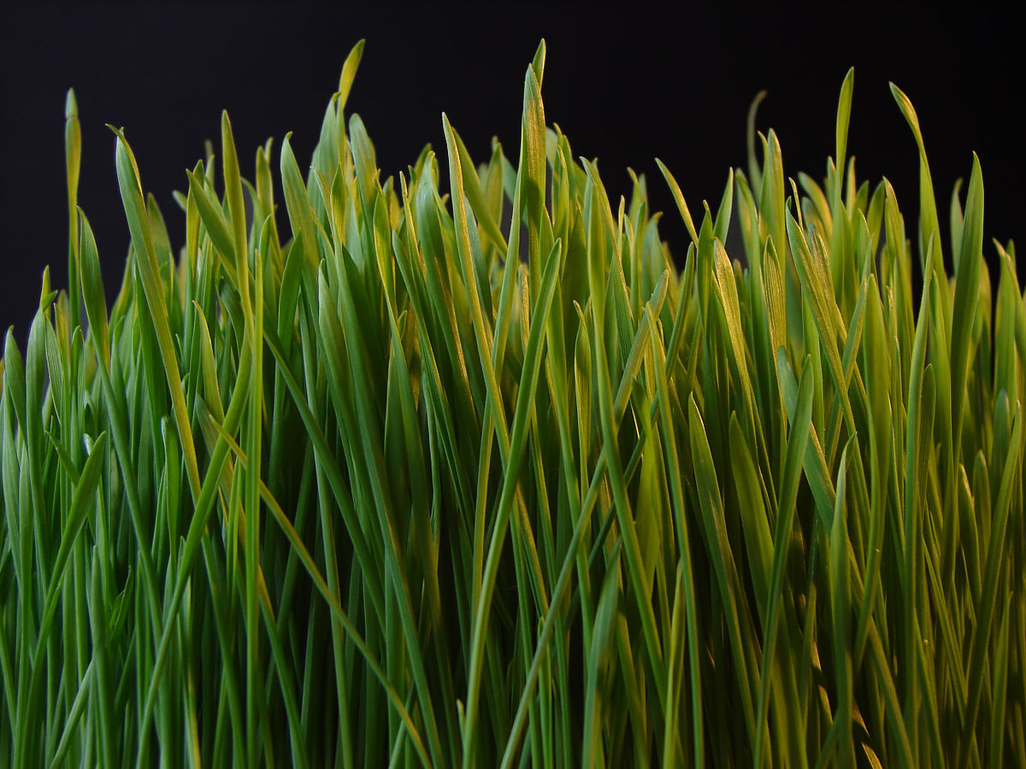
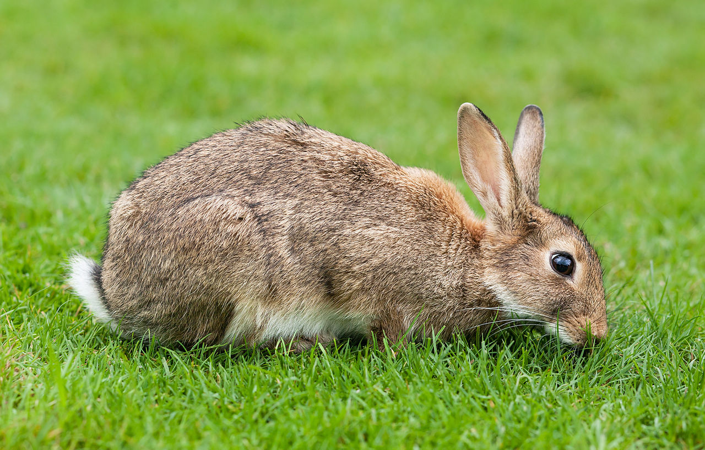
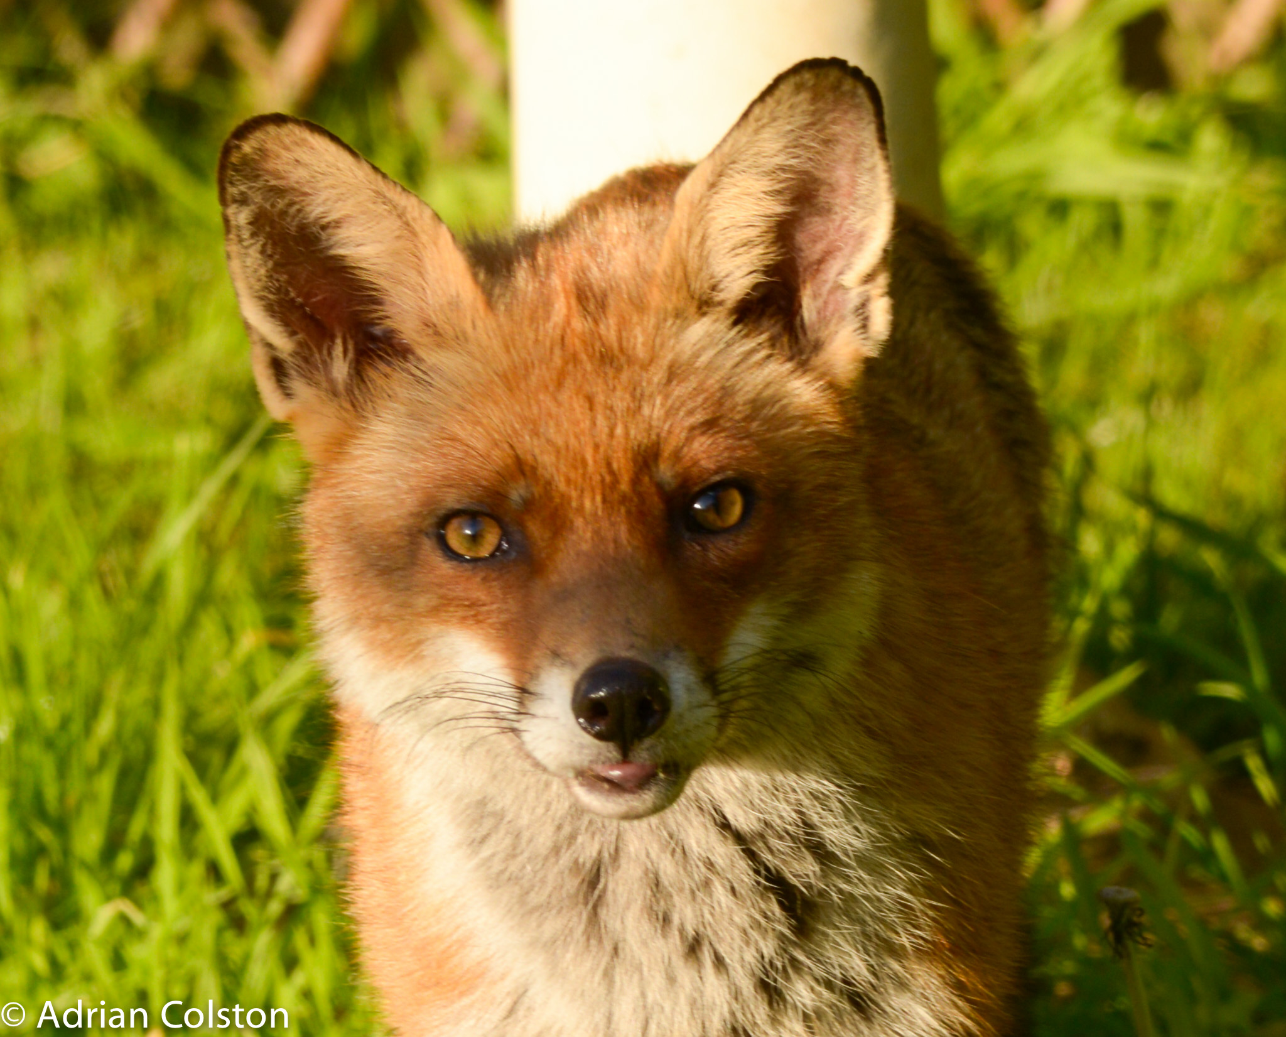
Grass
Rabbit
Fox
Producer
Primary consumer
Predator
Herbivore
Carnivore

