Slide 1
BINGO!
42 63 77 21
14 28 49 70
35 7 56 84

Slide 2
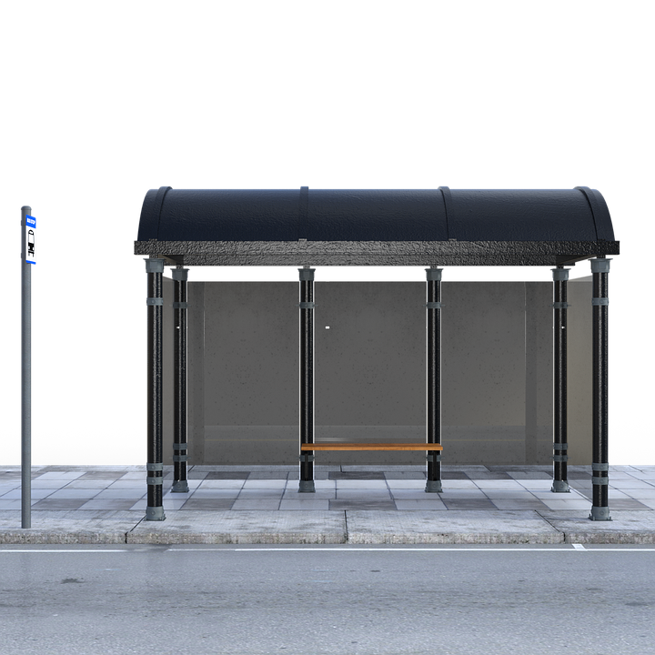
Bus stop method!

Slide 3
https://www.youtube.com/watch?v=4EcMON3F1yE

Slide 4
Let’s have a go!
36 ÷ 3 =
84 ÷ 4 =
84 ÷ 6 =
48 ÷ 3 =
144 ÷ 6 =

Slide 5
Activity
Choose one of the star challenges- don’t do them all!
Once you have done three questions- check the answers.
If you get any wrong, please try again to “fix it”.
Remember, I am on Teams for the whole session if you need any help!

Slide 6
*
24 ÷ 2 =
36 ÷ 3 =
54 ÷ 3 =
92 ÷ 4 =
84 ÷ 6 =
369 ÷ 3 =
**
96 ÷ 6 =
96 ÷ 4 =
78 ÷ 6 =
84 ÷ 3 =
78 ÷ 3 =
492 ÷ 4
***
104 ÷ 4 =
344 ÷ 8 =
186 ÷ 3 =
504 ÷ 6 =
238 ÷ 7 =
4944 ÷ 6 =

Slide 7
*
24 ÷ 2 = 12
36 ÷ 3 = 12
369 ÷ 3 = 123
**
96 ÷ 6 = 16
96 ÷ 4 = 24
78 ÷ 6 = 13
***
104 ÷ 4 = 26
344 ÷ 8 = 43
186 ÷ 3 = 62

Slide 8
*
4) 484 ÷ 4 = 121
5) 54 ÷ 3 = 18
6) 84 ÷ 6 = 14
**
4) 84 ÷ 3 = 28
5) 78 ÷ 3 = 26
6)492 ÷ 4 = 123
***
4) 504 ÷ 6 = 84
5) 238 ÷ 7 =34
6) 4944 ÷ 6 = 824

