Slide 1
Stephanie Peters

Slide 2
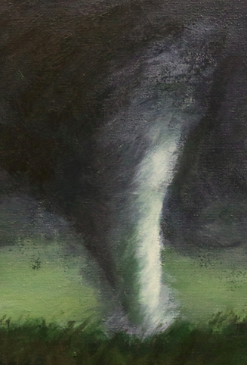
Early Life
Stephanie was born on October 10th, 1988.
She grew up on a farm in Maryland in the USA.

Slide 3
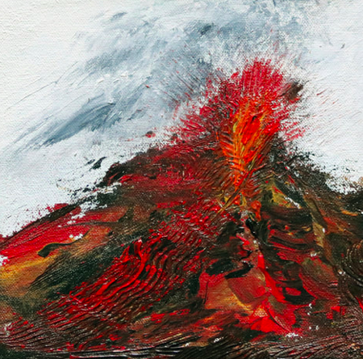
Early Life
She grew up raising animals and surrounded by open fields, later inspiring some of her artwork.
She completed her degree in Art History from the University of Arizona in 2009.

Slide 4
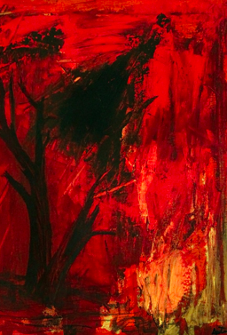
Style
Peters found inspiration in the natural world. She also found inspiration in natural disasters such as volcanoes.
She likes to combine abstract and traditional styles of painting. She does this by using mixed media in her artwork.

Slide 5
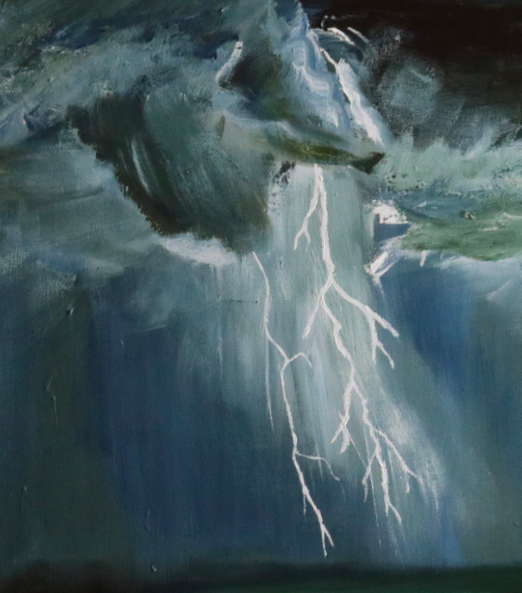
Medium
Stephanie uses a variety of mediums including acrylic paint, ink, fabric, string, charcoal, cartridge paper and canvases.

Slide 6
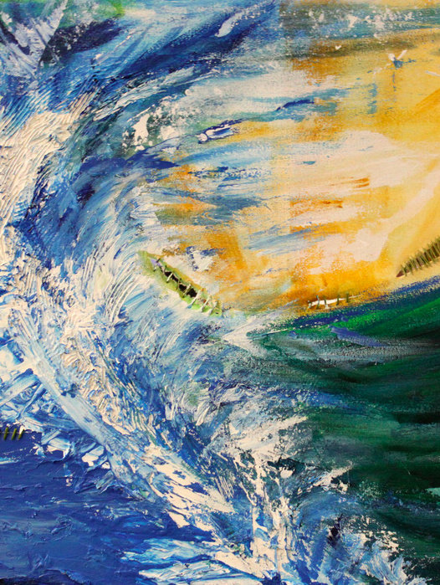
Connections
Peters paints natural disasters because it connects her with changing planet.
She is currently working on a collection about the changing earth.

Slide 7
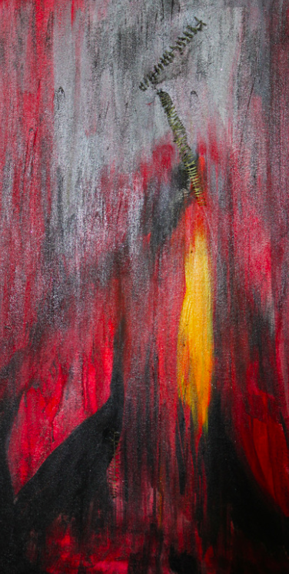
Aims
She aims to tell a story with her artwork and hopes that people will see her artwork as inspiration.
Peters is encouraged by all of nature, her art is described as bold, colourful, fearless but very pleasing to the eye

Slide 8
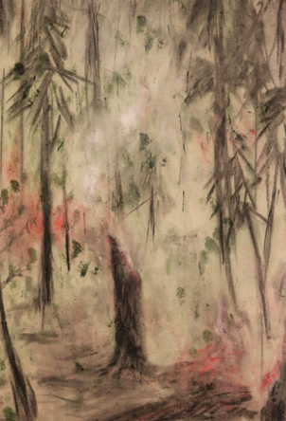
Fact File
The artist fact file should include:
Title (Stephanie Peters)
Date of Birth
Where they were born?
Did she train anywhere to become an artist or is she self taught?
What style does the artist use?
What medium do they use? (Acrylic paints, watercolours, oil pastels)
Tell me 2 or 3 interesting facts about Stephanie Peters.

