Slide 1
Tuesday 12th January 2021
I can find the features of a non-chronological report.

Slide 2
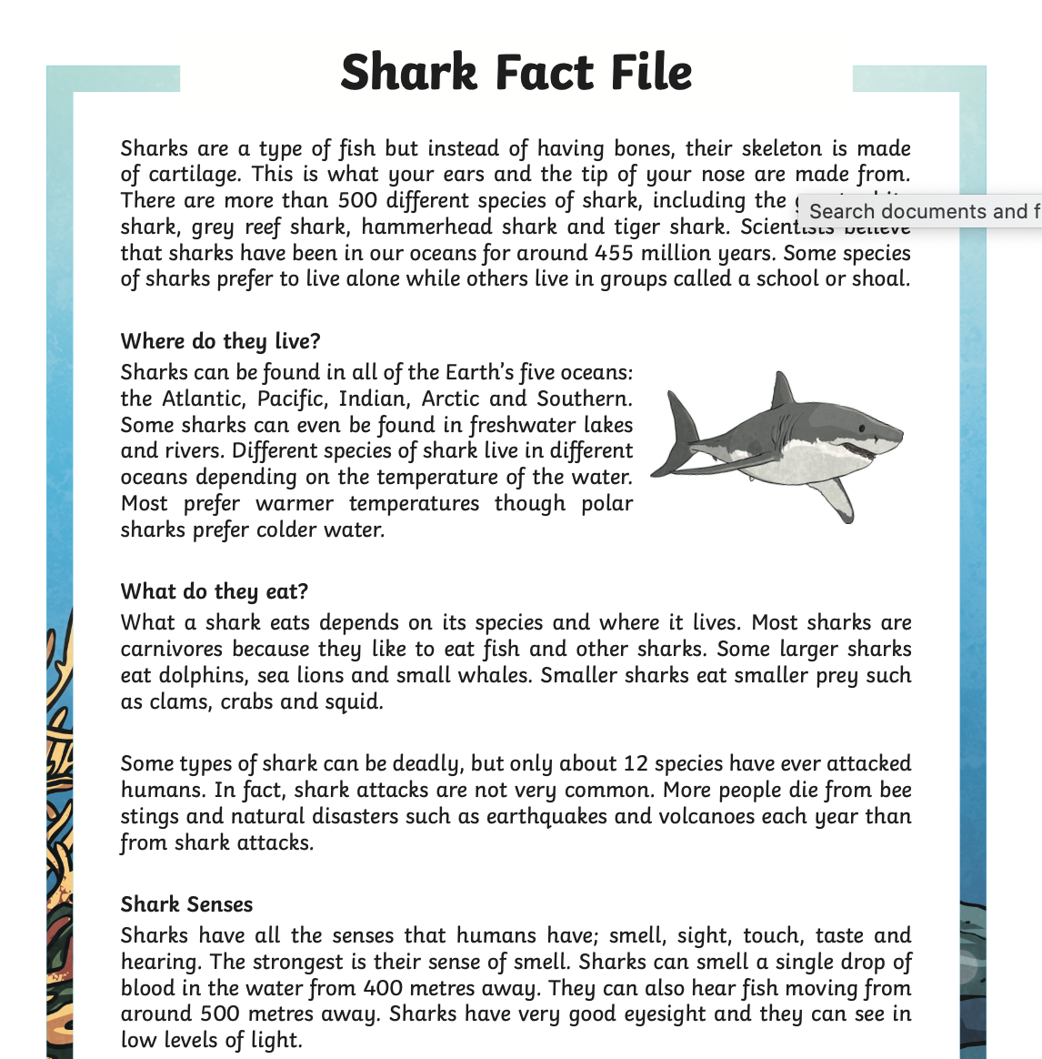
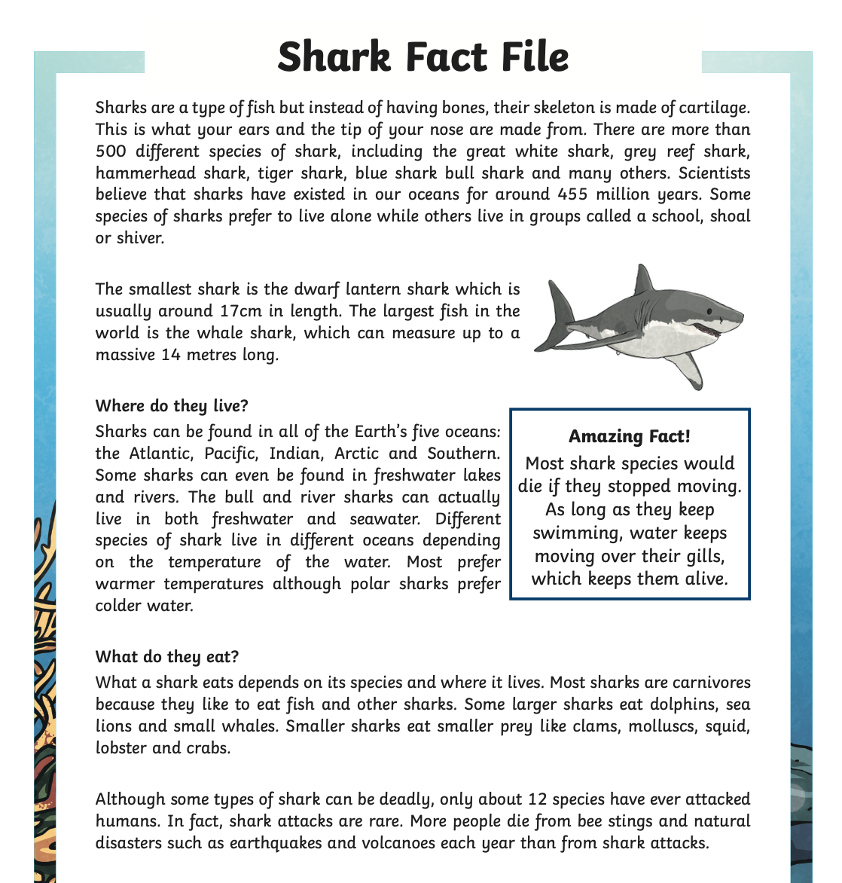
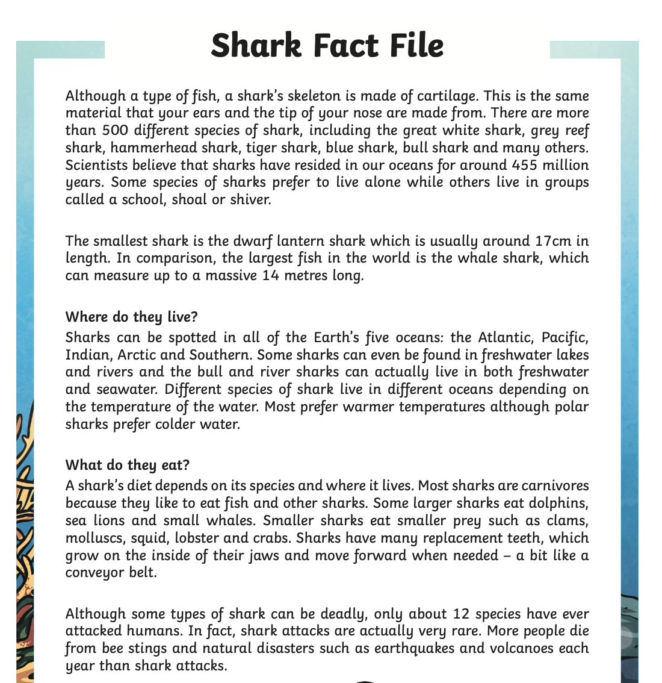
Tuesday 12th January 2021
First, please read the non-chronological report example on our online learning page.
*
**
***

Slide 3
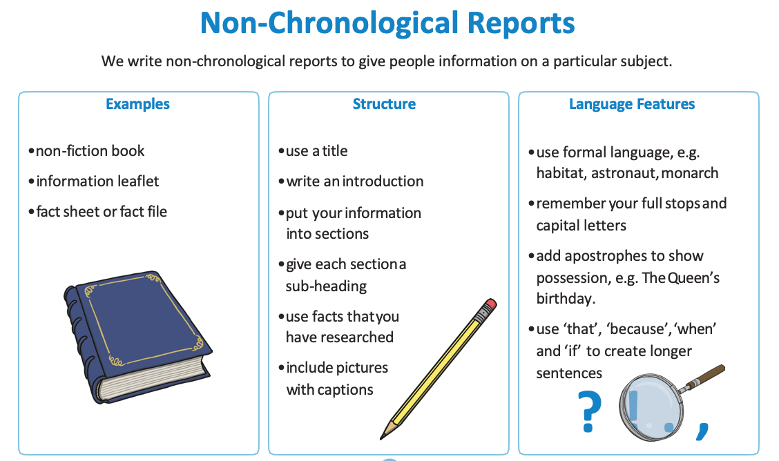
Tuesday 12th January 2021

Slide 4
Tuesday 12th January 2021
Can you find these features in your non-chronological report?
Can you underline or highlight them to show where they are?

Slide 5
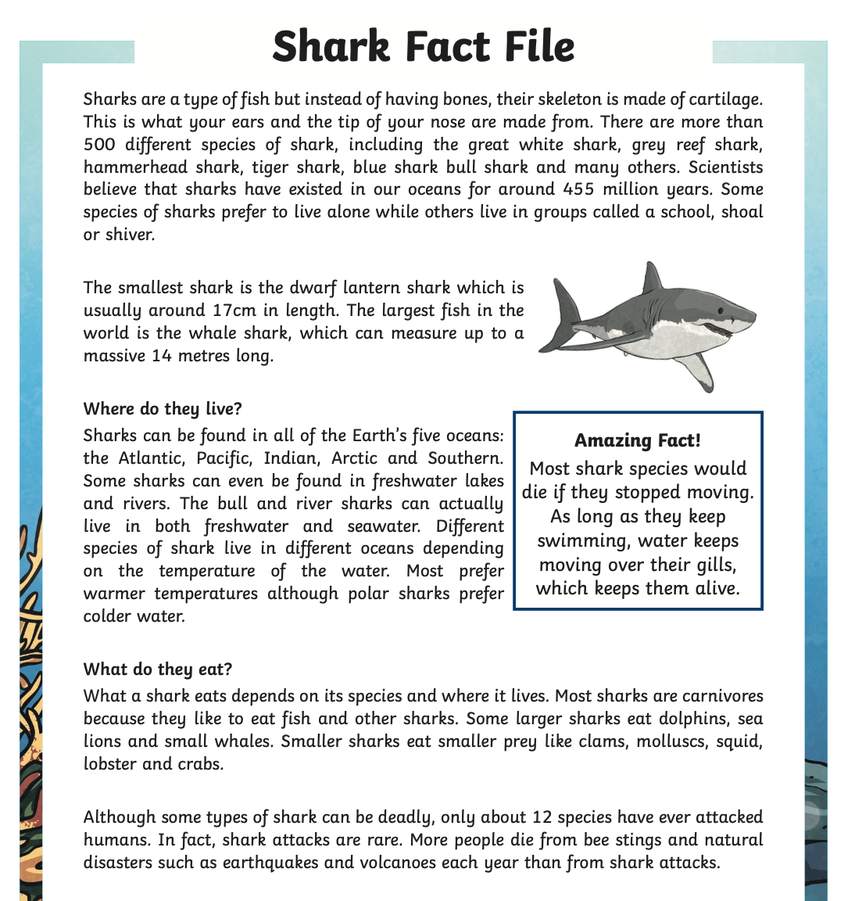
Tuesday 12th January 2021

Slide 6
Tuesday 12th January 2021
I have colour coded my features so I can clearly see where the features are in the text. I have started some for you. Can you find any more examples?

