Slide 1
Editing!
(The most important part of the writing process!)

Slide 2

Rainbow sentences
Underline each sentence you have written, in a different colour. Does it make sense? Does it need splitting into sentences that make sense? Is it too long?

Slide 3

Capital letter hunt!
Shade in every capital letter in your writing
2)Go back and check- Is it at the beginning of a sentence? Is it a name? No? Change it!

Slide 4
Sentence starter check
Using a highlighter- underline the first word/phrase at the beginning of each sentence.
Are there lots of the same?
Then Then Then
I I I
The The The
And, But- starting sentences X!
Have you used any fronted adverbials? Could you add any?
Where? How? When?
- As the sunlight began to fade,
In front of the colosseum,
Grunting and sweating,

Slide 5
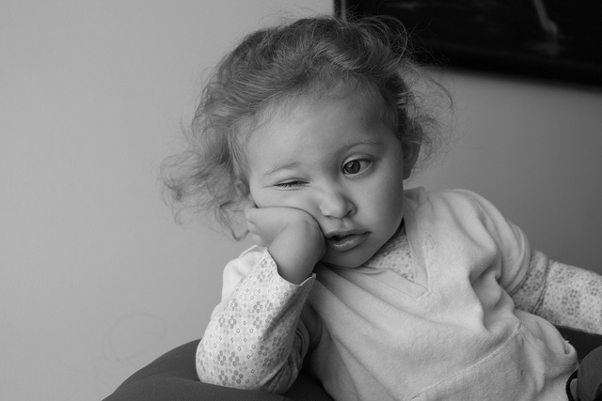
Boring word hunt
THESE WORDS ARE BANNED!
Looked
Went
Walked
Big
Small
Old
Scared

Slide 6

Final read through
Does it make sense?
Can you tick off each bit of your checklist?
Are you happy?
Will this WOW me?
Title?

