Slide 2
Aim
I can construct and interpret food chains
Success Criteria
I can order a simple food chain.
I can identify the producer, predator and prey.
I can interpret a variety of food chains.

Slide 3

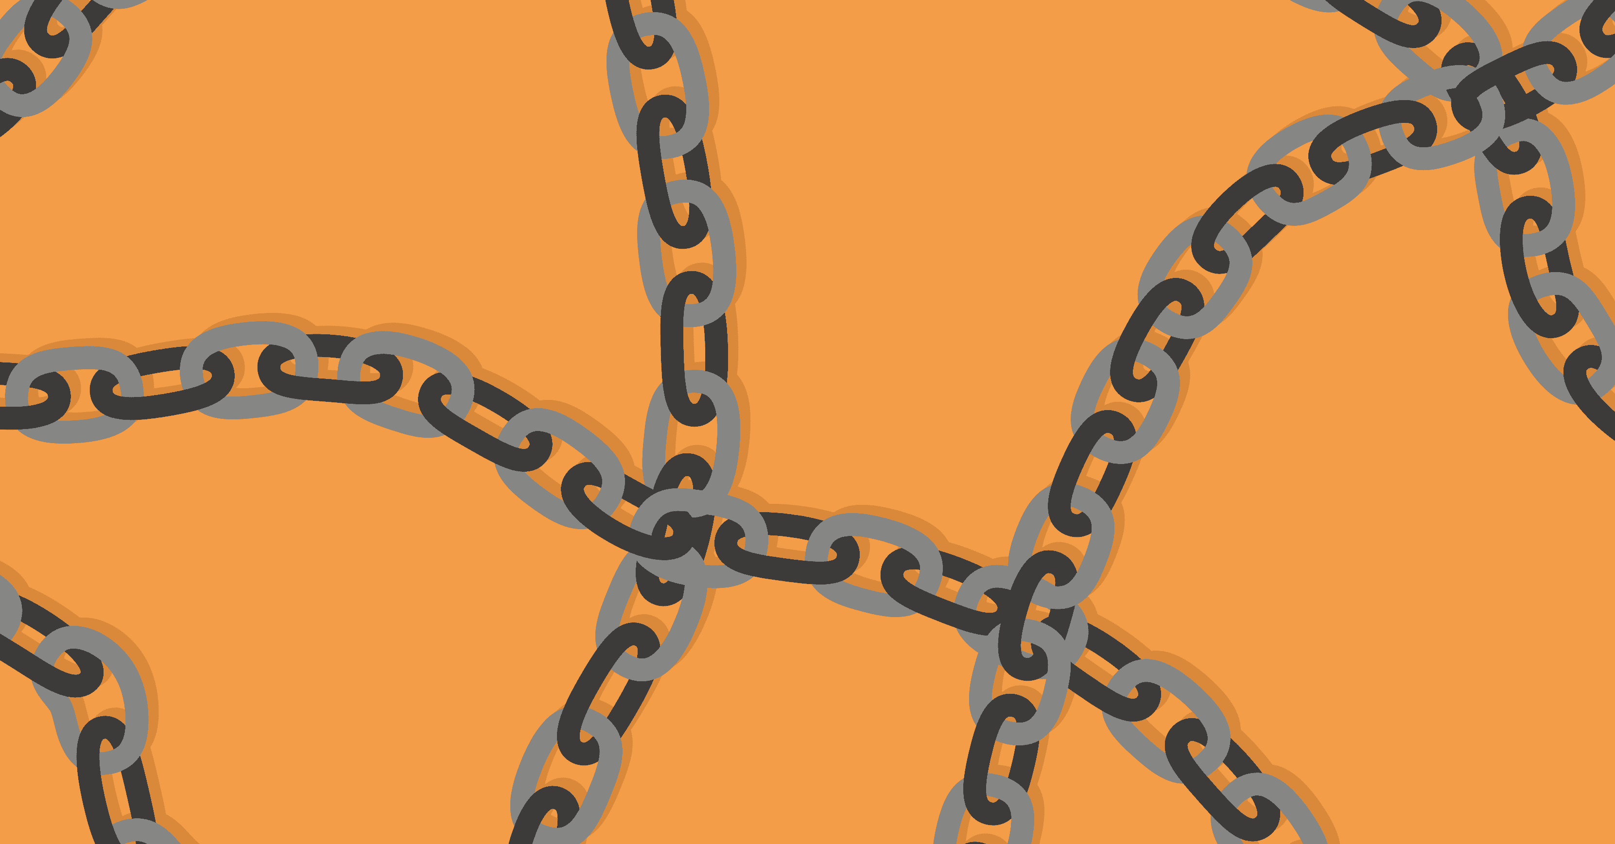
Food Chains
What is a food chain?
Now watch the following video clip and see if we can add to or refine our ideas.

Slide 4

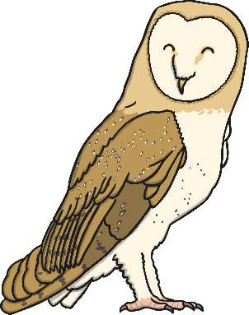
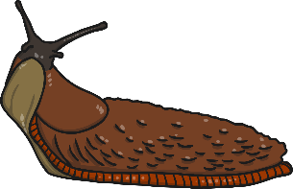
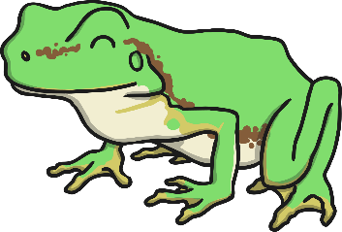
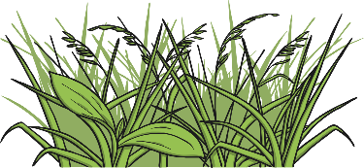
Interpreting Food Chains
How is this food chain constructed?
What do the arrows represent?
How should we label the different parts of the food chain?

Slide 5
Labelling Food Chains 1
Producer/Autotroph
Consumer
Consumer
Consumer
Primary Consumer
Secondary Consumer
Tertiary Consumer
Prey
Predator/Prey
Predator
Detritivore
Omnivore
Carnivore

Slide 6
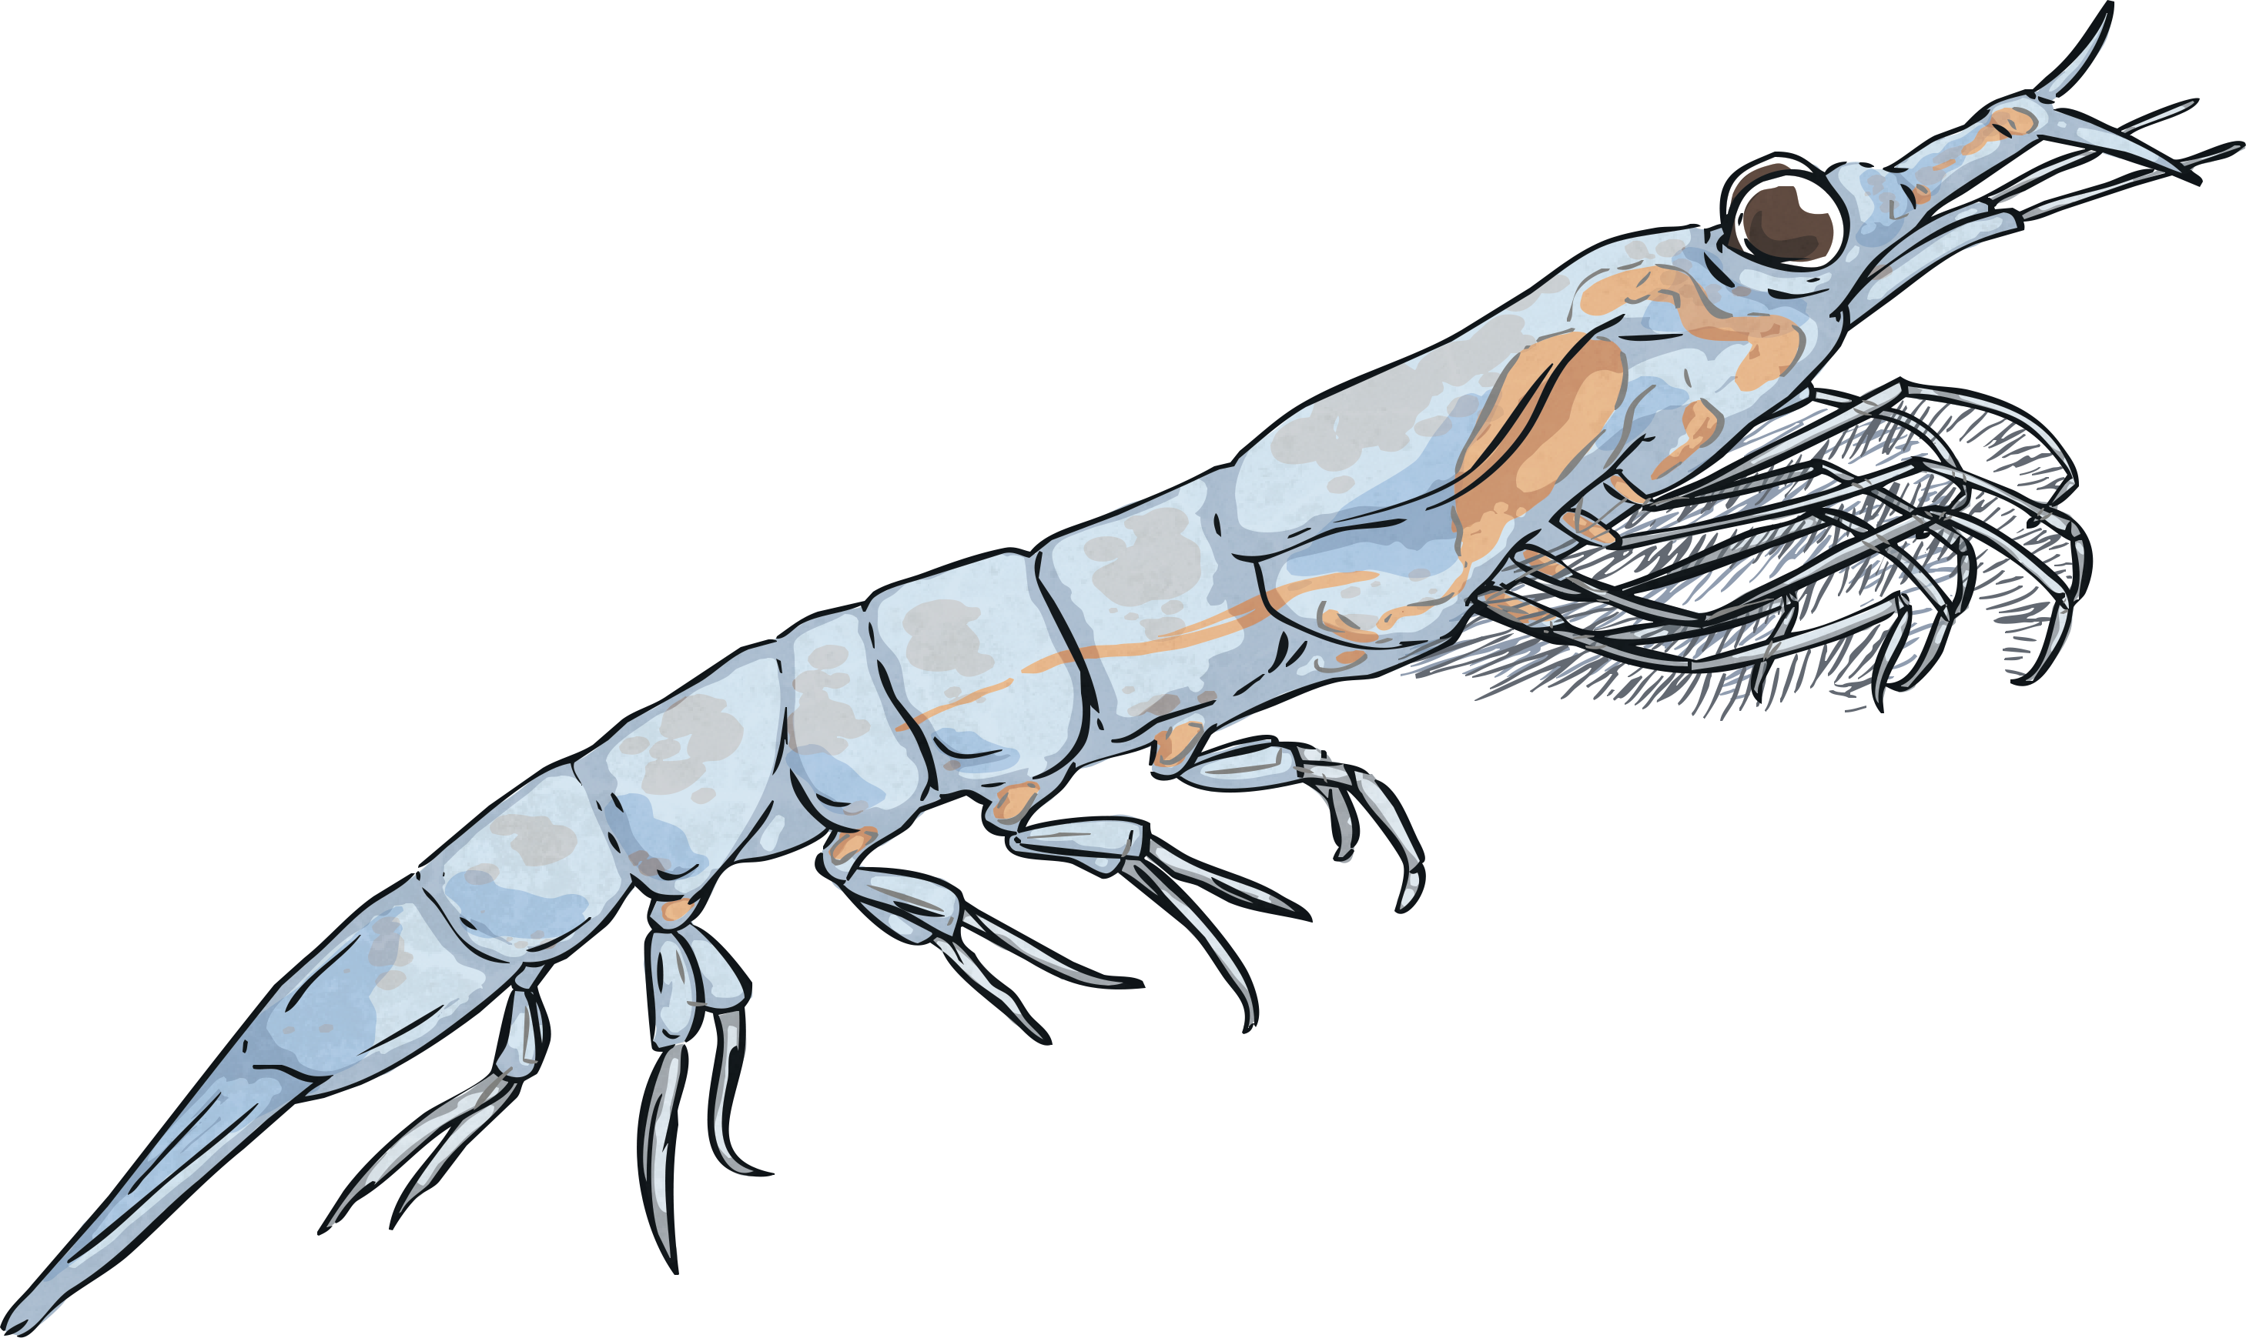
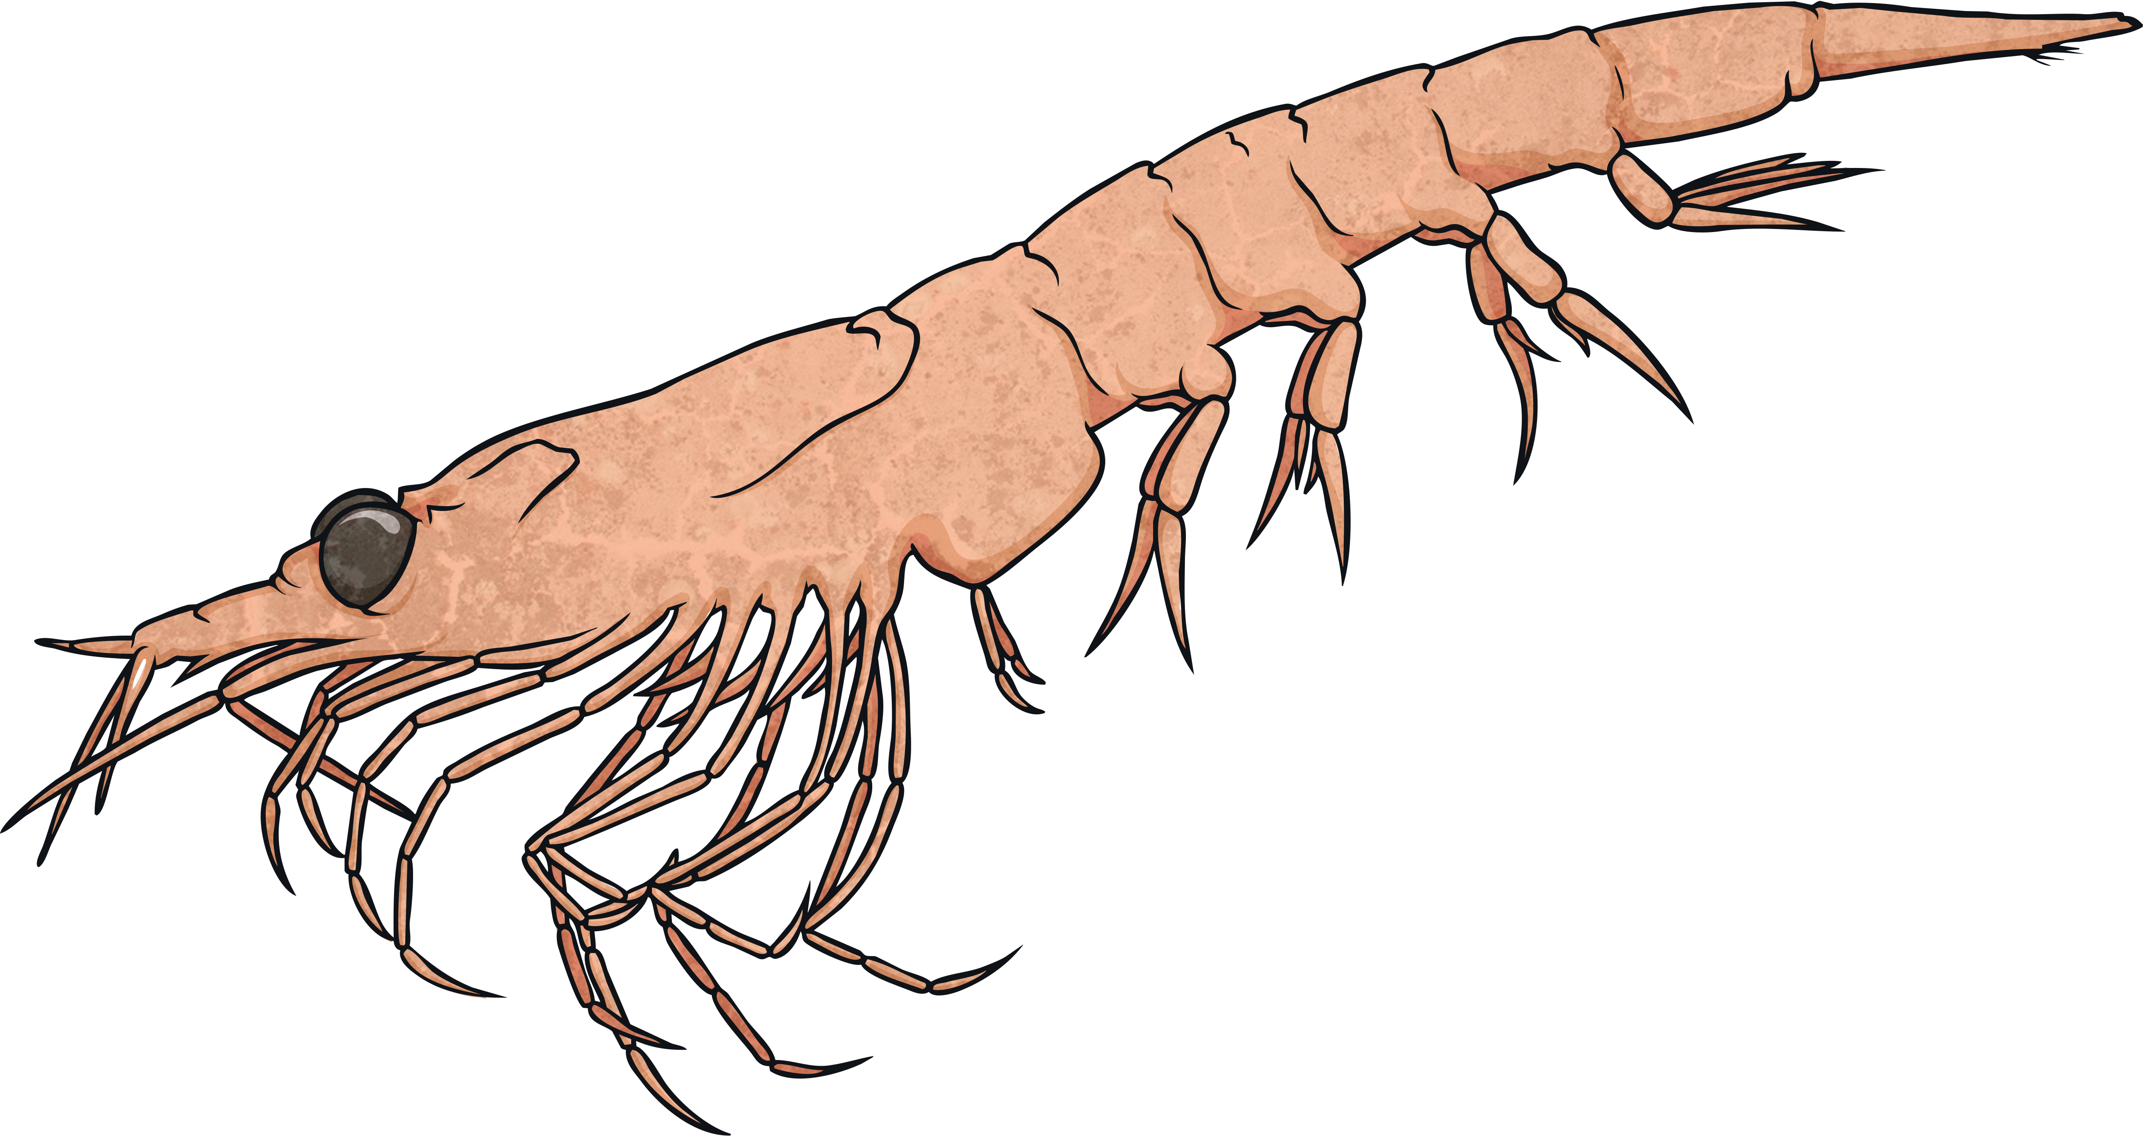
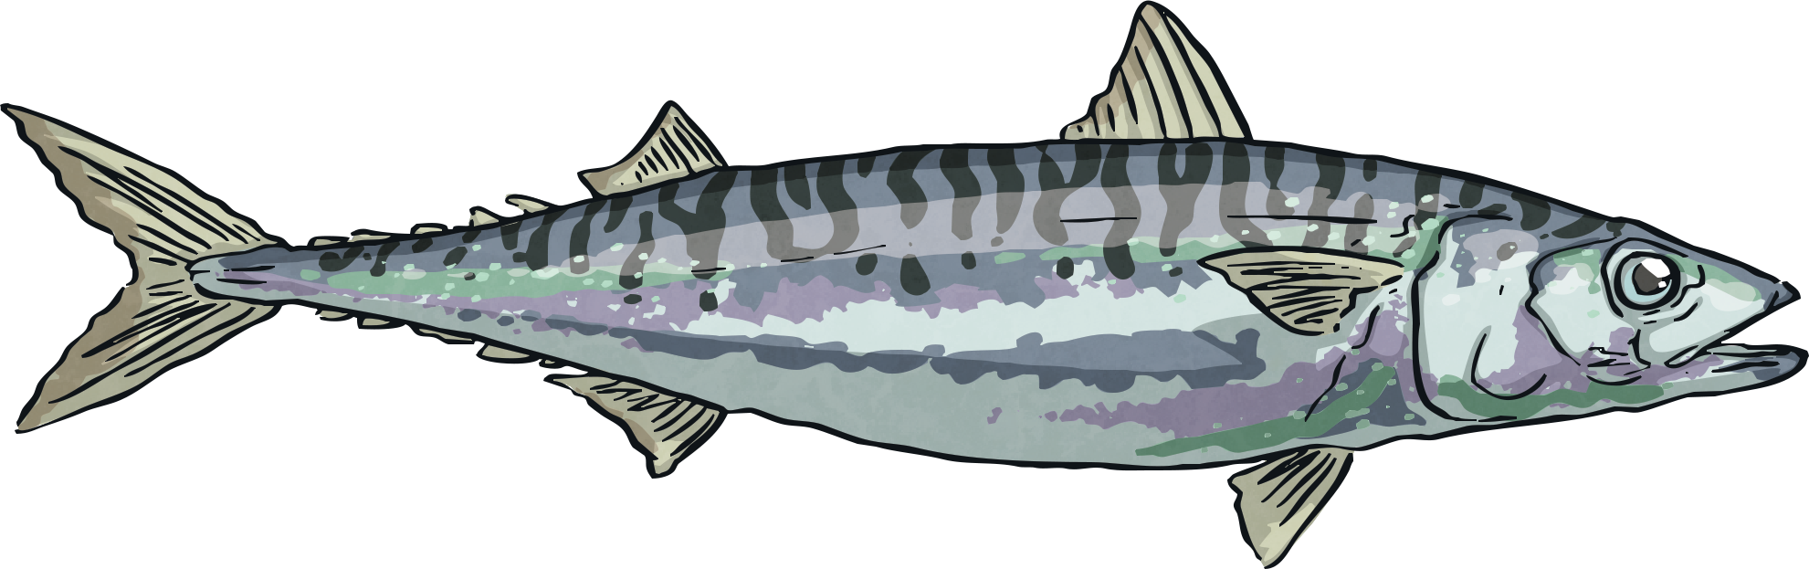
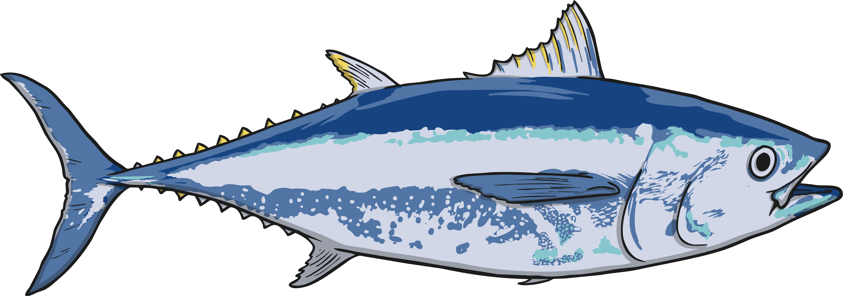
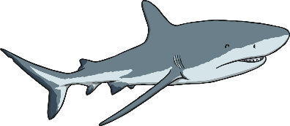
Labelling Food Chains 2
Here is a more complex example:
Producer/
Autotroph
Consumer
Consumer
Consumer
Consumer
Primary Consumer
Secondary Consumer
Tertiary Consumer
Quaternary Consumer
Prey
Predator/Prey
Predator/Prey
Predator/
Scavenger
Herbivore
Carnivore
Carnivore
Carnivore

Slide 7
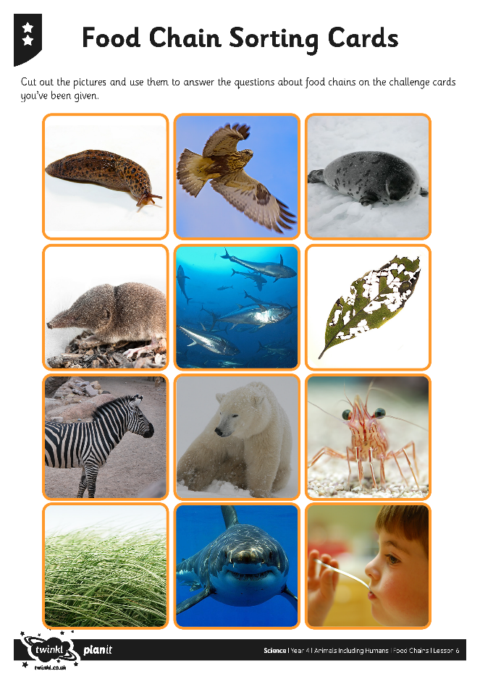
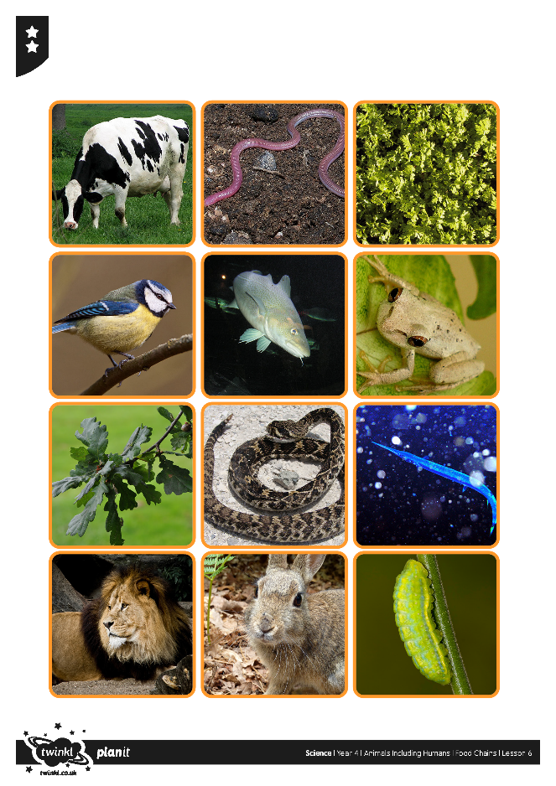

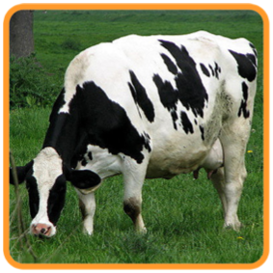

Food Chains Activity
Assessment
Cut out the cards that are on the website or try and draw them.
Now create different food chains for example:
Grass Cow Human

Slide 8
Food Chains Activity
Please can you create the following:
Create a food chain that contains one carnivore and one herbivore.
Create a food chain with one producer, a primary consumer and a secondary consumer.
Create a food chain where the last consumer is an omnivore.
Create the longest food chain you can including a producer, detritivore and at least one consumer.
Create a food chain with 4 consumers.

Slide 9

Aim
I can construct and interpret food chains
Success Criteria
I can order a simple food chain.
I can identify the producer, predator and prey.
I can interpret a variety of food chains.

