Slide 1

Monday 11th January 2021
To listen to the story please visit
https://www.youtube.com/watch?v=nQHaPPNr6zc
Please ask an adult before clicking on any links.

Slide 2
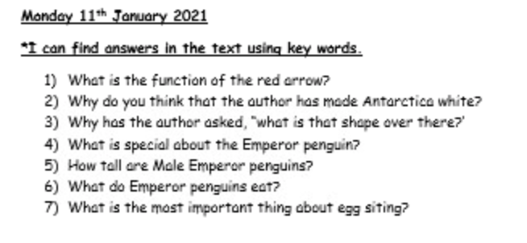
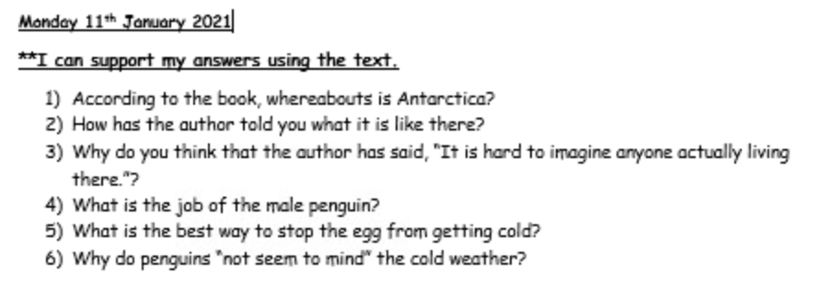
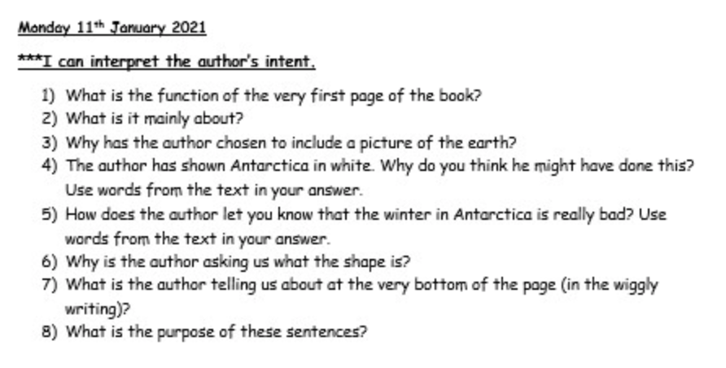
The questions are all on our online learning page and uploaded onto Seesaw.

Slide 3
