Slide 1
11.01.21
Grid Multiplication

Slide 2
11.01.21
Grid Multiplication
13 x 4 =
Show as an array…

Slide 3
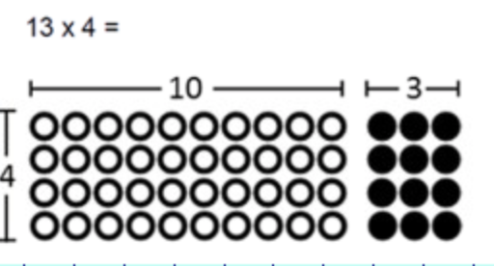
11.01.21
Grid Multiplication
13 x 4 =
Show as an array…

Slide 4
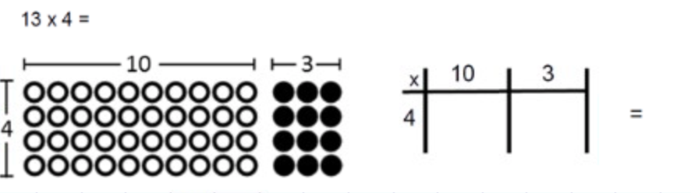
11.01.21
Grid Multiplication
13 x 4 =
Show as an array…

Slide 5
11.01.21
Grid Multiplication
13 x 4 =
Show as an array…
40
+ 12
___
52
___
40
12

Slide 6
11.01.21
Grid Multiplication
Draw your grid
2. Partition the 2-digit number across the top of your grid.
3. Write the 1-digit number along the side of your grid.
4. Multiply
5. Add your answers together.

Slide 7
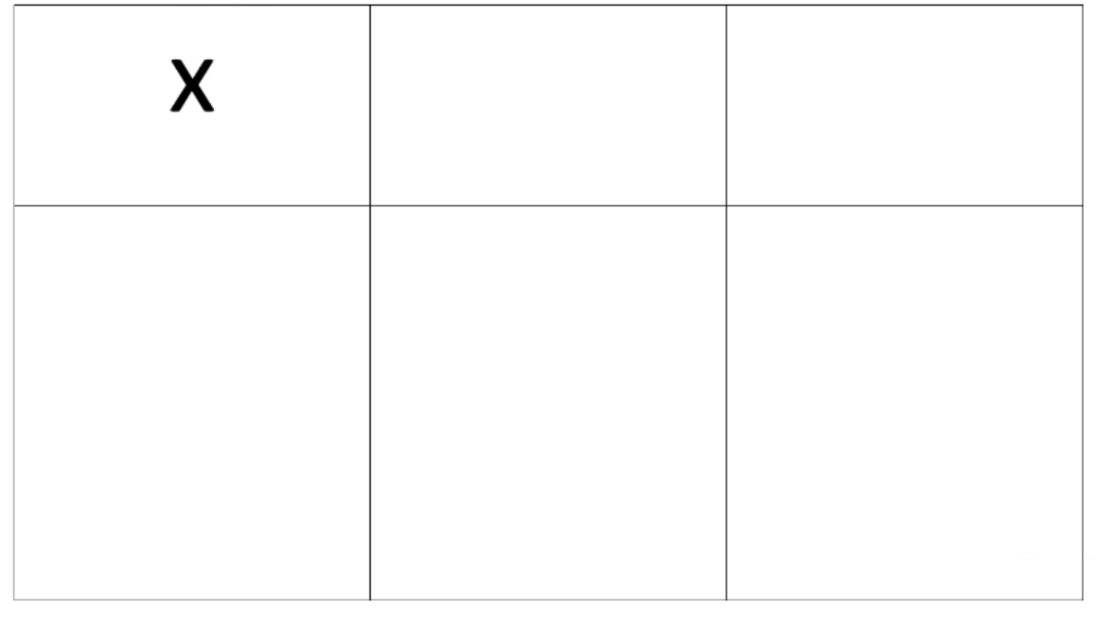
11.01.21
Grid Multiplication
14 x 3 =
10
4
3

Slide 8
11.01.21
Grid Multiplication
14 x 3 =
10
4
3
30
12

Slide 9
11.01.21
Grid Multiplication
14 x 3 =
30
+ 12
____
42
____
10
4
3
30
12

Slide 10
11.01.21
Grid Multiplication
Together we will do 19 x 4 =
10
9
4

Slide 11
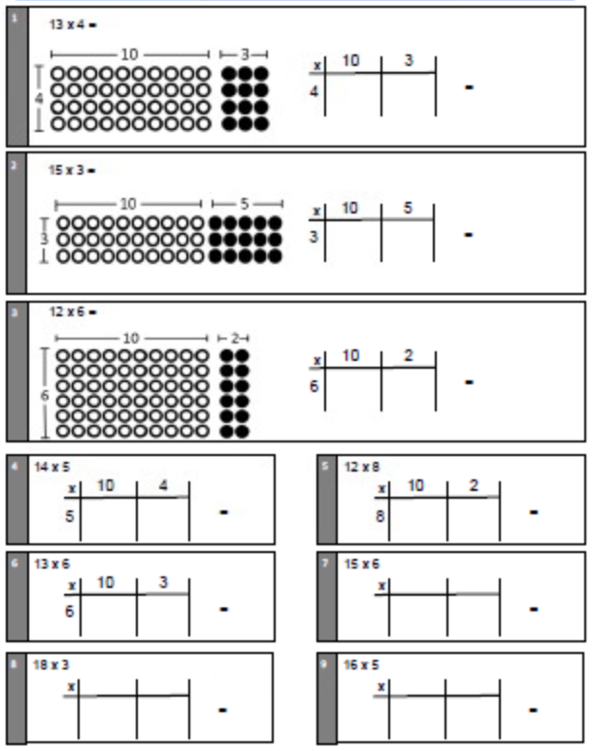
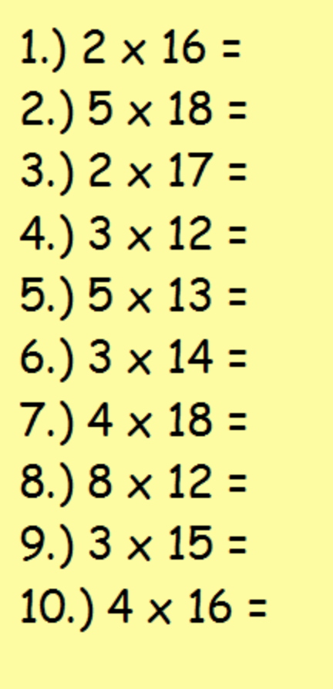
11.01.21
Grid Multiplication
*
**

Slide 12
11.01.21
Grid Multiplication - ANSWERS
*
**
13 x 4 = 52
13 x 5 = 65
12 x 6 = 72
14 x 5 = 70
12 x 8 = 96
13 x 6 = 78
15 x 6 = 90
18 x 3 = 54
16 x 5 = 80
2 x 16 = 32
5 x 18 = 90
2 x 17 = 34
3 x 12 = 36
5 x 13 = 65
3 x 14 = 42
4 x 18 = 72
8 x 12 = 96
3 x 15 = 45
4 x 16 = 64

