Slide 1
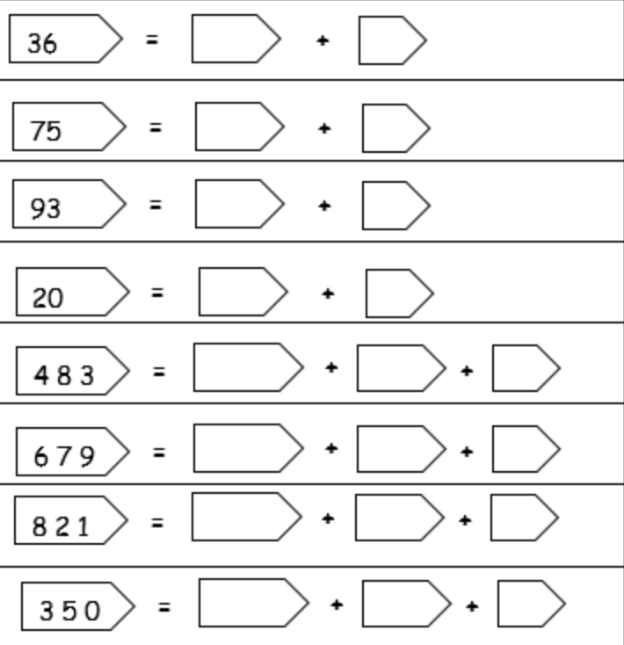
Partition these numbers….
*
**
26 = 20 + 6
67 =
81 =
23 =
389 =
826 =
470 =
638 =
720 =
***
430 = 400 + 30 + 0
100 =
500 =
308 =
205 =
888 =
901 =
662 =
141 =

Slide 2
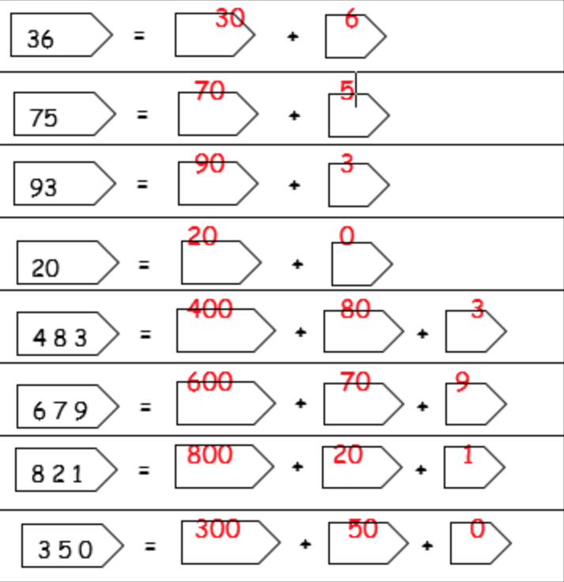
Partition these numbers….
*
**
26 = 20 + 6
67 = 60 + 7
81 = 80 + 1
23 = 20 + 3
389 = 300 + 80 + 9
826 = 800 + 20 + 6
470 = 400 + 70 + 0
638 = 600 + 30 + 8
720 = 700 + 20 + 0
***
430 = 400 + 30 + 0
100 = 100 + 0 + 0
500 = 500 + 0 + 0
308 = 300 + 0 + 8
205 = 200 + 0 + 5
888 = 800 + 80 + 8
901 = 900 + 0 + 1
662 = 600 + 60 + 2
141 = 100 + 40 + 1

