Slide 1


Slide 2
Aim
To explain how volcanoes are formed.
Success Criteria
I can show you how tectonic plates move.
I can tell you how a volcano is formed.
I can name some of the parts of a volcano.
I can tell you what happens when a volcano erupts.

Slide 3







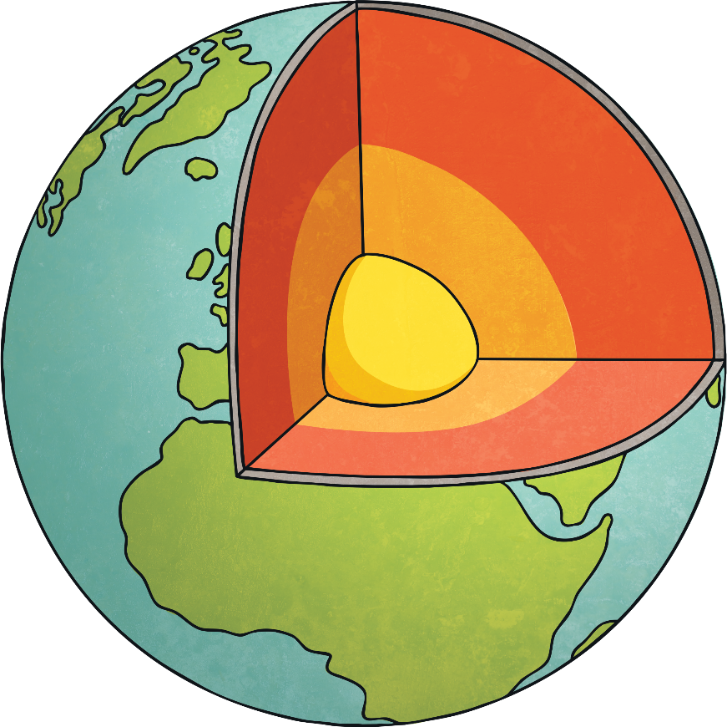
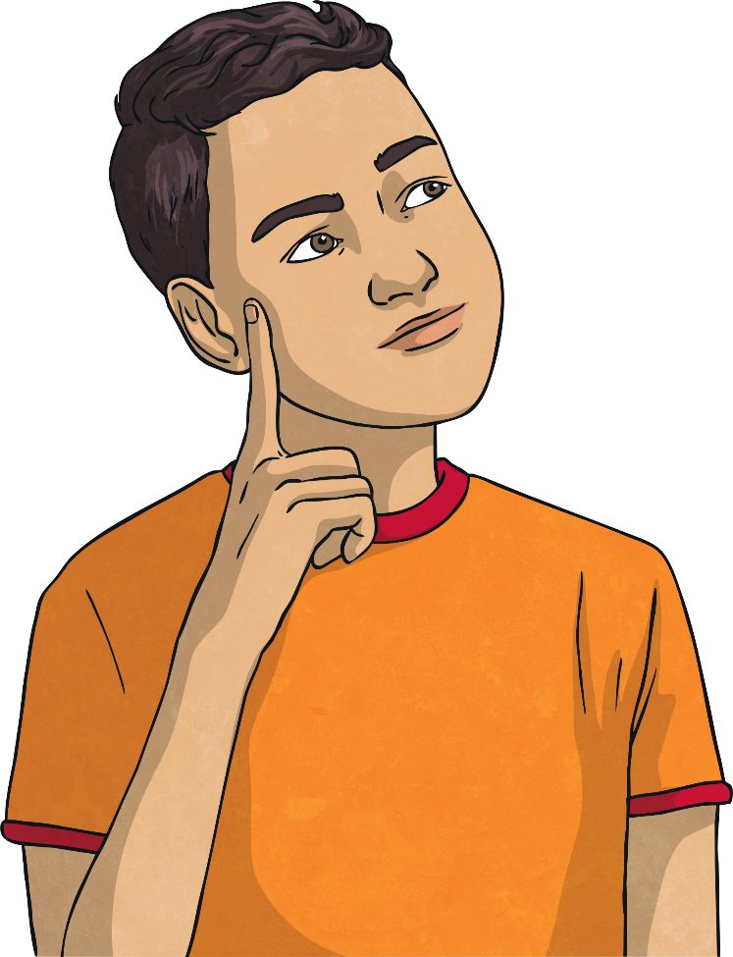
Can You Remember What’s
Under Your Feet?
crust
mantle
outer core
inner core

Slide 4
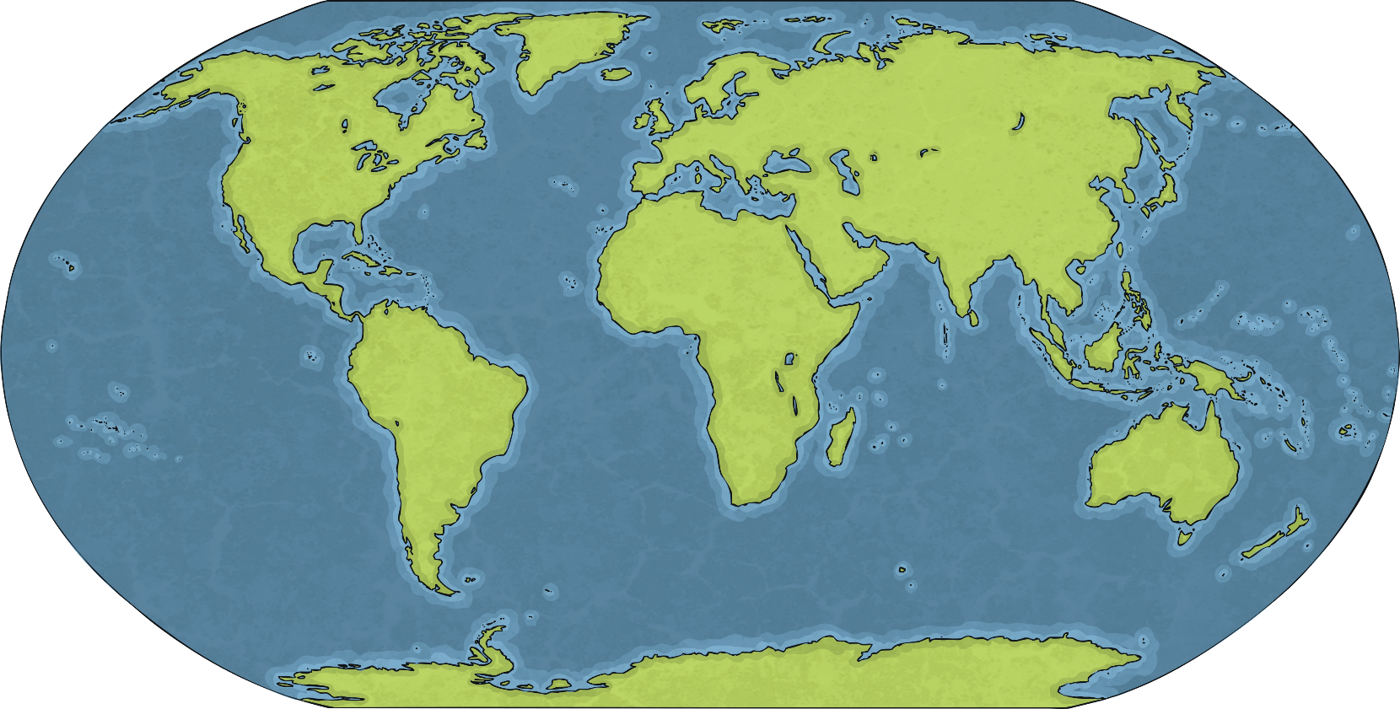
Eyjafjallajökull
Eyjafjallajökull is a volcano in Iceland.
Watch this video of it erupting in 2010.

Slide 5
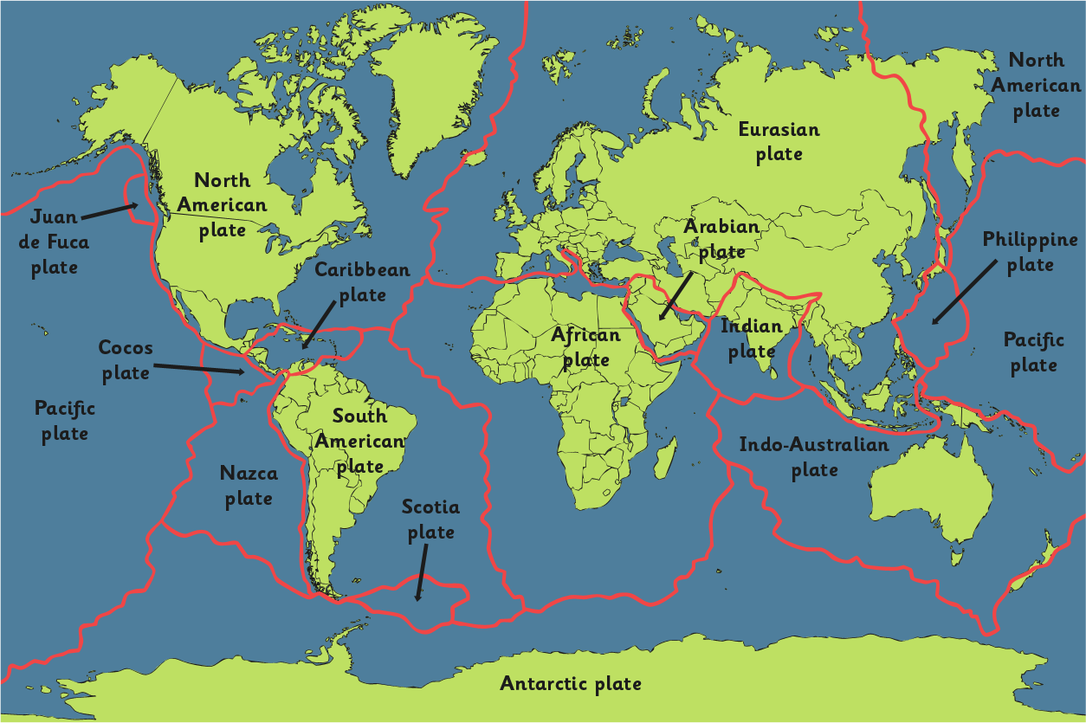
Tectonic Plates
The Earth’s crust isn’t one solid layer. It is broken up into huge areas called tectonic plates that float on top of the mantle.

Slide 6
How Can You Move Your Plates?
You will need two pieces of paper. These will be your plates.
Lay your “plates” flat onto the table.
How many different ways can you move the plates around?
Rubbing together
Towards
each other
Away from
each other

Slide 7
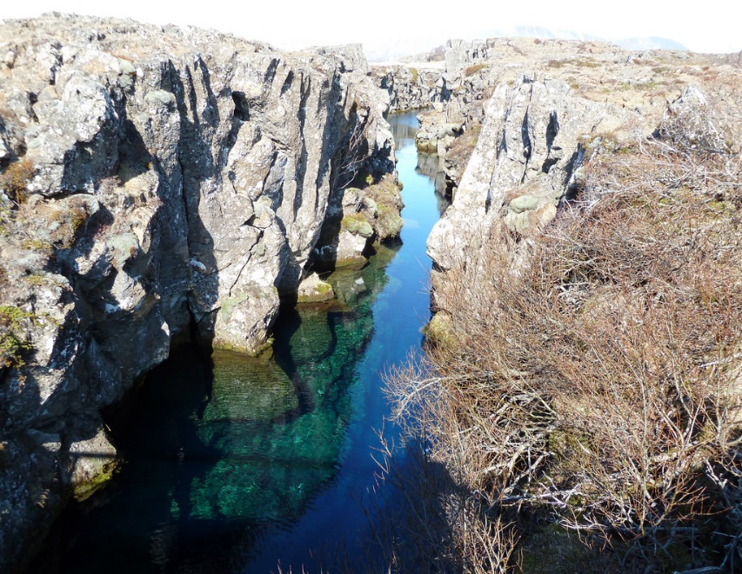
What Have Tectonic Plates Got to
do with Volcanoes?
This valley is over 9000 years old.
It is getting 7mm wider every year as the plates are still moving apart.
The rocky valley floor was caused by cooled lava.
This valley is surrounded by volcanoes that have formed as the plates move apart.
Watch footage of the valley here.
Photo courtesy of Rob Young (@flickr.com) - granted under creative commons licence – attribution

Slide 8
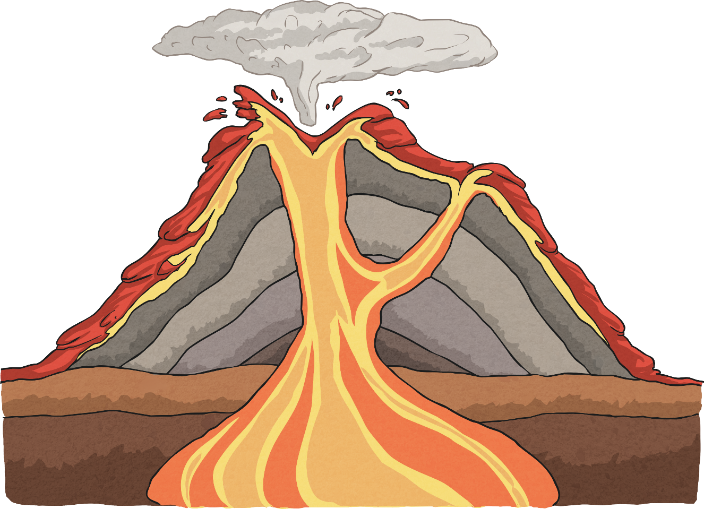
How Are Volcanoes Made?
2. This then affects the Earth’s crust, so that magma can sometimes erupt through it.
3. The lava and ash that has erupted through the crust build up to form the classic volcano cone shape over time.
1. Pressure builds up inside the Earth.
This process is happening all the time!

Slide 9
What’s It All Called?
eruption cloud
crater
conduit/main vent
magma chamber

Slide 10
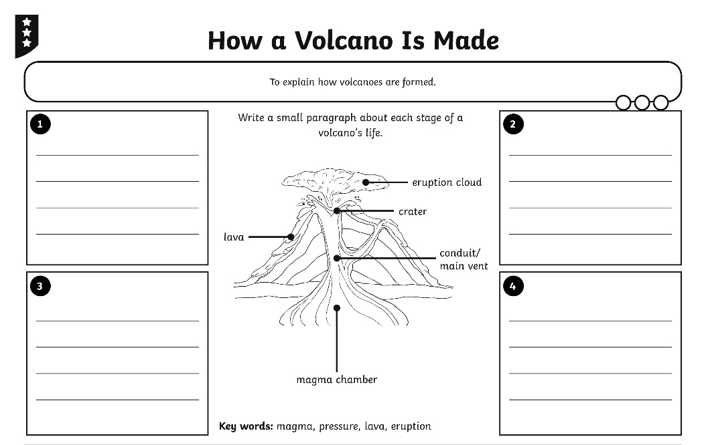
How a Volcano Is Made
Now complete the worksheet on the website!
Don’t forget to colour in your volcano!

Slide 11
Aim
To explain how volcanoes are formed.
Success Criteria
I can show you how tectonic plates move.
I can tell you how a volcano is formed.
I can name some of the parts of a volcano.
I can tell you what happens when a volcano erupts.

