Slide 1
Rights of the child!
The United Nations are a group of nearly 200 countries that have all signed to say that they agree the same thing.
The United Nations have created a list of 54 rights they feel that every child deserves!
These rights apply as long as by applying them, people are not affecting the rights of others
Today we’re going to look at the 9 rights on the following slide:

Slide 2
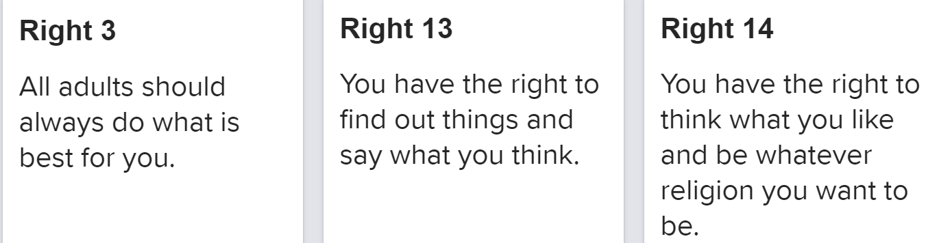
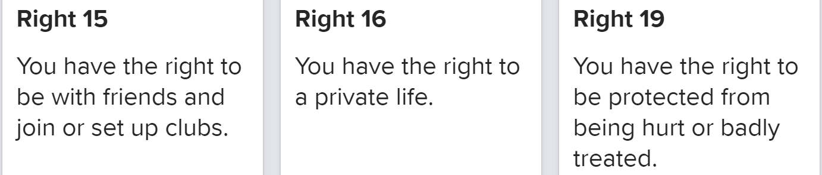
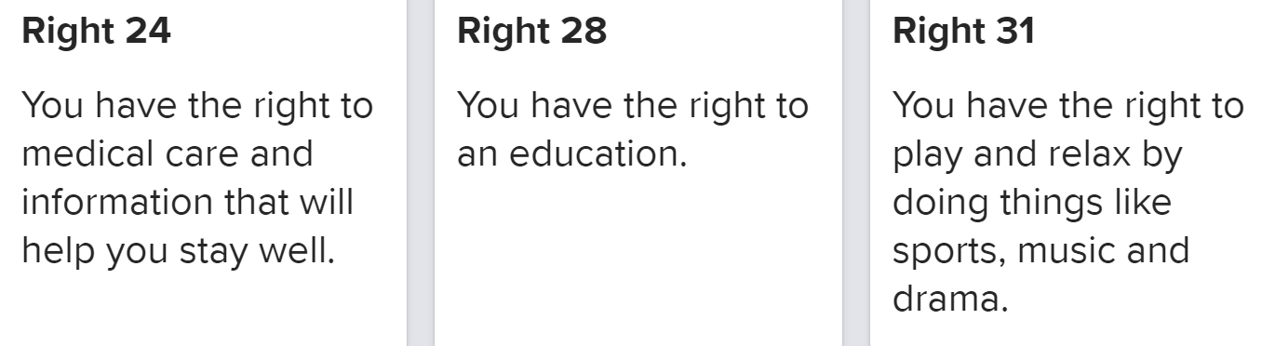

Slide 3
Task 1
Can you match the 9 rights on the previous slide to the scenarios on sheet A?

Slide 4
Task 2
Look at the rights on sheet B.
Can you order these from the ones that you feel are most important to the ones that you feel are least important?
  There are several ways you can do this:
    Put them in the empty diamonds (either cut out or write the number) so that the most important is at the top and least important is at the bottom.
    Write a list of the 9 rights (only their numbers e.g. Right 13) in order from most important to least important.
    Write numbers 1-9 on the rights diamonds so that the one you have numbered 1 is the most important and 9 is the least important.

Slide 5
Task 3
Use the right that you have chosen to be the most important and explain why you think this is the most important.
Do the same for the right that you believe to be the least important.

