Slide 1
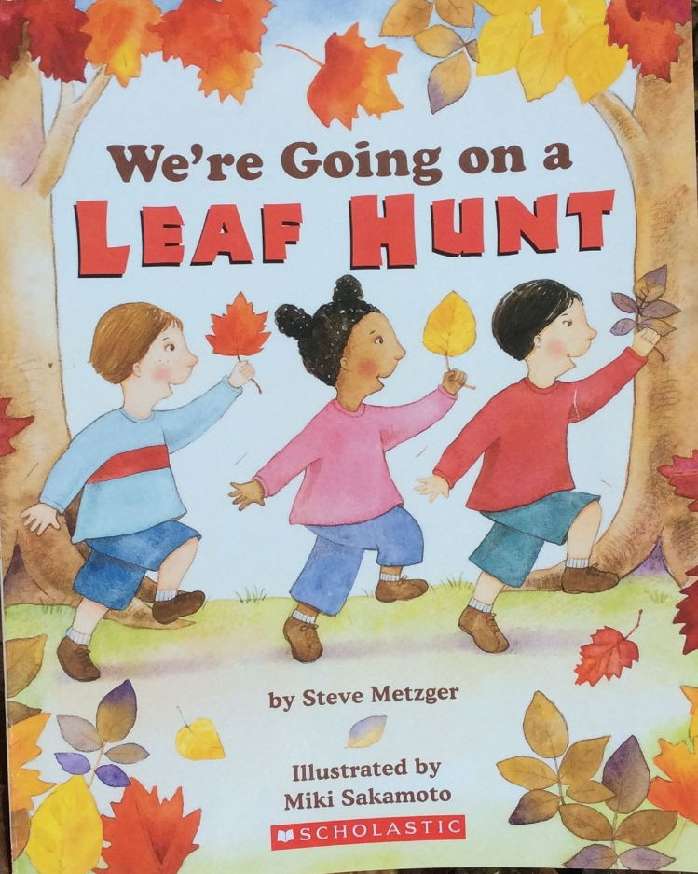

Slide 2
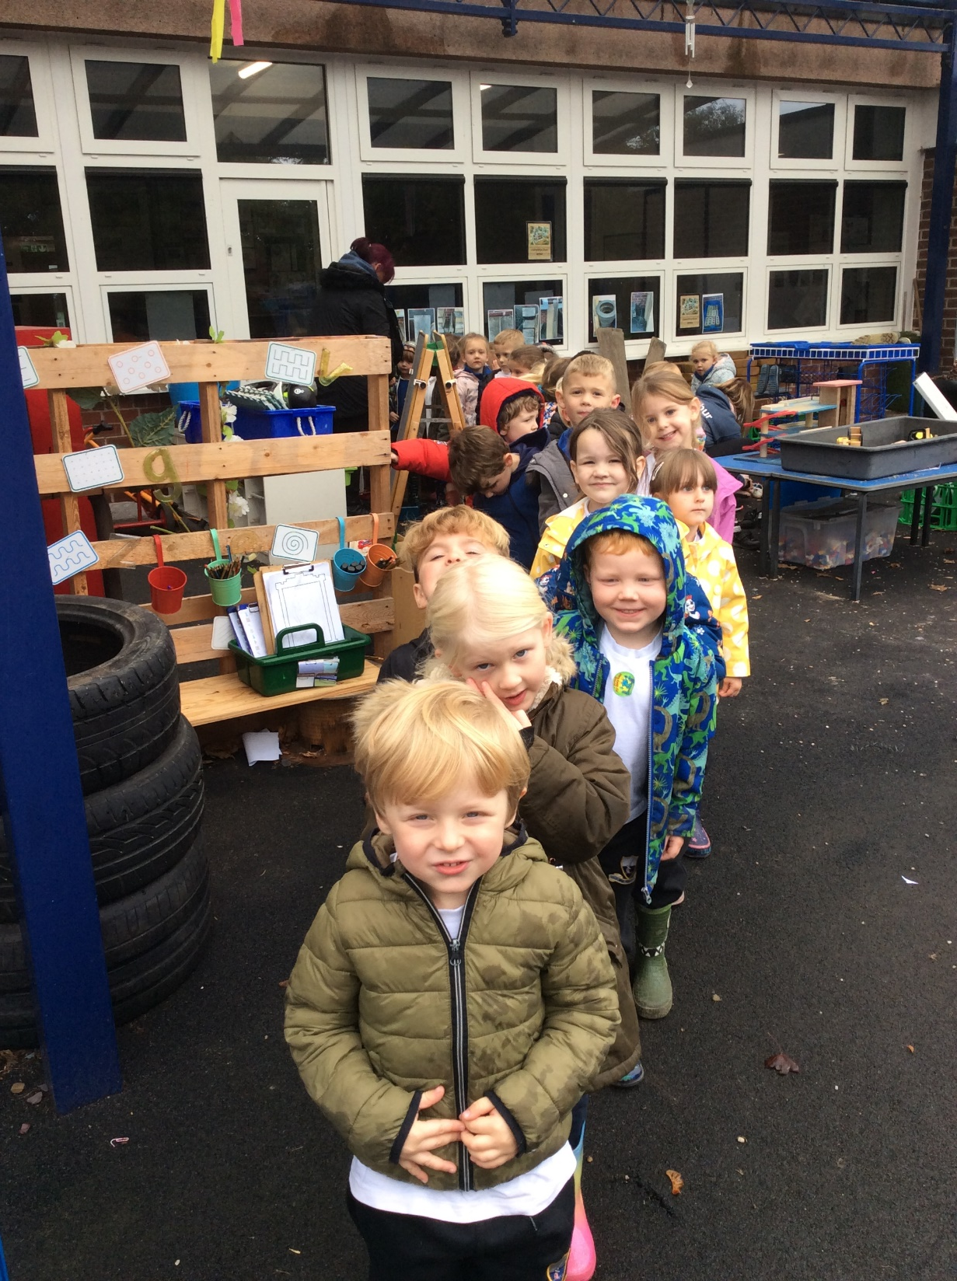
We’re going on a leaf hunt. We’re going right away.
Let’s find colourful leaves.
It’s a wonderful day!

Slide 3
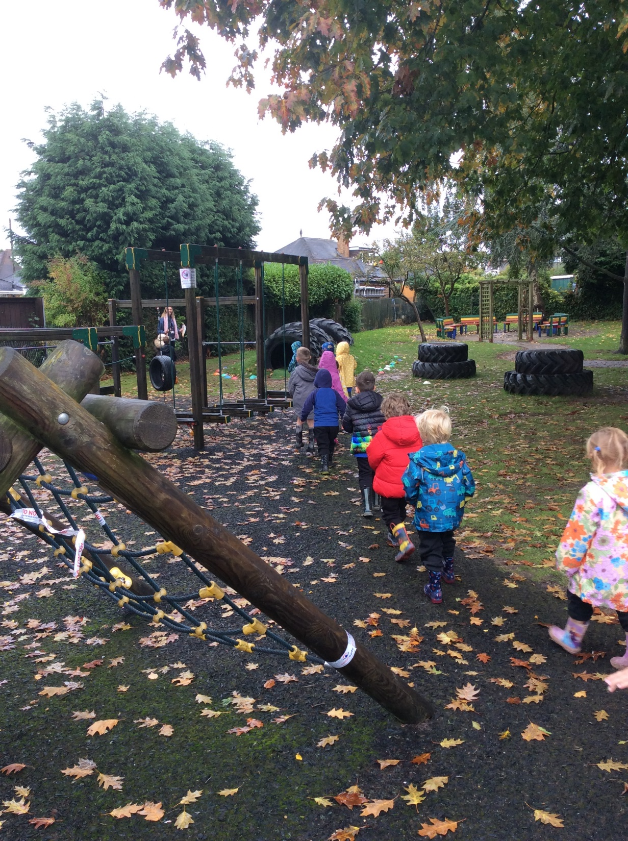
We’re coming to a mountain.
a tall tall mountain.

Slide 4
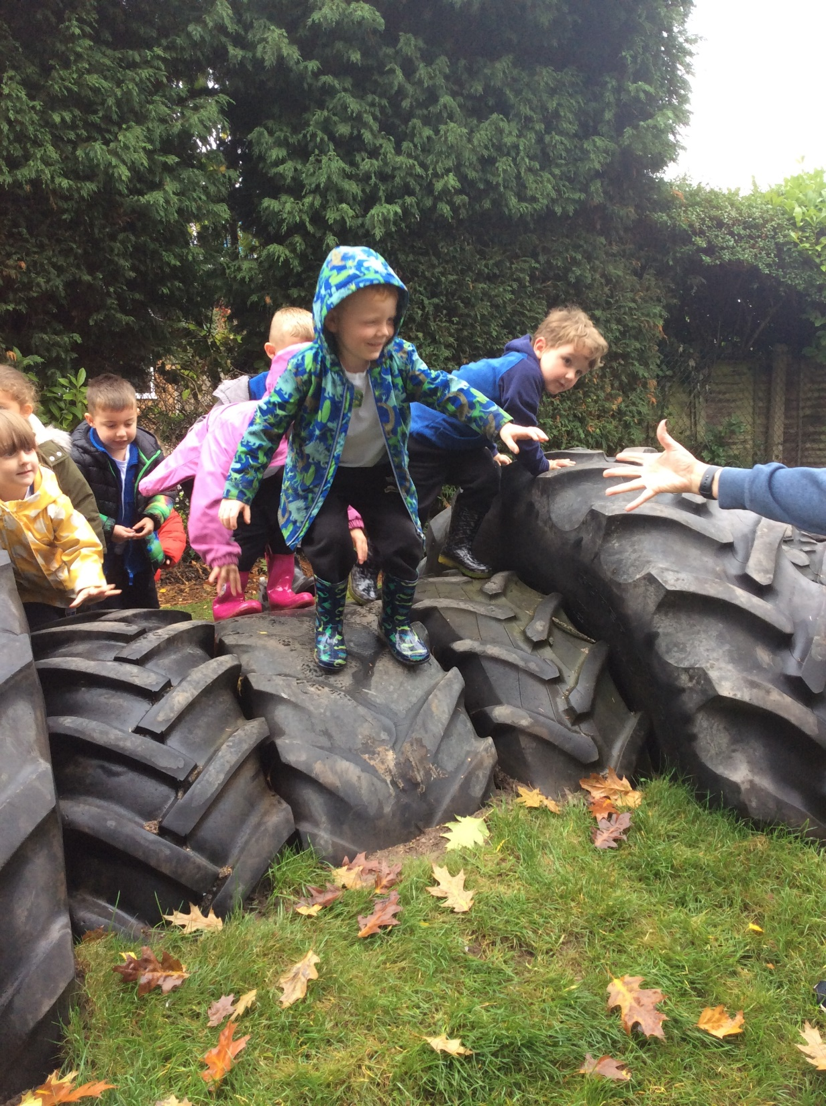
Climb, climb
huff, puff,
We made it!

Slide 5
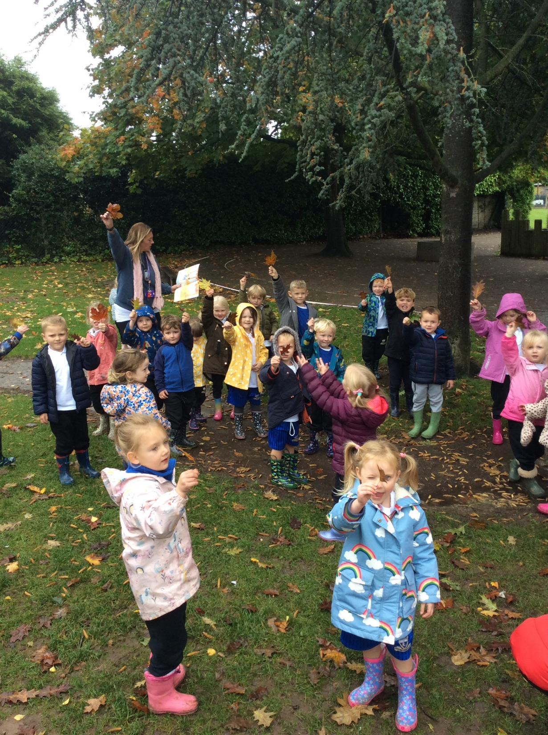
Pick up those leaves!

Slide 6
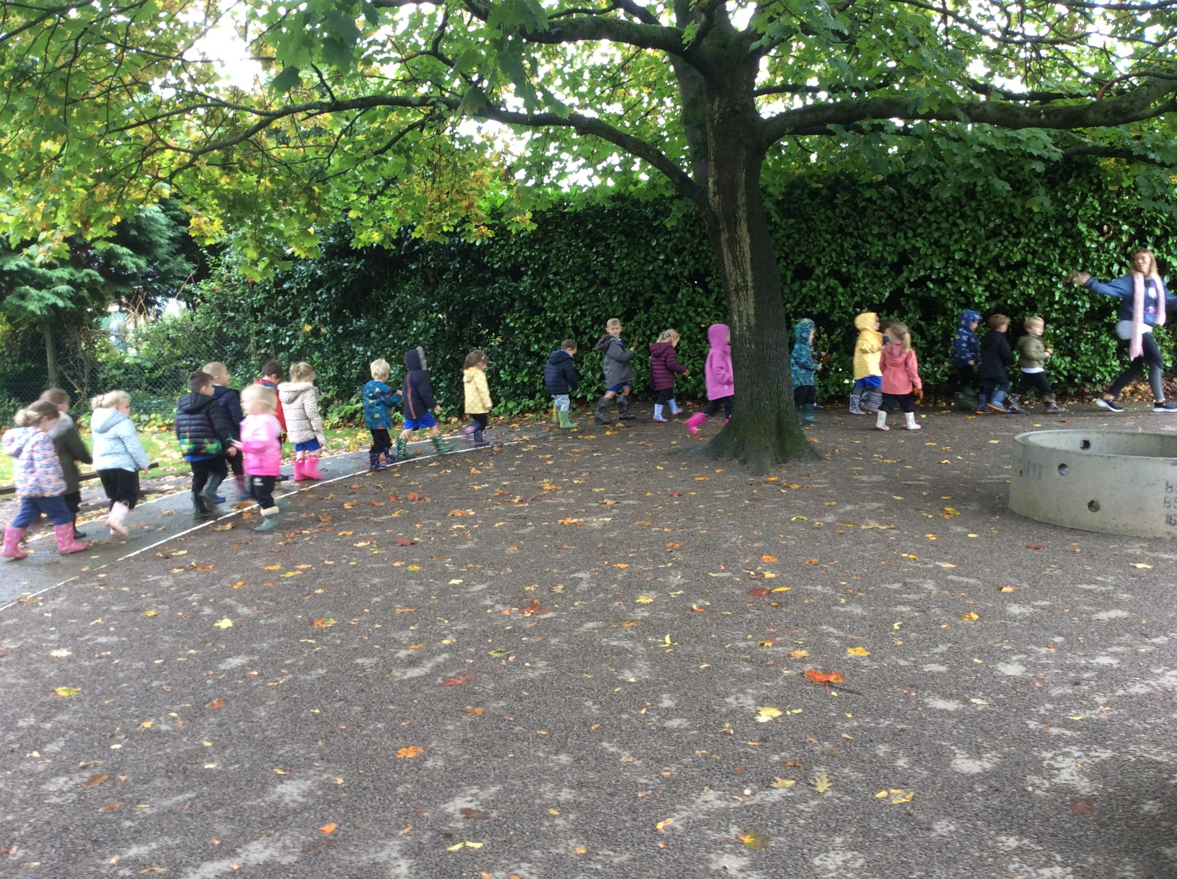
We’re going on a leaf hunt. We’re going right away.
Let’s find colourful leaves.
It’s a wonderful day!

Slide 7
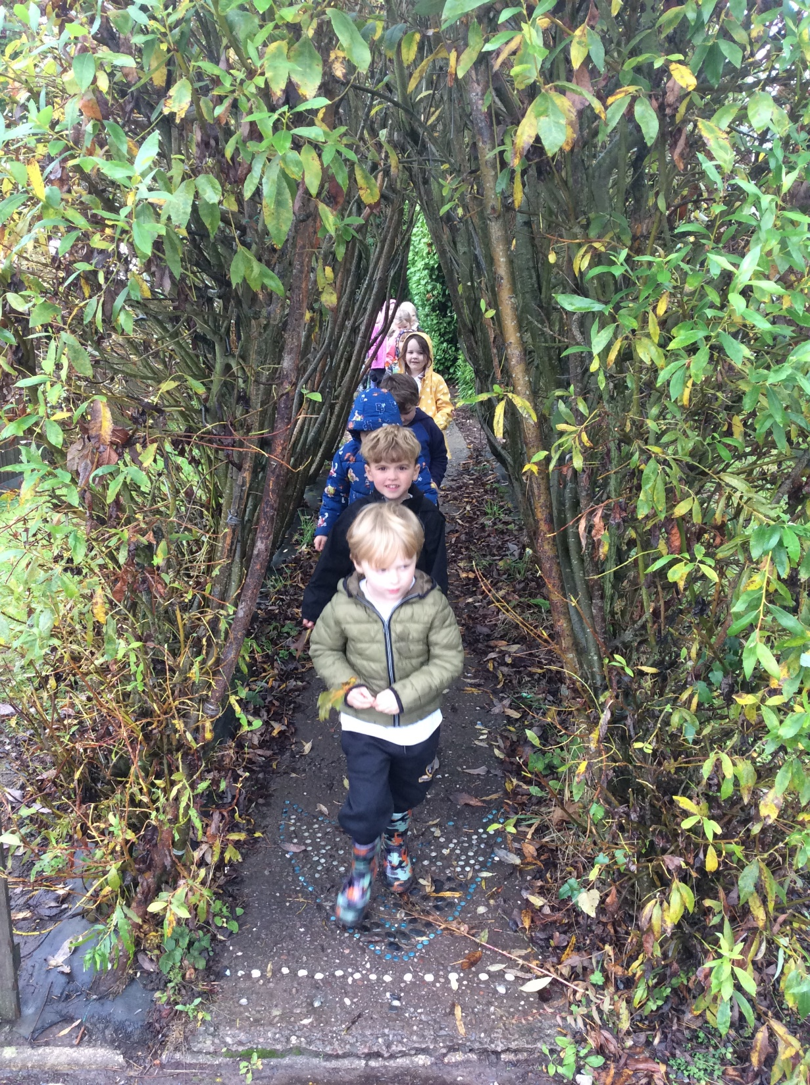
We’re coming to a forest.
a dark, dark forest
Step, step, squish, squash. We made it!

Slide 8
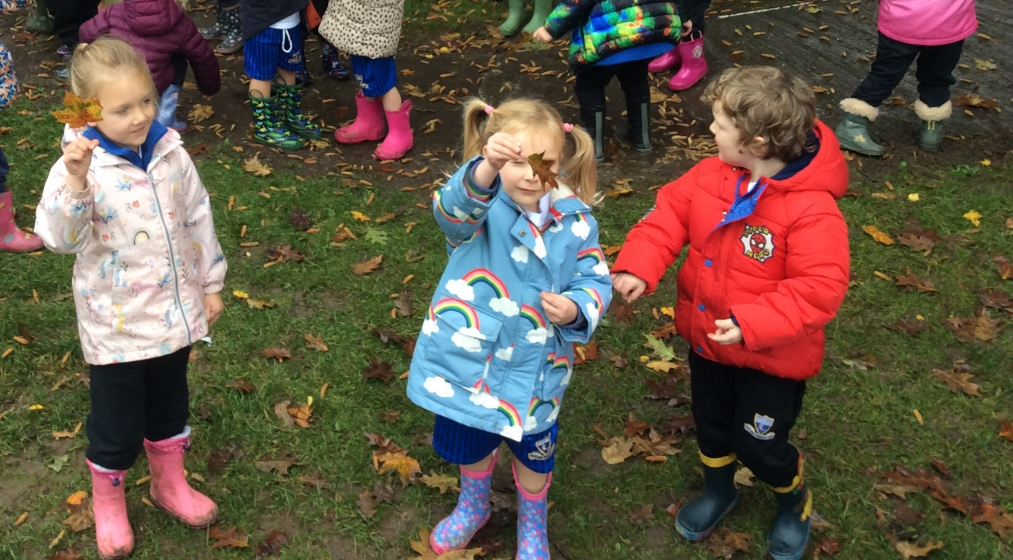
Pick up those leaves!

Slide 9
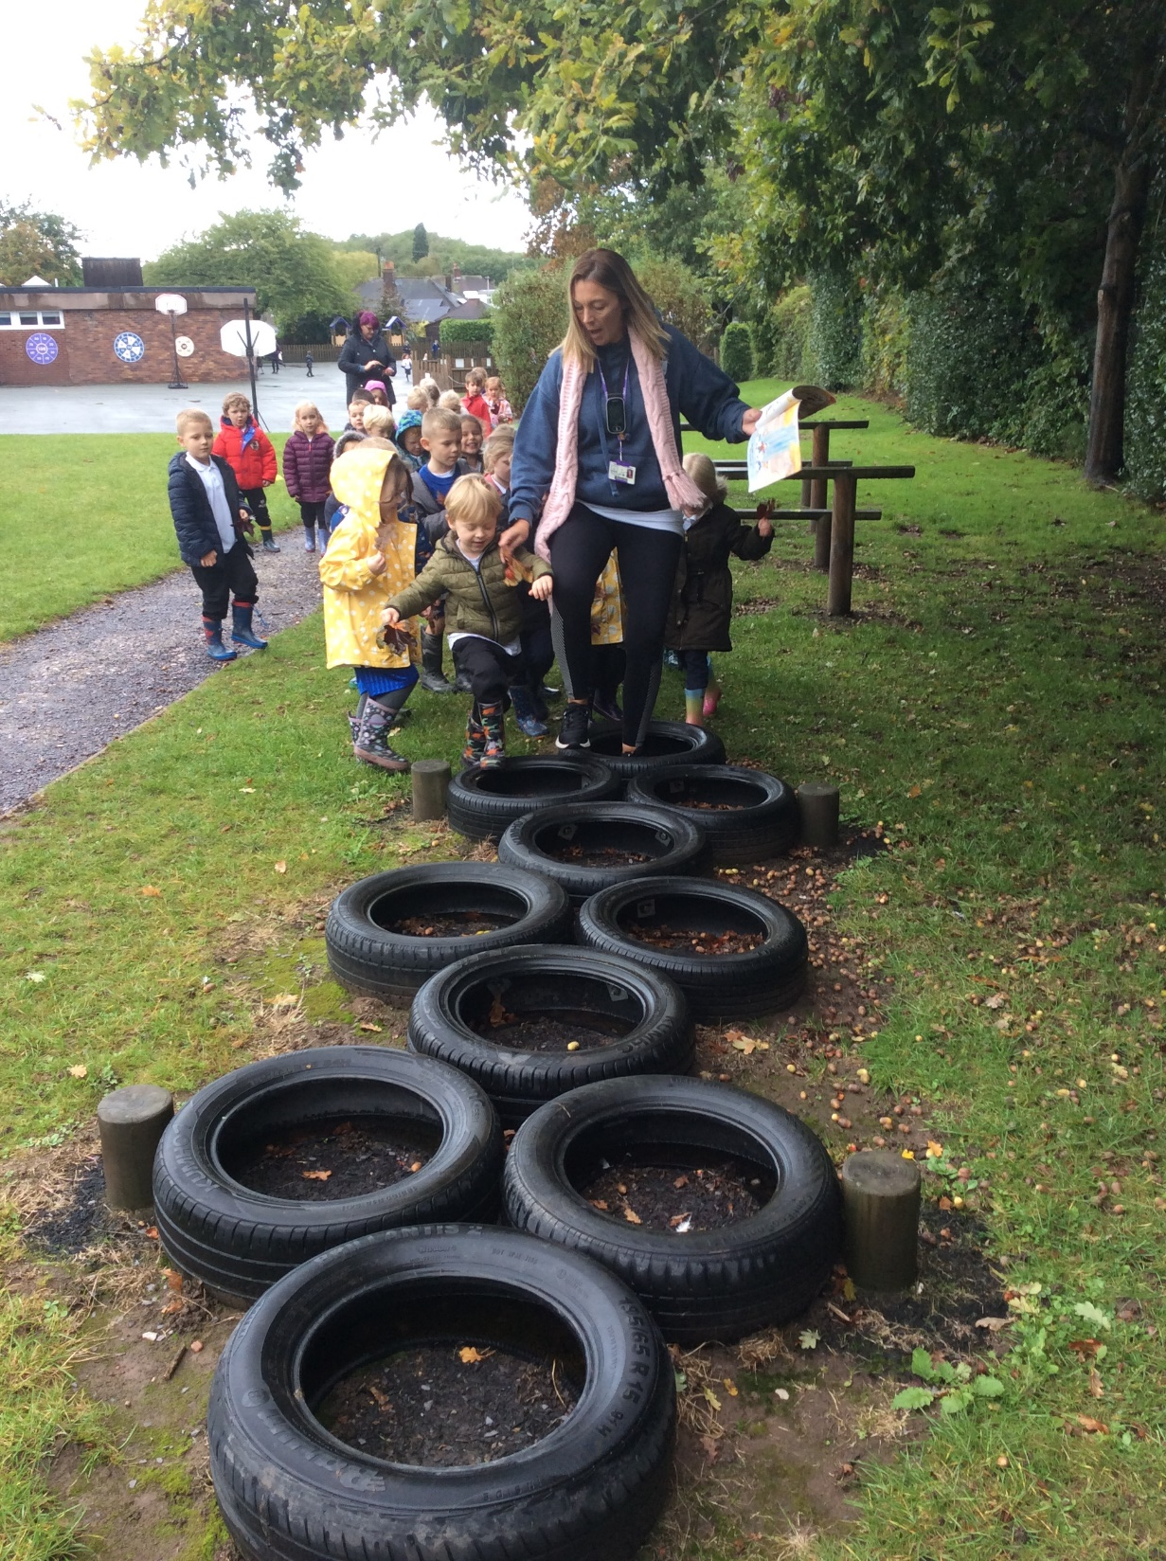
We’re going on a leaf hunt. We’re going right away.
Let’s find colourful leaves.
It’s a wonderful day!

Slide 10
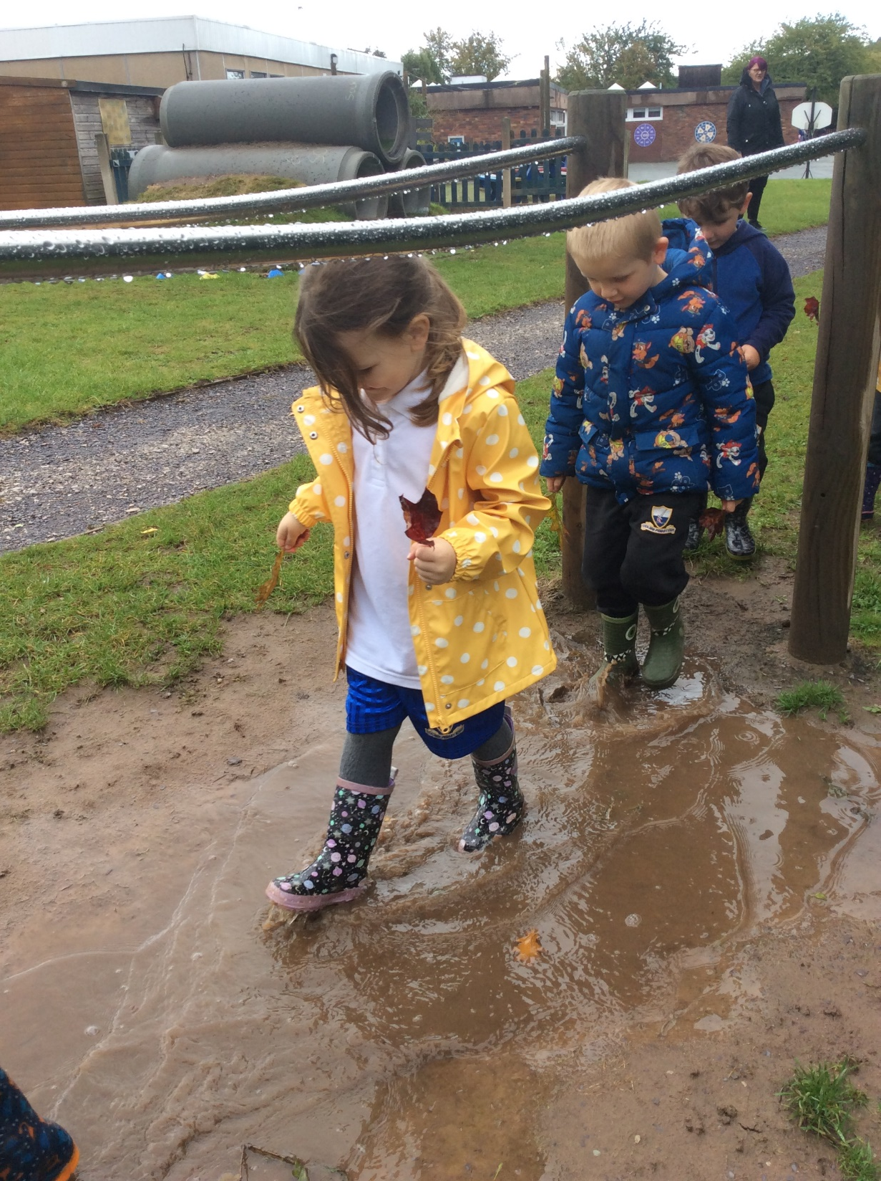
We’re coming to waterfall – a swooshing, swooshing waterfall.
Slip, slide, splish, splash.
We made it!

Slide 11
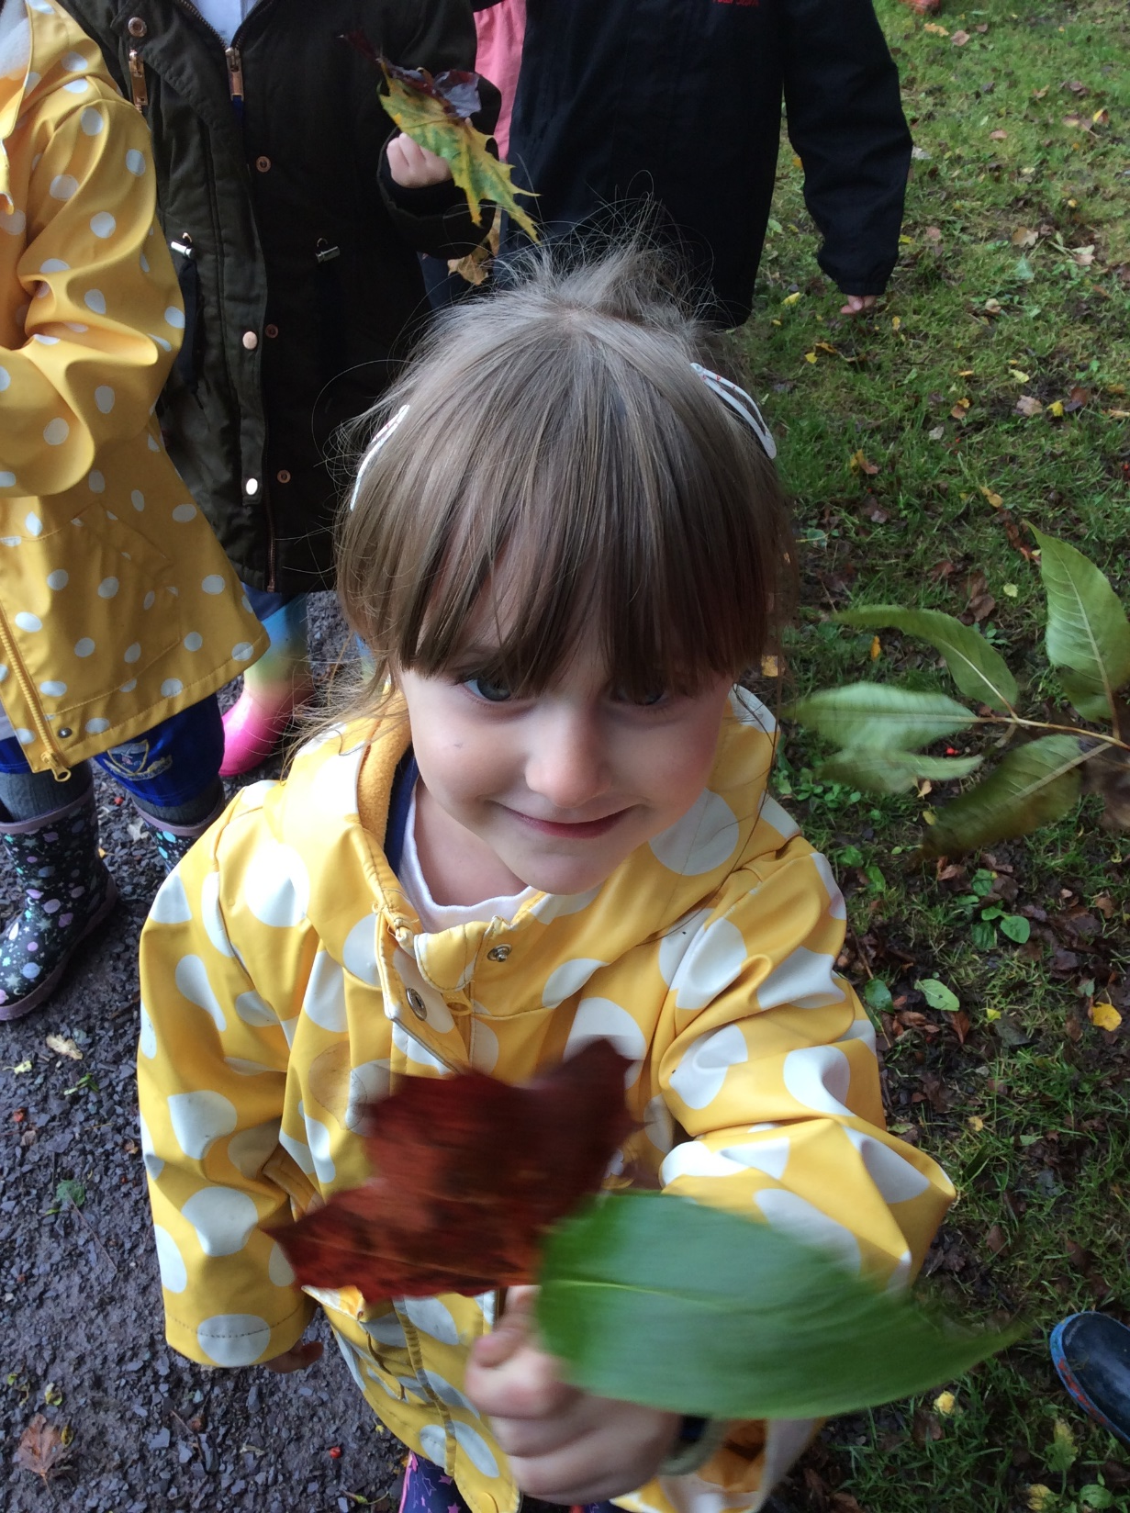
Pick up those leaves!

Slide 12
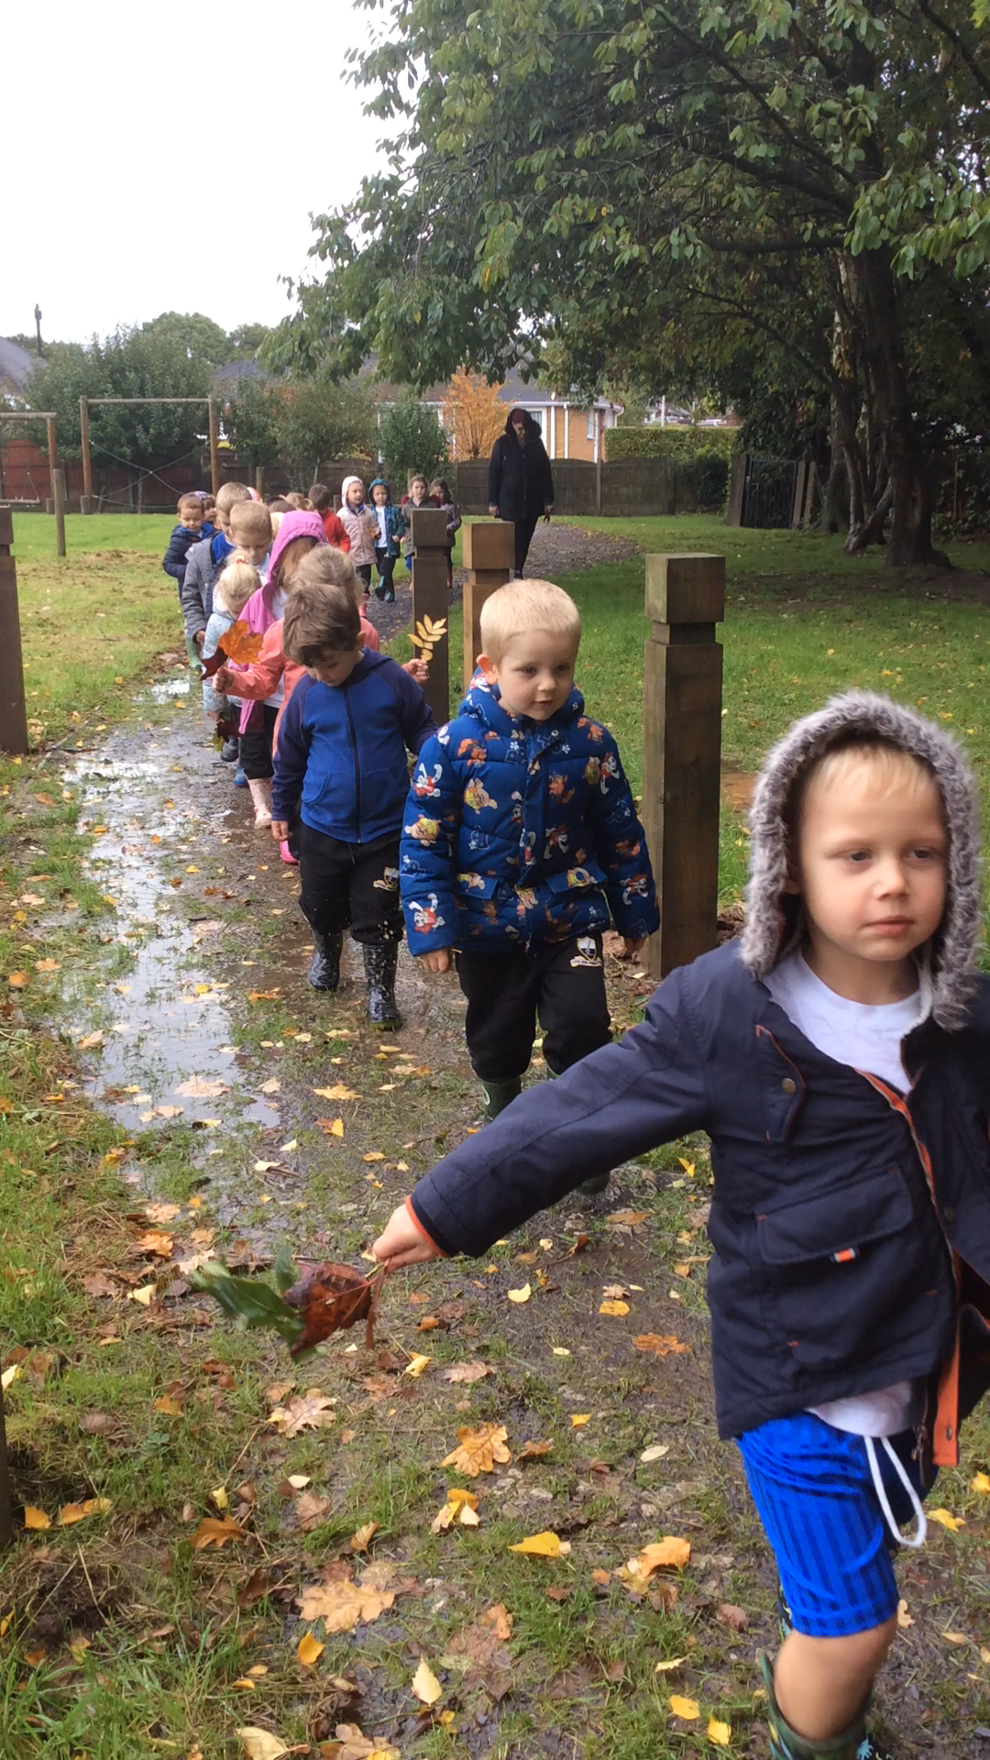
We’re going on a leaf hunt. We’re going right away.
Let’s find colourful leaves.
It’s a wonderful day!
Row, row, plip, plop!
We made it!

Slide 13
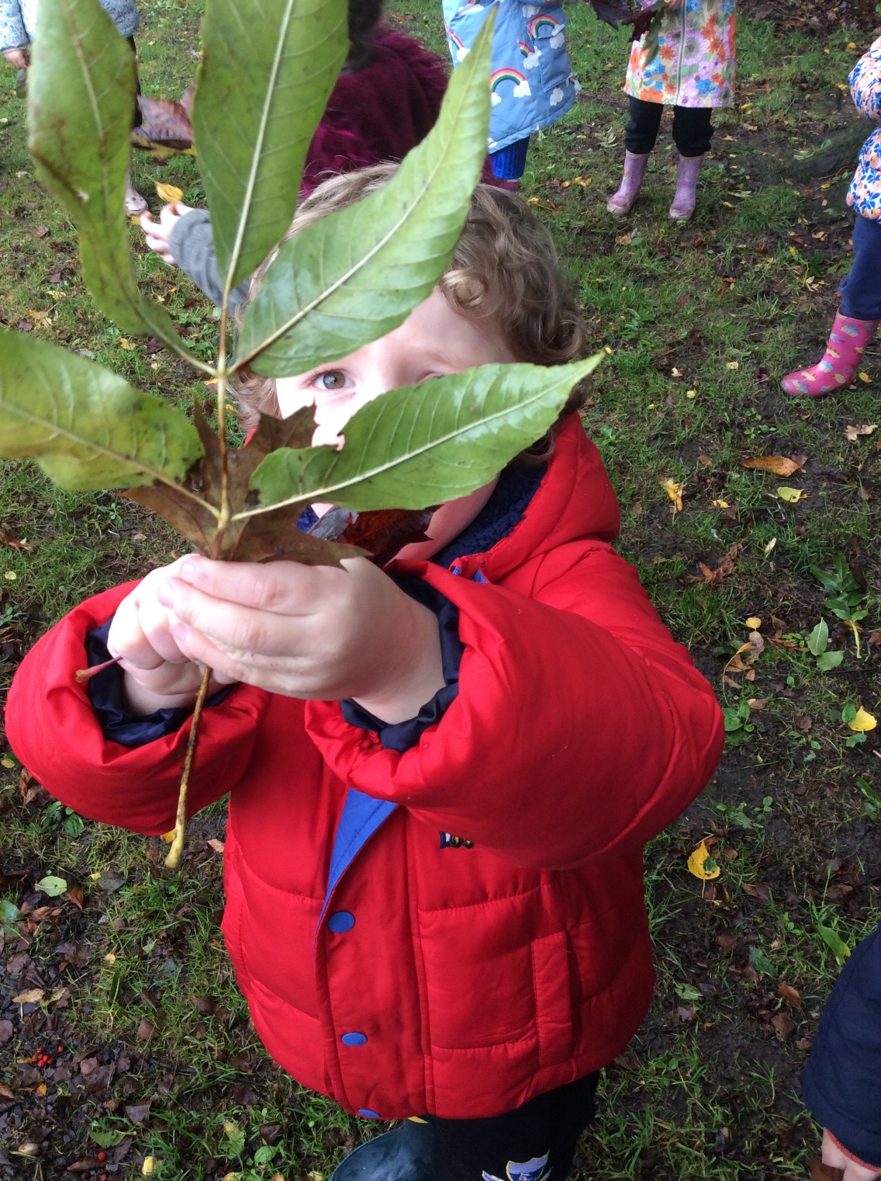
Pick up those leaves!

Slide 14
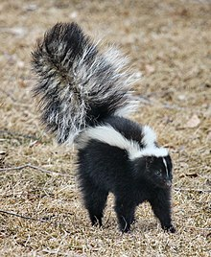
What’s that sound?
It’s coming from that bush!
It’s black. It’s white.
It’s black. It’s white.
It’s a…a…skunk!
LETS’s GO!

Slide 15
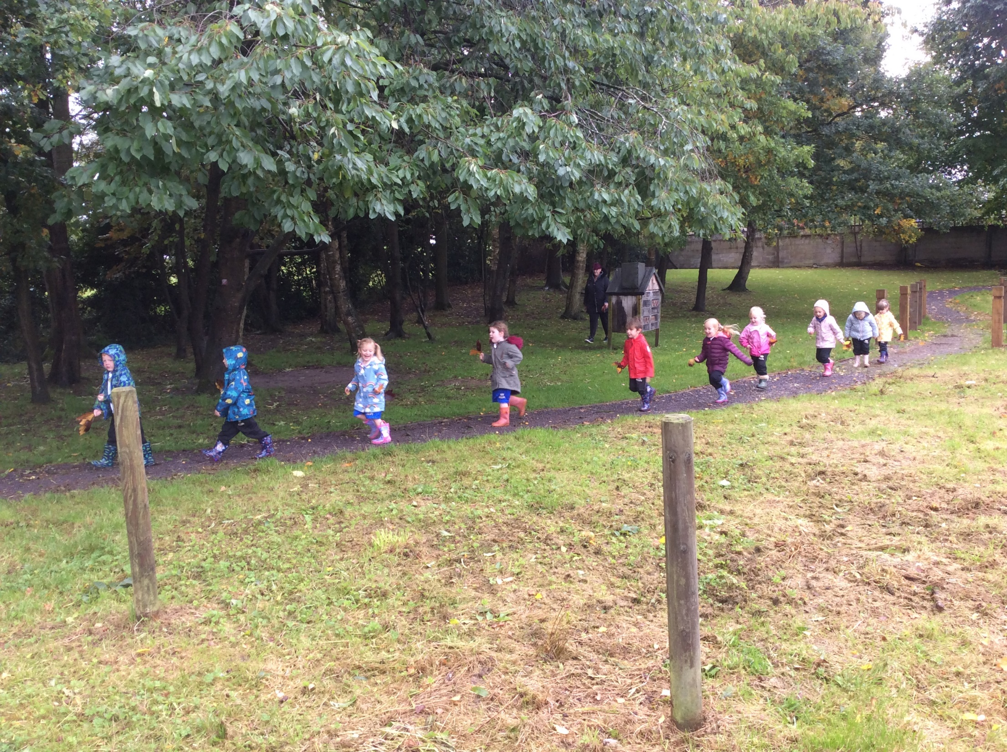
Back across the lake…
Plip, plop

Slide 16
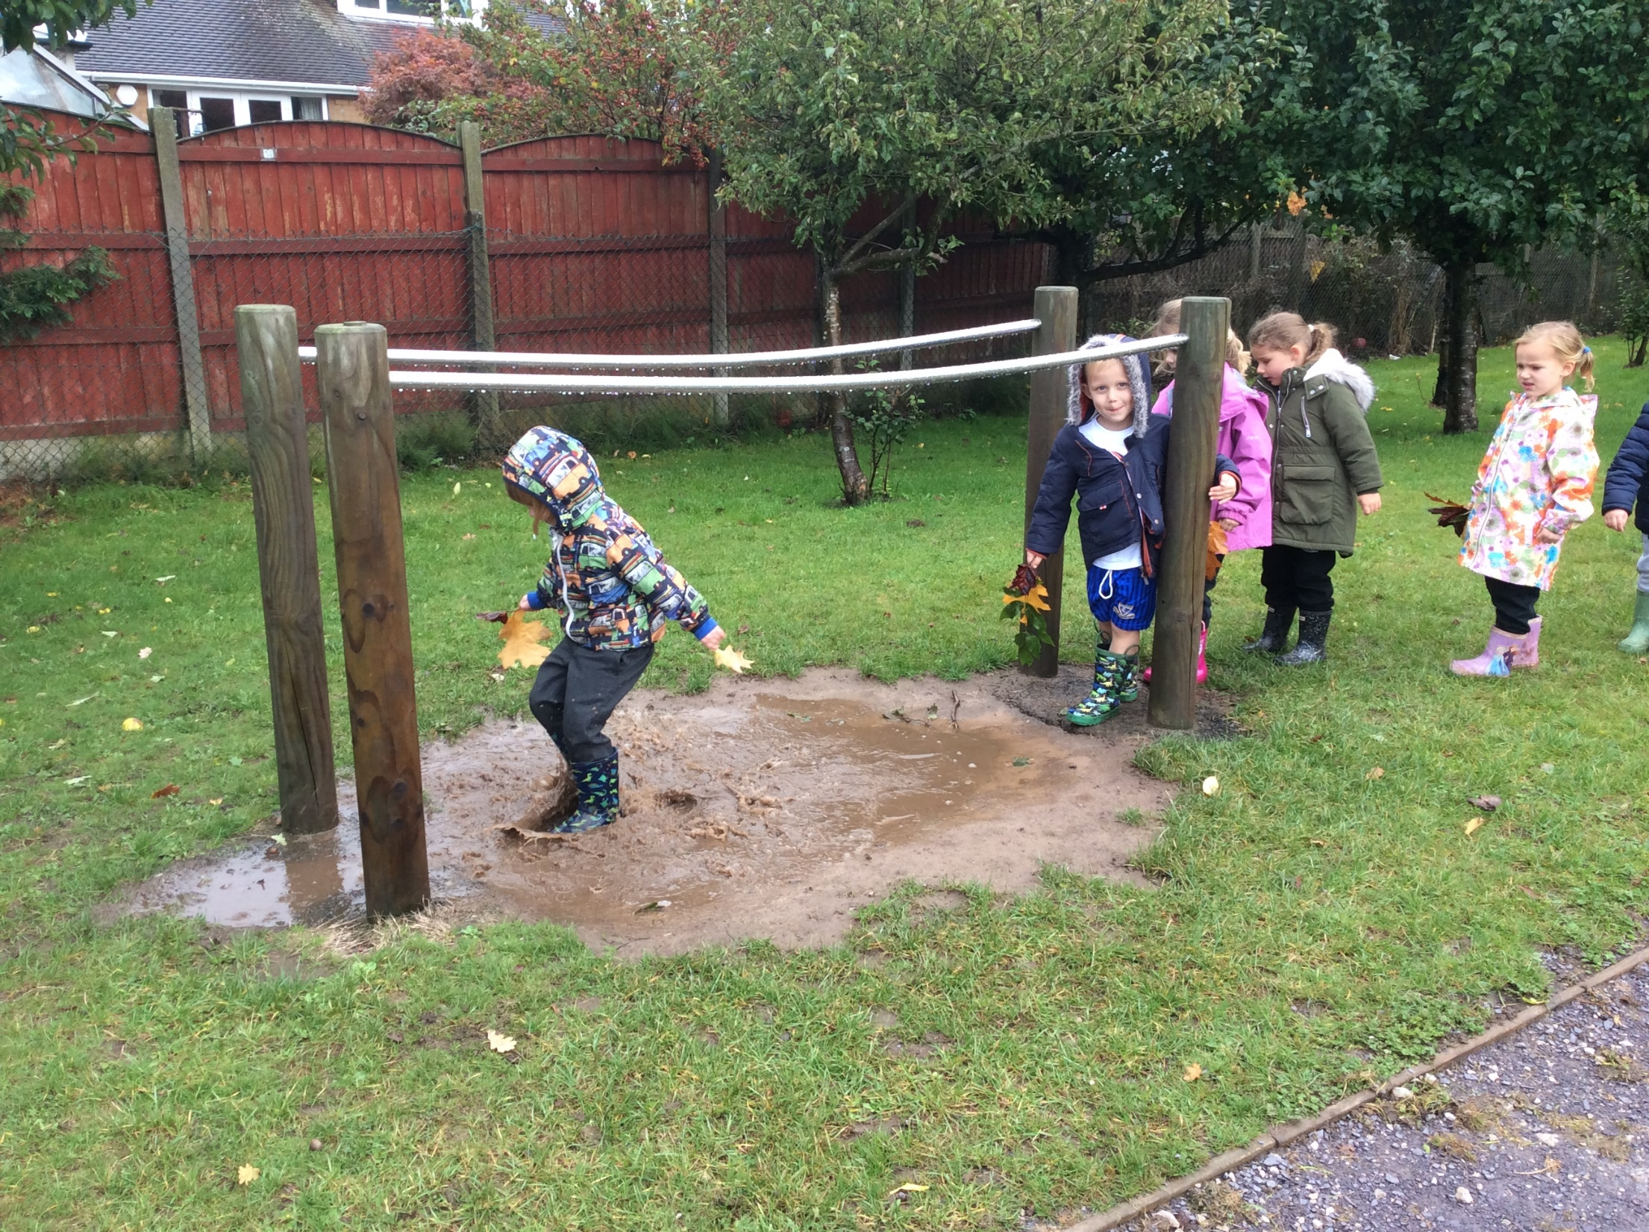
Back across the waterfall…
Splish, splash.

Slide 17
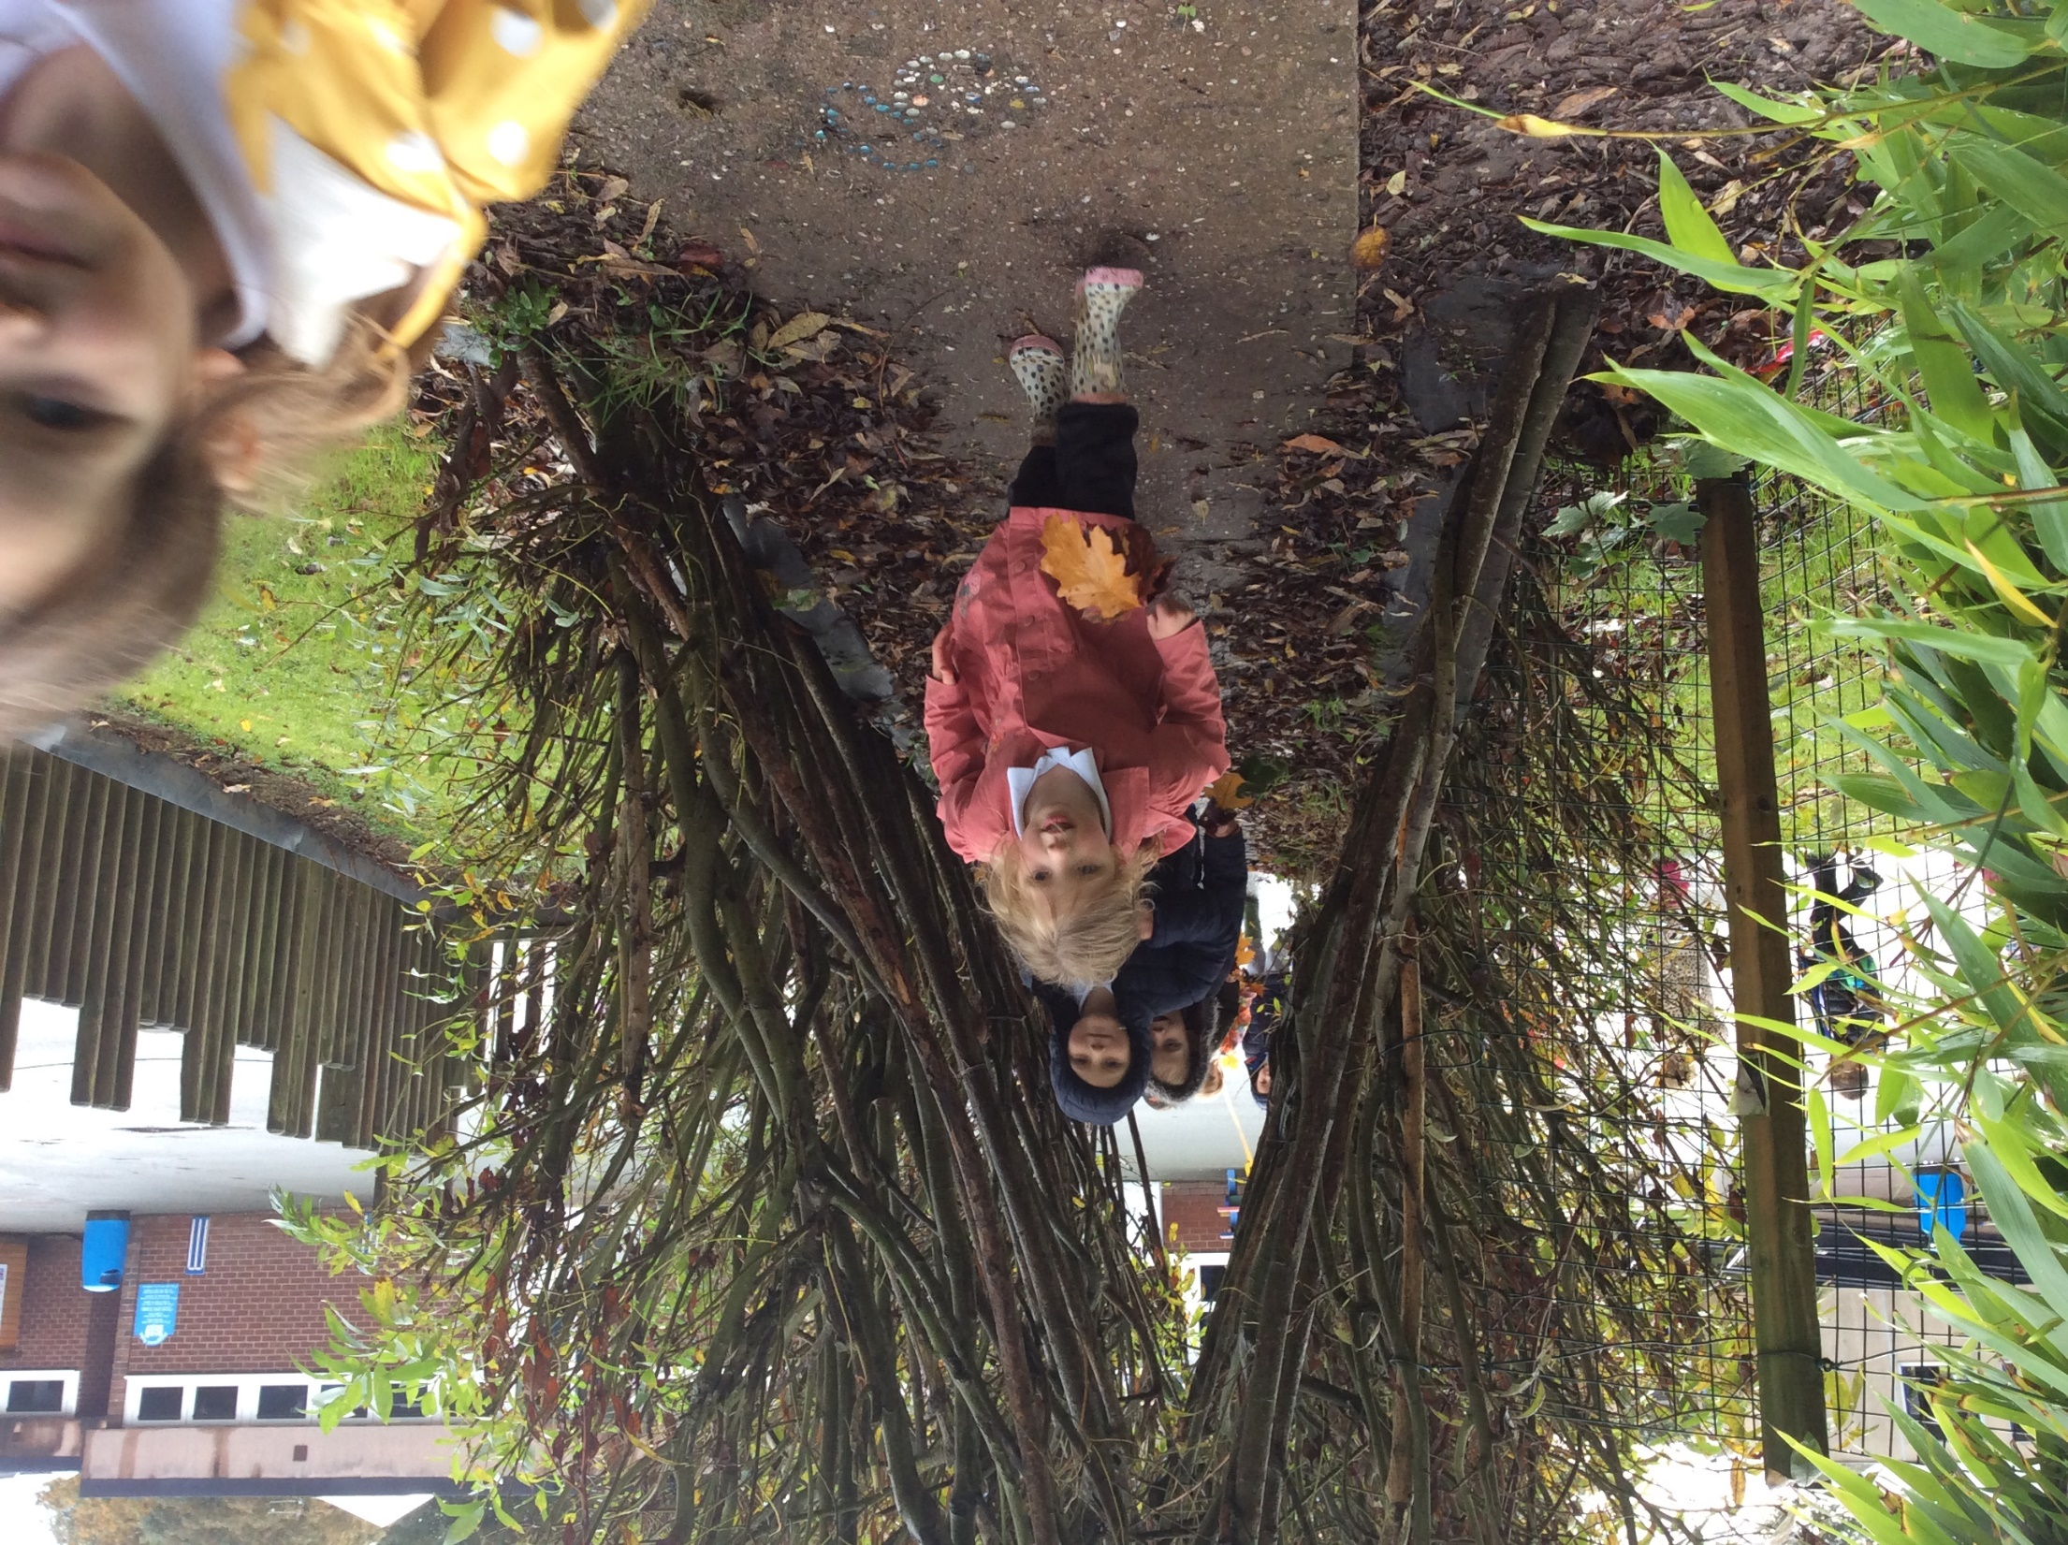
Back through the forest…
Squish, squash.

Slide 18
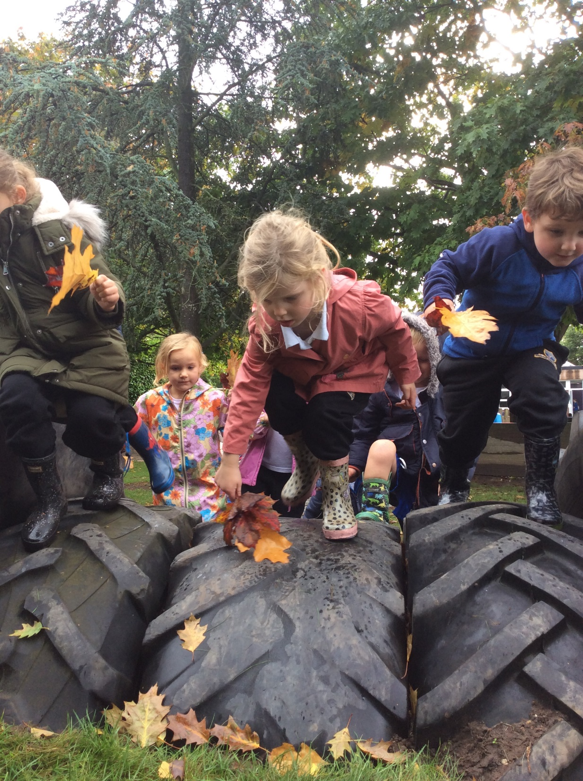
Back over the mountain…
Huff, puff.

Slide 19
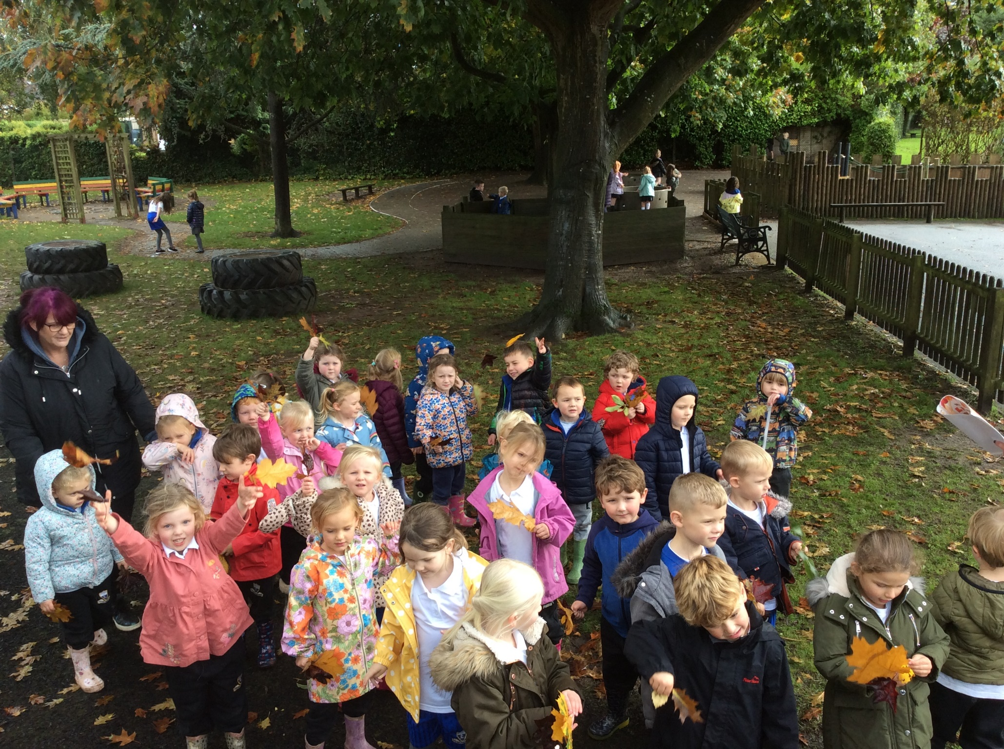
We’re home. We’ went on a leaf hunt.
What a wonderful day!
We found lots of colourful leaves.
Now let’s jump and play!

Slide 20
