Slide 1
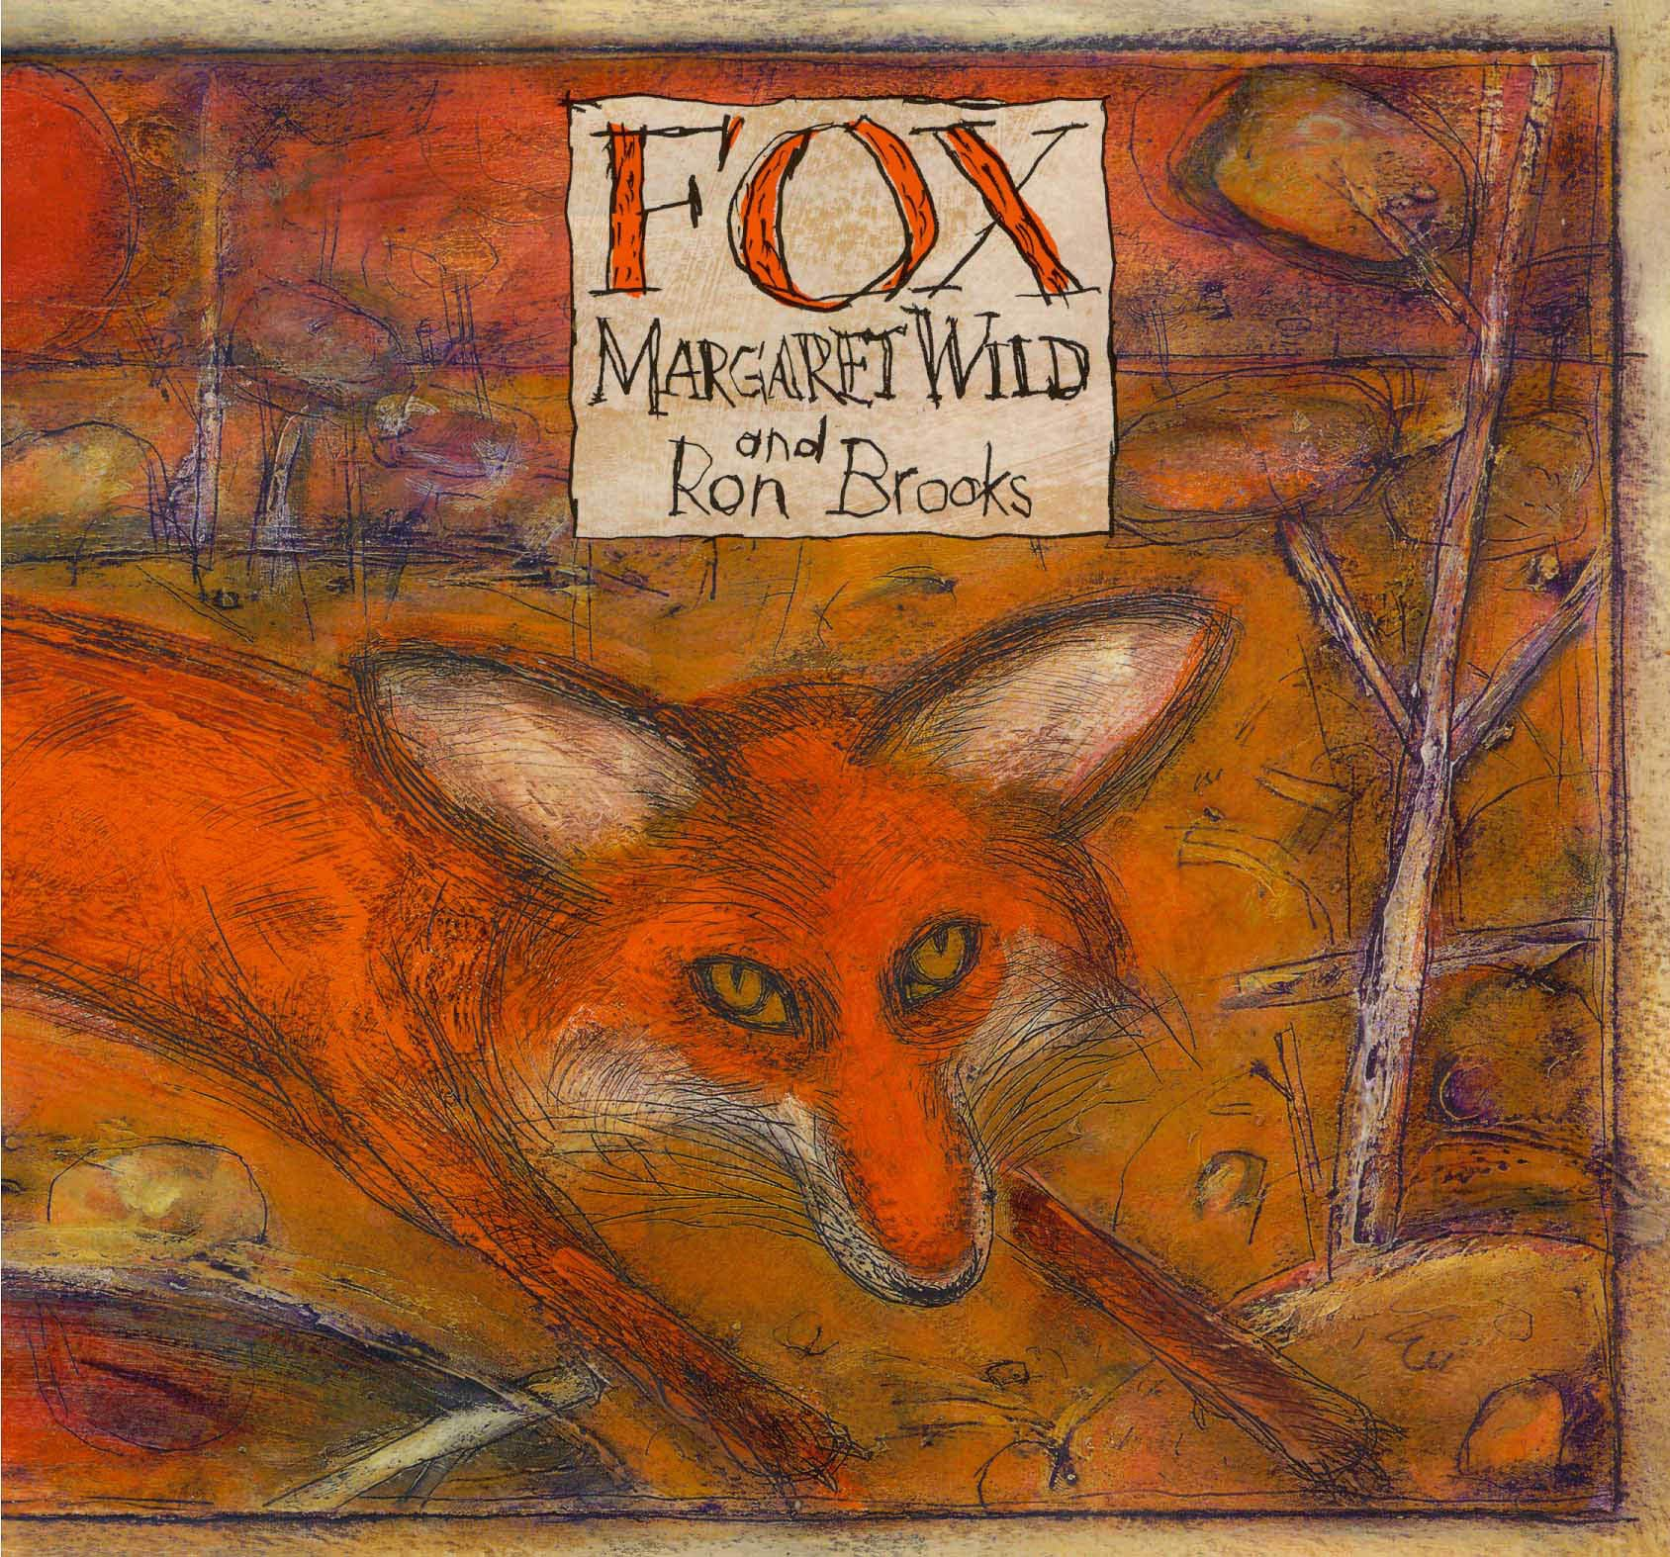
Friday 8th January 2021
Retelling the story of ‘Fox’.
If you would like to listen or read the story ‘Fox’ again, you can listen to it by using the link below. The link will work if you begin the PowerPoint presentation.
Please ask an adult before clicking on any links.
https://www.youtube.com/watch?v=y1AQgyhAvFQ

Slide 2
Friday 8th January 2021
We already have our sentences that we wrote on Wednesday.
We focused on using the correct punctuation when writing direct speech.
“What is that?” asked Fox.
“Look at our reflection!” Fox shouted.
“I am flying again,” cried Magpie.

Slide 3
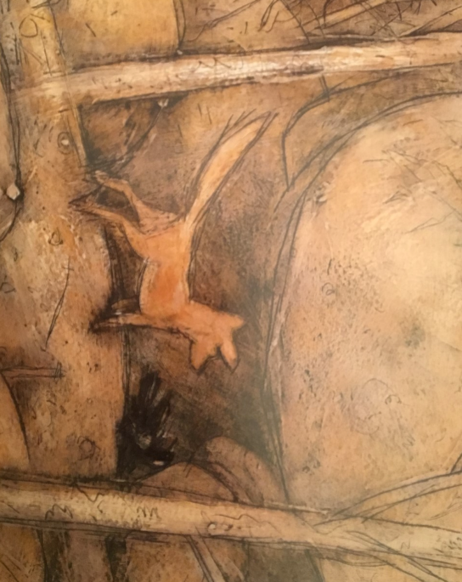
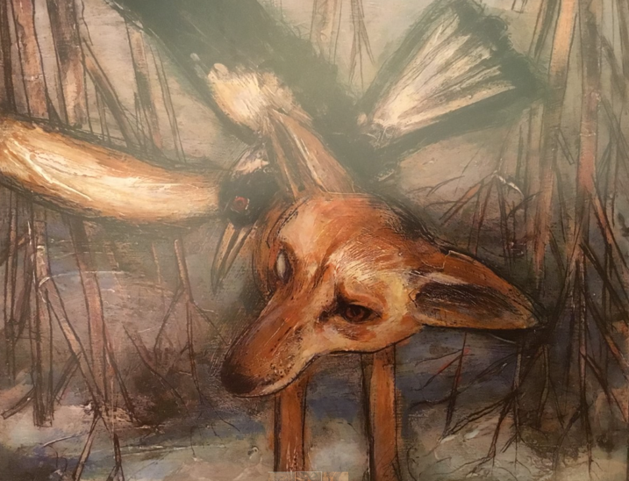
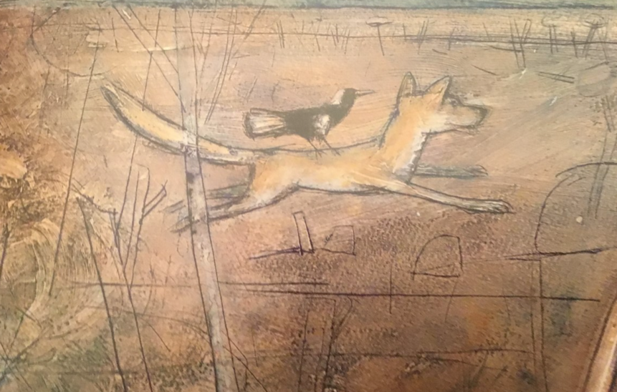
Friday 8th January 2021
How do the characters feel?
Planning Stage
What is happening in the story?
Where are they going?
What can they see?
What is around them?

Slide 4
Planning Stage
Magpie is sad because she has a broken wing.
Dog tries to help Magpie but she does not want his help.
Magpie turns away from Dog and walks into the shadows of the cave.
Dog is waiting for Magpie.
Weeks later, he persuades her to go with him to the river.
They look at their reflection and see a strange creature.
Dog races through the desert with Magpie on his back.
Dog runs as fast as lightning with Magpie on his back.
Magpie feels like she is flying again.

Slide 5
Writing Stage (WAGOLL)
Magpie feels sad because her wing is broken. Dog tries to help her but she turns away. She does not want his help. “I will never again be able to fly,” she sobs. Magpie turns away from Dog as she slowly steps into the cave and hides within the dark shadows. Days and weeks pass by as Dog waits patiently for Magpie to emerge from the cave. At last, she peers out of the entrance. Silently, Dog stands beside her. “Do you want to see something amazing?” he asks. Together they walk towards the riverbank. “Look at our reflection!” Fox shouts as Magpie glances towards the water and sees a strange creature looking back. She gasps in amazement. “You will be my missing eye and I will be your wings,” Dog yells. Together they sprint through the dusty desert.

Slide 6
Editing Stage
Punctuation – capital letters, full stops, commas
Speech marks - https://www.bbc.co.uk/bitesize/clips/zvftsbk
My sentence makes sense when I read it out loud.
A variety of verbs to show how the characters are speaking (shouted, yelled, sobbed, whispered, replied, asked)

Slide 7
