Slide 1
Square and Cube Numbers

Slide 3

1) ${\text{5}}^{\text{2}}$ =
2) ${\text{47}}^{\text{2}}$ = 47 ×
3) What is 9 squared?
4) ${\text{3}}^{\text{2}}$ + 11 =

Slide 4
1) ${\text{5}}^{\text{2}}$ =
2) ${\text{47}}^{\text{2}}$ = 47 ×
3) What is 9 squared?
4) ${\text{3}}^{\text{2}}$ + 11 =
25
47
81
20

Slide 6
1 row of 9 is equal to 9
1 and 9 are factors of 9
3
3 rows of 3 are equal to 9
3 is a factor of 9
3
Using 9 counters it is possible to make a square.
9 is a square number.

Slide 7
Is 10 a square number?
No

Slide 8

1) Is 4 a square number?
Yes
Have a think
2) Is 6 a square number?
No

Slide 9
Have a think
Does this show that 8 is a square number?
No

Slide 10
Have a go at questions
1 - 5 on the worksheet

Slide 11
3
3
3 rows of 3 counters is equal to 9
3 × 3 = 9
The product of an integer multiplied by itself is a square number.

Slide 12

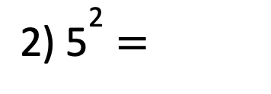
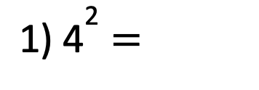
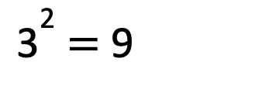
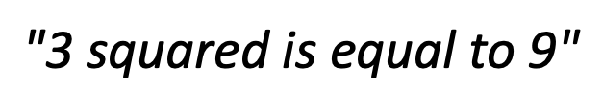

The product of an integer multiplied by itself is a square number.
3 × 3 = 9
${\text{3}}^{\text{2}}$ = 9
$$\text{"}\text{3 }\text{squared} \text{is} \text{equal} \text{to}\text{ 9"}$$
${\text{1) 4}}^{\text{2}}$ =
16
4 multiplied by itself
4 × 2 =
4 × 4 =
Have a think
$$\text{2}$$
25
3) 49 =
${\text{2) 5}}^{\text{2}}$ =
7
5 × 5 =
7
7
__ × __ = 49

Slide 13


Dora is thinking of a square number.
It is odd.
Its digits sum to 7
It is one more than a multiple of 8
25
What number is Dora thinking of?
Have a think
41
4 + 1 = 5
41’s digits sum to 5
1
4
9
16
25
2 + 5 = 7
1 + 6 = 7
24

Slide 14
Here are 6 cubes
Have a think
Is it possible to make a cube?

Slide 15
Here are 8 cubes
Is it possible to make a cube?
2
2
2
2 × 2
= 8
× 2
8 is a cube number.

Slide 16
4
4
4
4 × 4
× 4
= 64
16
64 is a cube number.

Slide 17
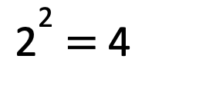
Cube numbers
Square numbers
2 × 2 × 2 = 8
2 × 2 = 4
3
${\text{2}}^{\text{2}}$ = 4
2 = 8
Have a think
4 × 4 × 4 = 64
3
4 = 64
“4 cubed is equal to 64”

Slide 18
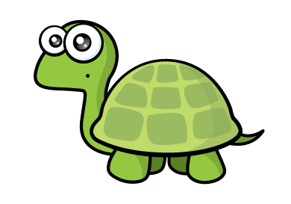

Have a think
5 cubed is equal to 15 because 5 multiplied by 3 is equal to 15
5 × 5 × 5
= 125
25
$${\text{5}}^{\text{3}}$$
= 125

Slide 19
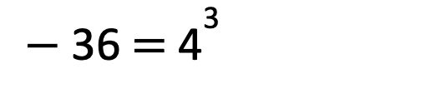
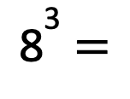

Have a think
Calculate:
$${\text{8}}^{\text{3}} \text{=}$$
512
8 × 8 × 8 =
64 × 8 =
$${\text{3}}^{\text{3}}$$
= 25 +
2
100
$−$ 36 = ${\text{4}}^{\text{3}}$

Slide 20
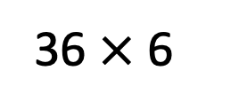



$${\text{1}}^{\text{3}}$$
3
Have a think
$${\text{3}}^{\text{3}}$$
36 $×$ 6
Match the calculation to the number.
3 × 3
27
$${\text{6}}^{\text{3}}$$
1
5 × 2
9
1 + 1 + 1
10

