Slide 1
English
Friday 8 January
The Queen’s Hat Paragraph
Use this link to watch and listen to the story read by the author and illustrator Steve Antony.
I hope you enjoy it.
https://www.youtube.com/watch?v=6Q8MQPVq_vg&t=33s (press control and click on the link)
Today, we are going to put our learning together to retell the story.
You will need:
A description of the hat – use your colour, size, shape ideas from Wednesday
What happened to the hat sentence – can you use a SWOOSH! Or SWISH! To start your sentence?
Where did it travel sentences – 3 sentences with 2 places in each using ‘and’ to join ideas.
Where did it land? You decide!
So that’s a paragraph with at least 6 sentences.

Slide 2
Click this link to watch me write my paragraph.
https://excaliburprimaryschool-my.sharepoint.com/:v:/g/personal/jweatherby_excalibur_cheshire_sch_uk/EUEammCpKC1Bhj7TvRqxRzUBf94LRHEZNPvW6-f2ndnfbA?e=Aoqp2g
The Queen’s favourite hat was deep ocean blue with a narrow band of crimson ribbon wrapped around and tied in a neat bow. One day, as the Queen was walking in her garden, the wind took the hat right off her head. SWISH! High in the sky, it soared above Buckingham Palace and across the River Thames. It drifted over Trafalgar Square and beneath Tower Bridge. The hat blew between the towers at Canary Wharf and all around the London Eye. Finally, it floated gently down to the top of Big Ben just as it chimed the hour.
Good sentences will:
Include capital letters
Include full stops
Make perfect sense
Use adjectives
Prepositions
Look neat
Fabulous sentences will:
Include capital letters for sentences and proper nouns
Include full stops
Make perfect sense
Use exciting adjectives
Use a variety of prepositions
Try different sentence beginnings
Show all letters formed correctly
You decide. How did you do? Good or fabulous?
I can’t wait to read your paragraphs!!!
Send them to me via the English link on Seesaw please.

Slide 3
The next 4 pages will support your writing.
You have already practised using adjectives and prepositions with locations in London.
Just like in school, try saying your sentence and if you like it, write it. If you think it could be improved try different ideas.

Slide 4
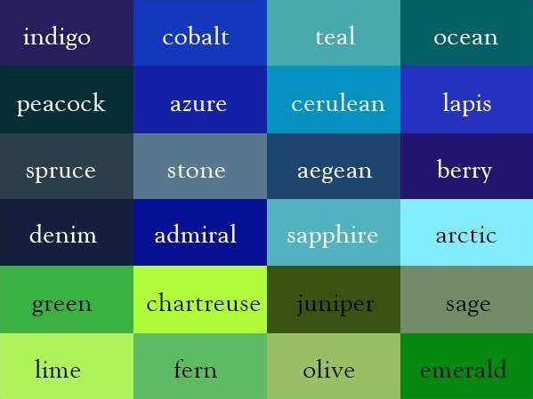

Slide 5
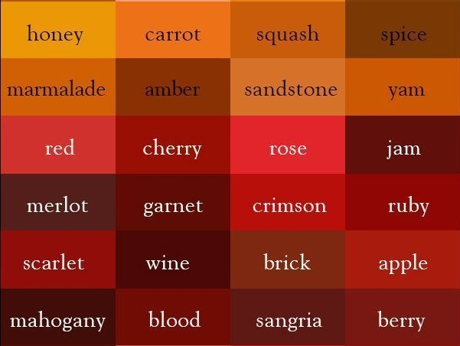

Slide 6
Prepositions which may help.
across around through behind between under over near toward beneath above among along

Slide 7
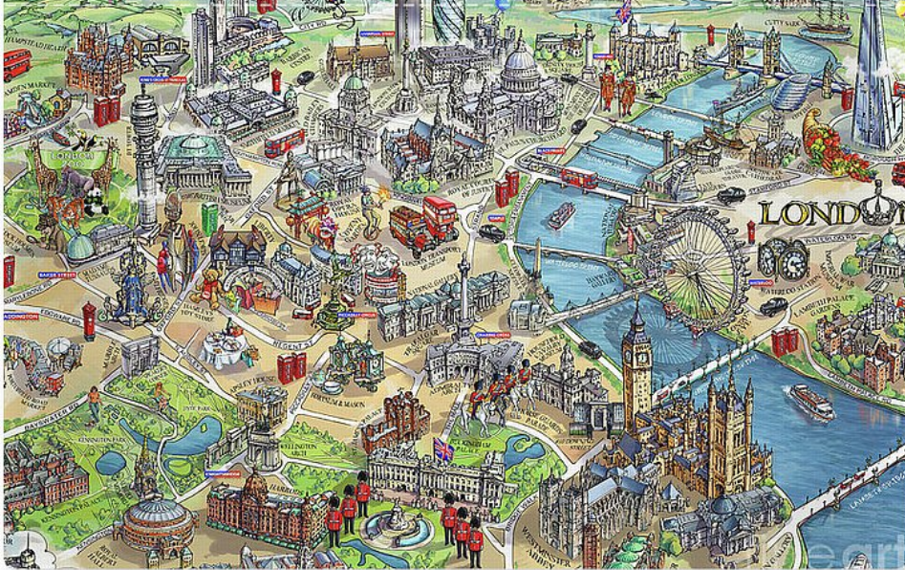
the River Thames
Buckingham Palace
the London Eye
theTower of London
the Shard
the Gerkin
Canary Wharf
a double decker bus
London cab
the London Underground
Tower Bridge
Trafalgar Square

