Slide 1
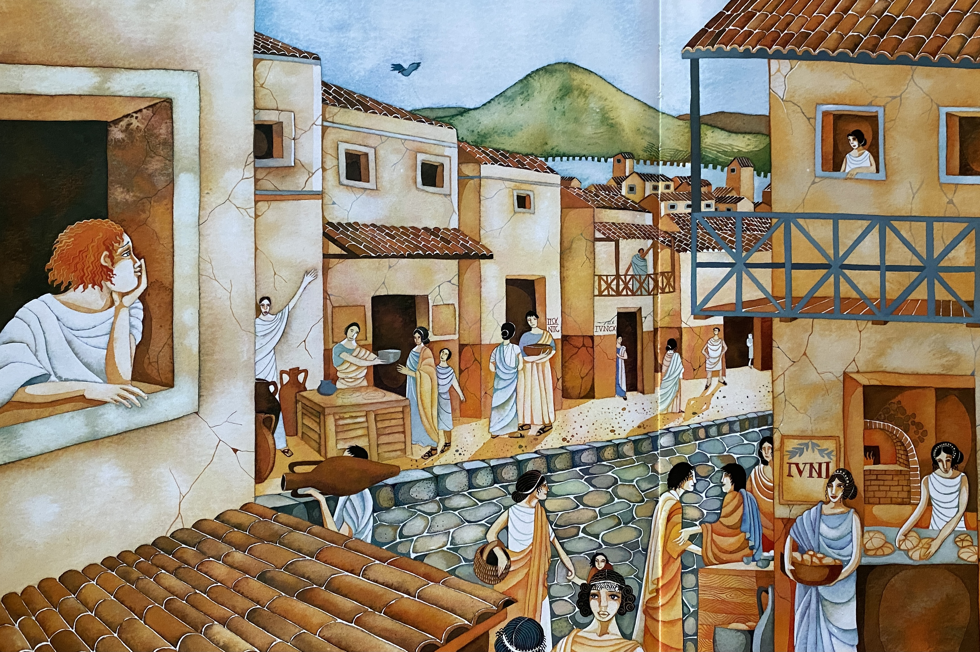
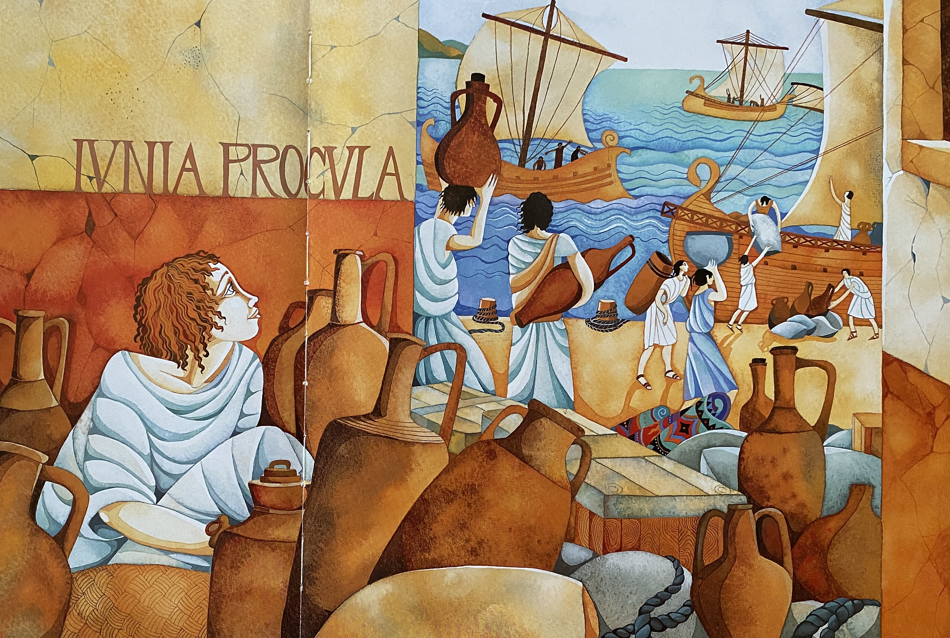
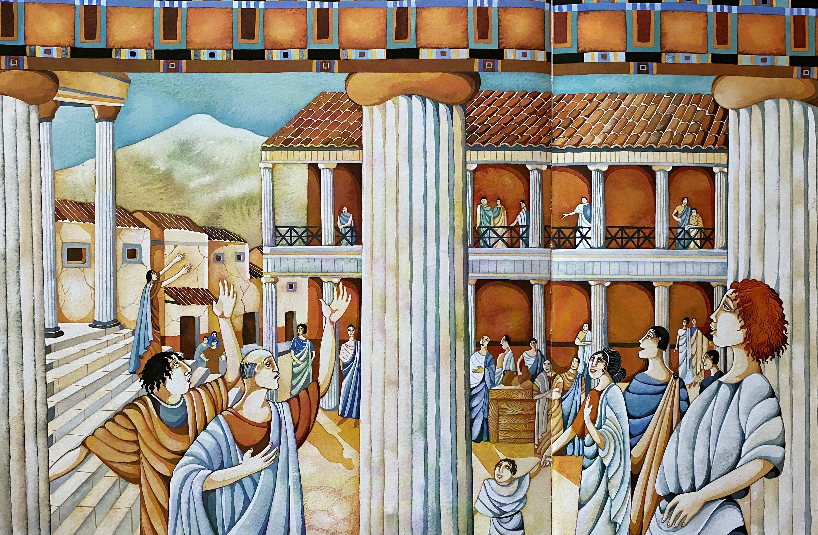
Objects – What do you see? Where are they in the picture?
Objects – What do you see? Where are they in the picture?
Objects – What do you see? Where are they in the picture?

