Slide 1
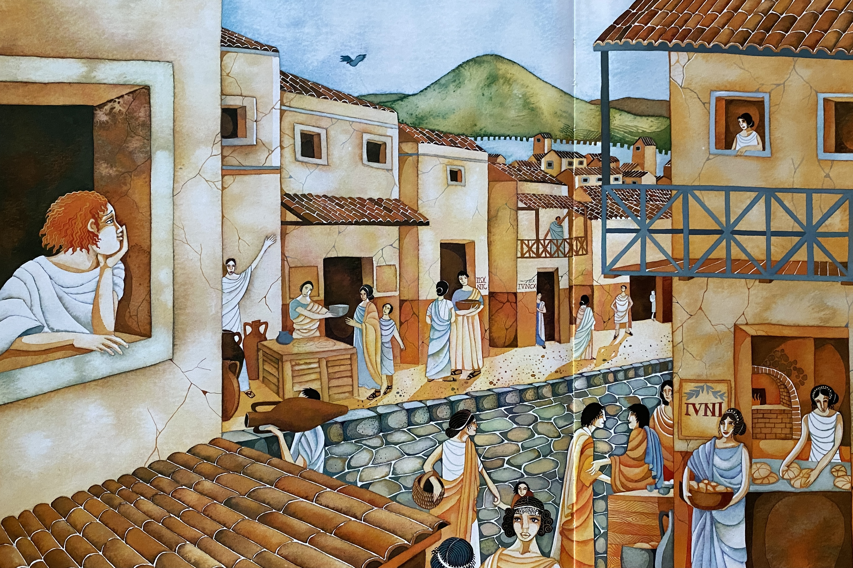
Between the old, stone buildings, the cobbled street bustled with activity. Selling their goods, tradesmen called out to people passing by as the smell of freshly baked bread wafted along the gentle breeze. Carrying the heavy, terracotta pots and vases that weighed a tonne, men grunted and sweated in the heat of the midday sun as children played tag, dodging and weaving between the legs of the busy city folk.

Slide 2
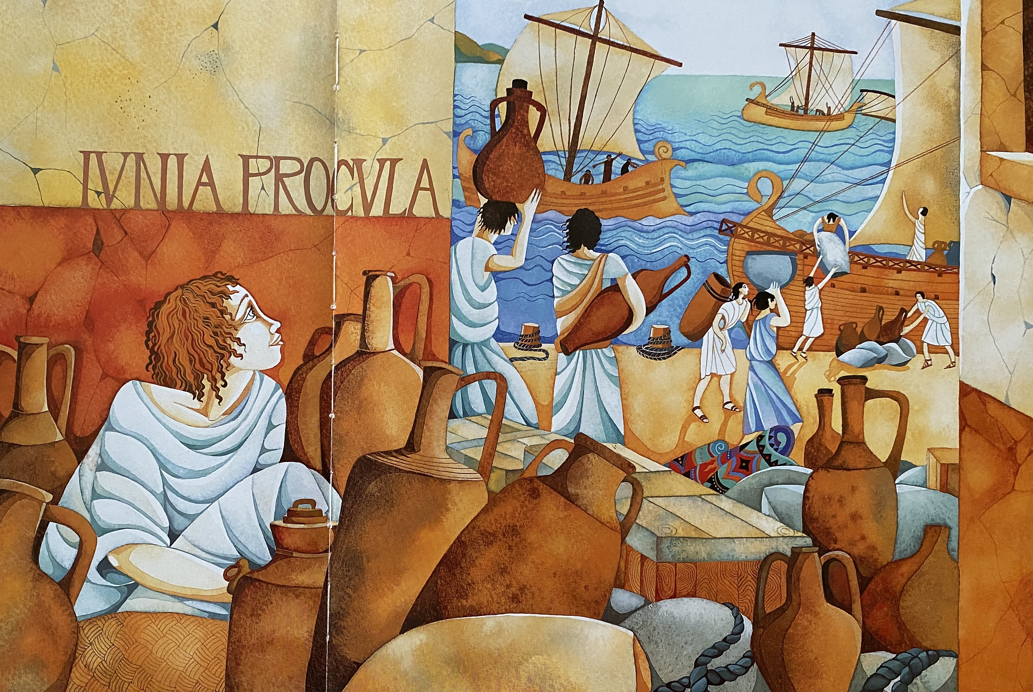
Down by the harbour, the shouts and cheers of fishermen told the city that they had been successful on their fishing trip. Unloading their rich catches into large, stone pots ready for the market, the smell of fresh fish filled the air. Gently lapping against the shore, the crystal, clear water glimmered in the magnificent sunlight as the lucky, uncaught fish leapt high in the air, chasing the rays of gold.

Slide 3
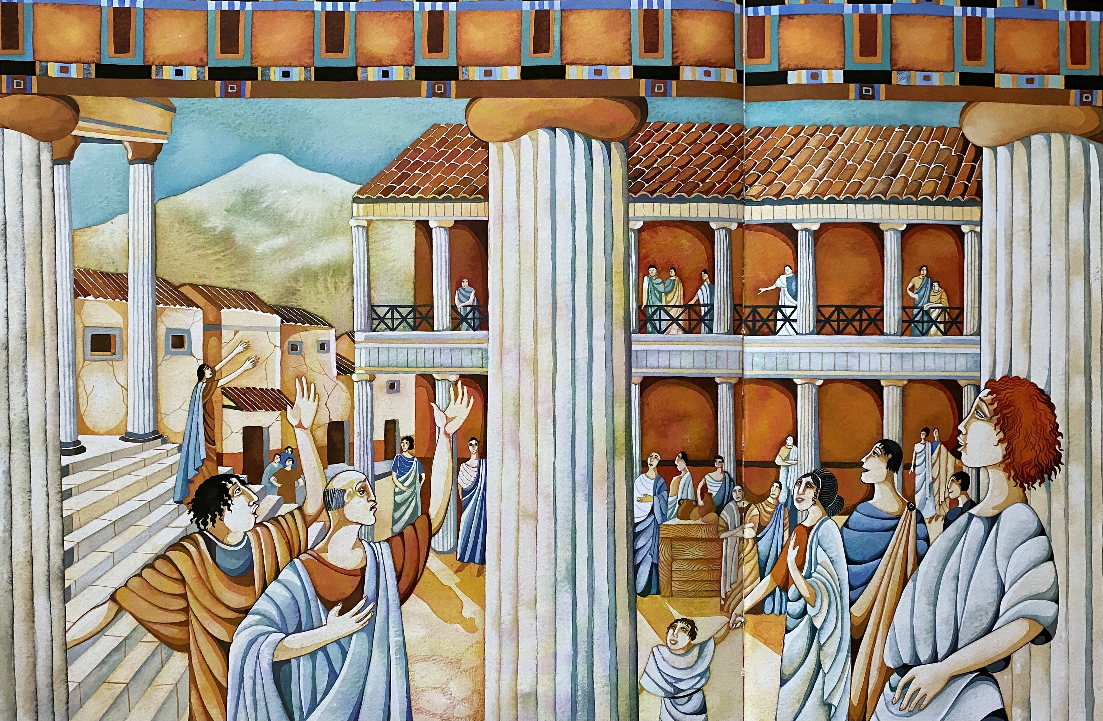
As was always the case on a Sunday, the colosseum was packed with poets and singers who wanted their voices to be heard by all. Because it happened so often, the jovial, eager audience who applauded at every chance were able to join in the chorus of their favourite song. Whilst the chaos of the city played out, the great protector, Vesuvius, loomed in the distance, casting a watchful eye out over its loyal, vulnerable citizens.

