Slide 1
English
Thursday 7th January 2021
Using Prepositions as Fronted Adverbials

Slide 2
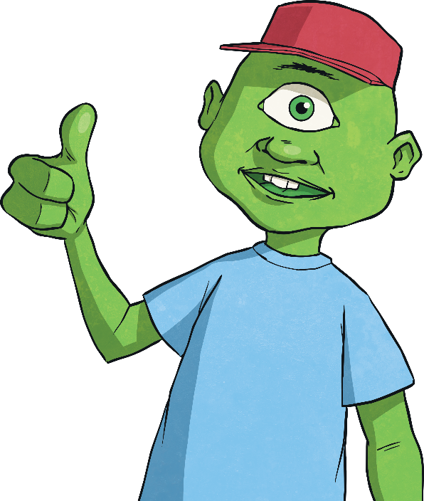
Fronted Adverbial Hunt
What is an adverbial?
An adverbial is a word, phrase or clause that is used, like an adverb, to modify a verb or a clause. Adverbs can be used as adverbials, but many other types of words, phrases and clauses can be used in this way, including prepositional phrases and subordinate clauses.
What is a fronted adverbial?
When an adverbial is used at the beginning of a sentence, they are often called ‘fronted adverbials’.

Slide 3
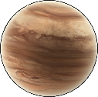
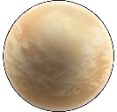

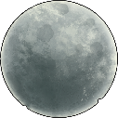
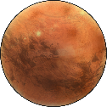
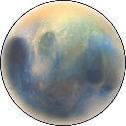
Writing Your Own Fronted Adverbials: ISPACE
Using ISPACE can help you remember six different ways to create fronted adverbials...
I
-Ing word
e.g. Shaking with fear, ...
S
Simile
e.g. Like a raging bull, ...
P
Preposition
e.g. Behind the clouds, ...
A
Adverb
e.g. Anxiously, ...
C
Conjunction
e.g. After he opened his eyes, ...
E
-Ed word
e.g. Exhausted, ...

Slide 4
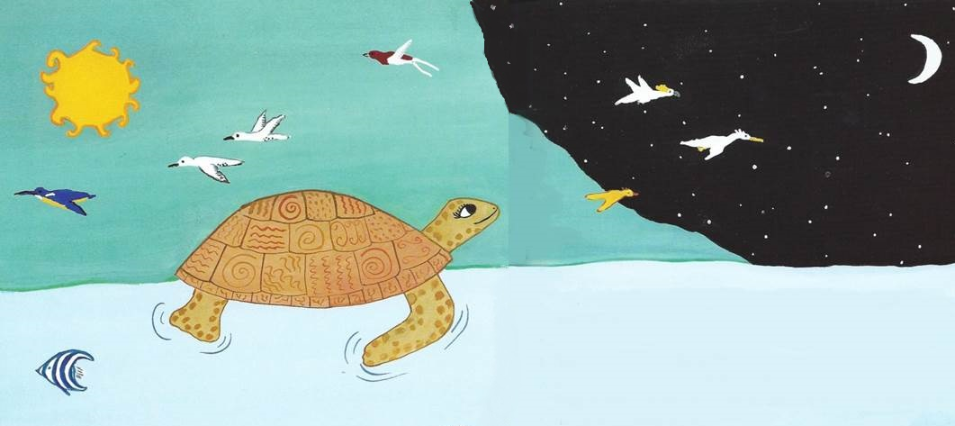
Above the surface, she breathed the clear air and felt the warmth of the sun.
Notes:
From ‘The Turtle and the Island’ by Barbara Ker Wilson, illustrated by Frané Lessac.
This is a story about a turtle that lives in the middle of a huge ocean. This picture shows the turtle resting in the middle of the ocean. The illustrator is showing both night and day in the same picture.

Slide 5
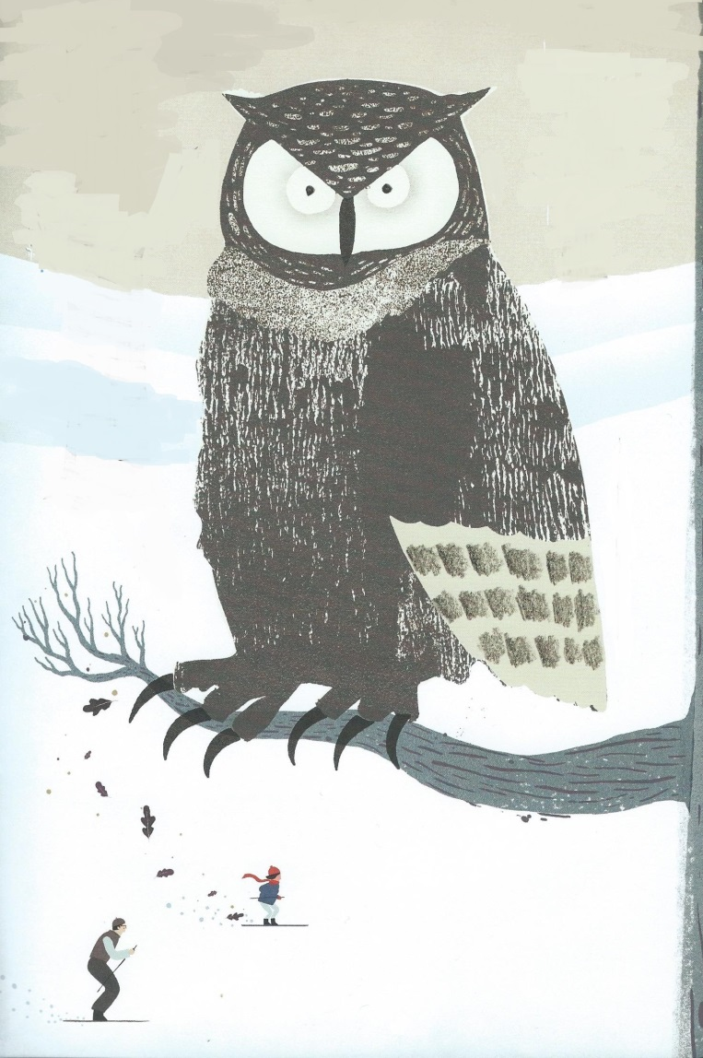
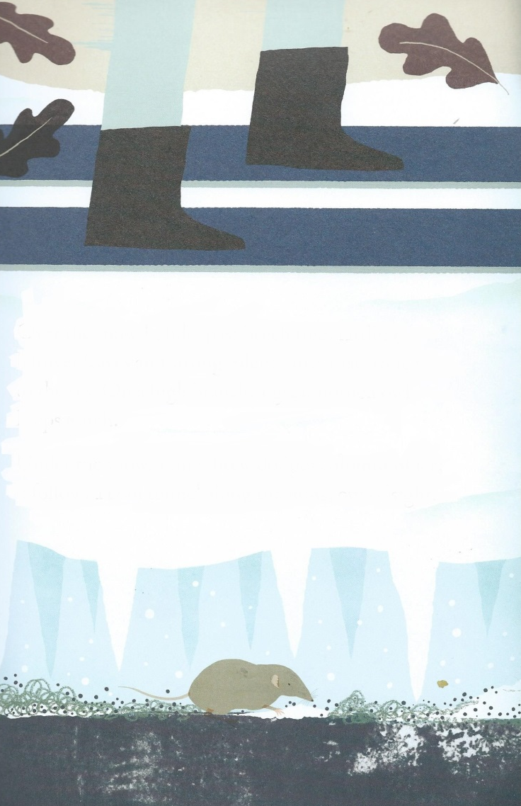
On a high branch, a great horned owl kept watch.
Under the snow, a tiny shrew dodges columns of ice.
Notes:
From ‘Over and Under the Snow’ by Kate Messner, illustrated by Christopher Silas Neal.
The author is describing the creatures that are busy during the winter. She doesn’t just say ‘there is an owl’, or ‘there is a shrew’. She starts the sentence with a fronted adverbial at the beginning telling you where the creature is.

Slide 6
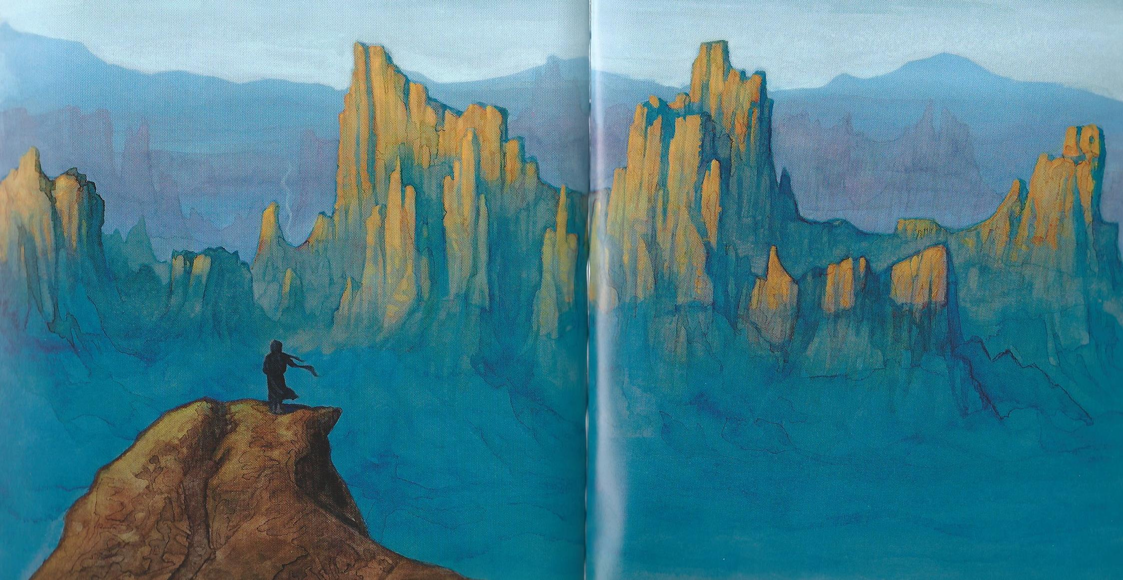
In the distance, huge towers of rock rose into the air.
Notes:
From ‘Mysterious Traveller’ by Mal Peet & Elspeth Graham, illustrated by P J Lynch.
The authors use two fronted adverbials again, this time each one beginning with a different preposition. They use ‘beyond’ to say where in the distance the towers of rock are. It makes the description of the setting on this page very precise.

Slide 7
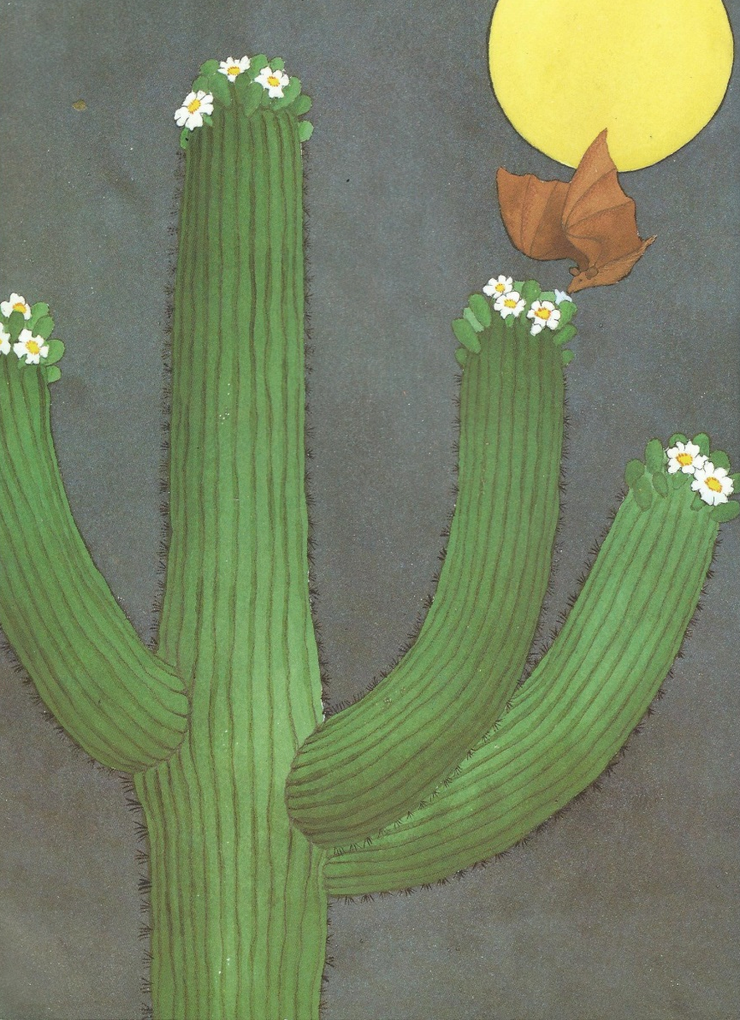
On of the top of the spikey cactus, the buds emerge and open into large, white flowers with yellow centres.
Notes:
From ‘Desert Giant: The World of the Saguaro Cactus’, written and illustrated by Barbara Bash.
This sentence is from a non-fiction book about a type of cactus plant. There are two fronted adverbials starting with prepositions. They give more detail about the yellows that grow from this plant.

Slide 8
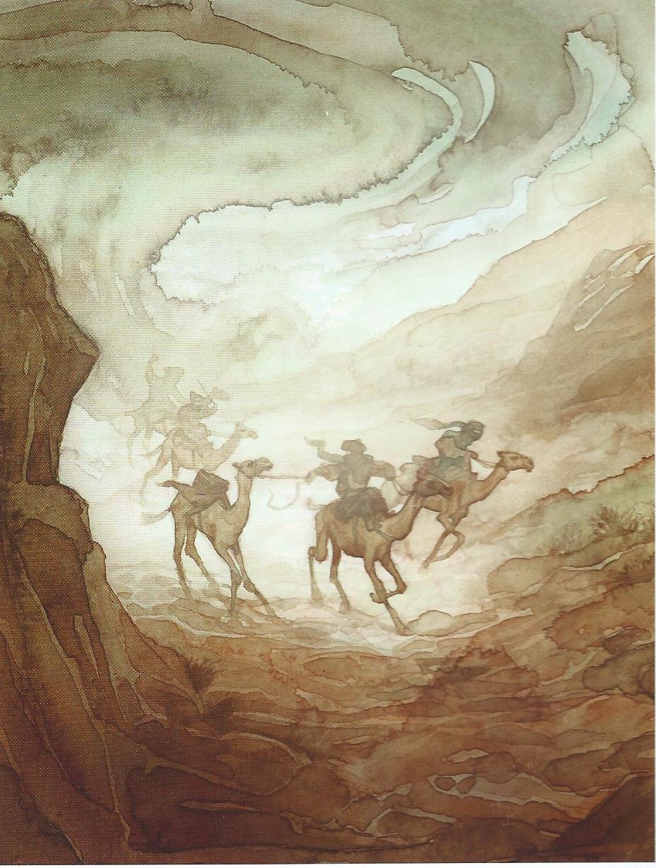
Behind them, the evening sky was now a boiling wall of sand and dust like a tidal wave.
Notes:
From ‘Mysterious Traveller, by Mal Peet & Elspeth Graham, illustrated by P J Lynch
The story starts with a dramatic sand storm. ‘Behind’ is another unusual preposition being used for a fronted adverbial. It is important to say ‘behind’ here, because it gives the sense that the men on camels are being chased by the sand storm.

Slide 9


