Slide 1
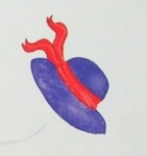
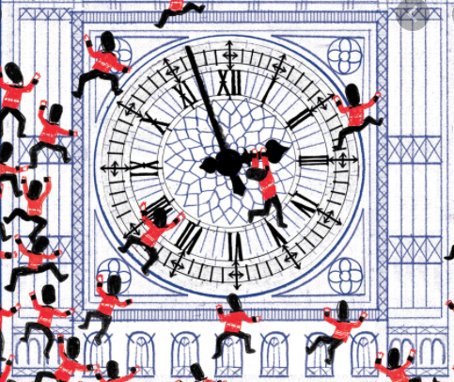
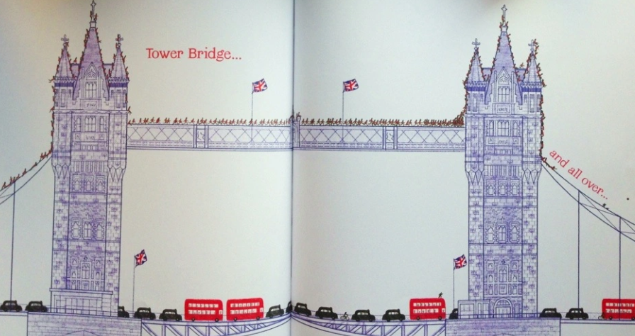
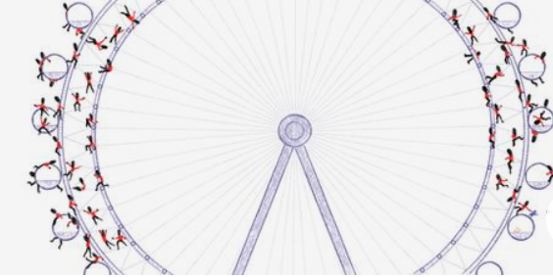
English
Thursday 7 January
The Queen’s Hat Prepositions
Use this link to watch and listen to the story read by the author and illustrator Steve Antony.
I hope you enjoy it.
https://www.youtube.com/watch?v=6Q8MQPVq_vg&t=33s (press control and click on the link)
In the story, the hat blows all across London.
Have you been to London? Can you name any sites around the city?

Slide 2
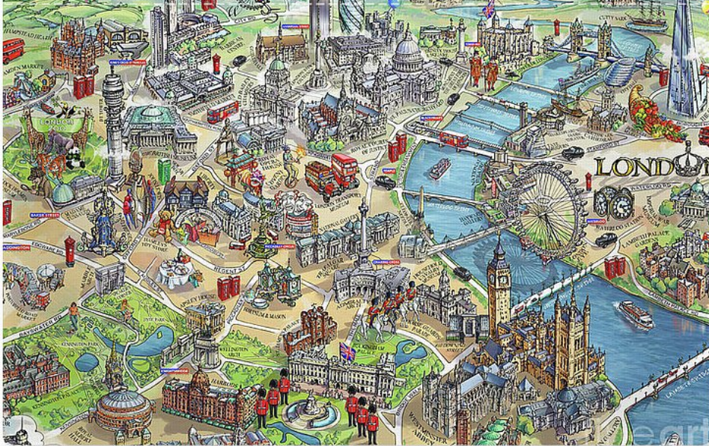
Have you heard of these places? Maybe you have actually been to some of them.
Can you see:
the River Thames
Buckingham Palace
the London Eye
theTower of London
the Shard
the Gerkin
Canary Wharf
a double decker bus
London cab
the London Underground
Tower Bridge
Trafalgar Square

Slide 3
The Queen’s hat blew all across London, past these sites around the city.
Did you use the link to find out what prepositions are and how to use them? If not, here it is:
https://excaliburprimaryschoolmy.sharepoint.com/:v:/g/personal/jweatherby_excalibur_cheshire_sch_uk/EeUvpcMa10JBtbE5FZ5xisYB0z0N91ZbrsA1KSeu4KPGTg?e=vVRifj
Think of prepositions to explain where the hat went e.g. across, around, through, behind, between, under, over, near, toward, beneath, above, among, along.
Now, use the prepositions to write at least 6 sentences using prepositions and places in London.
The hat blew around the London Eye.
It blew along the River Thames.
Between the towers at Canary Wharf the hat soared in the sky.
Try not to start with ‘The hat …’ or ‘It…’ every time.
Send me your responses via the English link on Seesaw please. I look forward to reading them.

