Slide 1
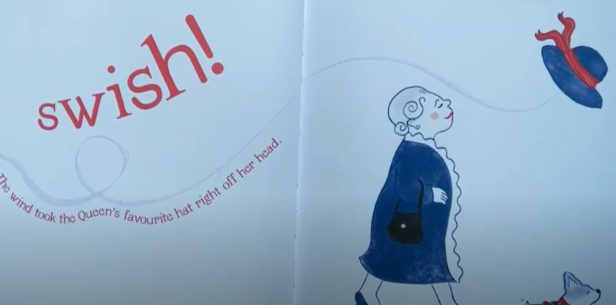
English
Wednesday 6 January
The Queen’s Hat
Over the next few days we are going to retell the story of The Queen’s Hat.
Use this link to watch and listen to the story read by the author and illustrator Steve Antony.
I hope you enjoy it.
https://www.youtube.com/watch?v=6Q8MQPVq_vg&t=33s
Concentrate on the hat today. How could you describe it? Collect adjectives. Think about colour, shape and size.
Think of other words for ‘blue’ and ‘red’.
Is it light or dark?
Is the ribbon wide, narrow, thin, thick?

Slide 2
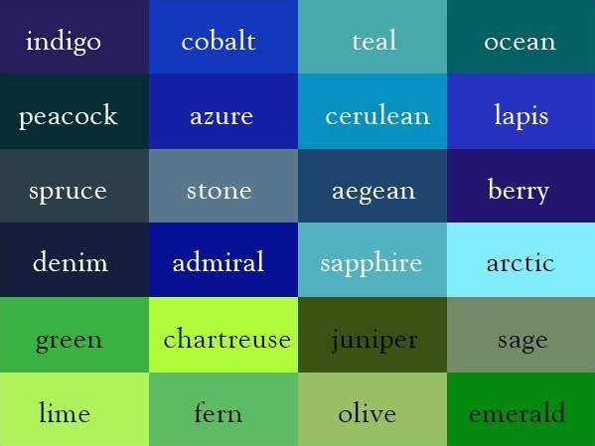
These words all mean blue.

Slide 3
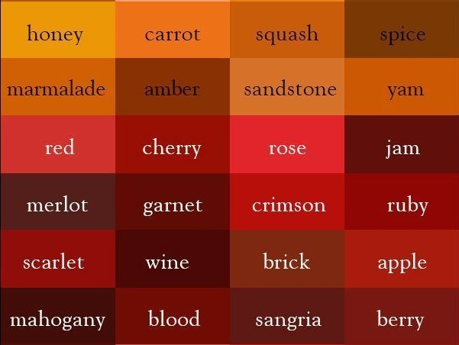
These words all mean red.

Slide 4
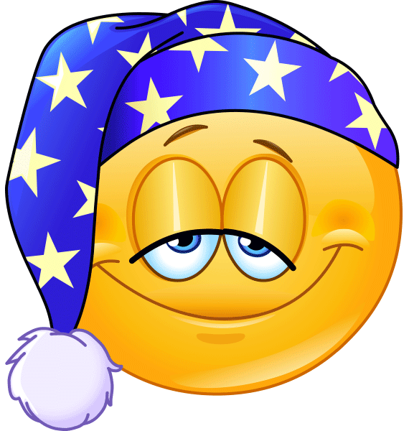
When you have collected lots of adjectives, improve this sentence in three different ways.
The Queen’s hat was blue.
Not very exciting! I nearly fell asleep!
How about:
The Queen’s favourite hat was a bright peacock blue and had a wide brick red ribbon wrapped around and tied in a bow.
Now you try.
3 sentences
Correct capitals
Full stops
‘and’ to join ideas
Please send me your sentences through the English link on Seesaw, thank you.

