Slide 1
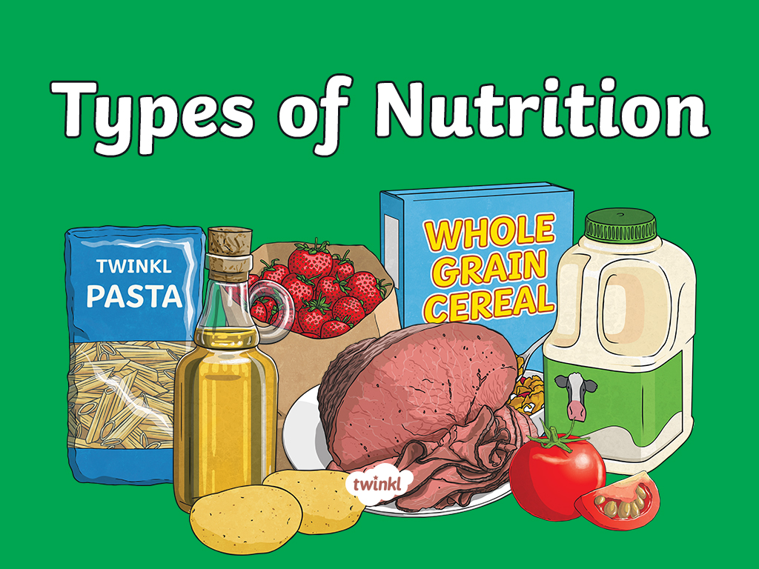

Slide 2

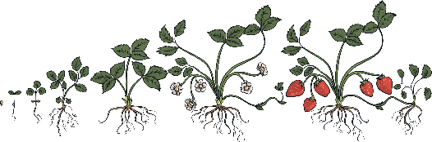
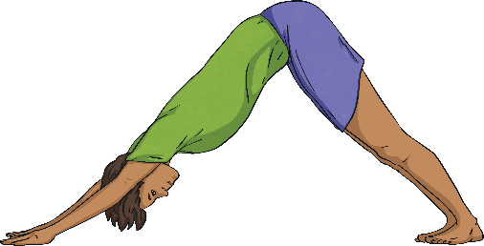
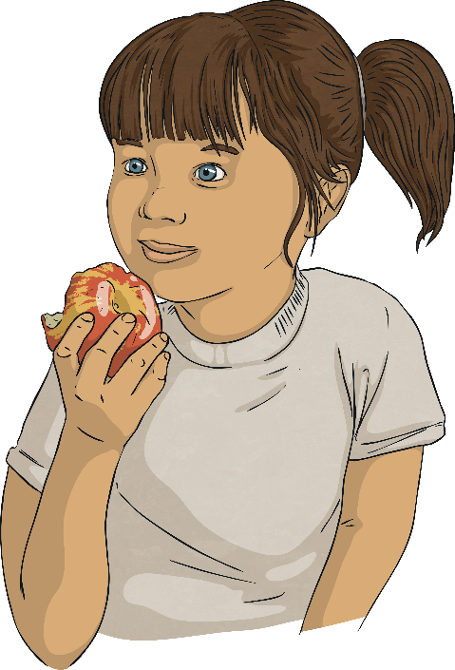
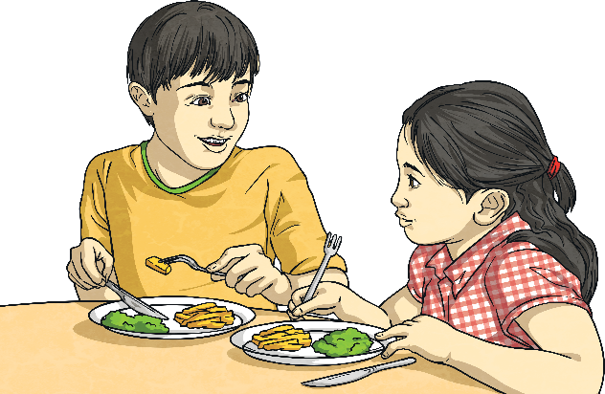
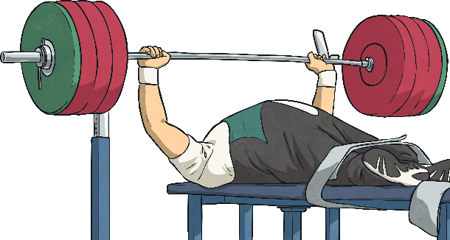
Living Things and Food
Why do living things need food?
To grow
To be strong
To be healthy

Slide 3
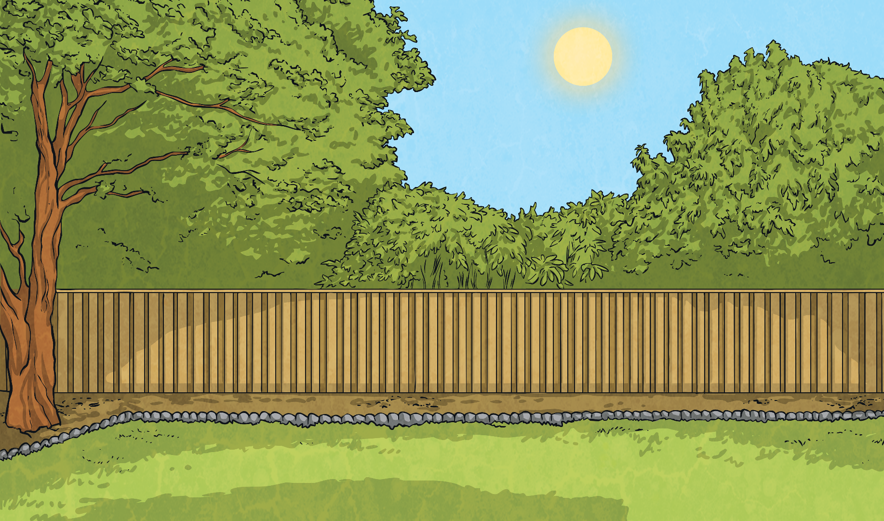
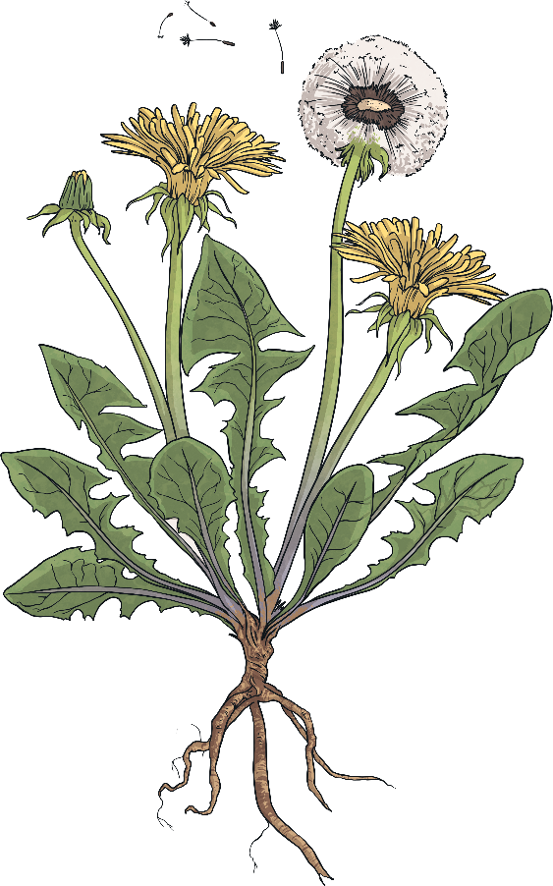

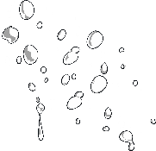
Photosynthesis
sunlight
How do plants obtain food?
Plants make their own food! This process is called photosynthesis.
They use water, sunlight and carbon dioxide (a gas in the air) to produce food in their leaves.
carbon
dioxide
water

Slide 4
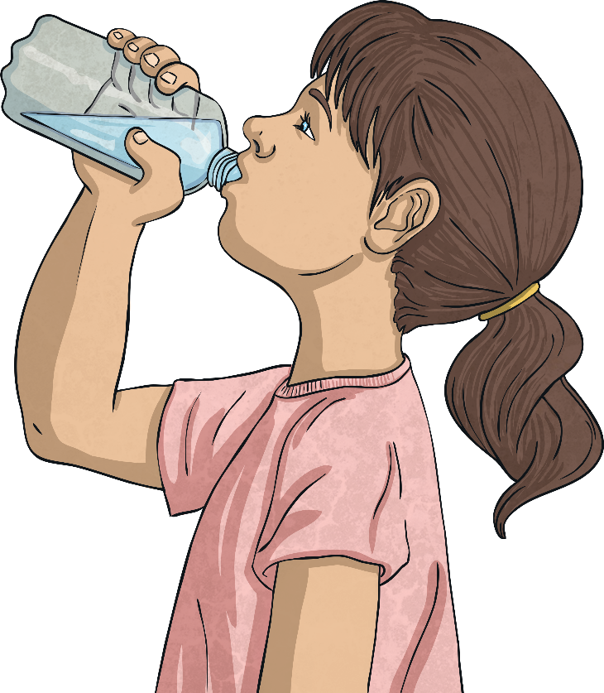
Animals and Photosynthesis
water
sunlight
What would happen to animals if they tried to obtain food in the same way as plants?
carbon
dioxide

Slide 5

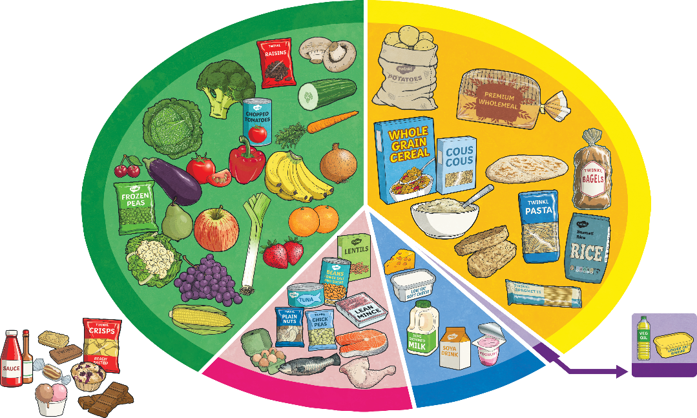
Human Food
What kind of foods do humans need?
Food is commonly divided into five food groups.
How many of the food groups can you remember?
As a group label the food groups.

Slide 6
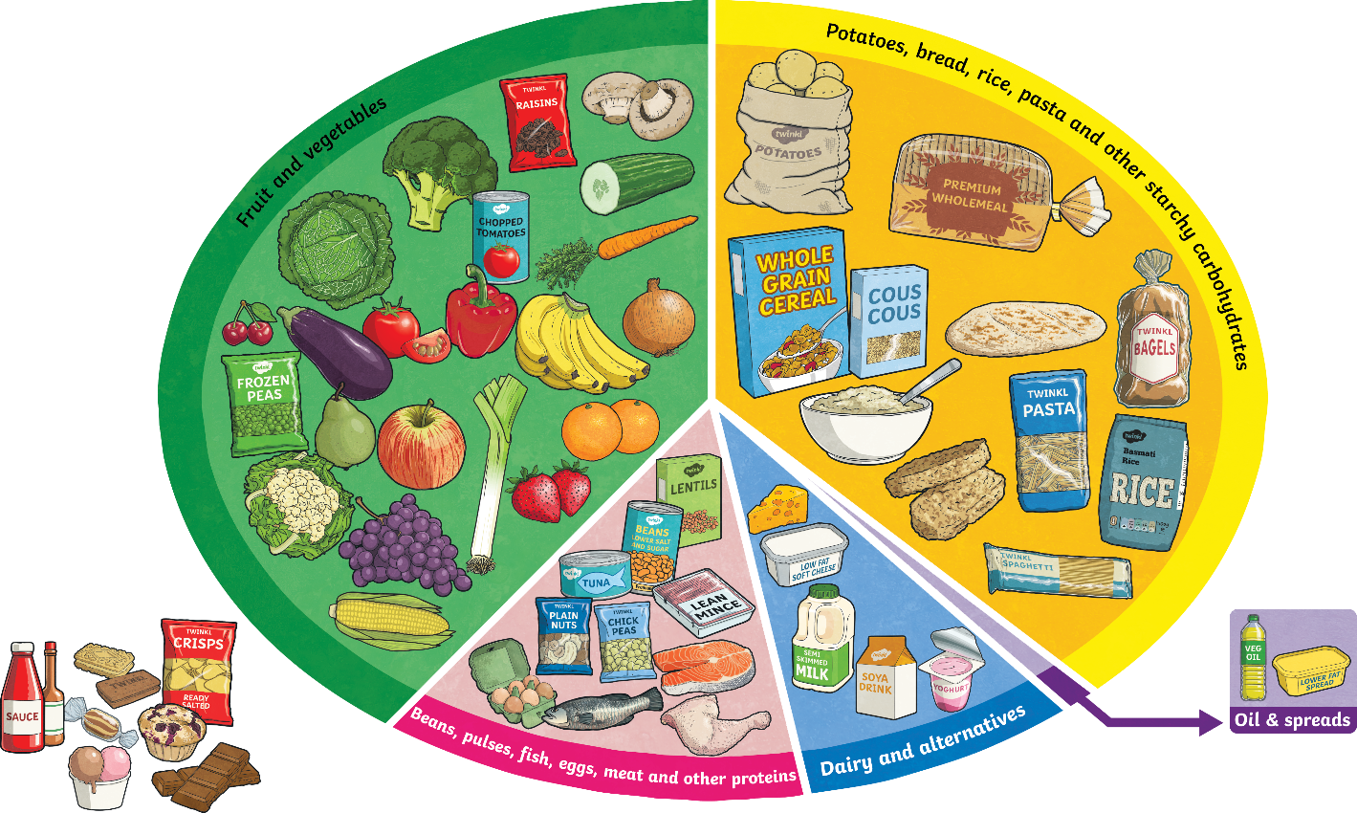
Human Food
What kind of foods do humans need?
Fruit and vegetables
Aim to eat 5 a day! Dried, frozen and tinned fruits and vegetables count as well as fruit juices. Important as sources of vitamins and minerals which reduce your risk of disease and keep you healthy. Limit fruit juice and/or smoothies to 150ml a day.
Potatoes, bread, rice, pasta and other starchy carbohydrates
These are important for giving us energy.
Oil and spreads
Choose unsaturated oils and use in small amounts.
Dairy and alternatives
These are important for strong teeth and bones.
Beans, pulses, fish, eggs, meat and other proteins
These are very important for helping us grow and build muscles. Try to eat 2 portions of fish a week and try to reduce intake of red and processed meat.
Why do you think foods that are high in sugar and/or fat are not a food group?
Check another group’s work using the picture, then give it back to them.
How many did you get correct?
Are there any groups you were confused by? Which ones? Why?

Slide 7
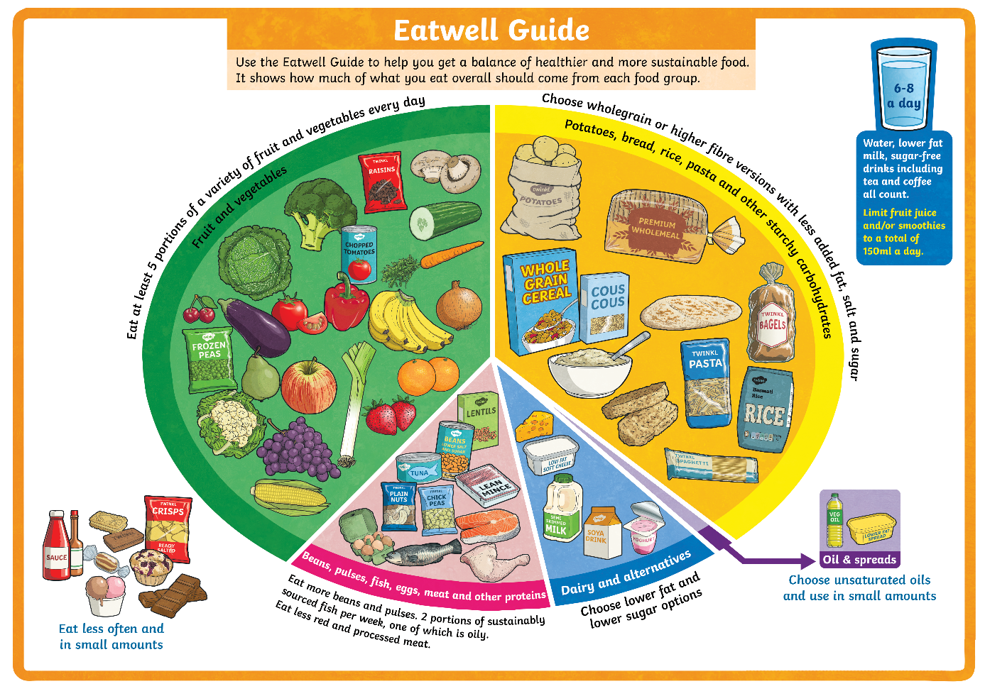
Food Groups
The Eatwell Guide helps us to make decisions about how to make sure we eat the right balance of nutrients in our diets.
The food groups are shown on the Eatwell Guide.
Notice that drinking plenty of water is also very important to keep us healthy.

Slide 8
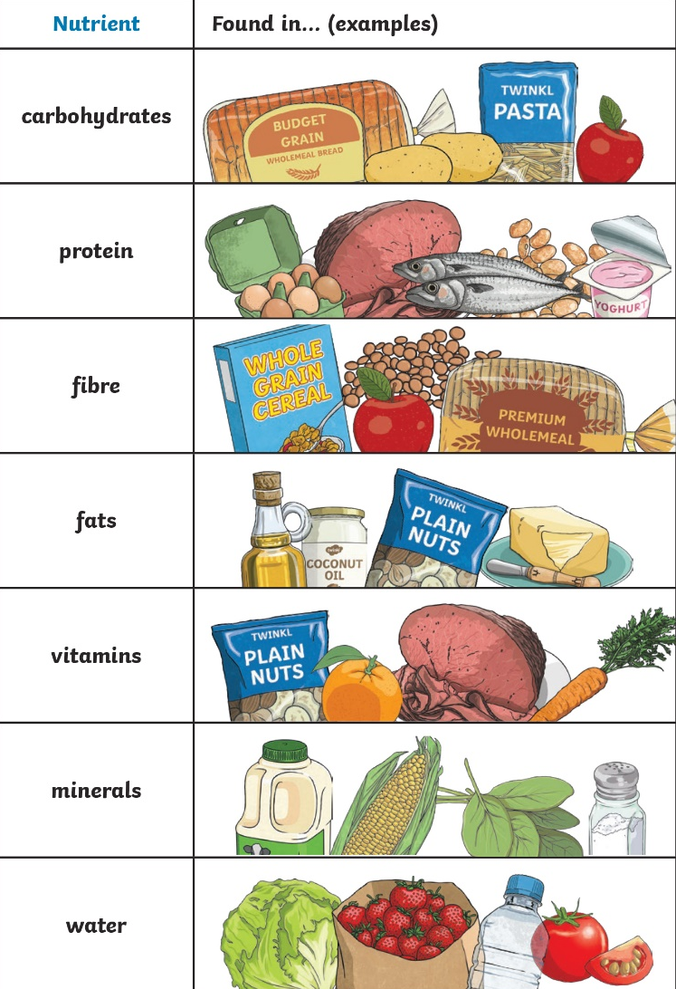
Types of Nutrients
Nutrients are substances that animals need to stay alive and stay healthy. These nutrients are found in the foods we eat.
There are seven nutrients.

Slide 9
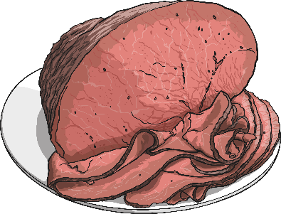
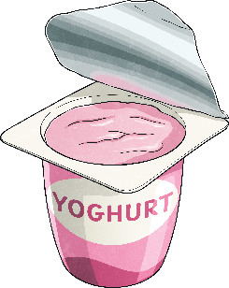
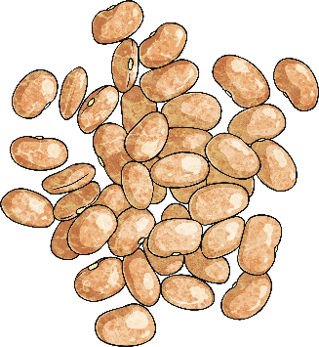
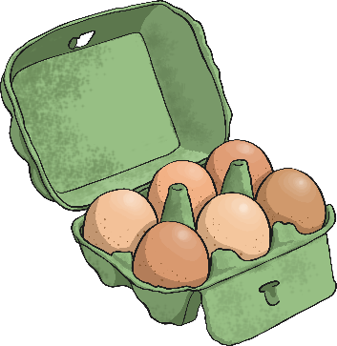
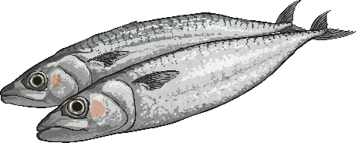
Types of Nutrients - Proteins
Proteins help your body to grow and repair itself.
Foods high in protein include:
Red Meat
Fish
Beans
Yoghurt

Slide 10
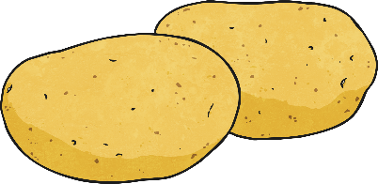
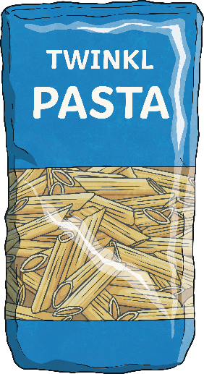
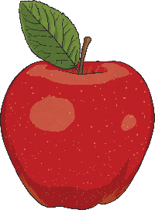
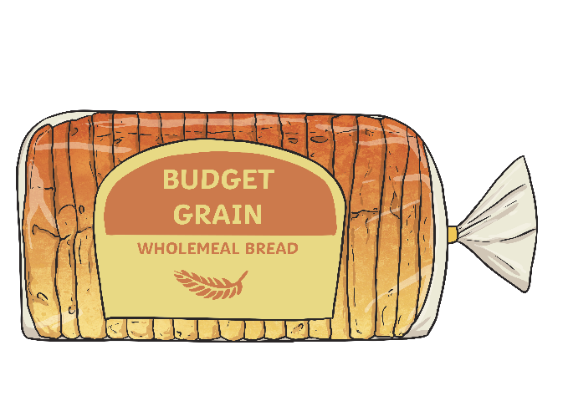
Types of Nutrients - Carbohydrates
Carbohydrates give
you energy.
Foods high in carbohydrates include:
Bread
Pasta
Fruit
Potatoes

Slide 11
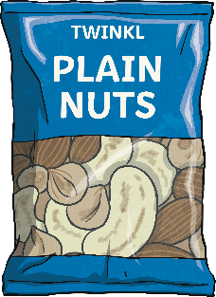
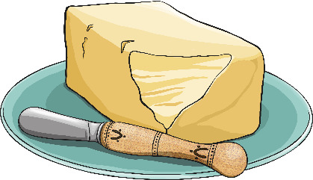

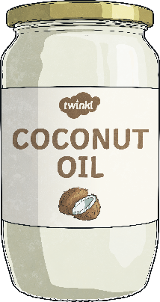
Types of Nutrients - Fats
Fats give you energy.
Foods high in fats include:
Nuts
Oils
Avocados
Butter

Slide 12

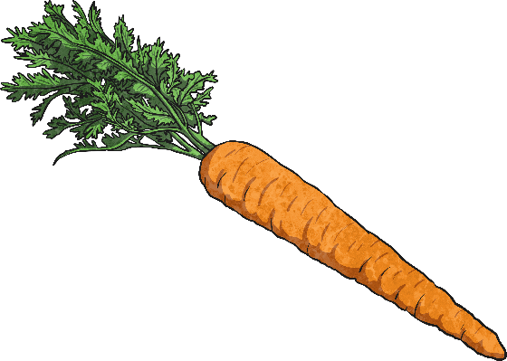

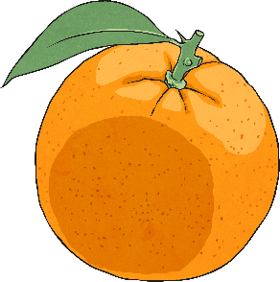
Types of Nutrients - Vitamins
Vitamins keep your
body healthy.
Foods high in vitamins include:
Oranges
Carrots
Beef
Nuts

Slide 13
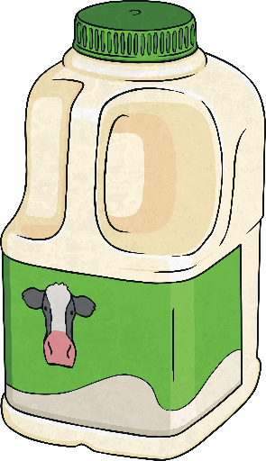
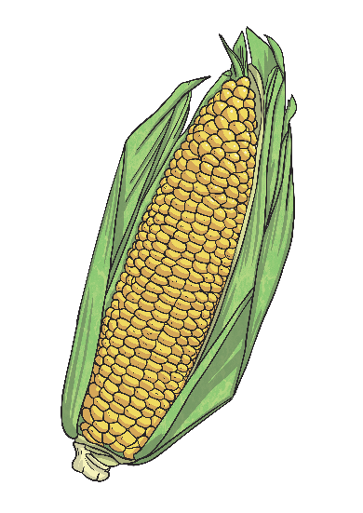


Types of Nutrients - Minerals
Minerals keep your
body healthy.
Foods high in minerals include:
Milk
Spinach
Salt
Sweetcorn

Slide 14
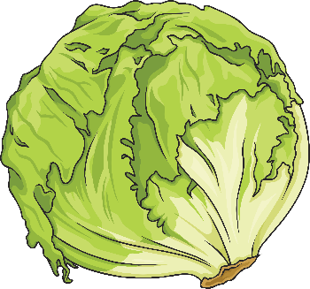
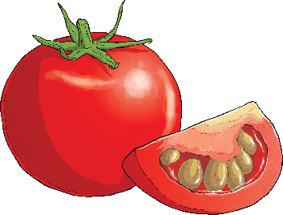

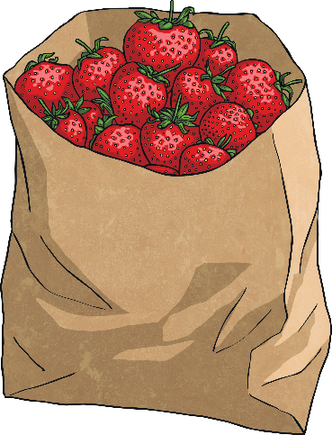
Types of Nutrients - Water
Water helps to move nutrients in your body and get rid of waste that you don’t need. It is an essential nutrient for our survival. While it is really important to drink plenty of water, it is also important to remember that many foods contain water also.
Foods high in water include:
Tomatoes
Cucumbers
Lettuce
Strawberries

Slide 15
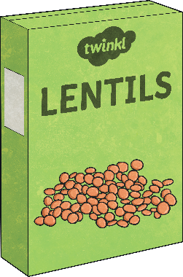
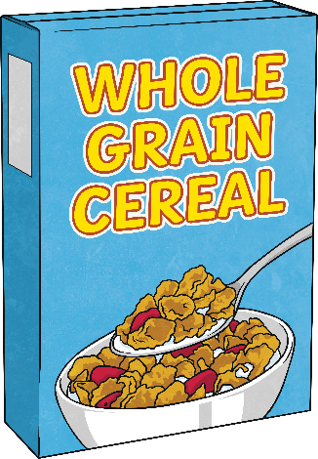
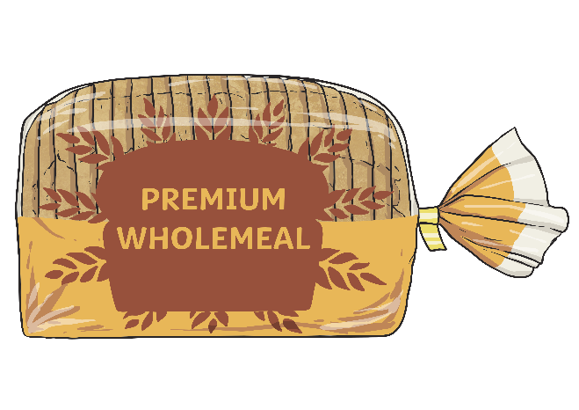
Types of Nutrients - Fibre
Fibre helps you to digest the food that you
have eaten.
Foods high in fibre include:
Cereal
Apples
Wholegrain bread
Lentils

Slide 16
Can you match the food groups to the items below?
Fruit and Vegetables Proteins
Carbohydrates Fats
Dairy Foods and drinks high in fat or sugar.

Slide 17


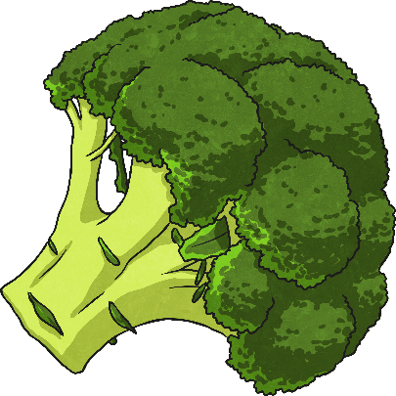
Food Groups and Nutrients
Within each food group, there are many foods which contain more than
one type of nutrient.
For example, eating broccoli from the fruit and vegetables section would provide with various different nutrients. This food is a great source of minerals (especially a mineral called potassium), a really good source of vitamins and it provides the body with fibre.

Slide 18
