Slide 1

Noun hunt!
A noun is a ……….
Task 1
Using the pictures from the book, can you make a list of 8 nouns you can see?

Slide 2
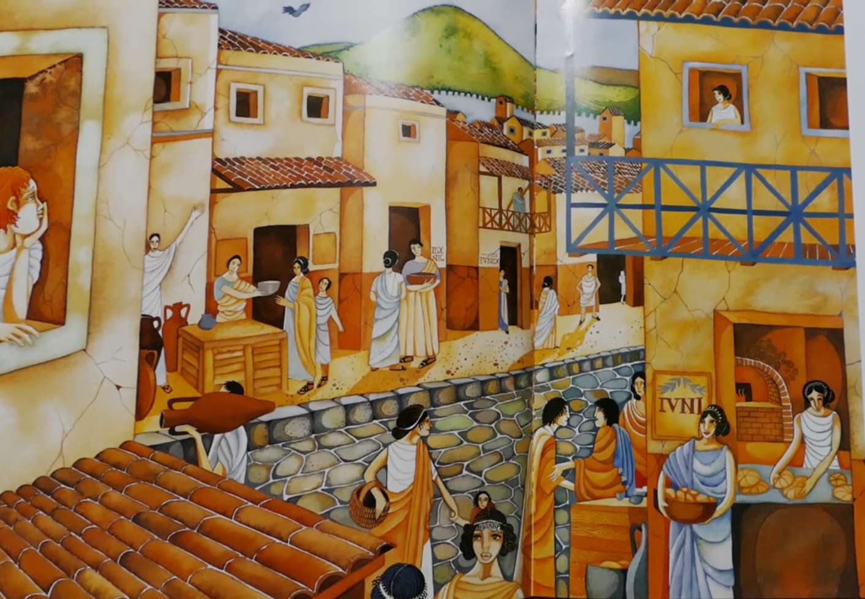

Slide 3
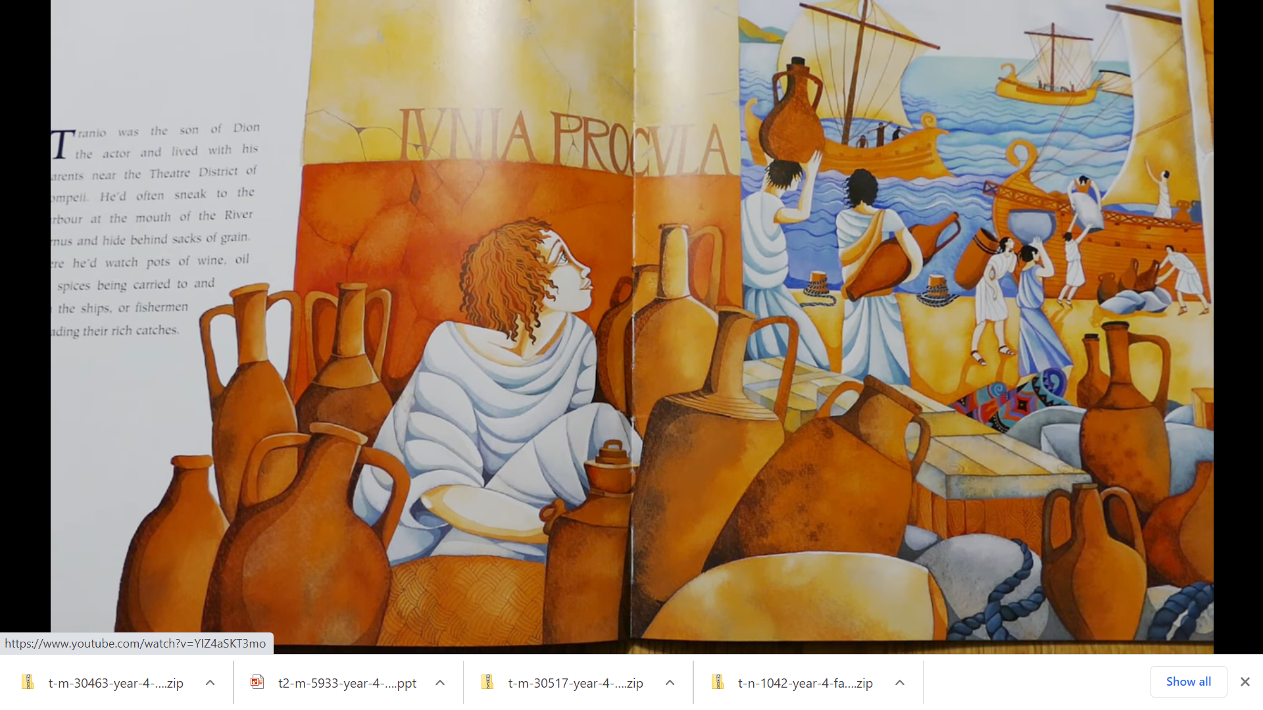

Slide 4
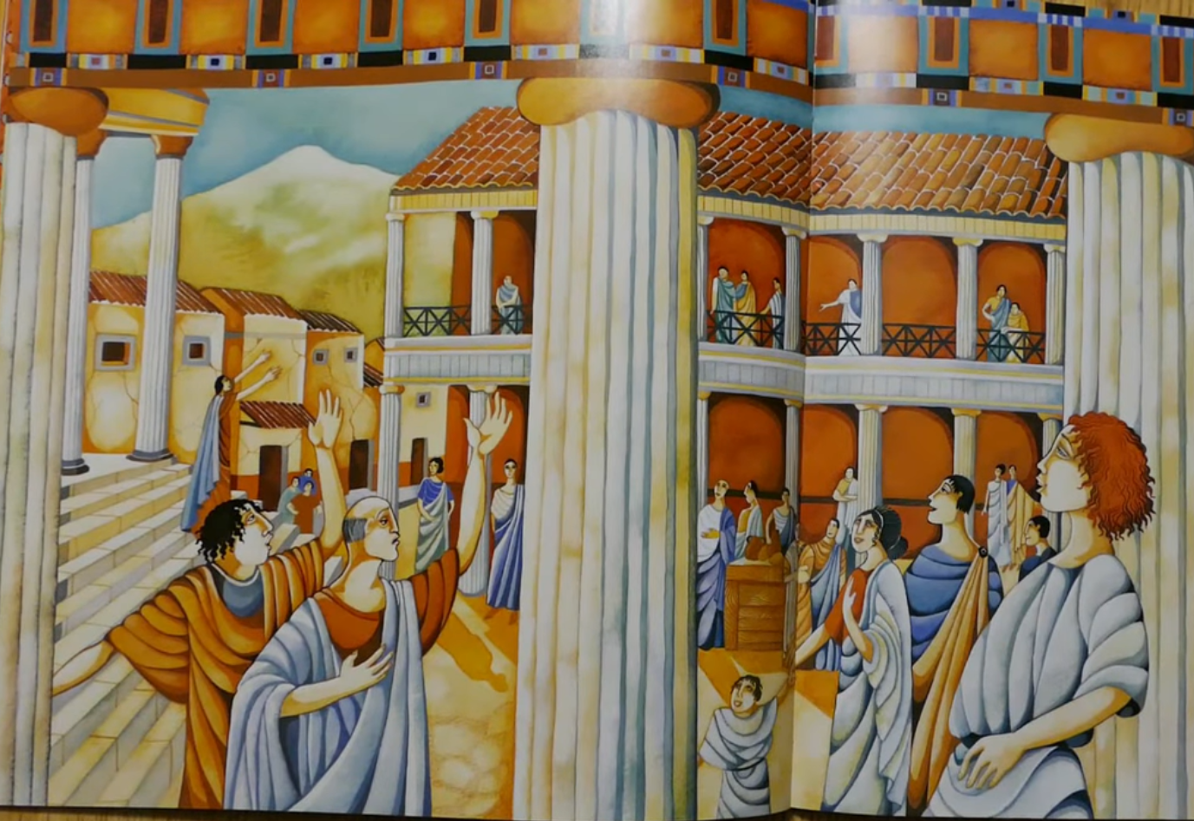

Slide 5
Now time to expand those nouns!
Adjective noun
Adjective, adjective noun
Adjective, adjective noun with ……….
Adjective, adjective noun who ……….
Adjective, adjective noun that ……….

Slide 6
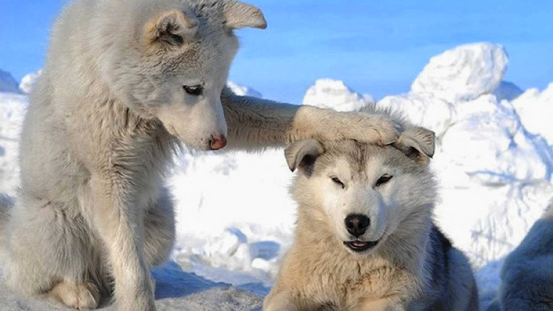
dog
Noun
Adjective noun
Adjective, adjective noun
Adjective, adjective noun with……….
Adjective, adjective noun who ……….
Adjective, adjective noun that ……….
white dog
white, fluffy dog
white, fluffy dog with its paw resting on the head of another dog.
Sat on the cold ice was a white, fluffy dog with its paw resting on the head of another dog.

Slide 7
Noun
Adjective noun
Adjective, adjective noun
Adjective, adjective noun with ……….
Adjective, adjective noun who ……….
Adjective, adjective noun that ……….

Slide 8
Wednesday 6th January 2021
LO- I can create expanded noun phrases
Choose a noun from one of the images, then build it up until you get an expanded noun phrase.
* adjective, adjective noun
** adjective, adjective noun with/who/that ……….
*** adjective, adjective noun with/who/that………. in a full sentence (with a second adjective, adjective noun phrase)
*Rickety, wooden boats
** Rickety, wooden boats that were bobbing in the water.
*** In the distance I could see rickety, wooden boats that were bobbing on the glistening, clear ocean water.

