Slide 1
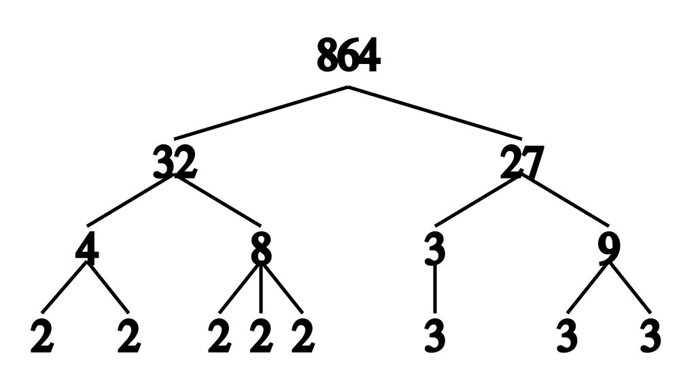
Prime factors of a number

Slide 2
Factors are numbers that divide exactly into another number.
A prime number is a number that is divisible by 1 and itself.
A composite number is a number which is not a prime number.

Slide 3
Prime Factors
A factor which is also a prime number is called a prime factor. To find the prime factors of a number, we can use a factor tree.
E.g. A factor tree for 70
70
7 10
2 5
Therefore, 7 x 2 x 5 = 70

Slide 4
Can you create a factor tree for 24?
Can you create a factor tree for 16?
Can you create a factor tree for 55?

