Slide 1
Tuesday 5th January 2021
Food Chains

Slide 2

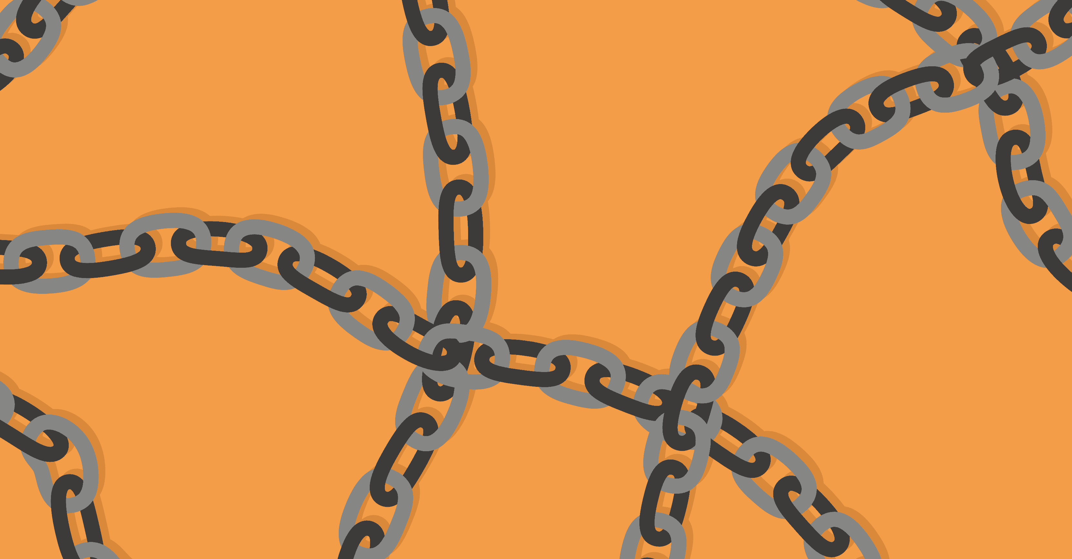
Food Chains
What is a food chain?
Now watch the following video clip and see if we can add to or refine our ideas.

Slide 3

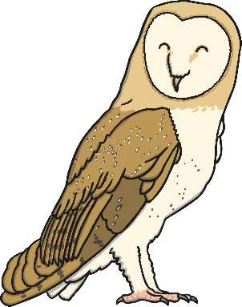
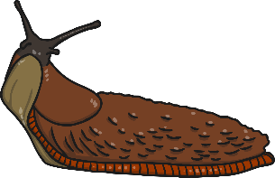
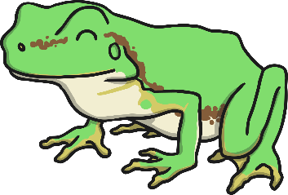
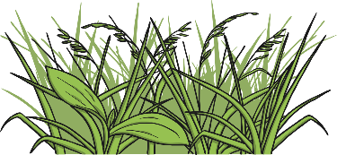
Interpreting Food Chains
How is this food chain constructed?
What do the arrows represent?
How should we label the different parts of the food chain?

Slide 4
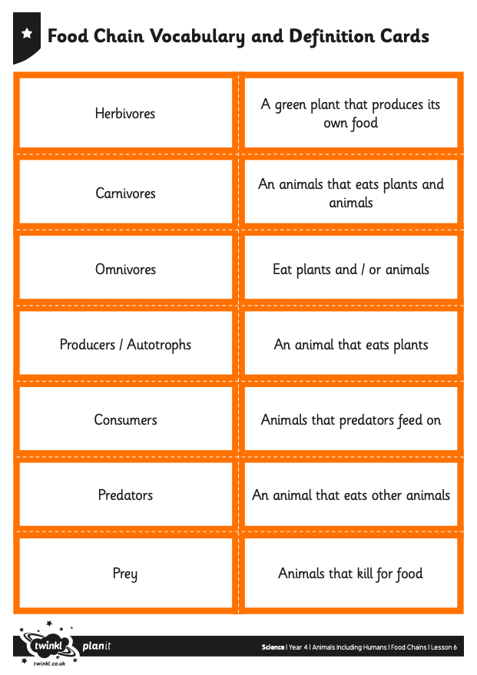
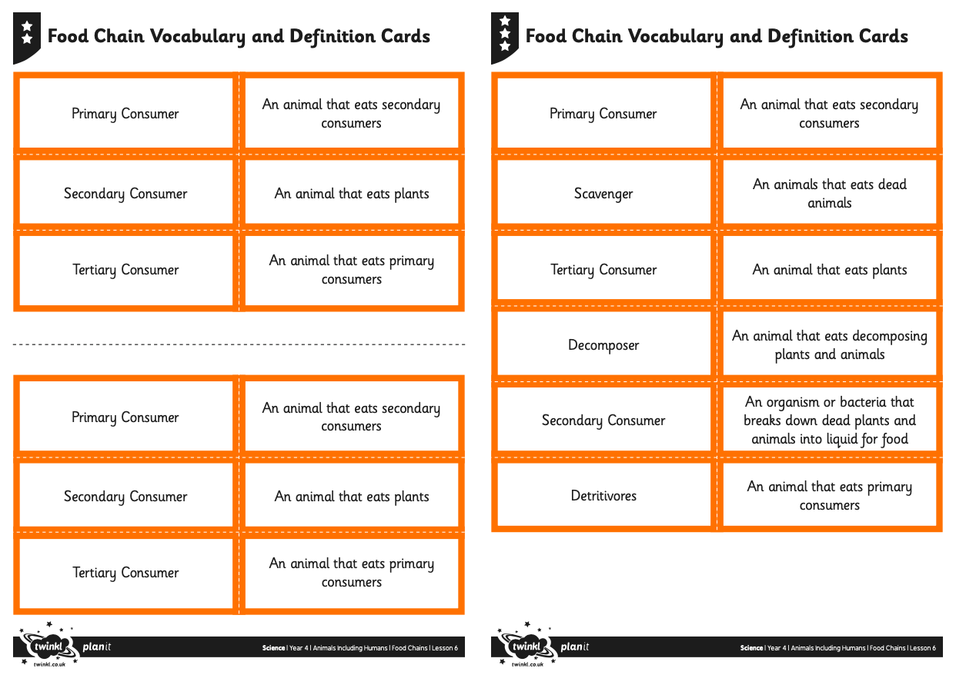
Food Chains Activity
Cut out the following words or write them down and match them to their definitions.
(The sheet is on the school website)

Slide 5

Interpreting Food Chains
Now complete the table with the matched definitions.
Words | Meanings
Herbivores | An animal that eats plants.
Carnivores | An animal that eats other animals.
Omnivores | An animal that eats plants and animals.
Detritivores | An animal that eats decomposing plants and animals.
Producers/Autotrophs | Plants that produced their own food.
Consumers | Animals that eat plant or other animals.
Primary Consumer | An animal that eats plants.
Secondary Consumer | An animal that eats the primary consumer.
Tertiary Consumer | An animal that eats the secondary consumer.
Prey | An animal that is hunted for food.
Scavenger | An animal that eats dead animals.
Predators | An animal that kills for food.
Decomposer | An organism or bacteria that breaks down dead plants and animals into liquid for food.

