Slide 1
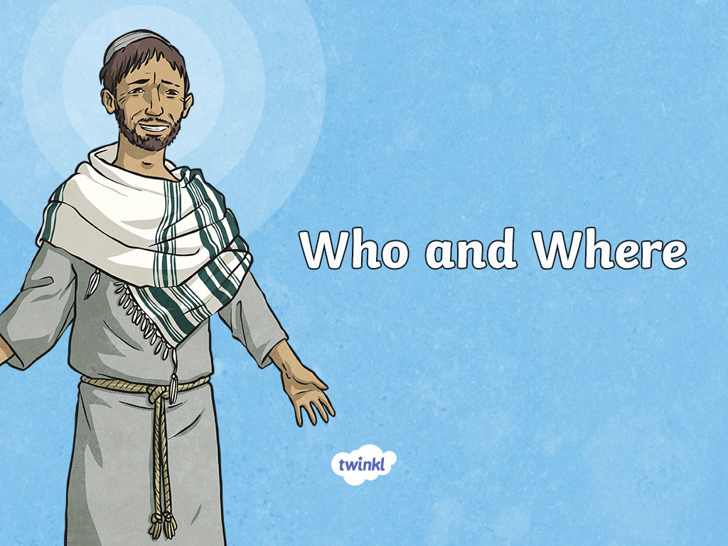

Slide 2







Religions of the World
Can you name the main religions of the world?
Sikhism
Judaism
Hinduism
Christianity
Buddhism
Islam

Slide 3
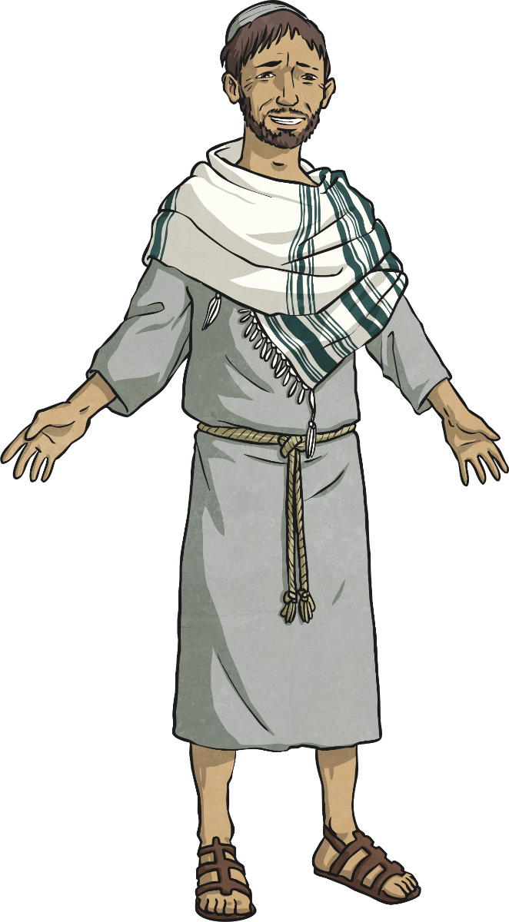
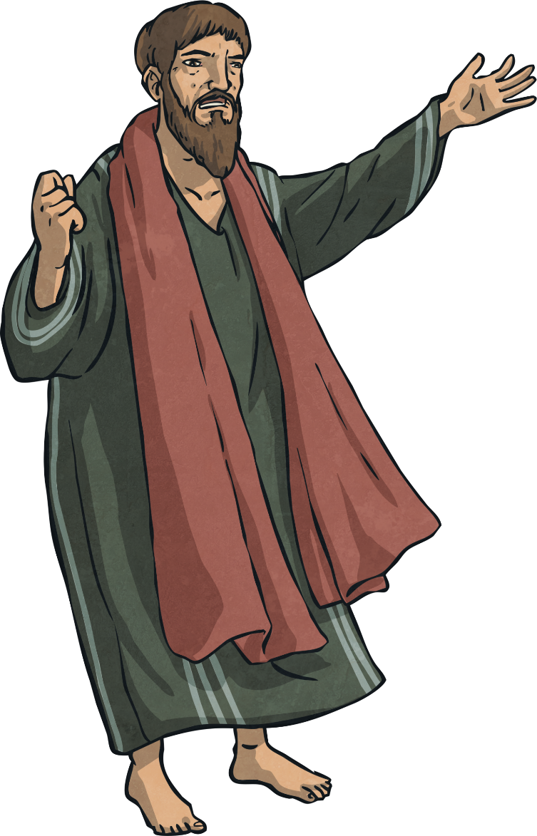
Founder
Christianity traces its beginnings to the birth, teachings and example of Jesus of Nazareth.
?
Jesus was born a Jew and Christianity originally developed as a part of Judaism.
Christians believe that Jesus gained many followers (and enemies). After his death and resurrection, his followers (led by the disciples) continued to spread the word of God.
Jesus lived until he was 33.
He was born just over 2000 years ago.
Christians believe that Jesus was the Son of God. Many believe he came to earth to teach humans about love, grace, fellowship and to prepare a way to God.

Slide 4

Names
Do you know any other names for Jesus of Nazareth?
Why are Christians called Christians?
Why is the religion called Christianity?
Jesus Christ
Son of God
The Good Shepherd
Lamb of God
Light of the World
Bread of Life
The words ‘Christian’ and ‘Christianity’ came from the name, Jesus Christ.

Slide 5
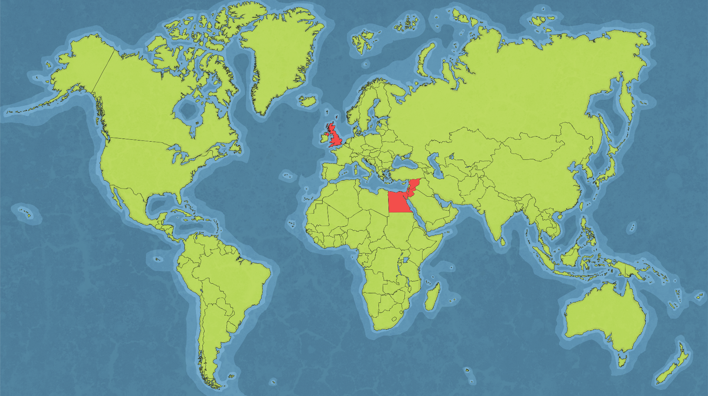
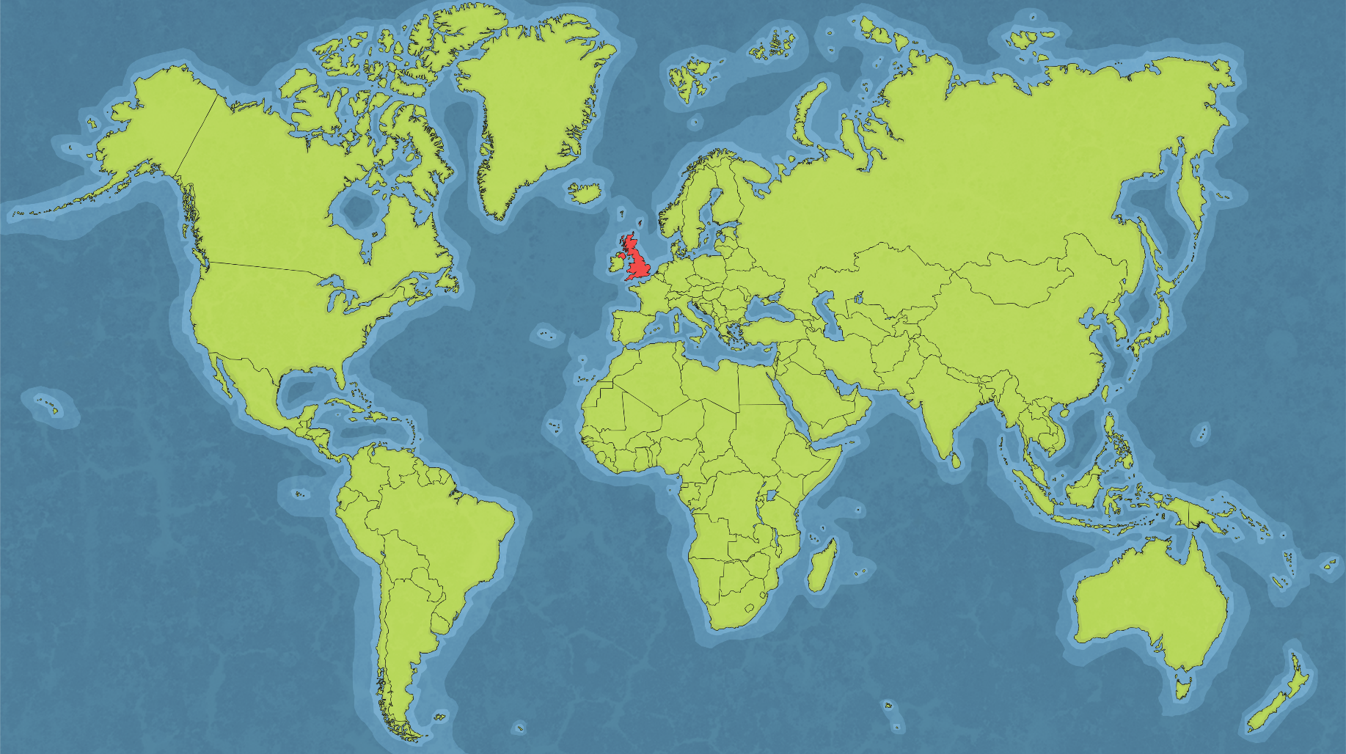
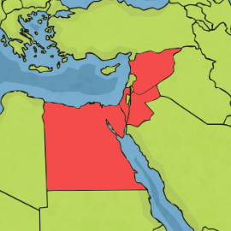
Middle East
Where in the world is Middle East?
Where did Christianity begin?
Europe
North America
Asia
UK
Africa
South America
Australasia

Slide 6
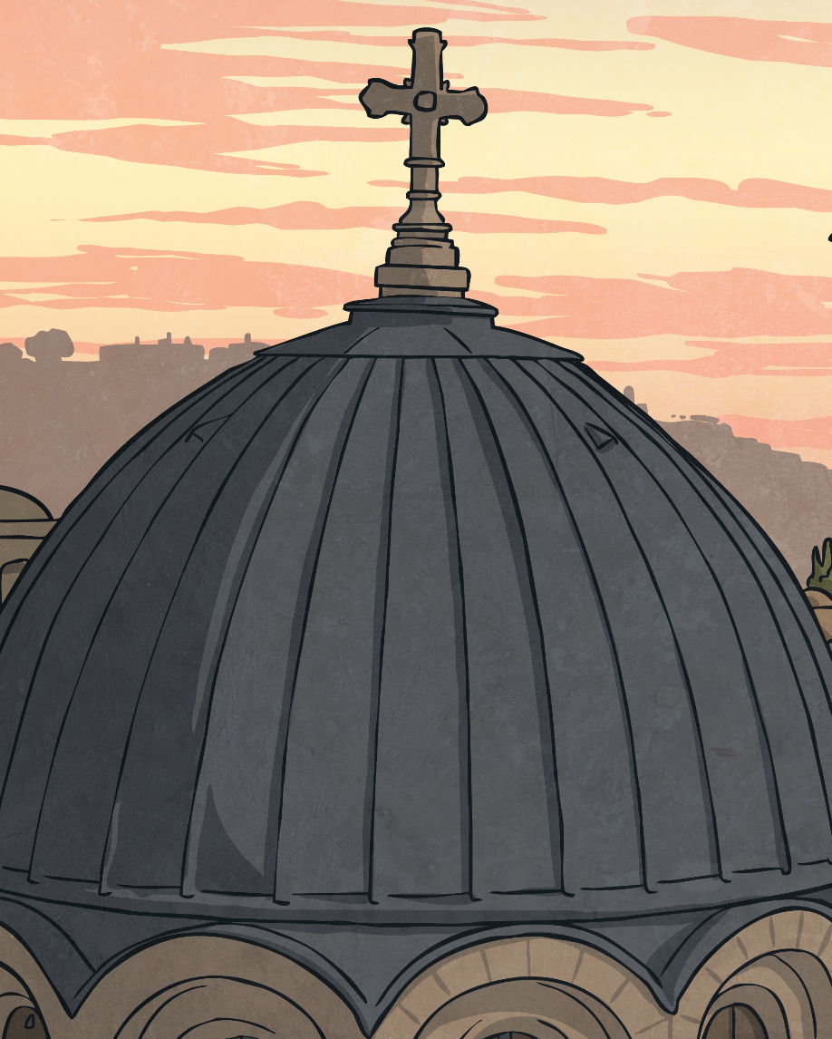
Middle East
Bethlehem is often named as the place where Christianity began as many Christians believe that is where Jesus was born. However, Christianity did not begin until after Jesus’ death, when his followers spread the word.
Therefore, other places are also key to the origins of Christianity. Christians believe that Jesus himself travelled to Egypt (to escape Herod), Syria and Jordan (as we call them now) to teach. His followers travelled to many different countries; including Greece, Turkey, Malta and Italy, to spread the word of Jesus.

Slide 7

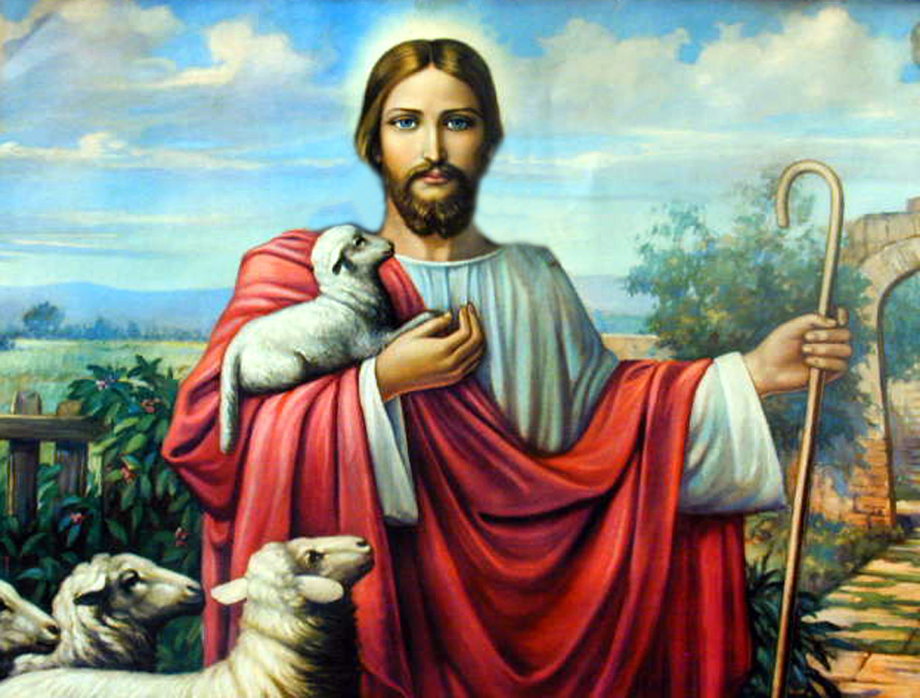
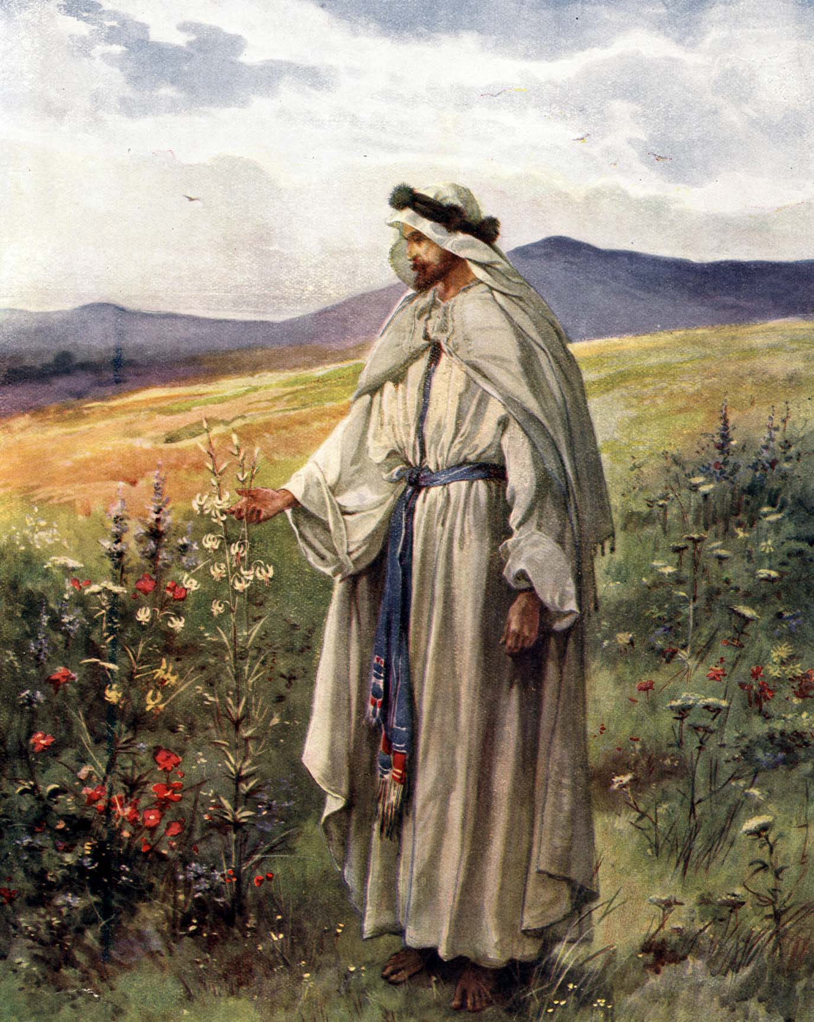
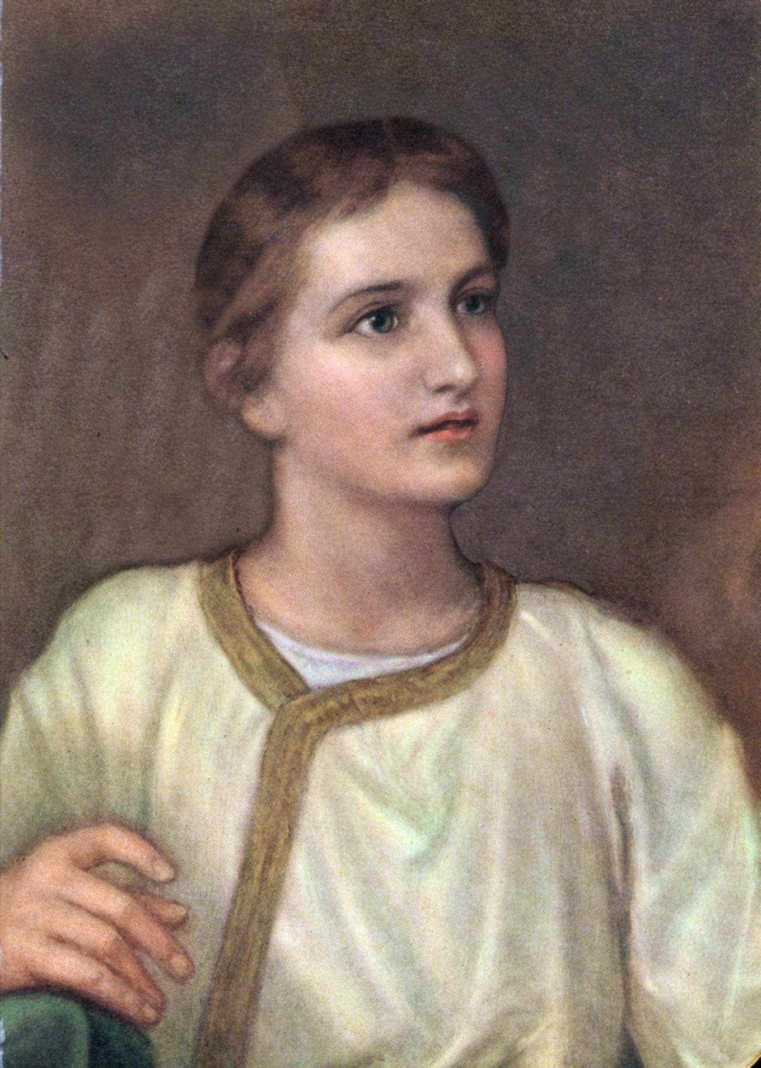
Representing Jesus
Look at the different images of Jesus.
Why do you think they show Jesus looking different or with different things?
Photo courtesy of biblevector (@flickr.com) - granted under creative commons licence - attribution

Slide 8
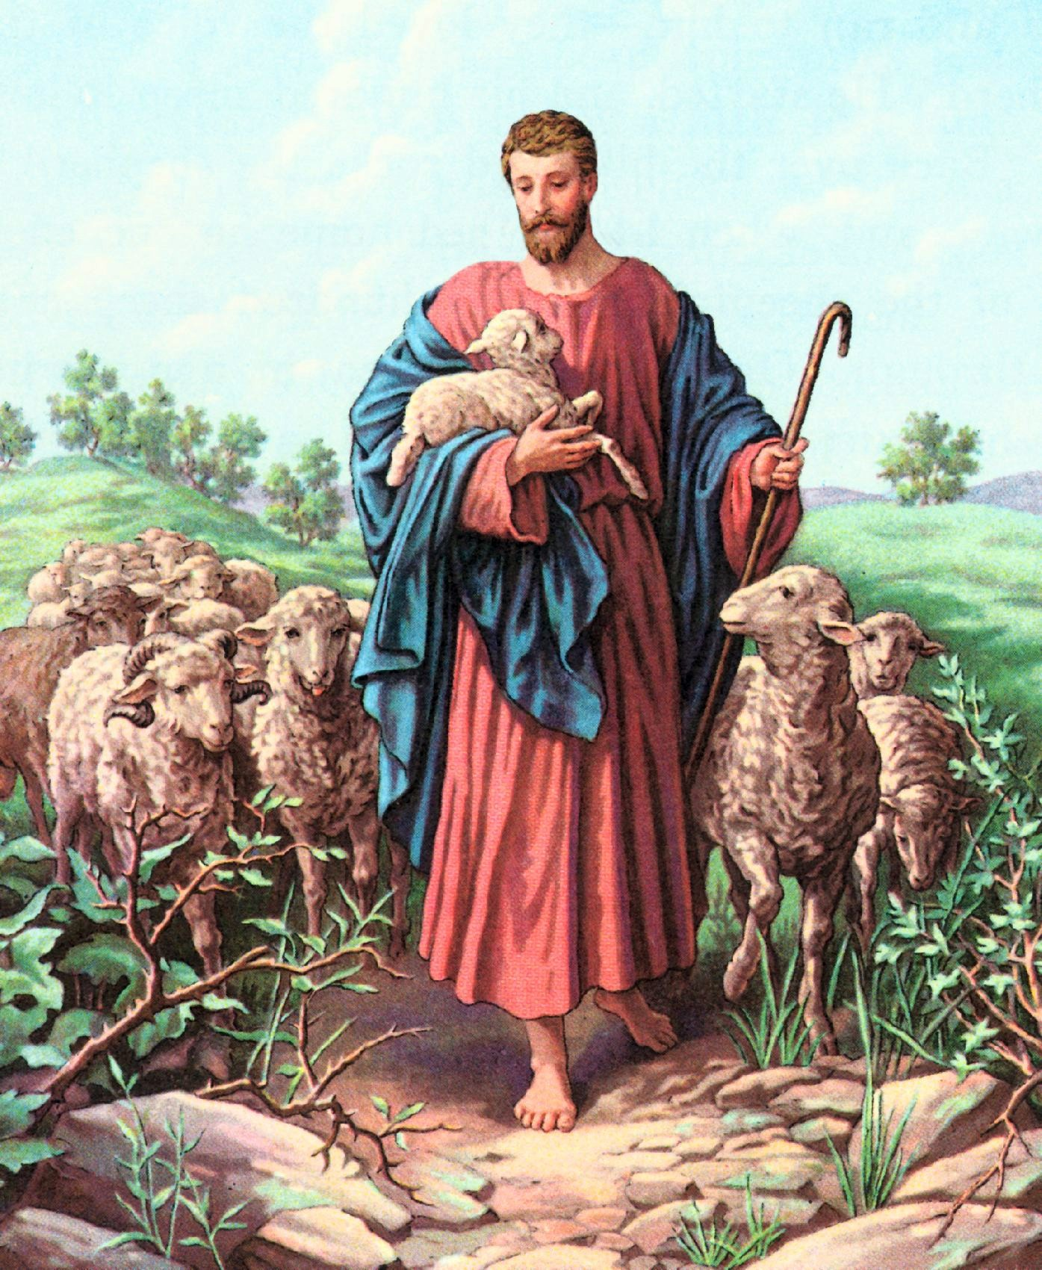
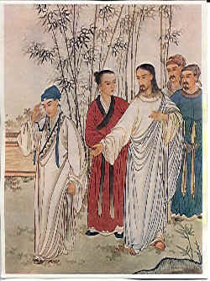
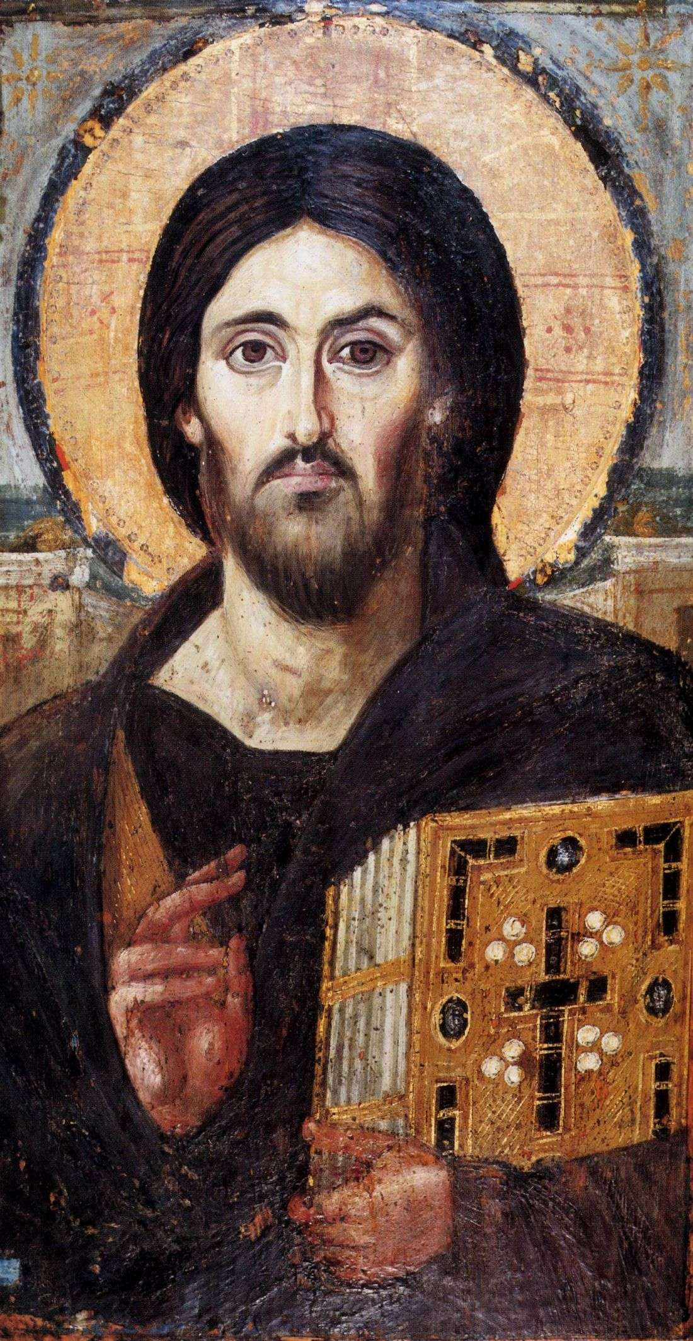
Representing Jesus
Look at the different images of Jesus.
Why do you think they show Jesus looking different or with different things?
Photo courtesy of biblevector (@flickr.com) - granted under creative commons licence - attribution

Slide 9
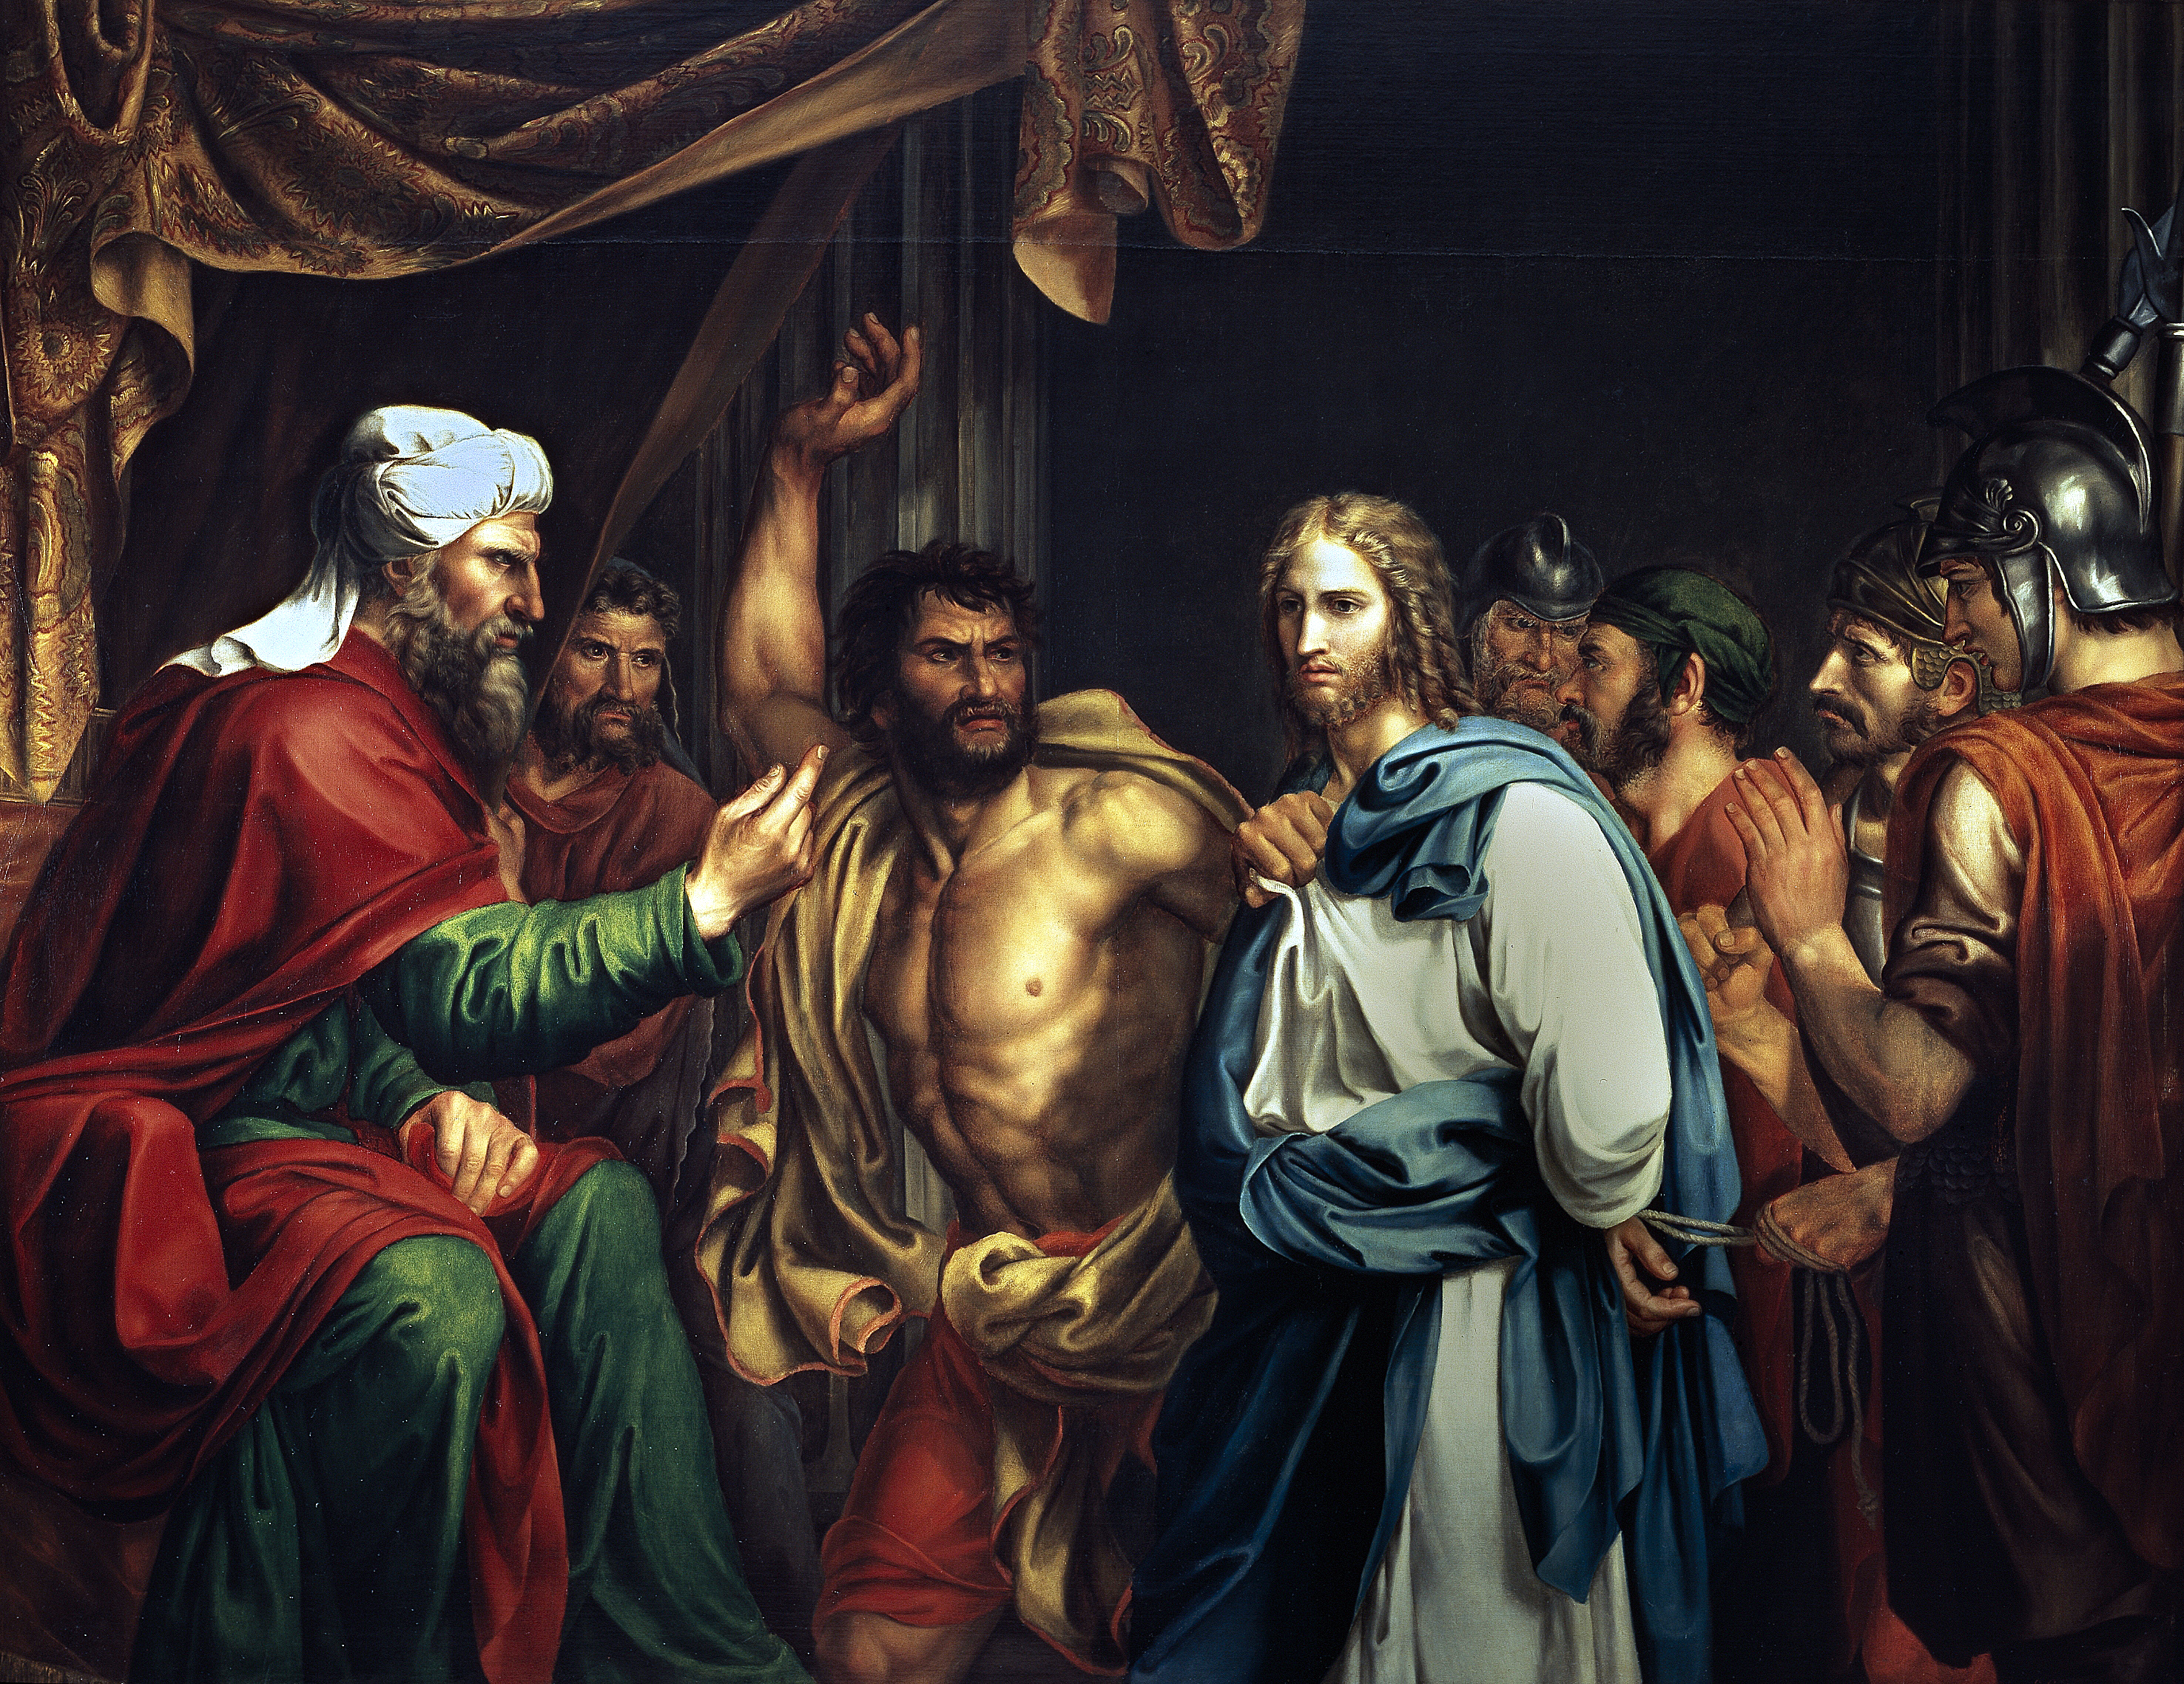
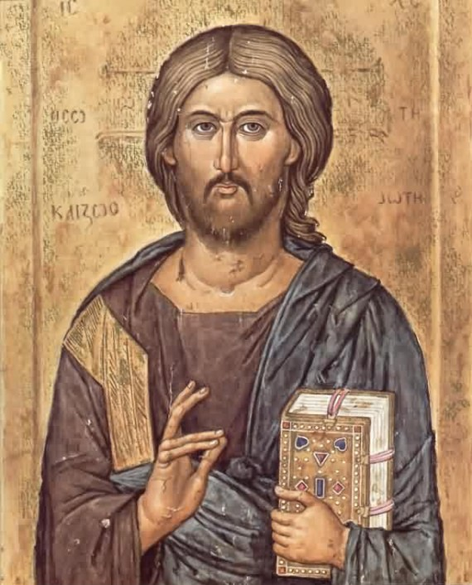
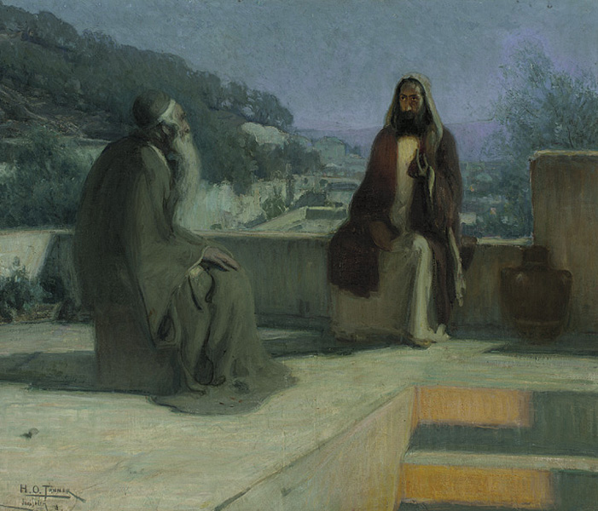
Representing Jesus
Look at the different images of Jesus.
Why do you think they show Jesus looking different or with different things?

Slide 10

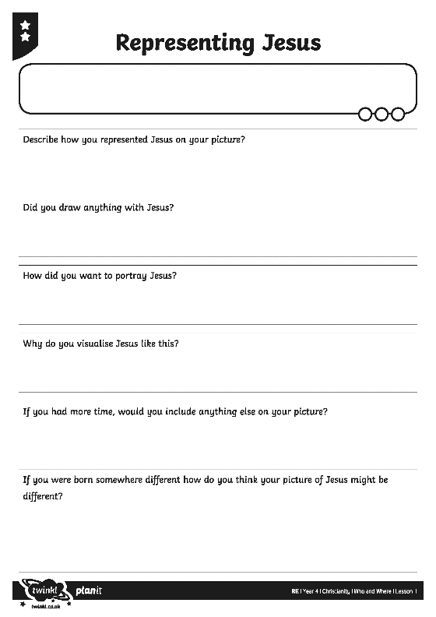
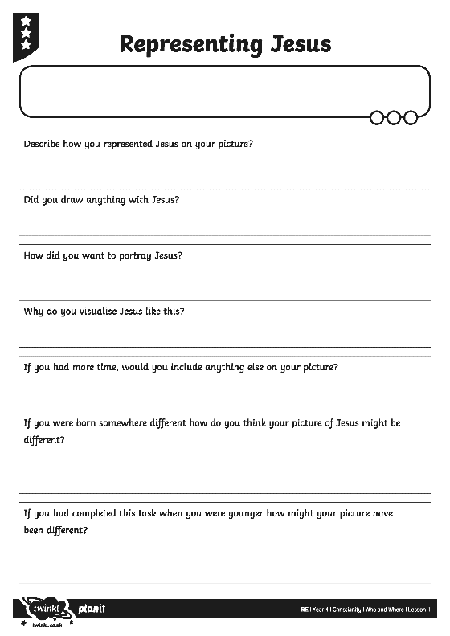

Representing Jesus
Create your own image of Jesus.
Think carefully about how you visualise him and how you will show that.

Slide 11

Representing Jesus
Did you draw anything with Jesus?
Why is Jesus an important person to Christians?

