Slide 1


Slide 3
10 × 18 × 10 =
95 × × 10 = 950
What is 10 times greater than 34?
4) 570 is 10 times greater than what number?

Slide 4
10 × 18 × 10 =
95 × × 10 = 950
What is 10 times greater than 34?
4) 570 is 10 times greater than what number?
1,800
1
340
57

Slide 6
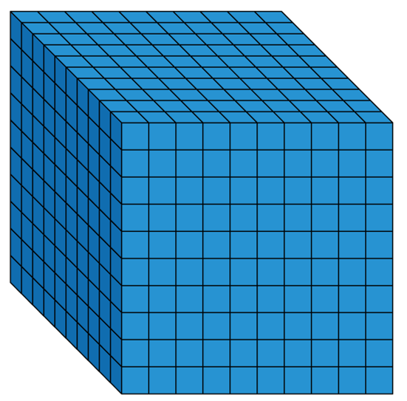
1 thousand
6 times
6 × 1 thousand =
6 thousands
6 × 1,000 =
6,000
1,000 × 6 =
6,000

Slide 7

Have a think
Th | H | T | O
7
8
Th | H | T | O
78 × 10 =
780
7
8
0
Th | H | T | O
78 × 100 =
7,800
7
8
0
0
TTh | Th | H | T | O
78 × 1,000 =
78,000
7
8
0
0
0
What stays the same? What changes?

Slide 8
Have a think
1) To multiply a number by 10 each digit moves
to the left on a place value grid.
1
2) To multiply a number by 100 each digit moves
to the left on a place value grid.
2
3) To multiply a number by 1,000 each digit moves
to the left on a place value grid.
3

Slide 9
× 1,000 = 52,000
52
What number, when it is made 1,000 times greater, is equal to 52,000?
TTh | Th | H | T | O
5
2
0
0
0
171
Have a think
1) 1,000 × = 171,000
41 × 10 × 10 × 10 =
2) 792 × 1,000 =
792,000
41 × 1,000 =
41,000
3) 10 × 41 × 10 × 10 =

Slide 10
Have a go at questions
1 - 7 on the worksheet

Slide 11
A small village primary school has 22 pupils.
A high school has 100 times as many pupils.
How many pupils attend the high school?
2,200 pupils
Have a think
× 100 =
22
2,200

Slide 12
Have a think
1) On Friday a shop sells 432 sandwiches.
  On Saturday the shop sells 10 times as many sandwiches.
  How many sandwiches does the shop sell on Saturday?
4,320 sandwiches
432 × 10 =
2) A baby walked 9 metres.
Alex ran 9,000 metres.
How many times further did Alex run?
9 × _____ = 9,000
1,000 times further
1,000

Slide 13
Have a go at questions
8 - 10 on the worksheet

