Slide 1
Christianity
A Paralysed Man
The Miracle Maker
Names of Jesus

Slide 2
RECAP
What is the significance of Jesus’ death?
Part of God’s divine plan to save humanity.
Christians believe that God sent Jesus to live as a human being in order to save humanity from the consequences of its sins.
Understanding Christian’s relationship with God
Worship
Singing to communicate with God
All ages can take part in worship when Christians go to church
Prayer (for support, forgiveness, guidance)
Holy communion

Slide 3
RECAP
Confession and Absolution
Four stages of forgiveness (Catholic Christians)
  Contrition- feeling remorseful
  Confession- saying sorry for sins to a priest at church
  Satisfaction- tasks given to achieve forgiveness (penance)
  Absolution- released from the feeling of guilt
Jesus ‘Prince of Peace’
Jesus Christ is called the Prince of Peace because He restores every broken relationship and allows us to live peacefully with God.

Slide 4
Today’s lesson:
We are going to focus on Jesus in more depth today.
We will look at the Bible story ‘A Paralysed Man’.
Think about forgiveness in this story.
We will then look at Jesus as ‘The Miracle Maker’.
Think about how Jesus can be seen as a rescuer/saviour.
Lastly, we will look at the many titles used for Jesus.

Slide 5
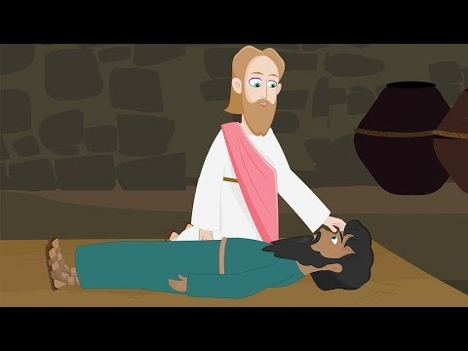
The Paralysed Man
https://www.youtube.com/watch?v=mfxTCr34mZI
Notes:
https://www.youtube.com/watch?v=mfxTCr34mZI

Slide 6
Think about The Paralysed Man story.
Make some notes on your thoughts to answer these questions.
What happened in this story?
What does the man need saving from?
How is the man being saved?
Why are the people angry with Jesus for forgiving the man’s sins?
What does this story show us about forgiveness? (There is no right or wrong answer, I want to know your thoughts).

Slide 7
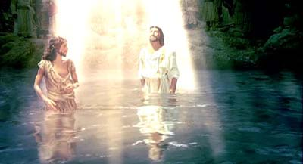
Jesus as ‘The Miracle Maker’.
Jesus’ Baptism
https://www.youtube.com/watch?v=JZ5jm5Ix5bY

Slide 8
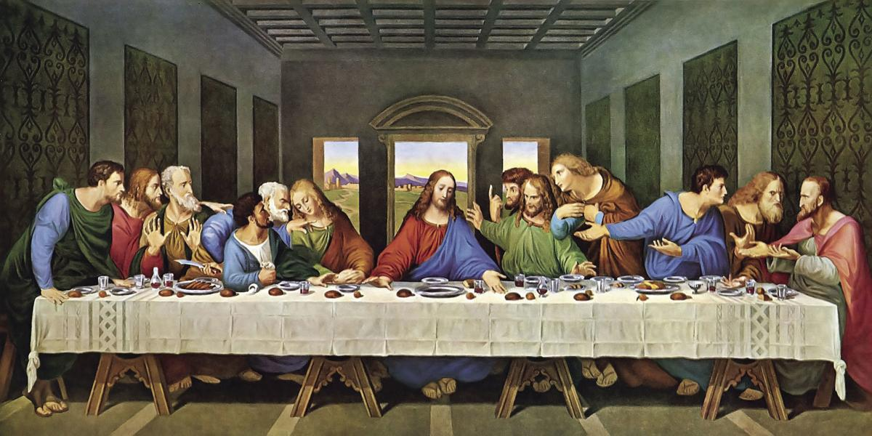
Jesus as ‘The Miracle Maker’.
The Last Supper
https://www.youtube.com/watch?v=UaiYNF5uchA

Slide 9
Think about Miracle Maker stories.
Make some notes on your thoughts to answer these questions.
You might like to do some further research on Jesus as the Miracle Maker to help you.
How can Jesus been seen as a miracle maker?
How can Jesus been seen as a rescuer/saviour?
What did Jesus sacrifice for mankind?

Slide 10
Titles used for Jesus
Son of God
Son of Man
Saviour
Suffering Servant
Teacher
King
Christ child
Friend of Sinners
Good Shepard

Slide 11
Titles used for Jesus
I have created a page of images of Jesus.
Think about which images match with which title of Jesus.
Briefly explain your choice of title and image.

