Slide 1
Multiply and Divide by 100

Slide 3

10 × 87 =
cm = 3 m
${\text{5}}^{\text{2}}$ =
5 × 37 × 2 =

Slide 4
10 × 87 =
cm = 3 m
${\text{5}}^{\text{2}}$ =
5 × 37 × 2 =
870
300
25
370

Slide 6
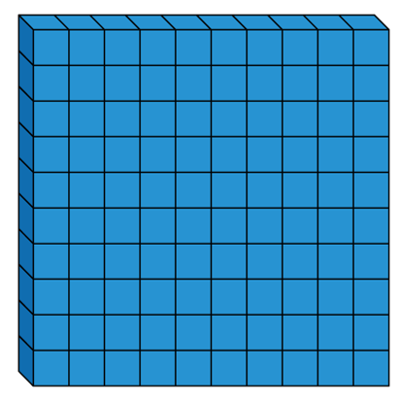
1 hundred
5 times
5 × 1 hundred =
5 hundreds
5 × 100 =
500
100 × 5 =
500

Slide 7

Have a think
6 × 100 × 9 =
6 × 9 × 100 =
54
54 × 100 =
5,400

Slide 8
× 100 = 1,300
13
What number, when it is made 100 times greater, is equal to 1,300?
Th | H | T | O

Slide 9
Have a think
1) = 100 × 44
4,400
2) 100 × = 5,100
51
2
3) 6 × 100 = 3,600
1,500
4) 100 × 13 = - 200

Slide 10
How many centimetres are equal to 7 metres?
Have a think
What key fact do we need to answer this question?
1 m = 100 cm
100 cm
100 cm
100 cm
100 cm
100 cm
100 cm
100 cm
100 × 7 =
700 cm

Slide 11
=
50 × 100 10 × 500
5,000
5,000
<
10 × 49 48 × 100
Have a think
=
1) 10 × 29 × 10 50 × 29 × 2
100 × 29
100 × 29
>
2) 100 × 91 92 + 100

Slide 12

Tommy has some 100s pieces in base 10
He has 23
What number has he made?
100
23 times
100 × 23 =
2,300

Slide 13
Tommy changes the pieces that he has.
He now has 47 pieces in total.
21 of his pieces are 10s and the rest are 100s
What number has he made?
Have a think
10
21 times
21
10s
10 × 21 =
210
47
100
26 times
26
100s
100 × 26 =
2,600
210 + 2,600 =
2,810

Slide 14
Dividing by 100

Slide 15

3
300 ÷ 100 = ___
300 = 3 groups of 100
7
700 ÷ 100 = ___
700 = 7 groups of 100
1,000 ÷ 100 = ___
10
1,000 = 10 groups of 100
30
3,000 ÷ 100 = ___
3,000 = 30 groups of 100

Slide 16
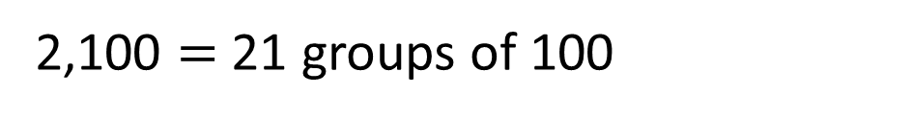
21
2,100 ÷ 100 = ___
2,100 = 2 thousands + 1 hundred
1 thousand = 10 hundreds
2 thousands = 20 hundreds
There are 21 hundreds altogether.
2,100 $=$ 21 groups of 100

Slide 17

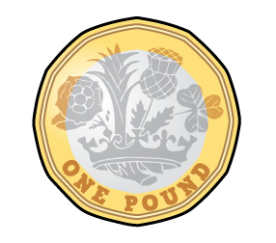
Eva has three hundred 1p coins.
How many £1 coins is this equal to?
3
300p
100p
100p
100p
300 ÷ 100 = 3

Slide 18
Th | H | T | O
100 times
the size
100 times
the size

Slide 19
Th | H | T | O
One hundredth
the size
One hundredth
the size
To find one hundredth, we divide by 100

Slide 20




$×$ 100
$×$ 100
Th | H | T | O
$÷$ 100
$÷$ 100

Slide 21

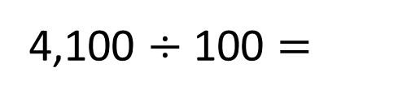

Th | H | T | O
$÷$ 100
$÷$ 100
4,100 $÷$ 100 =
4
1
41 is one hundredth the size of 4,100

Slide 22
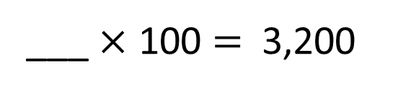

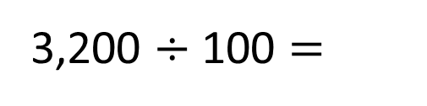

Th | H | T | O
$÷$ 100
$÷$ 100
32
___ $×$ 100 = 3,200
32
3,200 $÷$ 100 =
32 is one hundredth the size of 3,200

Slide 23


Th | H | T | O
$×$ 100
$×$ 100
32
___ $×$ 100 = 3,200
32
3,200 $÷$ 100 =
32 is one hundredth the size of 3,200
3,200 is one hundred times the size of 32

