Slide 1


Slide 3

1) 10 × 11 =
2) 11 × 10 =
3) 12 × 10 = $−$ 10
4) 5 × 2 = 2 ×

Slide 4

1) 10 × 11 =
2) 11 × 10 =
3) 12 × 10 = $−$ 10
4) 5 × 2 = 2 ×
110
110
130
5

Slide 6

1 ten
4 times
4 × 1 ten =
4 tens
40
4 × 10 =

Slide 7
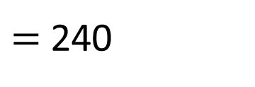
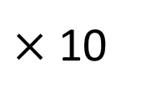
$×$ 10
24
$=$ 240
H | T | O

Slide 8

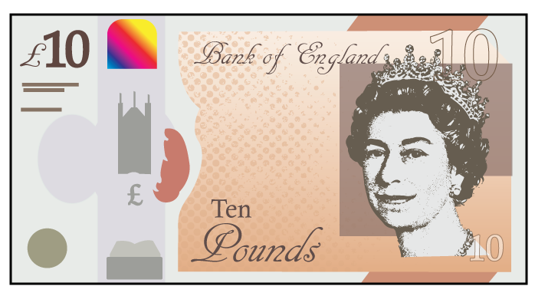
Have a think
Jack has 7 £10 notes.
How much money does Jack have?
7 × £10 =
£70

Slide 9
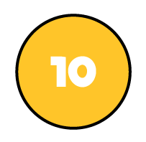


H | T | O
Each row has 2 tens and 1 one.
Each row has 21
There are 10 rows.
The calculation is
21 × 10 =
210

Slide 10
H | T | O
Have a think
Each row has hundreds.
2
Each row has tens.
0
Each row has ones.
3
There are rows.
10
The calculation is
× =
203
10
2,030

Slide 11
Have a go at questions
1 - 7 on the worksheet

Slide 12
Have a think
× 77 =
770
2 × 5
10
Have a think
270
360
_____ = 5 × 27 × 2
_____ = 36 × 2 × 5
_____ = 5 × 24 × 2
5 × 2 × 190 =
1,900
240
_____ = × 24
5 × 2
10

Slide 13
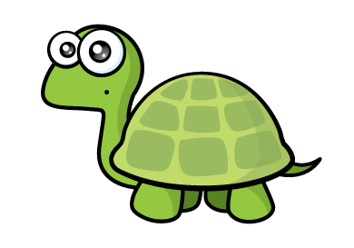
Whitney has 81 points.
Alex has 10 times as many points as Whitney.
810
How many points does Alex have?
Alex has 91 points because 81 add 10 is equal to 91
Have a think
81 × 10 =
810

Slide 14
Have a go at questions
8 - 11 on the worksheet

