Slide 1


Slide 3
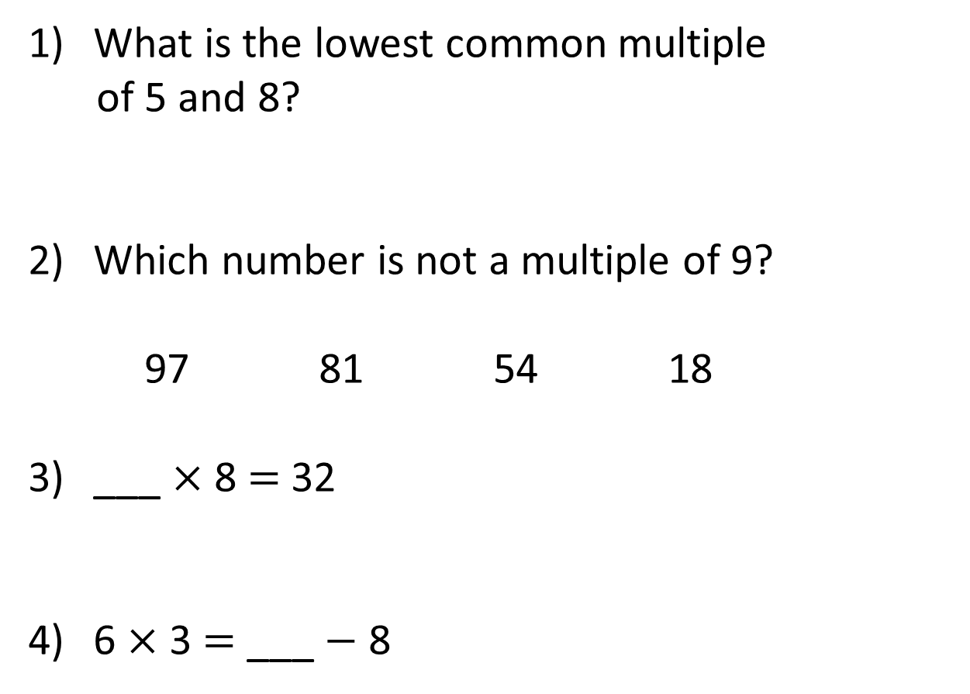
What is the lowest common multiple
of 5 and 8?
Which number is not a multiple of 9?
97 81 54 18
___ × 8 = 32
6 × 3 = ___ $−$ 8

Slide 4
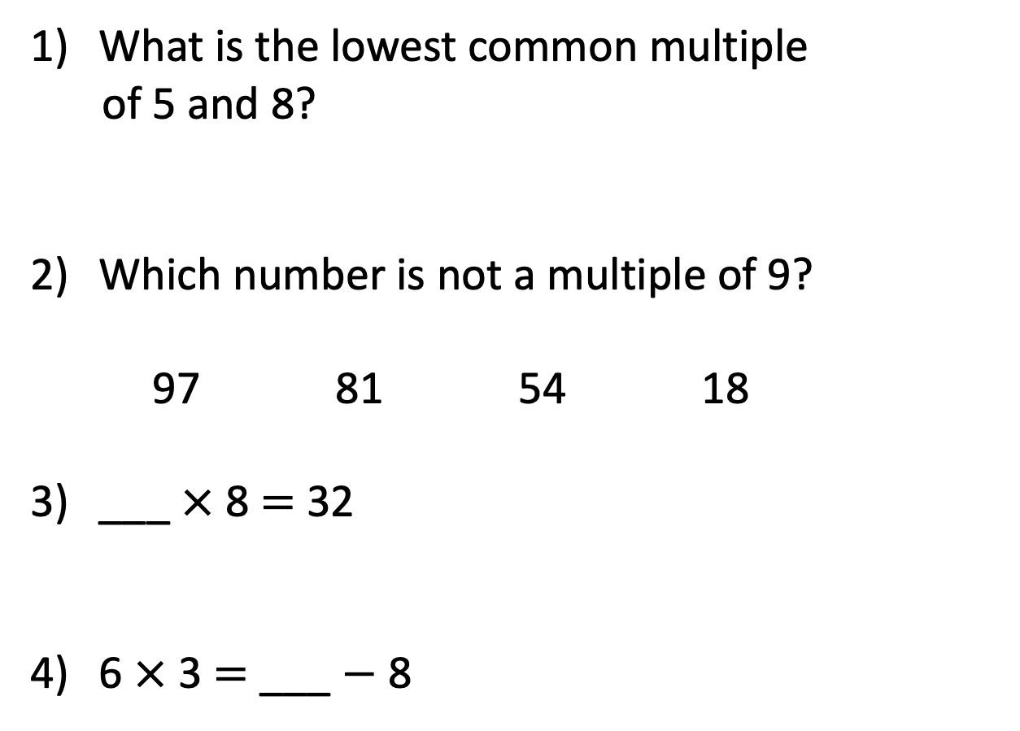
What is the lowest common multiple
of 5 and 8?
Which number is not a multiple of 9?
97 81 54 18
___ × 8 = 32
6 × 3 = ___ $−$ 8
40
4
26

Slide 6

What is a factor?
2 rows of 3 are equal to 6
2 × 3 = 6
3 columns of 2 are equal to 6
3 × 2 = 6
2 and 3 are factors of 6
Have a think
Are there any other factors of 6?

Slide 7
1 row of 6 is equal to 6
1 × 6 = 6
6 columns of 1 are equal to 6
6 × 1 = 6
1 and 6 are factors of 6
The factors of 6 are: 1, 2, 3 and 6

Slide 8
18 × 1
9 × 2
Factor pair
18
3 × 6
6 × 3
The factors of 18 are: 1, 2, 3, 6, 9 and 18

Slide 9
Have a think
__ × 1
10 × 2
20
20
5 × 4
1, 2, 4, 5, 10 and 20
The factors of 20 are: _________________

Slide 10
Have a think
25 × 1
25
5 × 5
1, 5, 5 and 25
1, 5 and 25
The factors of 25 are: _________________

Slide 11
Have a go at questions 1 to 4 on the worksheet

Slide 12
1, 3 and 7 are all factors of a number between 40 and 50
Have a think
What is the number?
42
The number must be a multiple of 3 and 7
3
6
9
12
15
18
21
24
27
30
33
36
7
14
21
28
35
42
49
56
63
70
77
84

Slide 13
List the factors of these numbers:
2
5
17
What do you notice?
29
1 and 2
Have a think
1 and 5
1 and 17
1 and 29
They all only have 2 factors

Slide 14

0.5 × 22 = 11
This means that 0.5 is a factor of 11
Factors have to be integers (whole numbers).
Have a think
What are the factors of 11?
1 and 11

Slide 15
Have a go at questions 5 to 9 on the worksheet

