Slide 1
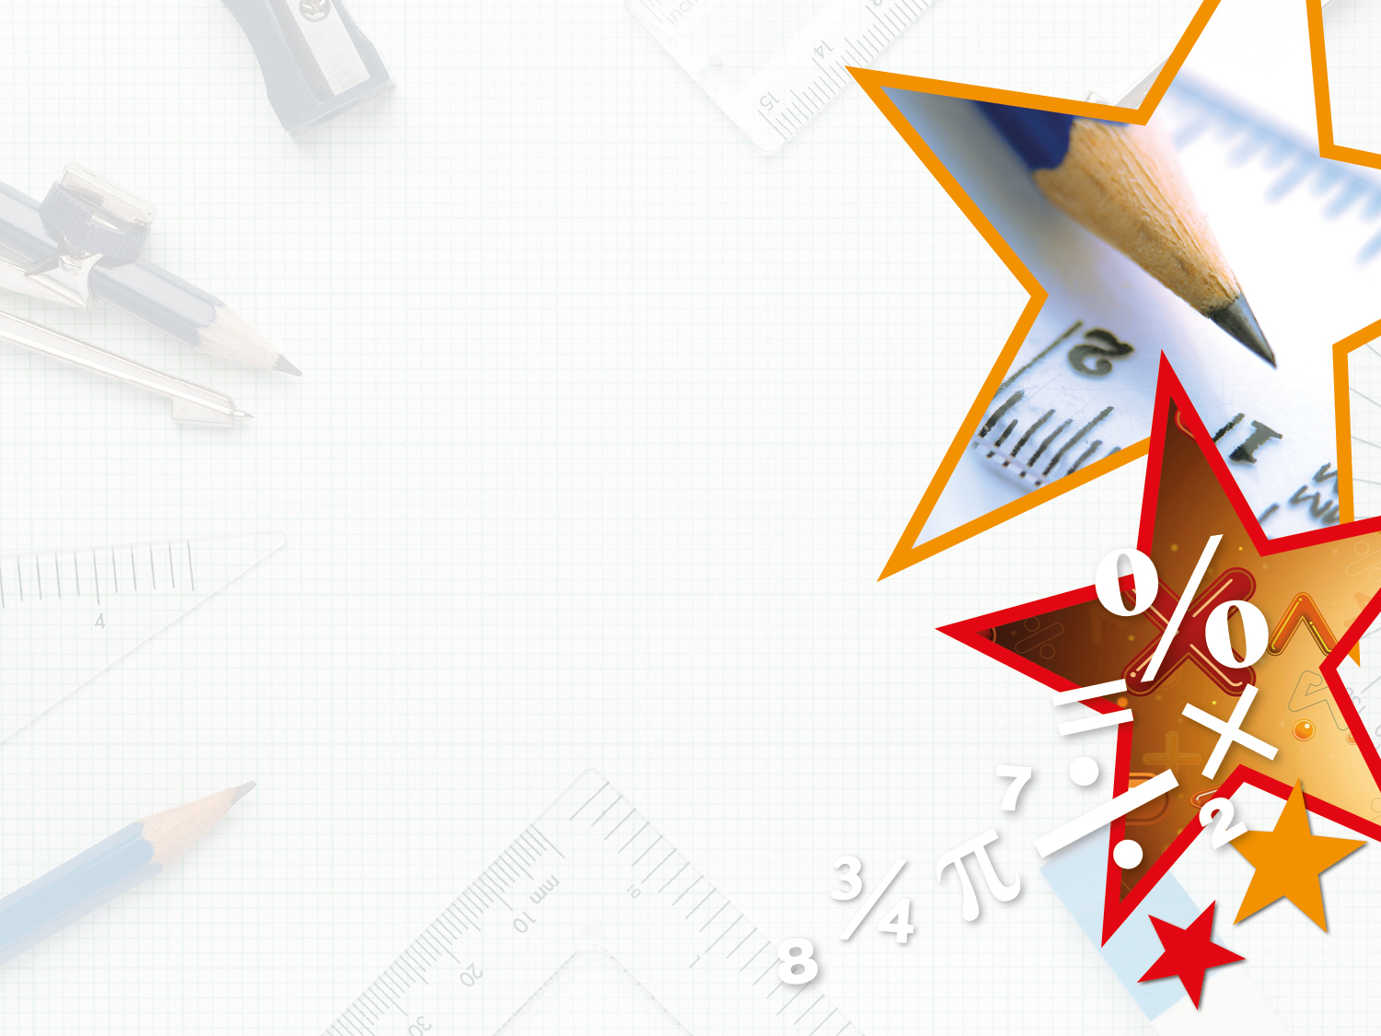

Horizontal and
Vertical
© Classroom Secrets Limited 2018

Slide 2
How many horizontal lines are there?
How many vertical lines are there?
© Classroom Secrets Limited 2018

Slide 3
How many horizontal lines are there?
How many vertical lines are there?
5 horizontal
© Classroom Secrets Limited 2018

Slide 4
How many horizontal lines are there?
How many vertical lines are there?
6 vertical
© Classroom Secrets Limited 2018

Slide 5
Fill in the table below.
Object | Type of lines – horizontal, vertical or both?
© Classroom Secrets Limited 2018

Slide 6
Fill in the table below.
Object | Type of lines –horizontal, vertical or both?
 | both
 | vertical
 | horizontal
 | both
© Classroom Secrets Limited 2018

Slide 7


Which of the images below has a vertical line of symmetry?
© Classroom Secrets Limited 2018

Slide 8

Varied Fluency 3
Which of the images below has a vertical line of symmetry?

© Classroom Secrets Limited 2018

Slide 9
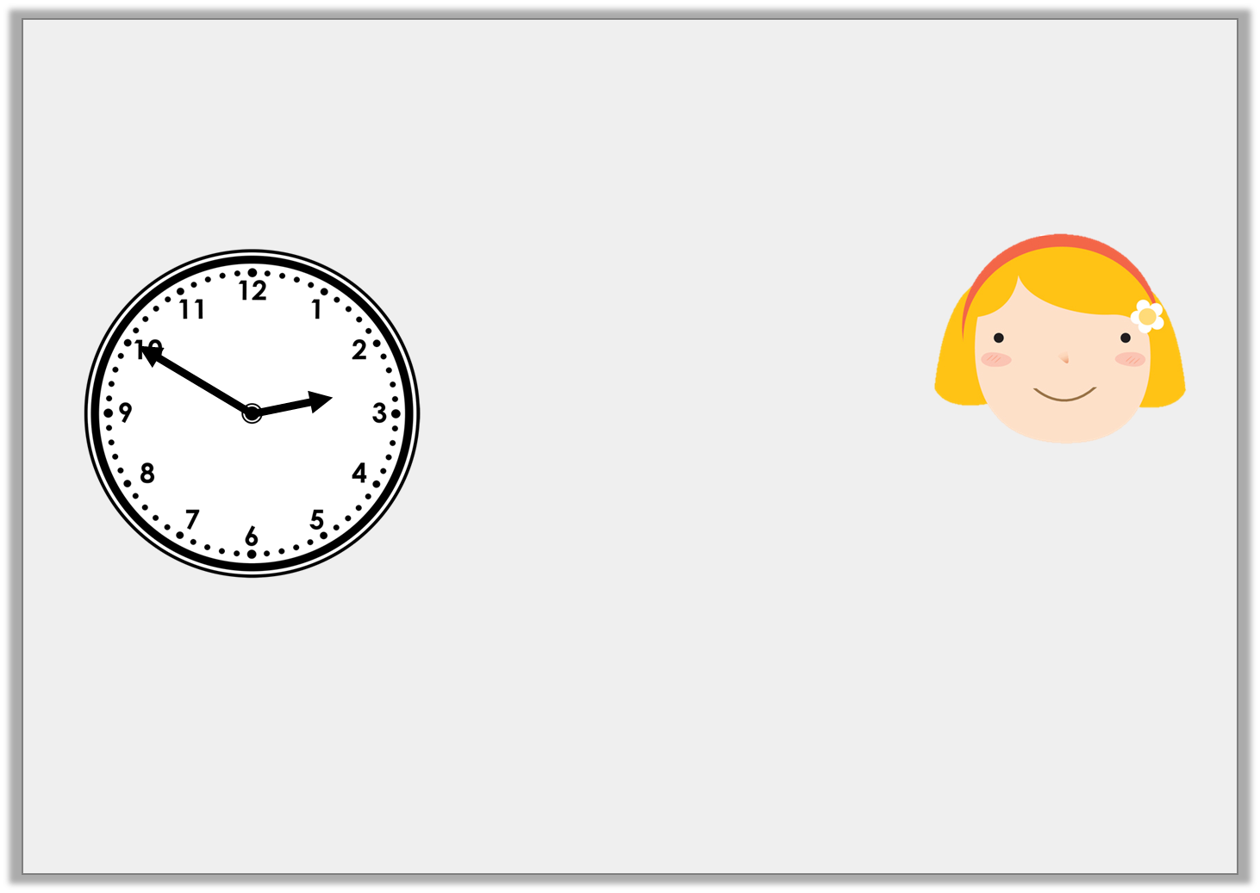
Ruby is looking for horizontal and vertical lines. The time is now:
Is she correct? Explain how you know.
In 10 minutes, one hand will be horizontal and one hand will be vertical.
© Classroom Secrets Limited 2018

Slide 10
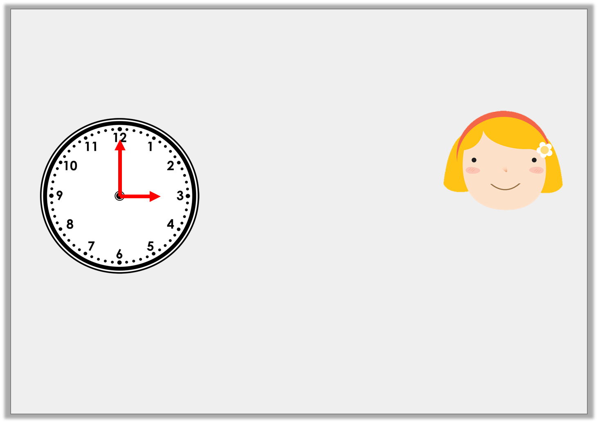
Ruby is looking for horizontal and vertical lines. The time is now:
Is she correct? Explain how you know.
Ruby is correct because at 3 o’clock the hour hand will be pointing to 3 so it will be horizontal and the minute hand will be pointing at 12 so it will be vertical.
In 10 minutes, one hand will be horizontal and one hand will be vertical.
© Classroom Secrets Limited 2018

Slide 11

Anna and her friends are writing their names in capital letters.
Which friend has more vertical lines in the
letters of their name than Anna?
ANNA
BILL
TANYA
KYLIE
© Classroom Secrets Limited 2018

Slide 12
Anna and her friends are writing their names in capital letters.
Which friend has more vertical lines in the
letters of their name than Anna?
4
ANNA
4
BILL
4
5
TANYA
KYLIE
© Classroom Secrets Limited 2018

Slide 13
Considering the lines of symmetry, which shape
is the odd one out?
Explain your answer.
T
+
© Classroom Secrets Limited 2018

Slide 14
Considering the lines of symmetry, which shape
is the odd one out?
Explain your answer.
The cross is the odd one out because it is the only shape with a horizontal and a vertical line of symmetry.
T
+
© Classroom Secrets Limited 2018

