Slide 1

Friday 26th June
Maths
I can’t believe that it is Friday already!
As reading time to the nearest 5 minutes is quite tricky, we are going to continue to practise this today. If you want to look over the powerpoint from yesterday to remind yourself then you can.
There are some activities on this powerpoint for you to try. There is even a challenge if you are feeling up for it!
There is a My Maths lesson that you might want to look at (optional) – Telling the time to 5 mins. You might need the school log in details which should be on your log in card.
https://app.mymaths.co.uk/5936-lesson/telling-the-time-to-5-mins

Slide 2
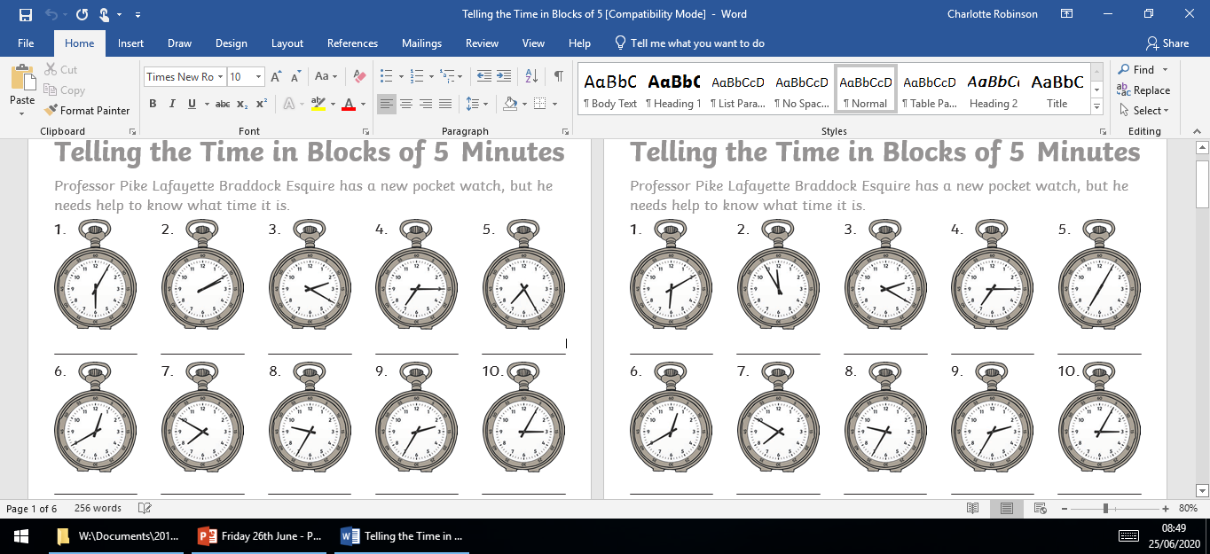

Slide 3
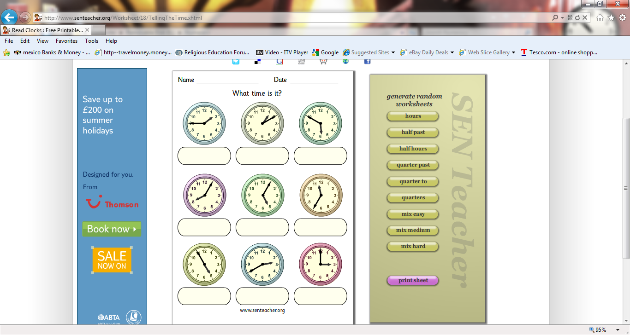

Slide 4
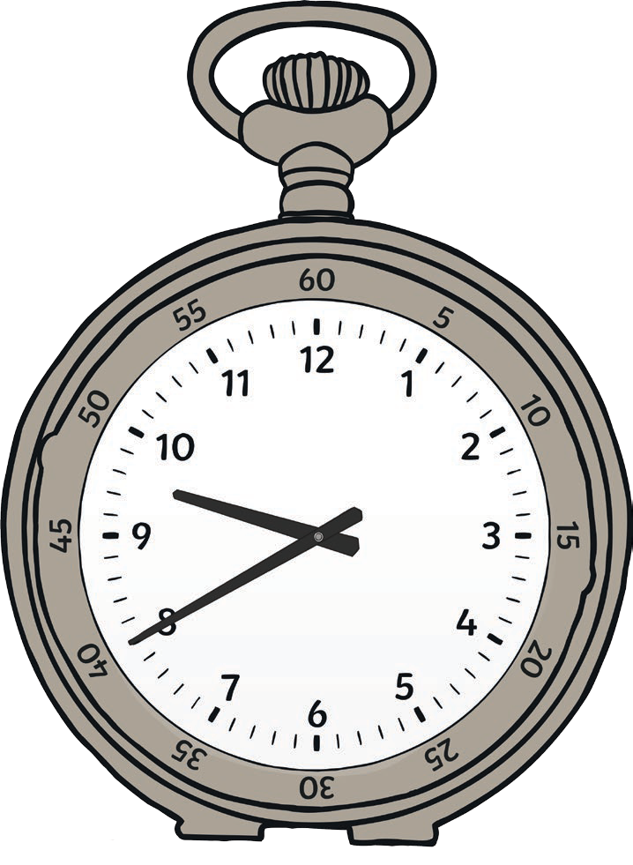
Challenge
Professor Pike’s pocket watch never tells the correct time! What time will the watch says if the real time was: 20 minutes to 10?
5 minutes slow
15 minutes fast
10 minutes slow
20 minutes fast
15 minutes slow
25 minutes fast ________________

Slide 5
Ready for some
answers?

Slide 6
Answers
5 minutes past 6
10 minutes past 2
20 minutes past 2
quarter past 7
25 minutes past 7
20 minutes to 1
10 minutes to 8
25 minutes to 10
25 minutes to 3
5 minutes past 3

Slide 7
Answer
s
5 minutes past 8
5 minutes past 5
25 minutes to 12
Quarter to 2
5 minutes to 5
20 minutes to 3
3 o’clock
10 minutes past 1

Slide 8
Challenge
Answers
Professor Pike’s pocket watch never tells the correct time! What time will the watch says if the real time was: 20 minutes to 10?
5 minutes slow
15 minutes fast
10 minutes slow
20 minutes fast
15 minutes slow
25 minutes fast ________________
25 minutes to 10
5 minutes to 10
Half past 9
10 o’clock
25 minutes past 9
5 minutes past 10

Slide 9

Friday 26th June
Maths
I have also uploaded some extra sheets if you would like some more practise. This is only if you want to!
Don’t forget to spend some time on Prodigy. Let’s see who can get up there on the leader board this week!
Have a lovely weekend.
Miss Robinson

