Slide 1

Thursday 25th June
Maths
Great work telling the time using quarter past and quarter to. Remember there are lots of clocks and watches around for you to use to practise telling the time whenever you want. Also, you can use your home made clock to practise showing different times.
We are going to look at telling the time to 5 minutes today. Do you know how many minutes there are in an hour?
Use these slides to help you to practise telling the time to the nearest 5 minutes.

Slide 2
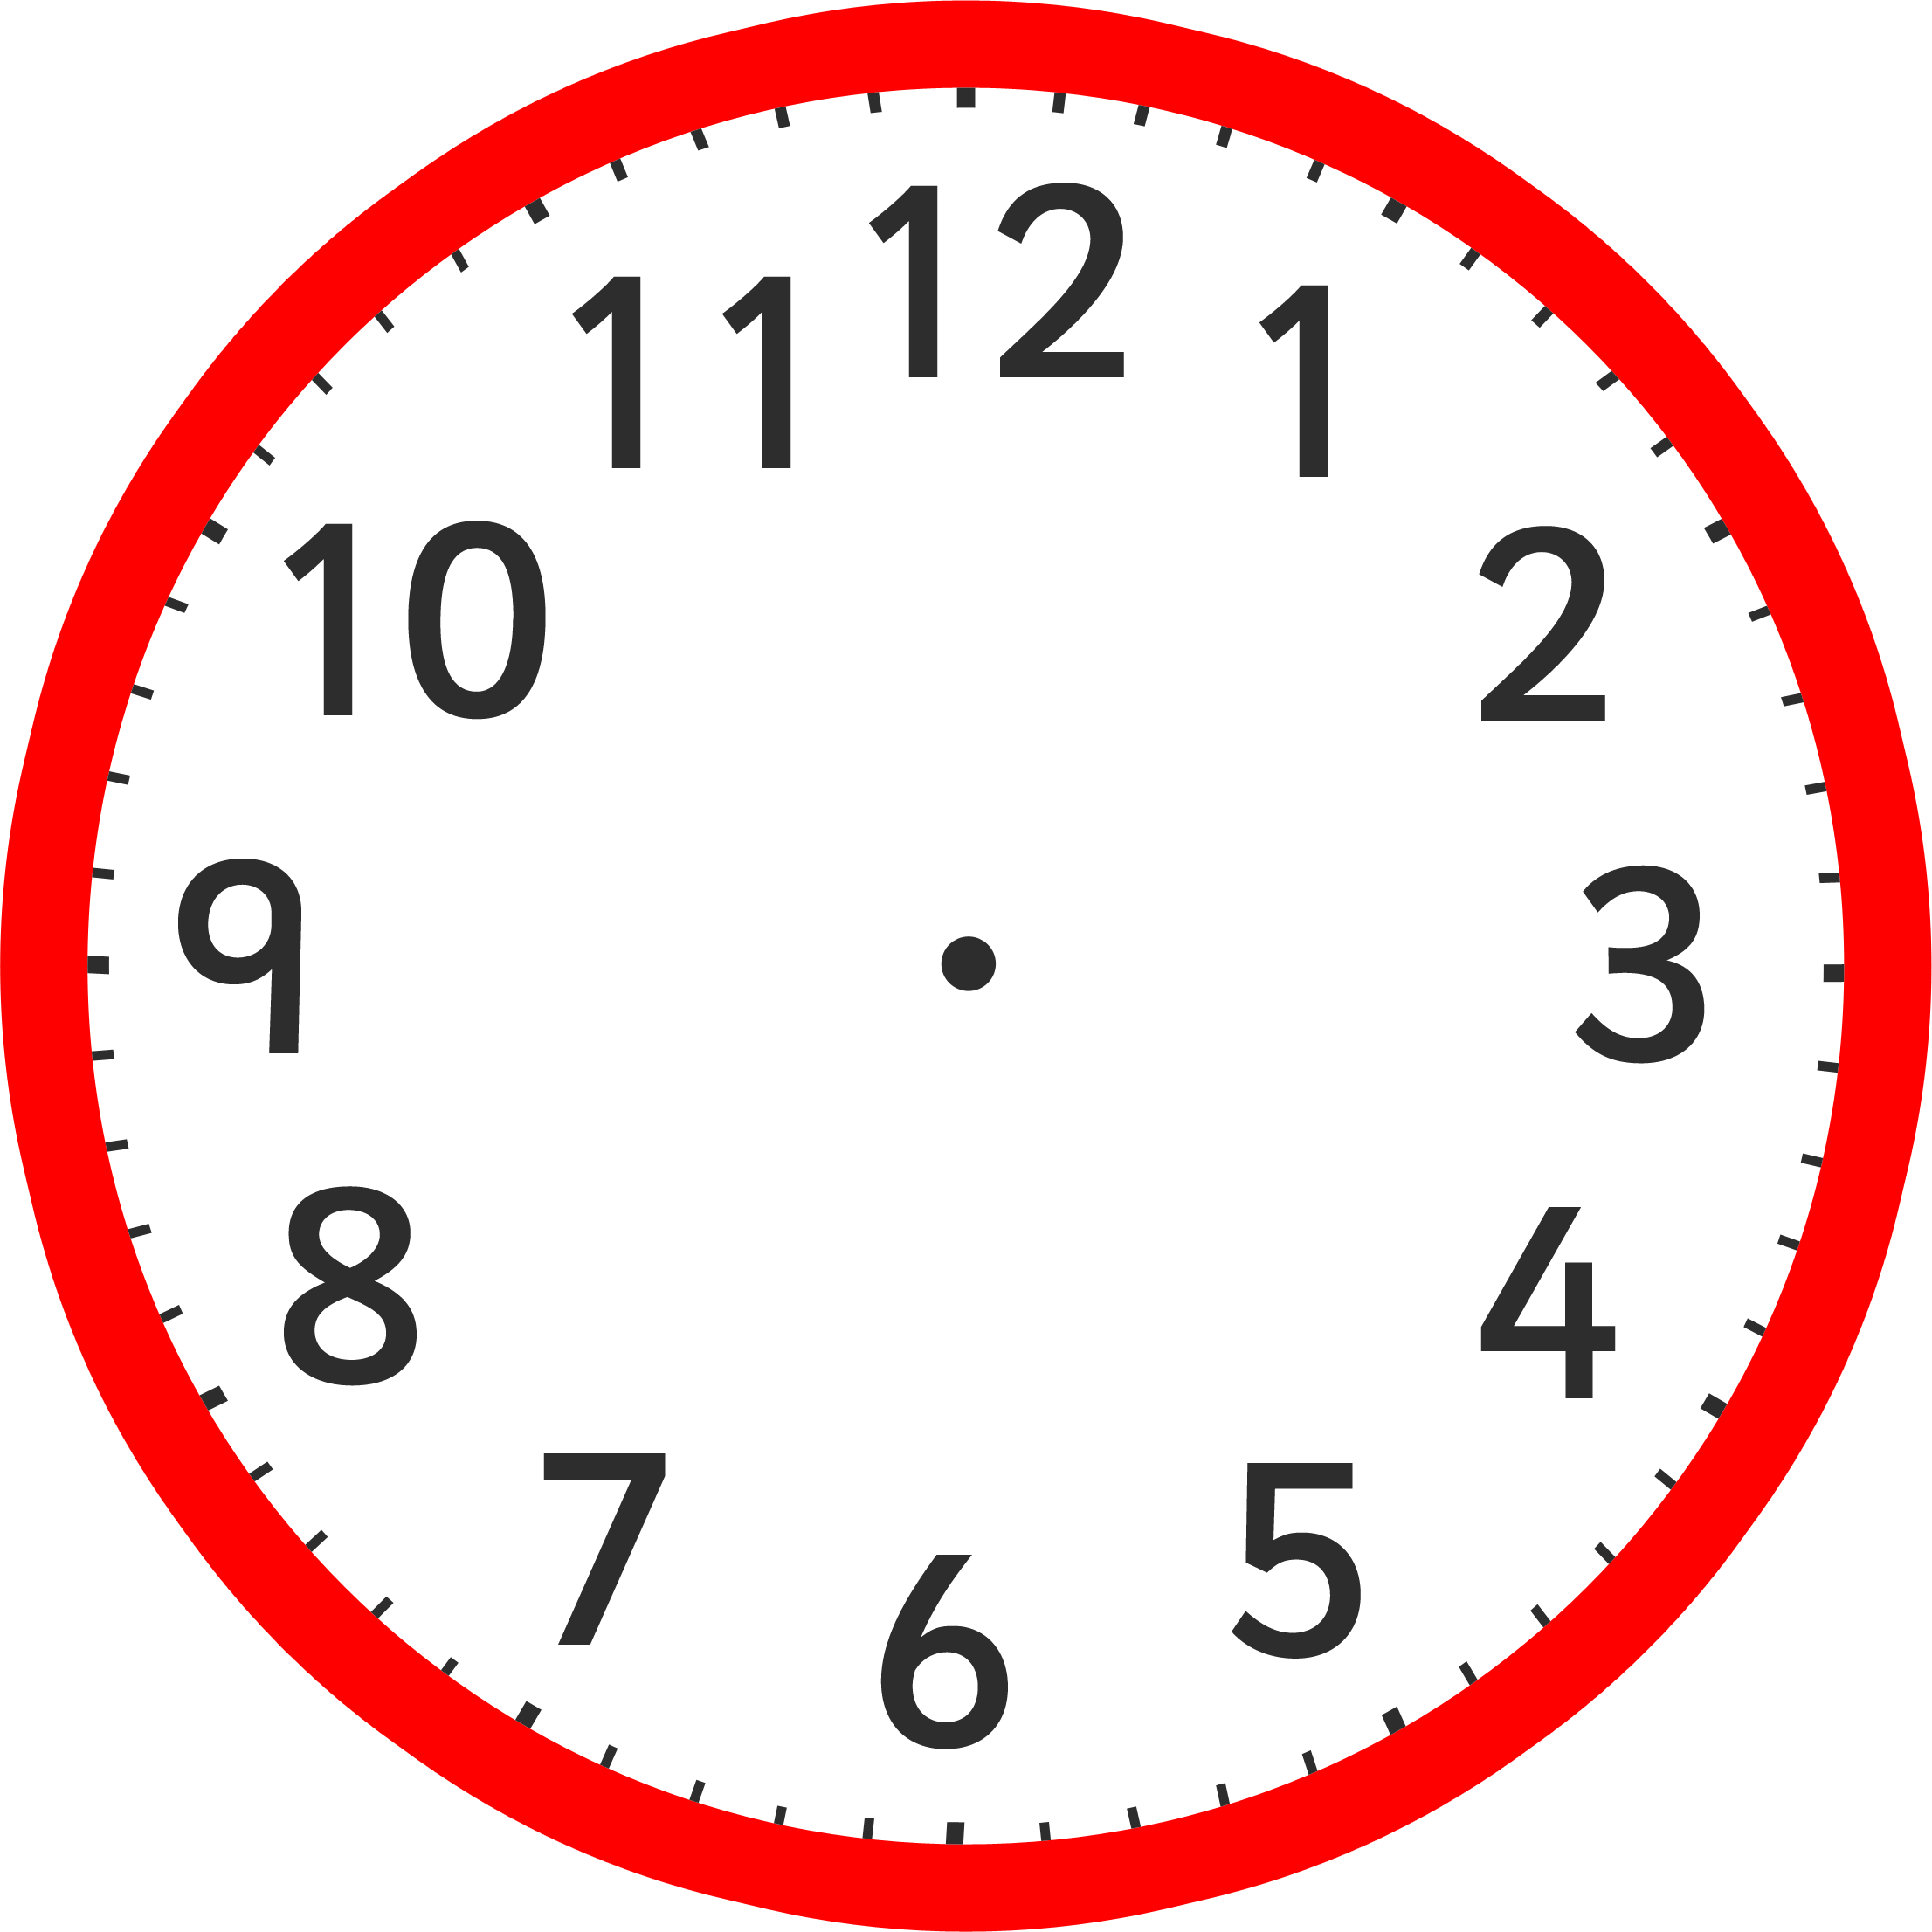

5
Telling the
Time in Blocks
Of 5 Minutes

Slide 3
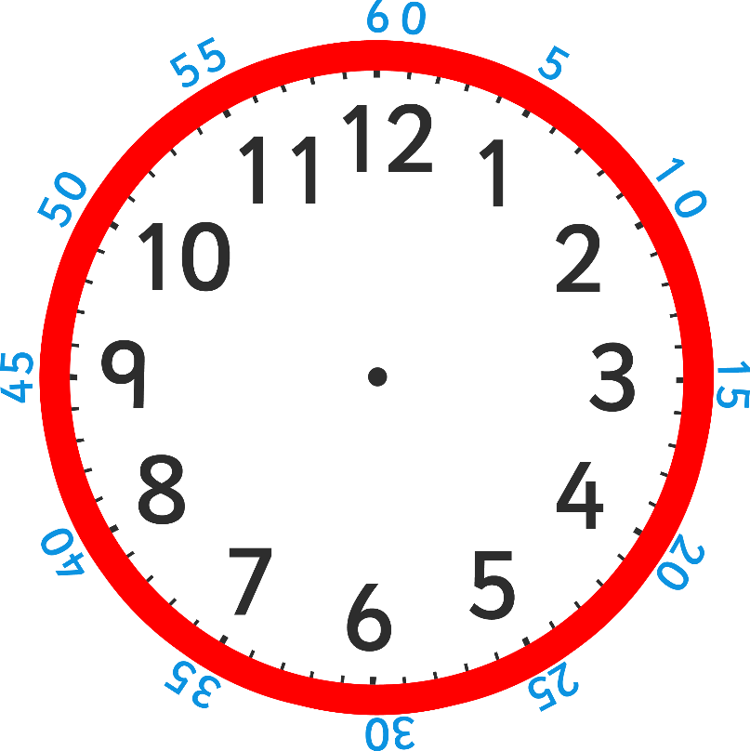
This clock shows the hours in black on the inside, and the minutes in blue around the outside (most clocks don’t show the minutes).

Slide 4
How many minutes past does the blue hand show?
Does it show 2 minutes past or 10 minutes past?

Slide 5
Black numbers are the hours and blue numbers are the minutes.
We read the time as ‘minutes past or to the hour’.
Think of it as ‘blue minutes past or to black’.
The time is 10 minutes past 12.

Slide 6
How many minutes past is the minute hand pointing to?
What time does the clock show?
(hint – blue past black )

Slide 7
The time is 20 minutes past 1.

Slide 8
What time is this clock showing us?

Slide 9
The time is 25 minutes past 3.

Slide 10
How many minutes past does the minute hand show?
What is the proper name for this?

Slide 11
The clock is showing 15 minutes past 1,
which is quarter past 1.

Slide 12
How many minutes past is this clock showing?
What is the proper name for this time?
Where is the hour hand pointing to?

Slide 13
The clock is showing 30 minutes past 10,
which is showing half past 10.

Slide 14
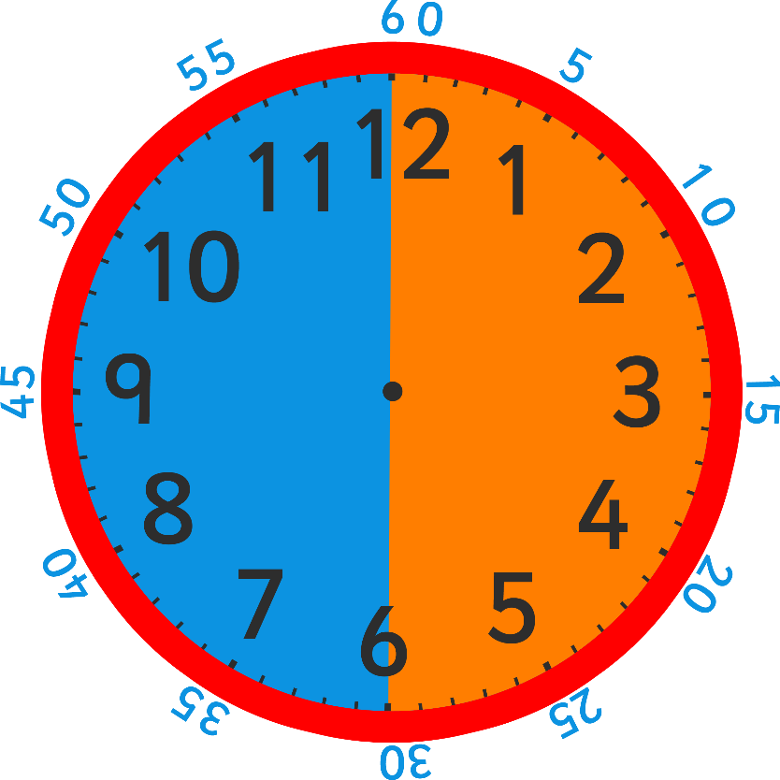
After the minute hand passes ‘half past’, the time stops being ‘minutes past’ and becomes ‘minutes to’.
This is slightly trickier because the minutes on the outside of the clock are still counting past the hour.
MINUTES
TO
MINUTES
PAST

Slide 15
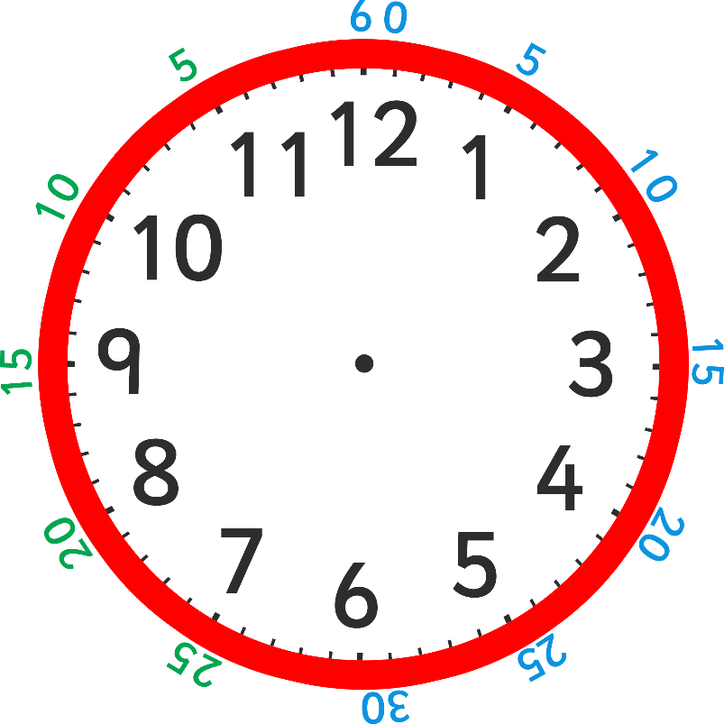
This clock makes it easier to read the minutes to the hour because all the numbers in green show the minutes to the hour.
The time will now be ‘green minutes to black’.
How many minutes is it to the hour?
What time is this clock showing us?

Slide 16

How many minutes to does the minute hand show?
What time is it?

Slide 17
What time is it?
The clock is showing 10 minutes to 8.

Slide 18
How many minutes to is the minute hand showing?
What is the proper name for this time?

Slide 19
The clock is showing 15 minutes to 5,
which is quarter to 5.

Slide 20


Which clock shows 10 minutes to 2?
Which clock shows 25 minutes past 11?
Which clock shows 25 minutes to 11?

Slide 21

Thursday 25th June
Maths
I have a number of challenges for you to choose from. You may even choose to do more than one!
Challenge 1 – o’clock, half past, quarter past and quarter to.
Challenge 2 – Reading the time to the nearest 5 minutes up to half past.
Challenge 3 – Reading the time to the nearest 5 minutes after half past.
Challenge 4 – Reading the time to the nearest 5 minutes.
Have fun!

