Slide 1

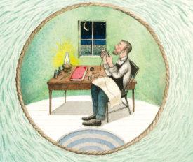
Good morning Year 2 Thursday 25th June
English
Enjoy the story here: https://www.youtube.com/watch?v=LZIrlGnXNlM
The lighthouse keeper writes in a log book everyday. A diary is like a log book but with more personal thoughts and feelings included.
Watch the story and then choose an important moment.
Think about what it would be like if you were the lighthouse keeper.
I’m going to choose this moment.
The new lighthouse keeper has arrived and is settling in on his first night.

Slide 2

English Thursday 25th June
Can you remember the features of diary writing?
Dates – I will make one up!
Personal feelings emotions
Past tense verbs
First person – I, me, my (I am pretending to be the lighthouse keeper)
Time connectives – when, this morning, then, next
Events in order
Thursday 25th June 1923
It was an early start this morning. So glad I packed my belongings last night. The crossing in the ship was calm and I actually saw a dolphin swimming alongside. Swinging across in the bosun’s chair was fun today, better than the usual swinging, spray soaked experience.
The storeroom is tidier than last time. I’ve checked, counted and stacked the barrels and boxes. I’m only here for 3 months but I’m sure there’s enough food for 6.
Now you try. You are the lighthouse keeper. Write a diary for a moment in the story.

Slide 3
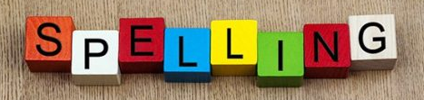
Thursday 25th June
English
Handwriting Use the handwriting paper on our Year 2 class page to practise your handwriting, especially if there is a letter or a word, you are not happy with. Careful with size and shape.
Spelling Practise your spellings. This week we are using ‘tion’ at the end of a word. Keep practising. Which method of practising suits you best?
https://www.educationquizzes.com/ks1/english-spelling/year-2-words-ending-in-tion/ Take a spelling quiz to support your learning.

Slide 4

Thursday 25th June
Maths
Miss Robinson has set you some maths for today.
Don’t forget to check in to Prodigy for 20 mins each day. I can see how many questions you try and how many you get right. Great work everyone on Prodigy – keep it going.

