Slide 1

Wednesday 24th June
Maths
We are going to continue practising telling the time today. I have some problems for you to try as well as some more practise telling the time from a clock.
There are some activities to try on this powerpoint and then some challenges to try.
I have also uploaded some extra telling the time sheets if you would like to practise reading the times.

Slide 2
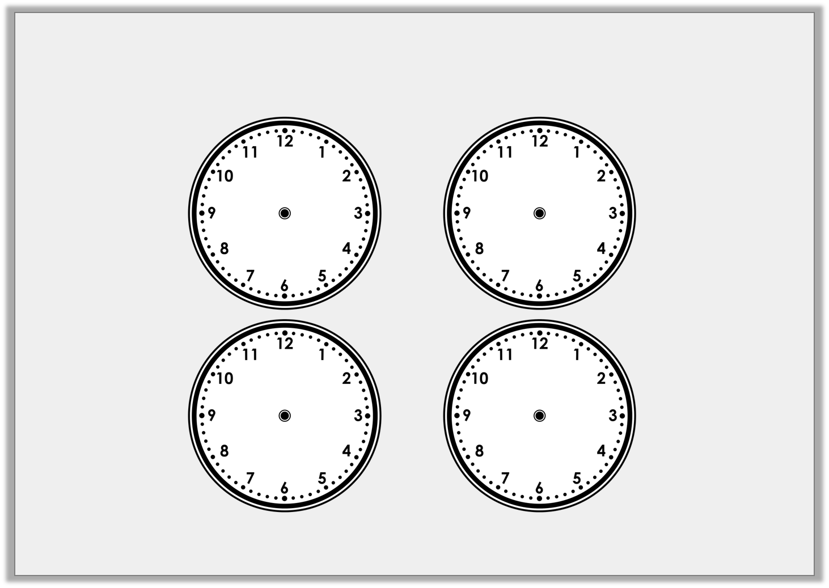

Look at minute hand to help you label the time each clock is showing.
quarter past
quarter to
half past
o’clock
© Classroom Secrets Limited 2018

Slide 3
o’clock
quarter past
half past
quarter to
© Classroom Secrets Limited 2018

Slide 4
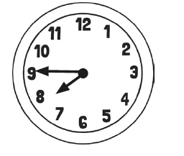
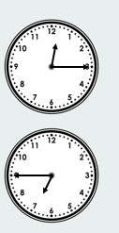
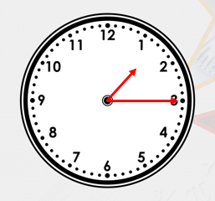
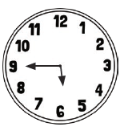
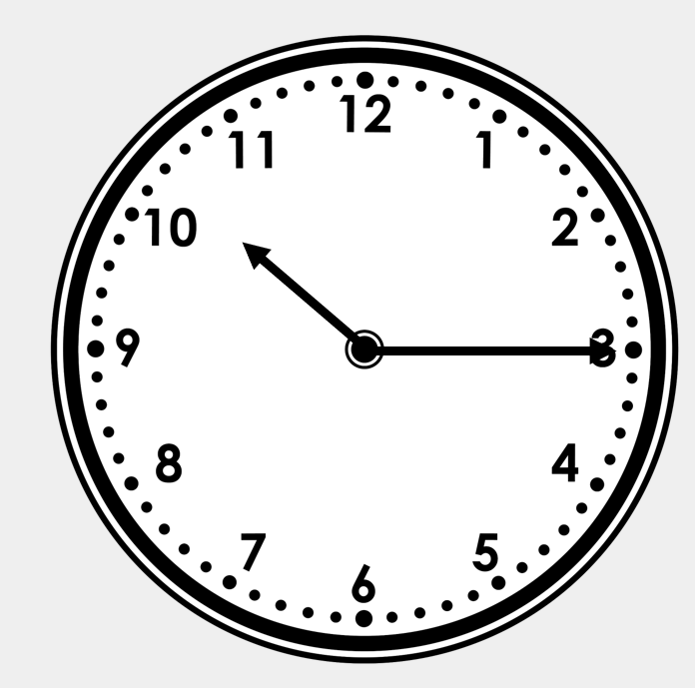
What time is it?
© Classroom Secrets Limited 2018

Slide 5
What time is it?
Quarter to 8
Quarter past 12
Quarter to 6
Quarter to 7
Quarter past 1
Quarter past 10
© Classroom Secrets Limited 2018

Slide 6
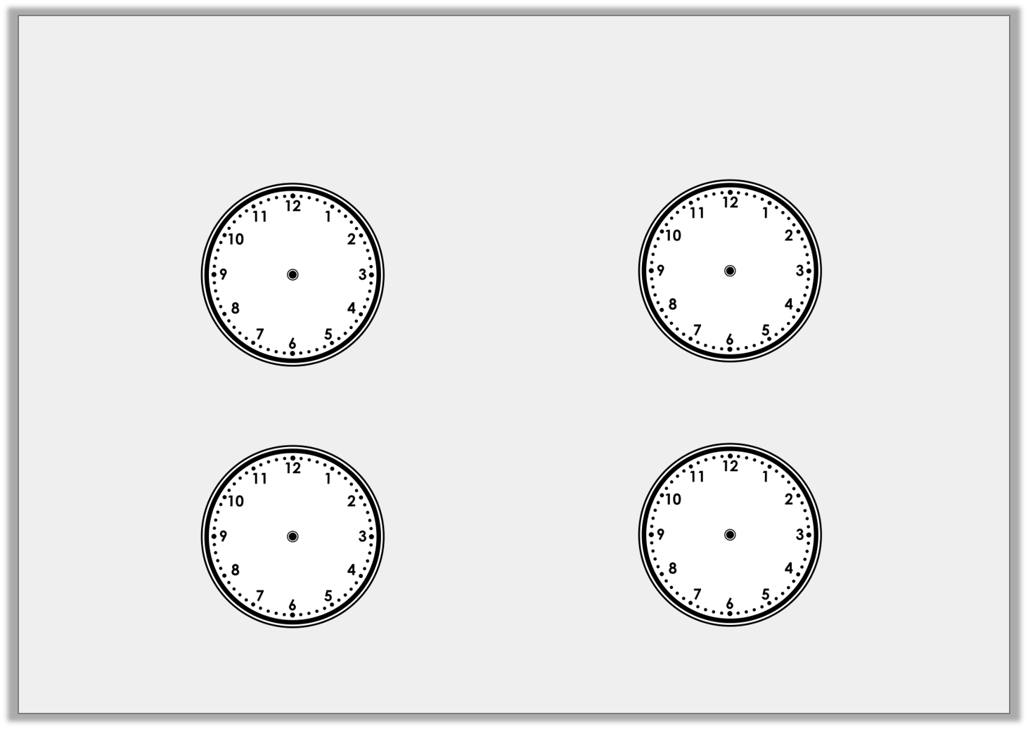
Where will the minute hand will be in 15 minutes time (a quarter turn)?
Half past 10 |  | Quarter to 11
8 o’clock |  | Quarter past 8
© Classroom Secrets Limited 2018

Slide 7
Half past 10 |  | Quarter to 11
8 o’clock |  | Quarter past 8
© Classroom Secrets Limited 2018

Slide 8
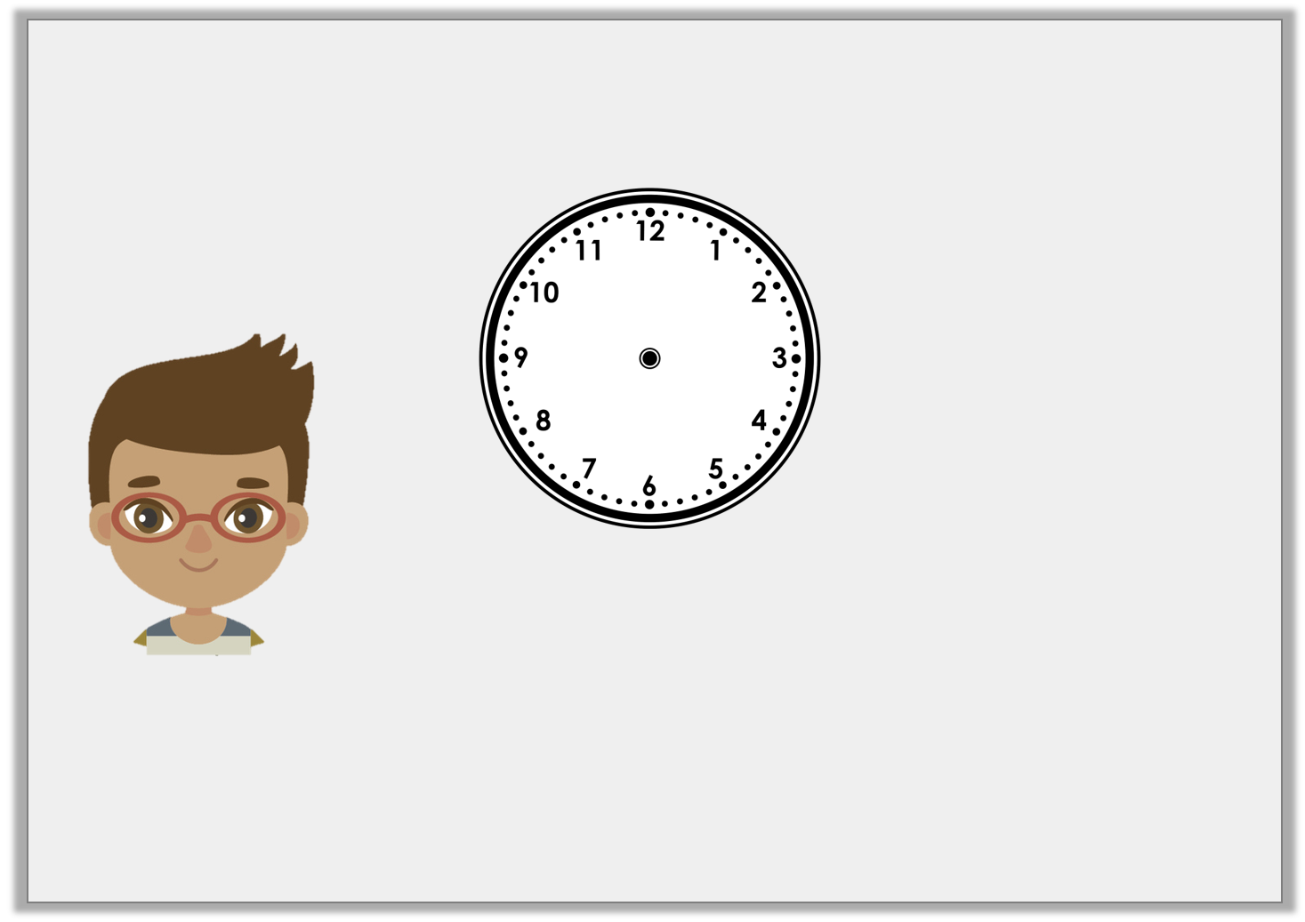
Mark is trying to tell the time.
Is Mark right? How do you know?
In quarter of an hour it will be half past 3.
© Classroom Secrets Limited 2018

Slide 9
Mark is trying to tell the time.
Is Mark right? How do you know?
Mark is right because the time shown on the clock is quarter past 3.
In quarter of an hour it will be half past 3.
© Classroom Secrets Limited 2018

Slide 10
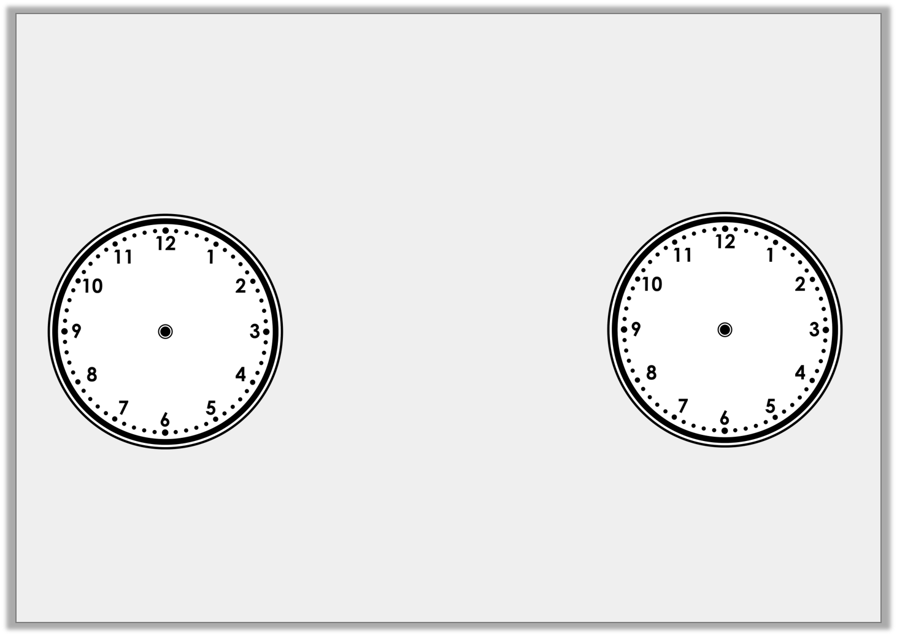
Playtime is 15 minutes long. What time would it finish if it started at the time shown on the clock?
Where will the hands be?
What time will it be?
© Classroom Secrets Limited 2018

Slide 11
Playtime is 15 minutes long. What time would it finish if it started at the time shown on the clock?
Half past 10
© Classroom Secrets Limited 2018

Slide 12
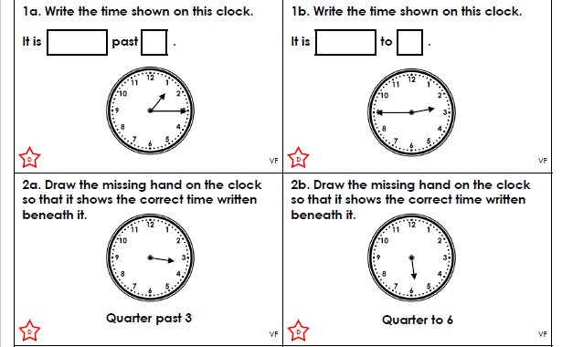
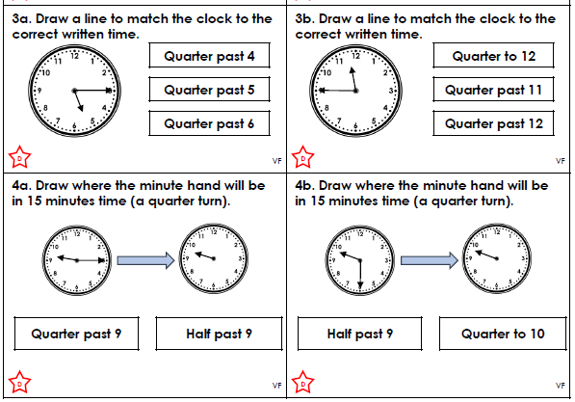
*Challenge 1

Slide 13
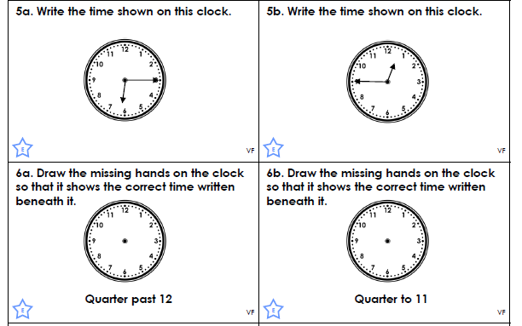

**Challenge 2

Slide 14
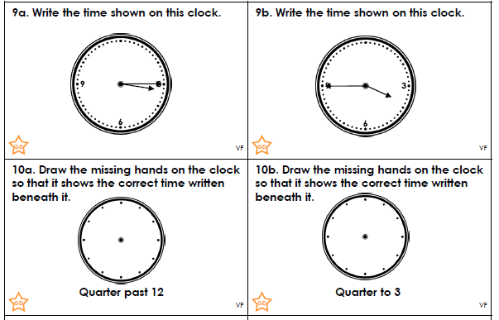

***Challenge 3

Slide 15
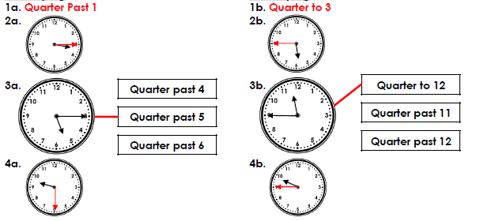

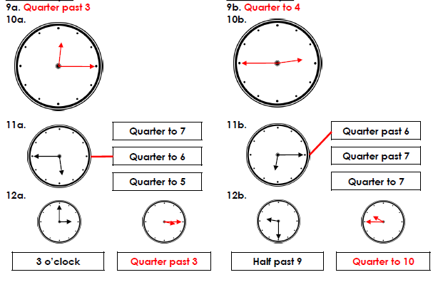
Answers
Challenge 1
Challenge 2
Challenge 3

