Slide 1

Good morning Year 2 Tuesday 23rd June
English This book ‘Hello Lighthouse’ won the Caldecot medal which is for artists of the most distinguished American picture book. The illustrations are beautiful.
Enjoy the story here:
https://www.youtube.com/watch?v=LZIrlGnXNlM
Tomorrow and Thursday we are going to pretend to be the lighthouse keeper and write diary entries for different points in the story.
Diaries are about what you did and saw and felt.

Slide 2
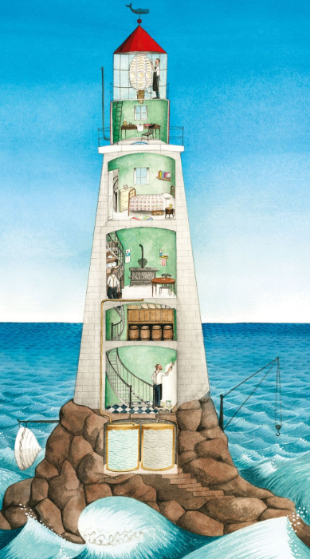
Tuesday 23rd June
English
Have a look at the interior of the lighthouse.
There are 6 levels apart from the water tanks below the lighthouse.
Look at each level and write 5 or more verbs to show what might go on at that level.
E.g. .
Counting, tallying, checking, monitoring, storing, rolling, stacking, hoarding, stockpiling.
Have you noticed mine end with ‘ing’.
Think of different and adventurous words.
You could use the ‘review’ and ‘thesaurus’ tool on this page.
Write your lists in your book ready for tomorrow.

Slide 3
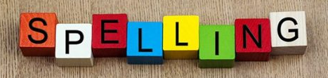
Tuesday 23rd June
English
Handwriting Use the handwriting paper on our Year 2 class page to practise your handwriting, especially if there is a letter you are not happy with. Careful with size and shape.
Spelling Practise your spellings. This week we are using ‘tion’ at the end of a word. Keep practising. Which method of practising suits you best?
https://www.educationquizzes.com/ks1/english-spelling/year-2-words-ending-in-tion/ Take a spelling quiz to support your learning.

Slide 4

Tuesday 23rd ^{d} June
Maths
Miss Robinson has set you some maths for today.
Don’t forget to check in to Prodigy for 20 mins each day. I can see how many questions you try and how many you get right. Great work everyone on Prodigy – keep it going.

