Slide 1


Telling the Time in Five-Minute Intervals

Slide 2

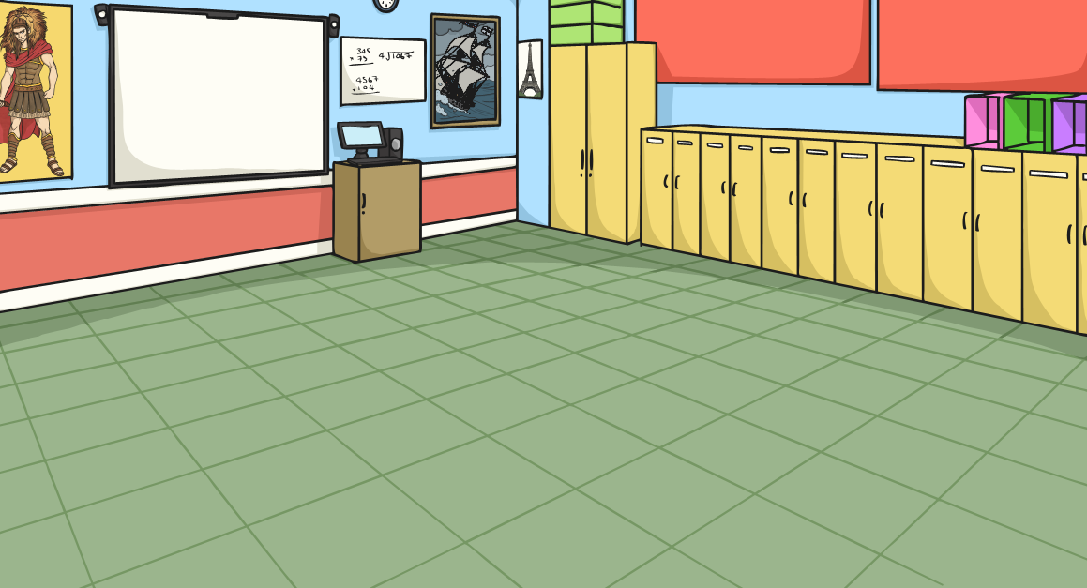
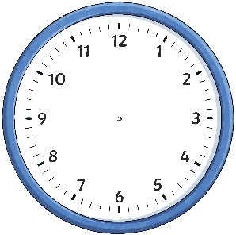
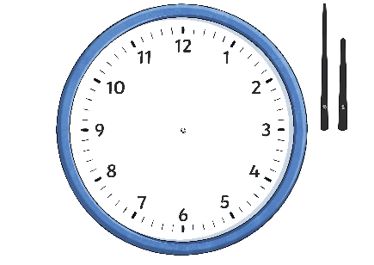
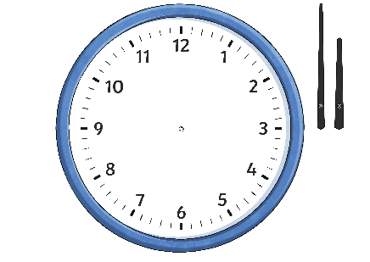
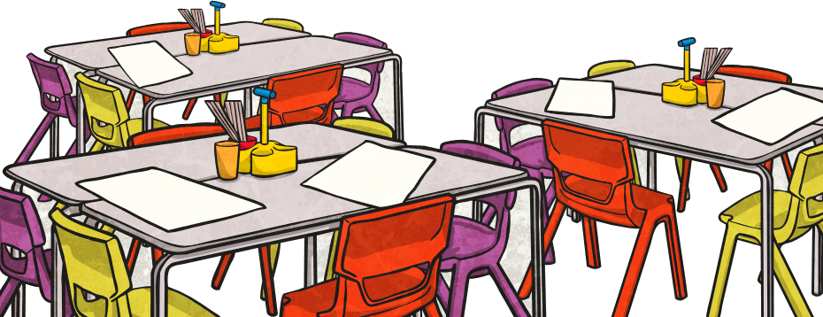
O’Clock, Half Past,
Quarter Past, Quarter To
Show these times on your own clock.
Click on the times to reveal the answers.
5 o’clock
Half Past
7
Quarter Past 1
Quarter
To 11
Half Past 10
Quarter
To 3
Quarter Past 10
6 o’clock
Quarter Past 7
Half Past 11
Quarter
To 2
3 o’clock

Slide 3

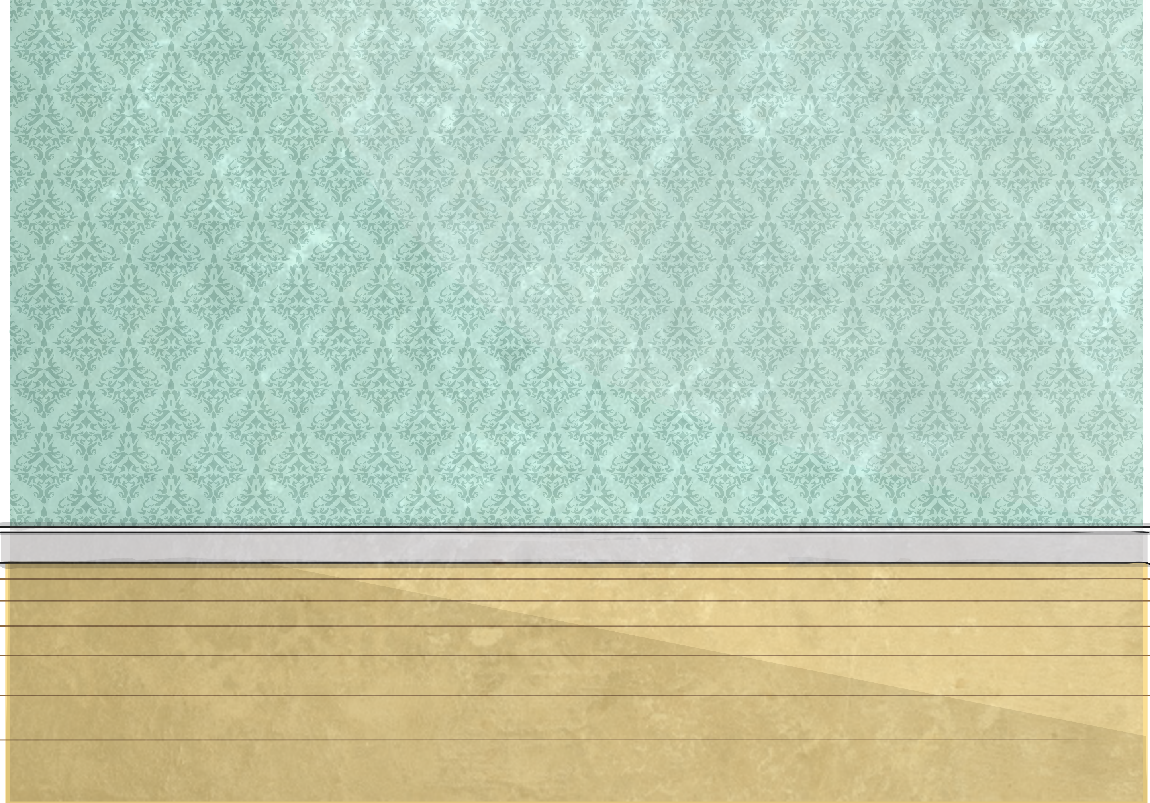
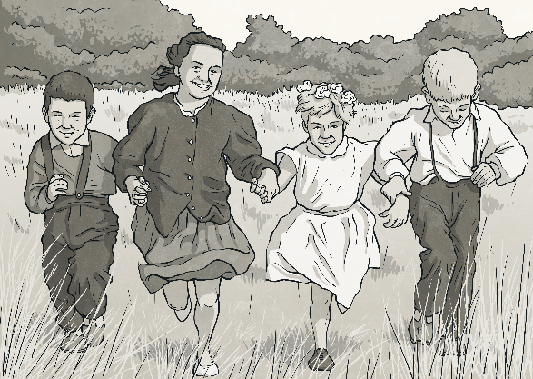

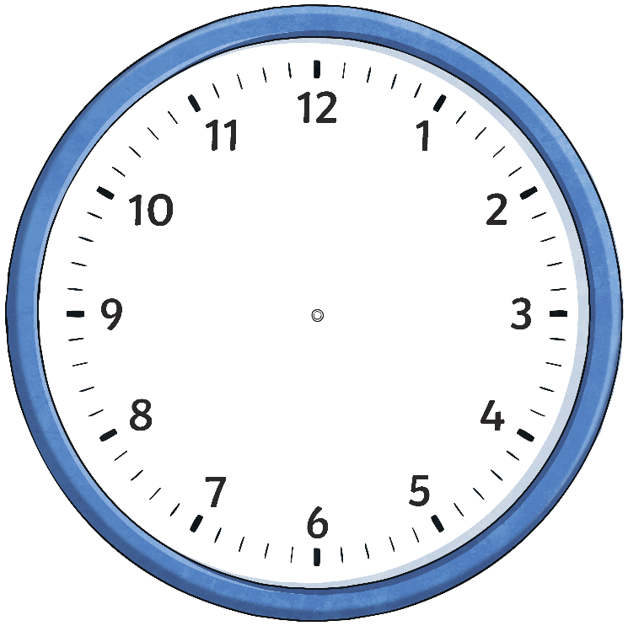
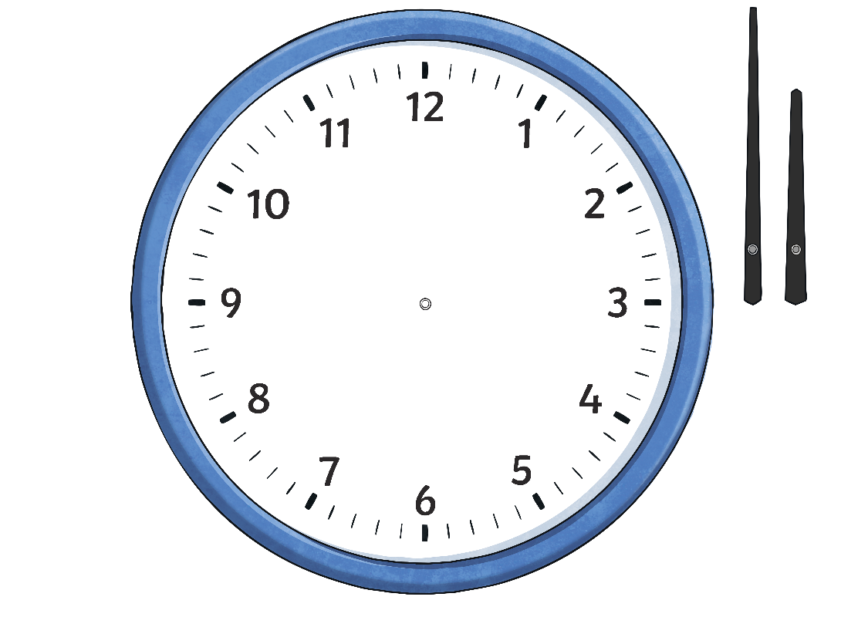
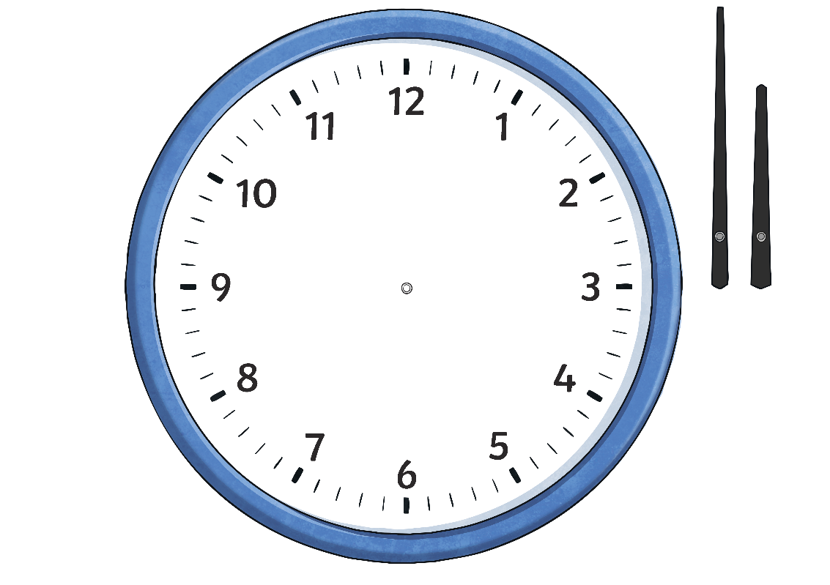
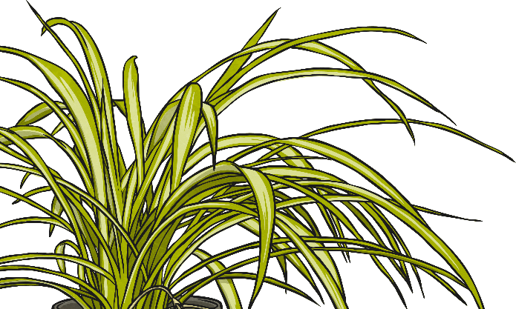
Telling the Time Past the Hour
Starting at 12, we count clockwise round the clock to tell us
minutes past the hour.
5 past
10 past
quarter past
(15 minutes)
20 past
25 past
30 minutes past
(half past)

Slide 4
Telling the Time Past the Hour
What time is it?
5 past
hide hint
hint
10 past
15 minutes past
(quarter past)
20 past
25 past
5 past 5
30 minutes past
(half past)

Slide 5
Telling the Time Past the Hour
What time is it?
5 past
hide hint
hint
10 past
15 minutes past
(quarter past)
20 past
25 past
10 past 9
30 minutes past
(half past)

Slide 6
Telling the Time Past the Hour
What time is it?
5 past
hide hint
hint
10 past
quarter past
20 past
quarter
past 11
(15 past 11)
25 past
30 minutes past
(half past)

Slide 7
Telling the Time Past the Hour
What time is it?
5 past
hide hint
hint
10 past
15 minutes past
(quarter past)
20 past
25 past
20 past 2
30 minutes past
(half past)

Slide 8
Telling the Time Past the Hour
What time is it?
5 past
hide hint
hint
10 past
15 minutes past
(quarter past)
20 past
25 past 12
25 past
30 minutes past
(half past)

Slide 9
Telling the Time Past the Hour
What time is it?
5 past
hide hint
hint
10 past
15 minutes past
(quarter past)
20 past
Half past 9
(30 minutes past 9)
25 past
half past
(30 minutes past)

Slide 10

Telling the Time to the Hour
Starting at 12, we count anticlockwise round the clock to tell us
minutes to the hour.
5 to
10 to
quarter to
(15 minutes to)
20 to
25 to

Slide 11
Telling the Time to the Hour
What time is it?
hide hint
5 to
hint
10 to
15 minutes to
(quarter to)
20 to
5 to 6
25 to

Slide 12
Telling the Time to the Hour
What time is it?
hide hint
5 to
hint
10 to
15 minutes to
(quarter to)
20 to
10 to 8
25 to

Slide 13
Telling the Time to the Hour
What time is it?
hide hint
5 to
hint
10 to
15 minutes to
(quarter to)
20 to
quarter to 2
(15 minutes to 2)
25 to

Slide 14
Telling the Time to the Hour
What time is it?
hide hint
5 to
hint
10 to
15 minutes to
(quarter to)
20 to
20 to 12
25 to

Slide 15
Telling the Time to the Hour
What time is it?
hide hint
5 to
hint
10 to
15 minutes to
(quarter to)
20 to
25 to 3
25 to

Slide 16


