Slide 1

Monday 22nd June
Maths
This week we are going to focusing on telling the time. Mrs Weatherby has asked you to practise o’clock and half past times.
To help you with our work on time I would like you to make your own clock with moving hands. It is really useful to practise showing different times.
There is a template that you could use or you could design your own.
If you have a paper plate then that would be ideal for the face of the clock.
You could use card, lollipop sticks, straws or whatever works for you as the hands but they do need to move so that you can use it to show different times.
Be as creative as you can.
Use the clock to show o’clock and half past times.

Slide 2
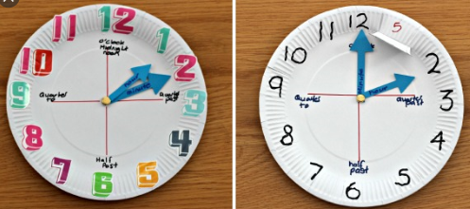
Here are some examples of homemade
clocks to give you some ideas.

Slide 3
