Slide 1
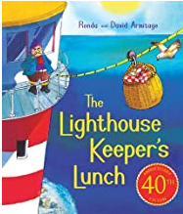
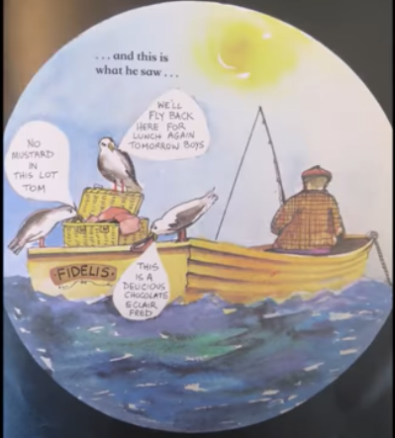
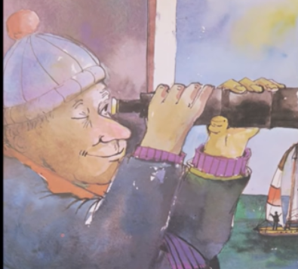
Good morning Year 2 Monday 22nd June
English Last week we wrote a playscript set in the kitchen of the little white cottage perched high on the cliffs.
Today, we are going to write another short playscript. This time it is set at the end of the book. This time, I challenge you (hope you’re feeling brave) to use a new form of punctuation. Read on to find out what!!!!
Some of you may have ‘The Lighthouse Keepers Lunch’ on your shelf. Read it or listen to a grown up read it to you.
Or, listen to the story using this link:
https://www.youtube.com/watch?v=46wCRq50Wwg
The gulls have decided to leave the basket alone. Through his telescope, Mr Grinling spies a fisherman. I think know what happens next!

Slide 2
Monday 22nd June
English
Imagine a conversation between the gulls. They would be hungry, looking, scavenging for food. They would be delighted to have found another basket. They would be cautious and careful as they stole the food.
Your playscript needs: see if you can spot them all in my example (I’m sure yours will be better)
* a title
* a setting with who, where, sound and lighting information
* characters that speak to each other
* character direction (is the gull feeling excited, delighted, cautious, anxious, thrilled) inside brackets ( )
* stage direction ( What should the gulls do? Stand perfectly still, fly around in circles, bob close to the boat on the swell of the sea)
A New Basket to Pilfer
Fred, Bert and Tom are swooping and circling around the bay when they spot a lone fisherman. It is a clear, crisp morning and the only sounds are those of the rippling waves and gulls screeching to each other.
Fred (feeling excited) Hey Tom! Can you see what I can see?
Tom: Would that be a basket of goodies Fred?
Bert flies around at a distance to get a better view.
Bert: (cautiously) Slow down boys, he mustn’t see us. D’you think it’ll be full of mustard?
Tom: (hungrily) Nah! I’m starving. Come on. What’s the plan?
Fred: (thinking) Mmm. Let’s fly around, survey the scene, not get noticed and then quiet as a flying fish land beside the basket.
Bert: Sounds like a plan, come on I’m ravenous.

Slide 3

Monday 22nd June
English
There’s something else. Did you spot it? A new kind of punctuation for us in Year 2 the colon :
Two little dots, did you spot them? Look again. It’s a very grown up form of punctuation.
Fred, Bert and Tom are swooping and circling around the bay when they spot a lone fisherman. It is a clear, crisp
morning and the only sounds are those of the rippling waves and gulls screeching to each other.
Fred: (feeling excited) Hey Tom! Can you see what I can see?
Tom: Would that be a basket of goodies Fred?
Bert flies around at a distance to get a better view.
Bert: (cautiously) Slow down boys, he mustn’t see us. D’you think it’ll be full of mustard?
Tom: (hungrily) Nah! I’m starving. Come on. What’s the plan?
Fred: (thinking) Let’s fly around, survey the scene, not get noticed and then quiet as a flying fish land beside the basket.
Bert: Sounds like a plan, come on I’m ravenous.
So, now you have two choices.
Write your playscript using pictures for the different characters, no colons needed.
Write your playscript using the characters name followed by a colon.

Slide 4
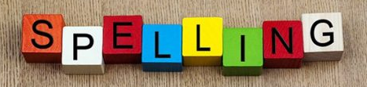
Monday 22nd June
English
Handwriting Use the handwriting paper on our Year 2 class page to practise your handwriting, especially if there is a letter you are not happy with. Careful with size and shape.
Spelling Practise your spellings. This week we are using ‘tion’ at the end of a word. Keep practising. Which method of practising suits you best?
https://www.educationquizzes.com/ks1/english-spelling/year-2-words-ending-in-tion/ Take a spelling quiz to support your learning.

Slide 5

Monday 22nd June
Maths
Miss Robinson has set you some maths for today.
Don’t forget to check in to Prodigy for 20 mins each day. I can see how many questions you try and how many you get right. Great work everyone on Prodigy – keep it going.

